Slide 1

Working Better Together for the Implementation of the 2030 Agenda
Training on Joint Programming
19 November 2019
Kampala, UGANDA
Notes:
FACILITATOR: WHOLE SESSION

Slide 2
Introductions
  Write on a card what you think Joint Programming is
  A little later you will be asked:
  come to the front, state your name and where you are from
  put your card on the flip chart
Notes:
Let’s get started by doint our introductions.
First please take a moment to write on a card what you think JP is
I will then invite you to come to the front, say who you are and where you work and put your card on the Board – we will try to synthesise your ideas at the end.

Slide 3
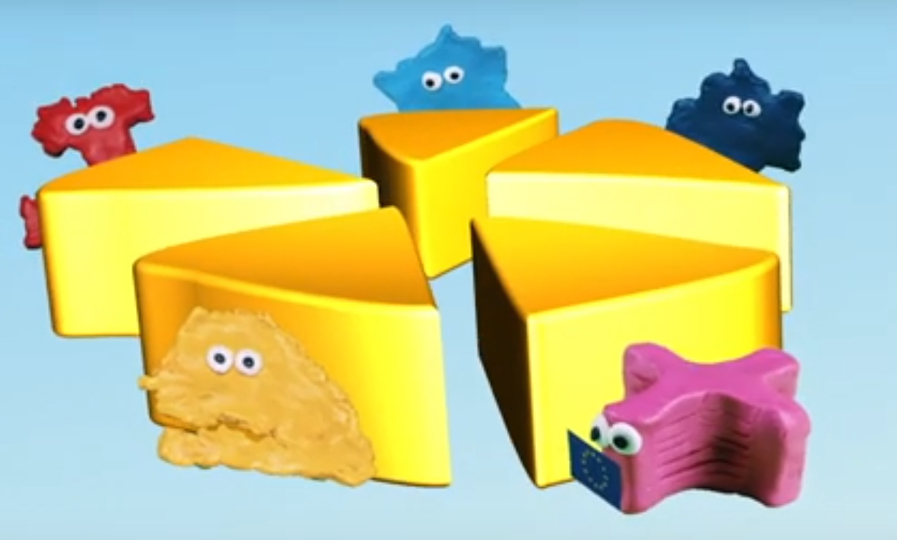
And an introduction from our friends in the field …
Notes:
Joint Programming: an introduction (Senegal) video [plays for 2 minutes and 8 seconds] – click the graphic to play the video
Before playing, ask participants to note the main themes that are discussed. These include efficiency and transaction costs, being a good and effective partner, and looking for improved ways of working that deliver better results.
https://www.youtube.com/watch?v=Ak0A8ELXcts&list=PL0NKSZy4-2Da-YBHX2mST6KgLhWxXqWGW

Slide 4
The most important slide of the day!
Joint Programming is the model for European Cooperation Global Strategy & New Consensus
  Supporting the 2030 Agenda & SDGs
  “working better together” (WBT)
  The “preferred approach” to cooperation
  “Voluntary, flexible and inclusive’ tailored to country context”
  Working ‘beyond aid’ to address global challenges
Shared Vision, Common Action. EU Global Strategy for Foreign and Security Policy (June 2016), pp 49-50
New European Consensus on Development: Our World, Our Dignity, Our Future, (May 2017), para 75
Notes:
If you only remember one thing then this is it! Let’s get the most important messages across right at the start of the day: Joint Programming is now the model for European Cooperation.
WHY?
One thing on which we can all agree is that today´s globalized world faces many interconnected challenges and addressing them effectively requires going beyond national interests and individual actions: We need to join forces to be able to make a real change!
The 2030 (SDG) Agenda presents us with the framework of a consensus - although it still needs to gain traction – and this provides an opening for us to Work Better Together as Europeans, and with our partners outside Europe, to create opportunities to meet these challenges.
This training on Joint Programming promotes the commitment to Working Better Together. It is intended to help you build on your skills and experience to adapt and apply Joint Programming principles and practices so that they can help you deliver better results.
In using Joint Programming to support the 2030 Agenda and the SDGs, we will see how the JP approach brings together political, development and beyond aid commitments to deliver results using principles of transparency, accountability, and inclusive partnerships.

Slide 5
Today’s objectives
For you
  Enhance understanding of JP as a useful and relevant approach
  Identify entry-points to support 2030 Agenda implementation through JP
  Acquire skills and insights to advance the WBT commitment
For WBT team
  Understand your implementation challenges and future knowledge/learning needs
Notes:
Today’s objectives are based on our understanding of participant’s needs from previous trainings. This Joint Programming training is the 3rd of its kind and we continue to adapt.
We have heard from some of you in response to the survey. Thank you to those of you that responded. We hope that we will meet your needs todayu.
TALK ABOUT HOW TO HANDLE QUESTIONS – HAVING A SLOT AT THE END OF EACH PRESENTATION, NOT SLIDE BY SLIDE

Slide 6
What we will cover today
  The context for “working better together”
  WBT as a response to changing context & global challenges & added-value
  Tools and approaches for WBT - Experience at country level
  Getting ready to work better together
  Conclusion & wrap-up
Notes:
In our first session we will look quite quickly at how joint programming is defined, its underlying motivations and what it hopes to achieve.
In all the sessions there will be opportunities for you to discuss the issues with others, share your experiences, and ask any questions you may have. We aim to be able to answer all your questions by the end of the day but if not they will be noted and follow up action taken.
We will look at two things: First, the challenges and commitments that JP is designed to address, principally the 2030 Agenda and the SDGs, but also looking beyond aid and development. Second, we will use the JP Guidance to consider what JP typically comprises and how it can add value.
After lunch we will look in more detail at the tools and processes for adapting and applying the JP approach. This is the session that will give you the technical detail you need to begin working on JP and to apply it to your work on the 2030 Agenda. We will also hear from a colleague who has first-hand experience of JP implementation. We hope you will have some interesting questions for her.
In our final working session we return to group work. We will invite you to begin to apply the principles and tools to develop your own roadmap.
Finally, we will wrap up by reviewing the results of the day and agreeing on any follow-up actions that are required either by you or by us.

Slide 7
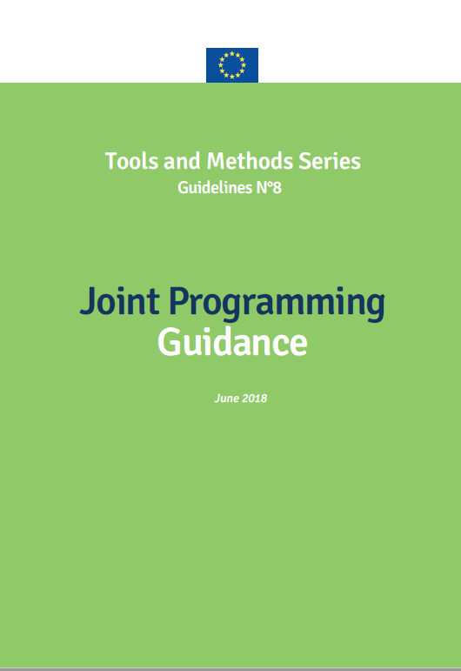
JP Guidance
  What is Joint Programming (JP)?
  Getting started on JP
  Joint analysis
  Joint response
  Joint results framework
  Tools and approaches
      Division of labour
      Stakeholder consultation
      Policy dialogue
  Visibility
  Fragile states
  Broadening the scope
Notes:
The JP Guidance document is the key reference for everything we will cover today. It contains almost everything you could ever wish to know about JP.
The important point about the guidance is just that – guidance. It isn’t a set template or instructions for what to do and when. If you are starting from scratch it will guide you though the whole process. If you are picking up opportunities as they arise it will give you some tools to work with.
Please refer to it throughout the day. We will use it in our later presentations so we hope you will become quite familiar with it and will be able to use it to guide your own JP work in the future.

Slide 8
Introductions
  Raise of hands:
  Who has experience of Joint Programming? Joint Implementation?
  At your tables:
  1. Write on card how working together can make your job better OR what you most need to make working together a reality.
  2. Introduce yourself and put card on flip chart (10 min.)
Notes:
Let’s get started by doint our introductions.
First please take a moment to write on a card what you think JP is
I will then invite you to come to the front, say who you are and where you work and put your card on the Board – we will try to synthesise your ideas at the end.

