Slide 1

The context for Working Better Together - building on what we know
Training on Joint Programming
19 November 2019
Kampala, UGANDA
Notes:
FACILITATOR: WHOLE SESSION

Slide 2
What is Joint Programming?
  Policy (2016)
  New European Consensus on Development Getting more out of our work - “working better together”
  Combines development & external action
    “adaptable and responsive to changing needs”
    “voluntary, flexible, inclusive, tailored to country context”
  Beyond programming: implementation & results
The Global Strategy on the EU’s Foreign and Security lopment (May 2017)
Notes:
Trainer: As seen during our introductory exercise this morning, JP can mean a lot of different things for different people. This is not a bad thing, as JP should, essentially, be about “working better together” towards shared results., in the largest sense of the term. It is a voluntary and flexible process which should be tailored to each country context and adaptable to the changing needs of the partner country. For that same reason, Joint Programming should not be seen as being restricted to development cooperation programming – it can be a tool for improving joint, European external action as a whole.
In a nutshell: If JP does not make sense at country level, it does not make sense at all!
Fortunately, we know from past JP evaluations, missions and feasibility exercises that most of the European partners in country who have, in the past, decided to engage in JP did so on the basis of a perceived clear, added value of the process within their country contexts.

Slide 3
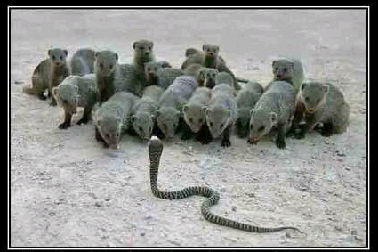
Notes:
Trainer: So, what is this added value of working better together?
As you can see on the first picture, the cobra is a shared problem like poverty. The mongeese are the EU, EU MS, like-minded donors and partner governments working together to address shared challenges. Our collective European efforts – combined with national partners including Government, NGOs and the private sector – can be more effective in formulating strategies and implementing effective approaches.
The second picture emphasises how we can build on one another’s experience and skills to reach new heights.
The human tower demonstrates the somewhat organic approach to “working better together”. It also emphasises that the approach has been strongly influenced by individuals with a high level of personal commitment.

Slide 4
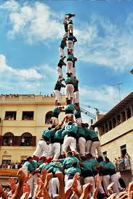

Notes:
Trainer: So, what is this added value of working better together?
As you can see on the first picture, the cobra is a shared problem like poverty. The mongeese are the EU, EU MS, like-minded donors and partner governments working together to address shared challenges. Our collective European efforts – combined with national partners including Government, NGOs and the private sector – can be more effective in formulating strategies and implementing effective approaches.
The second picture emphasises how we can build on one another’s experience and skills to reach new heights.
The human tower demonstrates the somewhat organic approach to “working better together”. It also emphasises that the approach has been strongly influenced by individuals with a high level of personal commitment.

Slide 5
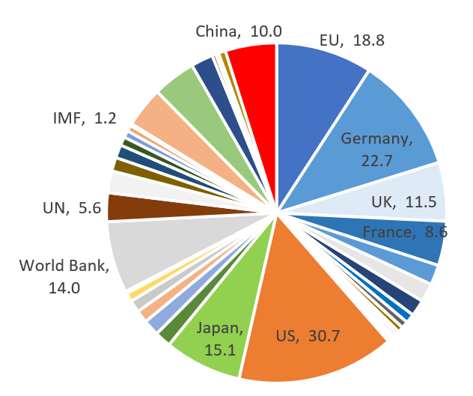
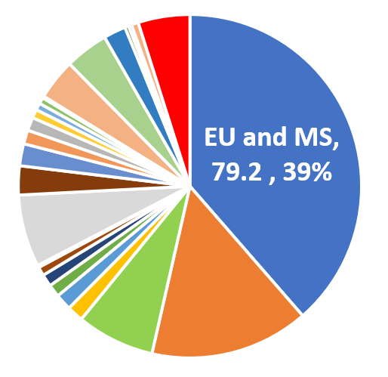
ODA: Visibility Influence Impact
The EU disbursed total ODA of USD 18.8 billion in 2017 (10% of total)
20 other EU MS contributed a further combined USD 60+ billion
Combined EU/MS ODA represents 40% of the global total
Notes:
Trainer: In the context of development cooperation, this joined-up approach matters more than ever before.
This global analysis of ODA shows that the EU and its MS can have much greater impact, visibility and influence when they are represented as a common block. The EU combined ODA contribution – almost USD 80 billion in 2017 – is 2,5 times as big as that of the second largest donor, the US with USD 31 billion.
-----------------------------
[N.B. The numbers in this slide are all from the OECD/DAC CRS Database, downloaded February 2019 (USD 189.7 billion). The exception is for China, which is an estimate of annual commitments (not disbursements) of approximately USD 10 billion annually taken from an AidData paper]
http://docs.aiddata.org/ad4/pdfs/WPS46_Aid_China_and_Growth.pdf

Slide 6
Value of Working Better Together, at country level:
Information and data sharing
More visibility and impact - a single “EU branding” for high quality (and quantity) support
Speaking with one voice - Policy and political dialogue
Less fragmentation and reduced transaction costs (in the long-run!) – division of labour.
Intensifies & formalizes financial (energy, WASH); cross-sector implementation (nutrition) and non-financial Joint Implementation (working together is a norm, not the exception)
Notes:
Trainer: As we can see from these strong policy commitments, there is a clear recognition of the added value of Joint Programming at HQ levels. But how does it matter at country level? Here is what some of YOU have said in the pre-training survey – and what other practitioners say - about the value of working better together at country level:
The most commonly shared perception among practitioners is that JP increases the value and visibility of European ODA, both vis-à-vis partner country governments and European tax payers, by promoting a single “EU Brand” of high quality and quantity support, including through joint communication and visibility actions. This helps addressing and some of the new phenomena challenging the principles, weight and impact of EU ODA – for example, the rise of new donors with different ODA approaches and agendas (e.g. China), as well as the weight of increased domestic resource mobilisation in many partner countries.
Information and data-sharing was also mentioned by many of you as a key positive element of JP.
Speaking with one voice increases the EU's reach in the policy and political dialogue with the government and other emerging donors.
For example in Cambodia case: Human Rights dialogue.
Intensifies and formalizes joint implementation – “Working together is the norm, not the exception”(Tunisia). However: JP objectives can provide a strategic framework for cross-sector collaboration, because they encompass various sectors – E.g. Burundi: Resilience objective. Ethiopia: Nutrition
Our presence in absolute terms matters, but we also need to be aware of our profile and position relative to others. Fragmentation for example is a problem for the partner country because it makes external support more difficult to coordinate and harder to monitor. BUT it is also a problem for EU taxpayers because it increases the risk that we are duplicating our expenditure and transaction costs.
It is true that JP requires its own investment (RH) in the short term, but in the long term it reduces transaction costs for all- Dol between donors.

Slide 7
EC proposal for the NDICI
ARTICLE 10 (general programming) | Joint programming shall be the preferred approach for country programming
ARTICLE 12 (geographic programming) | 12.3: Multi-annual Indicative Programmes shall be built on: A national or regional strategy in the form of a development plan […] accepted by the Commission […] A framework document laying down the Union policy towards the concerned partner or partners, including a joint document between the Union and MS A joint document between the Union and the concerned partner […] setting out common priorities
ARTICLE 12 | […] where possible, Joint Programming document shall replace the Union’s and member states programming documents
Notes:
Trainer: JP is also at the heart of the ongoing discussions about the next EU MFF 2021-2027: I would like to invite colleagues from DEVCO to explain this in more detail.
DEVCO: The EU’s new financing instrument institutionalises joint programming as the preferred approach for programming and implementing EU cooperation. Joint Programming is also to form the basis for formulation of Multi-annual Indicative Programmes that respond to partner countries own plans and priorities.
Of great significance is a commitment to replacing EU & MS bilateral programming documents with a single JP document.
NDICI - Neighbourhood, Development and International Cooperation Instrument
Article 10 - Joint programming shall be the preferred approach for country programming
Article 12 - where possible, Joint Programming document shall replace the Union’s and member states programming documents [at partner country level]

Slide 8
Lessons Learned (Policy Context)
  New European Consensus on Development - Our world, our dignity, our future (2017) = SDGs
  EU Global Strategy - Foreign and Security Policy (2016) = Keep EU Relevant on the Global Stage
  Council Conclusions on Stepping-up Joint Programming (2016) = Quality Programming
  Busan Global Partnership on Development Effectiveness (2011) = EU as a Preferred Development Partner
  Paris Declaration on Aid effectiveness (2005) = EU Global Lead in Making Cooperation More Effective
Notes:
Trainer: Accordingly, the value of Joint Programming and working better together has long been recognized at global/ international level: Rooted in the 2005 Paris and the 2011 Busan declarations on development effectiveness (Reminder on principles: Ownership; A focus on Results; Partnerships for Development; Transparency and shared responsibility).
EU policy commitments to Joint Programming have been reaffirmed and strengthened over time – most recently through the ‘New Consensus on Development´, which promotes the use of JP as a development effectiveness tool for advancing towards the SDGs. The EU’s new Global Strategy makes JP an external action and political priority as well.
On that note, I am handing over to colleagues from EEAS and DEVCO to explain these policy commitments in more detail.

Slide 9

Coffee Break 10h30-11h00
  Over coffee please choose and discuss one example or opportunity in working together for:
  SDGs,
  Making EU more influential,
  Making programming more effective,
  Making EU a better partner,
  Demonstrating EU a best practice in aid effectiveness.
Notes:
Facilitator: Many of you have relevant experience and we want to draw on this at an early stage of our training.

