Slide 1

The 2030 Agenda and Development Effectiveness
Training on Joint Programming
19 November 2019
Kampala, UGANDA
Notes:
FACILITATOR: WHOLE SESSION

Slide 2


Agenda 2030:
A challenge and an opportunity
Adopted at the UN Summit in September 2015
Brings together follow-up to MDGs and Rio+20
17 Goals. Poverty eradication and three dimensions of sustainable development (economic, social, environmental) + peace, governance, gender…
Universal – applies to developed and developing countries alike – very important shift
Leave no-one behind, focus on inequality and exclusion
Voluntary National Reviews

Slide 3
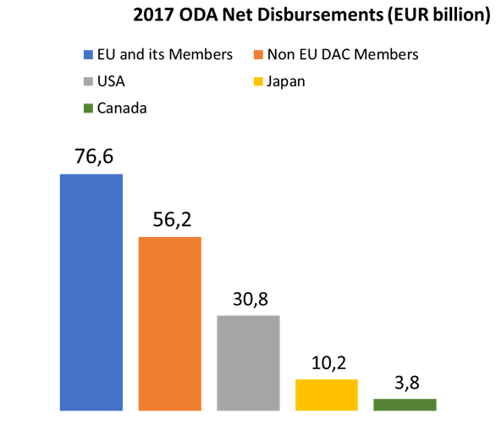
EU’s ODA is 2½ times the US
EU+ MS
USA
Joint EU work can help us address:
  2030 Sustainable Development Agenda and the SDGs
  Beyond Aid
  Effectiveness: ownership, transparency, partnership, results

Slide 4
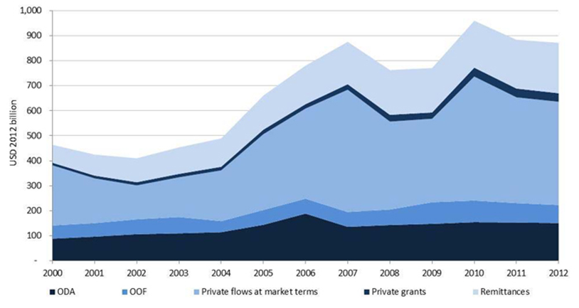
Billions to trillions…. Not just ODA

Slide 5
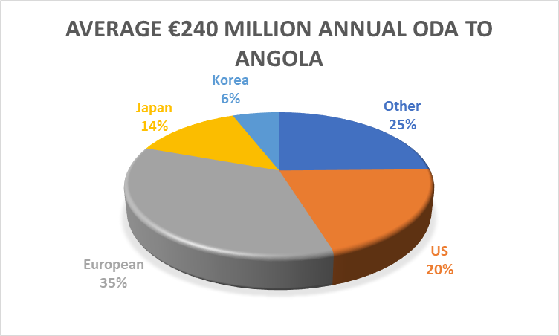
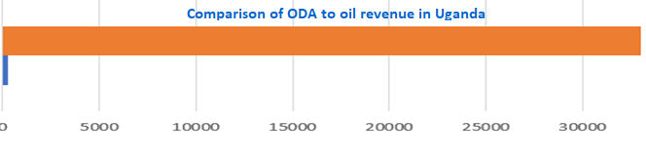
Notes:
And the potential to mobilise domestic resources should not be underestimated – bar chart at the bottom compares ODA to oil revenue in Uganda

Slide 6
New partnerships for Agenda 2030
Increasingly important role for the private sector and private citizens
AND need to use Public Finances better – Global Partnership – ownership, results, transparency & accountability, partnerships
AND, getting a seat at the partner countries Domestic Revenue collection & allocation table is vital!

Slide 7
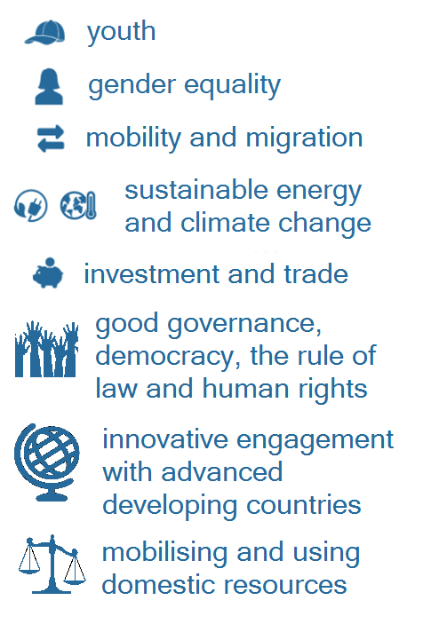


European Consensus on Development (2017)
Eradicate poverty
Integrate systematically the social, economic and environmental dimensions of sustainable development
Address the crucial nexuses
with external policies
Migration Security
Humanitarian Climate
Focus on cross-cutting elements

Slide 8
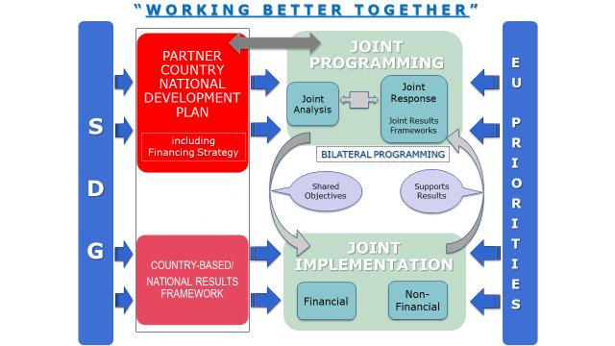

Slide 9
SDG Working Session (45 mins)
  Working Discussion at Your tables (choose 1), what practical ideas do you have for how as an EU group together with like-minded donors we can:
  Ensure SDGs are a priority for partner country political leaders?
  Contribute to domestic resource mobilization and partner country allocations to SDGs?
  Restructure our own programming sectors to better address the SDGs?
  Use culture, language and scholarships to strengthen local support for the SDGs?

Slide 10
Report Back
  One table from each question will report back and then the other tables covering the same question will be asked to comment.

Slide 11
Main messages
  2030 Agenda: a challenge and an opportunity
  Money matters: but partnerships matter too.
  NDICI: Joint programming the preferred approach (to replace EU/MS strategies)
  There are opportunities & entry-points at all stages of the programming cycle
  LUNCH – Please return at 14h00

