Slide 1

Learning from the JP experience
Training on Joint Programming
19 November 2019
Kampala, UGANDA
Notes:
FACILITATOR: WHOLE SESSION

Slide 2
Global State of Play of Joint Programming
21
(+6)
23
COUNTRIES IN THE PROCESS OF JOINT PROGRAMMING
38
7
COUNTRIES EXPLORING JOINT PROGRAMMING POTENTIAL
Joint Monitoring / Results Framework
Bolivia, Burkina Faso, Cambodia, Comoros, Ethiopia, Ghana, Honduras, Kenya, Laos, Nicaragua, Palestine, Senegal
Replacement
FR in Comoros, FR and IT in Kenya, EU in Laos, EU in Palestine, EU in Senegal
JOINT PROGRAMMING DOCUMENTS
Bolivia (2017-2020), Burkina Faso (2017-2021), Burundi (2019-2022)*, Cambodia (2014-2018/2019-2020), Central African Republic (2017-2021), Comoros (2015-2020), Egypt (2017-2020), Ethiopia (2017-2020)*, Ghana (2017-2020), Guatemala (2014-2020), Honduras (2018-2022), Ivory Coast (2017-2020), Kenya (2018-2022), Laos (2016-2020), Moldova (2017-2020), Nicaragua (2018-2020), Palestine (2017-2020), Senegal (2018-2023), Togo (2014-2020), Tunisia (2017-2020)*, Uganda (2015-2019)
Old: Chad (2014-2017)**, Mali (2014-2018)**, Myanmar (2014-2016)**, Namibia (2014-2017), Paraguay (2014-2018), Rwanda (2014-2018)
Roadmap (9): Azerbaijan, Dominican Republic*, Ecuador, Haiti, Mozambique*, Tajikistan, Uzbekistan, Vietnam*, Zimbabwe
12
Joint Analysis (14): Armenia, Belarus, Benin*, Cameroon*, Chad*, Congo Brazzaville, Democratic Republic of Congo,, Georgia, Lebanon*, Madagascar*, Mali, Nepal, Niger, Zambia
High potential (25): Bangladesh, Cuba, Djibouti, El Salvador, Eritrea, Gabon, Guinea Conakry, Iraq, Jordan, Kyrgyzstan, Liberia, Malawi, Mongolia, Myanmar, Nigeria, Paraguay, Rwanda, Sierra Leone, Somalia, South Africa, South Sudan, Tanzania, Ukraine, Vietnam, Yemen
Low potential (13): Afghanistan, Algeria, Angola, Bhutan, Colombia, Gambia, Libya, Mauritania, Morocco, Pakistan, Philippines, Sao Tome e Principe, Sudan
44 active
82
Active+potential countries
*drafts **working towards a 2nd joint programming document

Slide 3
Working better means working smarter
Joint programming is:
A catalyst for trust-building,
A means of deepening dialogue & policy cohesion
Building an identifiable European presence
Adding Value in difficult political contexts
  A way to pool risk
  A means of exploring new areas for engagement / sectors
  More active knowledge sharing at country level / improving analytic capacity
  Concrete measure for European priorities (CSO, migration, investment, etc.)

Slide 4
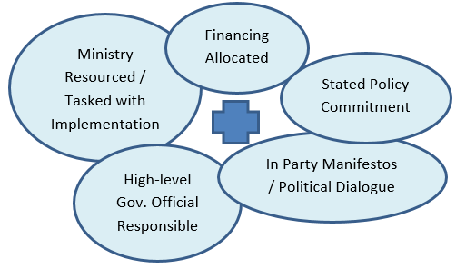
Greater impact through improving relevance

Slide 5
What works for dialogue?
VERY USEFUL | NOT SO USEFUL
Strong Technical Dialogue (e.g. specialist skills) | Exclusive emphasis on helping poor/ poverty
Economic Partners / Investments | Solidarity for solidarity’s sake (history)
Mutual benefits - creating a relationship of confidence/trust | Political dialogue framed by 'international problems'
Objectives jointly identified – need to be gov. political priorities | Over-emphasising the role of NGOs
Programming to demonstrate results/benefits (i.e. not tied) | Perception of imbalance - Donor-Recipient / Patronising / Colonial
Provincial/local level engagement
Use convening authority/shared challenges for equal partnership
Notes:
Example from Mozambique – JP Scoping Exercise

Slide 6
Independent evaluation and OECD Peer Review find:
A common vision and a higher EU profile:
Shared vision and coherent policy add value but need to be part of a clearer intervention logic
Potential for greater impact by joining-up development work, a reform focus & politically strategic interventions
“Expand and refine implementation” of JP:
Extend the scope & reinforce partner country ownership
Process matters: strengthen results-based focus & approaches
SDGs as opportunity to bring coherence (financing, policy dialogue, prioritisation & partnering)
Evaluation of EU Joint Programming process of development cooperation (2011-2015)
OECD Development Cooperation Peer Review of European Union 2018

Slide 7
Comparative advantages
In Angola, dialogue with senior government officials is a challenge but Portugal has a very influential cultural presence (e.g. art exhibits attended by elites) and most ministers studied in EU.
In Philippines, the government is critical of global governance, but a core group of influential technocrats want to be world leaders on the SDGs.
In Moldova, many ministers complain they are pressured by corrupt politicans just like donors are - donors like Bulgaria, Poland, the Czech Republic and Romania have preferential access because they are perceived to share the same experience as Moldova re: the EU and local corrupt elites.
Notes:
Comparative advantage may not be where you expect….

Slide 8
Country-level reflections from the last years Global workshop in Cambodia:
  Quality of process institutionalises momentum & flexibility
  Joint analysis is a key step (and reoccurring)
    Vision, Added-value, Strategy, Politics, Risks
  Incentives & motivation (EU/MS staff and counterparts)
  MICs and LIC/LDC emphasise different issues
  Lighter processes (when context requires)
JP Global Learning Event, Cambodia, 4-6 December 2018

Slide 9
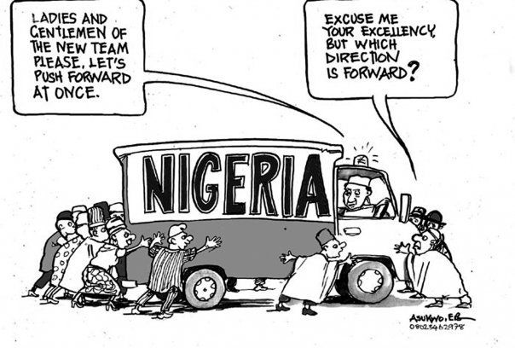
Good Practices in Collaboration
Notes:
Facilitator: These are some good practices taken from a very different area of life – the Arts. The lessons learnt on how artists best work together are very applicable to Joint Programming, as you can see: What you need is… [READ slide]

Slide 10

Good Practices in Collaboration
3. Everybody has a role; no duplication; encourage alternative perspectives/ creative thinking
4. Constant feedback in managing the work flow
5. Regular meetings focused on problem solving
6. Verbal communication – email to confirm decisions
Notes:
Facilitator: These are some good practices taken from a very different area of life – the Arts. The lessons learnt on how artists best work together are very applicable to Joint Programming, as you can see: What you need is… [READ slide]

Slide 11

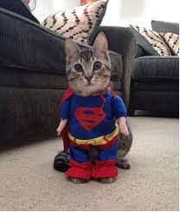
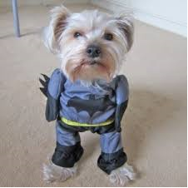
Good Practices in Collaboration
7. Focus on results that are fun
8. Build a sub-group of advocates/champions.
Notes:
Facilitator: These are some good practices taken from a very different area of life – the Arts. The lessons learnt on how artists best work together are very applicable to Joint Programming, as you can see: What you need is… [READ slide]

Slide 12
Working Session 1 (30 min at table 15 min rapid report back):
Please read the activity options related to doing a Joint Analysis.
Then, at your table imagine you are all newly arrived Heads of Cooperation in a low income country that has recently had budget support cancelled. How would you use Joint Analysis with the EU and EU MS to identify influential allies (and entry points) that could be partnered with to encourage the partner government to raise more domestic revenue for addressing the SDGs?
Notes:
Facilitator: These are some good practices taken from a very different area of life – the Arts. The lessons learnt on how artists best work together are very applicable to Joint Programming, as you can see: What you need is… [READ slide]

Slide 13
Working Session 2 (30 min at table 15 min rapid report back):
Please read the activity options related to doing a Joint Response and Preparing for Joint Policy Dialogue.
Based on the previous exercise, you know who your allies are and what your entry points are.
What do you need to do as a Joint Response to prepare for Joint Policy Dialogue? E.g. What resources can you use as the EU to improve leverage in formal dialogue, what resources and access do you have to informal dialogue? What do you do to speak with one voice and demonstrate a consensus? How do you address competition with other development partners?
Notes:
Facilitator: These are some good practices taken from a very different area of life – the Arts. The lessons learnt on how artists best work together are very applicable to Joint Programming, as you can see: What you need is… [READ slide]

Slide 14
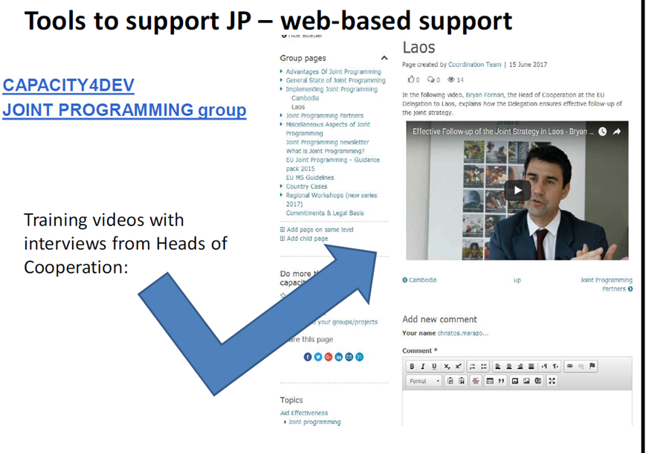
Tools to support JP
JP Guidance
JP Tracker / EU aid explorer
Capacity4Dev
  Aid and Development Effectiveness
  Joint programming
  Political economy
  Financial instruments (budget support etc)
DEVCO Academy (online learning, country videos)
Trainings, e.g. on Policy Dialogue
ODA info systems (OECD, IATI)
Notes:
Devco to speak here

Slide 15
Thank you!
Feel free to contact us:
  DEVCO A1 & A2, JP experts
    DEVCO-Joint-Programming-Support@ec.europa.eu
    JOINT-PROGRAMMING-SUPPORT@eeas.europa.eu
    NEAR-Joint-Programming@ec.europa.eu
    AND, please assess the training at exit:
    Flipchart 1 - please rank your impression,
    Flipchart 2 - for suggestions,
    Flipchart 3 - for redundancies, complaints.

