Slide 1
Inscription des Cultures créoles au Patrimoine culturel immatériel de l’UNESCO Inscription of Creole Cultures to the Intangible Cultural Heritage of UNESCO
3rd country Conference
“Creole as Cultural Heritage: Framing, strengthening and Advocating.”
August 15th and 16th, 2019
University of the West Indies (UWI) Open Campus-Dominica

Slide 2
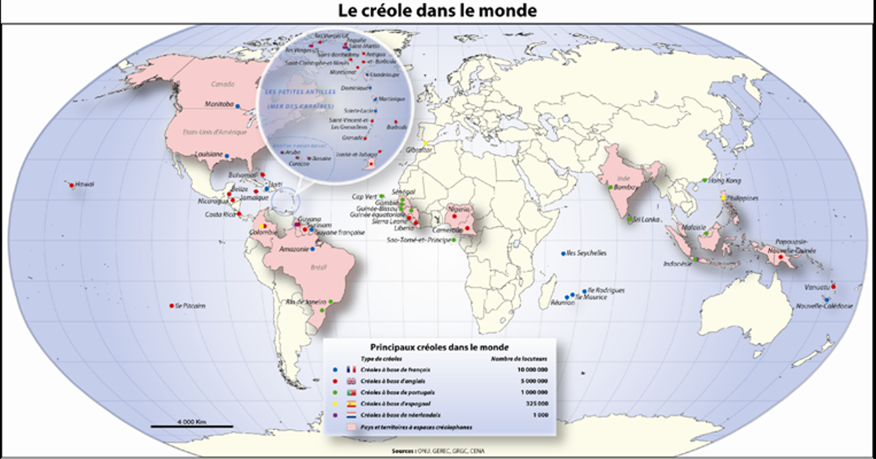

Slide 3
Kreolitude
The term ‘Kreolitude' refers to ‘Négritude’,
a French literary and political movement
of the 1930s,’40s, and ’50s,
linked to anticolonialism and slavery.

Slide 4
As a result of this literary movement and while ensuring
that the research in progress and the recognitions derived are not obscured,
‘Kreolitude’ proposes
an artistic and cultural framework
to define Creole culture
in all its components.

Slide 5
The complexity of its origins leads to
a composite identity that does not allow an individual to fall into
the myth of returning to ancestral roots.
But it leads to an individual 'reconstruction’
within a new culture, rich in its differences.
It implies a sense of creativity and inventiveness
so that these differences become a collective work in a process
of creation that goes far beyond a merely juxtaposed
multi-cultural society.

Slide 6
‘Kreolitude’ definitely aims at the future
thus contributing to the construction of a better world.
Therefore one needs to identify the values ​
​that have allowed the Creole people around the world
to set up a society of peace,
respectful of its cultural differences,
harmoniously mixed
(though imperfect because in daily becoming) .

Slide 7
Creole values
Living together in peace and harmony, especially through the practice of dialogue and compromise
Solidarity
`
Resisting injustice and practicing love and respect for other human beings, the neighbour, the 'big family’
Welcoming people and practising hospitality
Tolerance towards different religious practices, acceptance of freedom of worship and different beliefs
Cooperation and 'work together' with a sense of celebration
The profound, 'umbilical' link with Nature, mother earth and
the ancestors.

Slide 8
If Creolity is defined as a feeling, i.e. to be Creole,
‘Kreolitude’ would be defined as an action,
that of understanding the Creole fact and
knowing what it can bring to other people.
It aims today at offering an alternative to the current
“merchant” ' civilization.

Slide 9
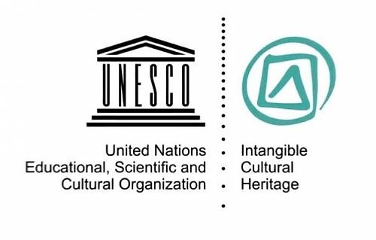
As a symbol,
a file will be presented to
UNESCO
for the inscription of 'Creoles Cultures’
on the Representative List of the
Intangible Cultural Heritage of Humanity.

Slide 10
Belize, Guatemala, Honduras and Nicaragua:
Language, dance and music of the Garifuna in 2001
Brazil: Capoeira circle in 2014
Cuba : The Rumba in 2016
The Tumba Francesa in 2003
France, Guadeloupe: The Gwoka in 2014
France, Réunion Island: The Maloya in 2009
Jamaica : The Reggae in 2018
Maroon heritage of Moore Town in 2003
Mauritius : The Séga tambour of Rodrigues in 2017
The Séga tipik in 2014 .

Slide 11
In February 2018, the Group
"Creole cultures / Kiltir Kreol / Cultures créoles"
was introduced on LinkedIn (https://www.linkedin.com/groups/8259466),
dealing with the theme
"Developing a knowledge base on creole cultures”.
This initiative aims at raising awareness among artists,
cultural professionals, creators and mediators,
so that they transmit their passion for their heritage
to the public at large.
Creoles cultures / Kiltir Kreol / Cultures créoles
https://www.linkedin.com/groups/8259466

Slide 12
avec le soutien de / with the support of Wallonie-Bruxelles International

Slide 14
Marc LINTS
Sénior Consultant
Administrateur du groupe “crowdfunding-financement participatif” (Capacity4dev.eu)
http://capacity4dev.ec.europa.eu/crowdfunding/
Administrateur du projet « G3MS » (Capacity4dev.eu)
https://europa.eu/capacity4dev/g3ms
France : Collaborateur du LABA
http://lelaba.eu/
Seychelles : Coordinateur du Réseau Euro-ACP pour le patrimoine
Creoles cultures / Kiltir Kreol / Cultures créoles
https://www.linkedin.com/groups/8259466
Contact:
Actions Culturelles Internationales asbl
Belgique België Belgium
TEL +322 358 52 39 Portable +32475 85 52 39
SKYPE ID : marclints
Courriel : mmarclints@gmail.com

