Slide 1
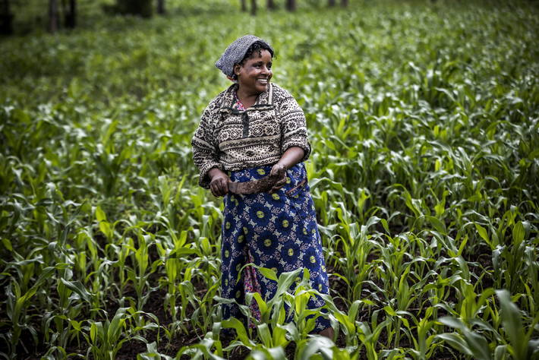



Research and Innovation for Agricultural and
Food Systems Transformation in Developing Countries
DEVELOPMENT SMART INNOVATION THROUGH RESEARCH IN AGRICULTURE (DeSIRA)

Slide 2
BACKGROUND: NEW DIRECTION FOR INNOVATION TO ADDRESS THE SDG
Need for systemic changes for agricultural and food systems transformation to address SDGs
Importance of innovation to support systemic changes able to address urgent challenges (climate change, biodiversity, food security, etc.)
Limit of the top-down transfer of knowledge and technology model to address systemic changes
Importance of the Agricultural Innovation Systems emphasizing the key role of networks to create knowledge, access resources, and mobilize competencies
RESEARCH
EXTENSION
AGRICOLTURAL PRODUCERS
SUPPORT SYSTEMS
EDUCATION

Slide 3
BACKGROUND: NEW DIRECTION FOR RESEARCH TO SUPPORT INNOVATION
  New vision of research
  More science in development for contributing to impact at scale
  More interaction with actors to strengthen the capacities to innovate (farmers, farmers’ organizations, local communities, NGOs, private sector, public sector)
  New approaches
  Combine several research approaches: academic research, participatory research, action-research, farmers research
  Conduct several research activities: knowledge production, design of methods, facilitation, capacity building, expertise

Slide 4

DeSIRA Origin
DeSIRA was launched in 2017 with first projects in 2019
DeSIRA was supported by
Key Commitments : COP21, One Plant Summit 2017, Ouagadougou Declaration 2018
Key Consultations : Member State, European Delegations, IFAD, FAO, BMG Foundation
DeSIRA is in line with the new EU Green Deal Policy and its Farm to Fork dimension
DeSIRA addresses multiples and interconnected SDGs
DeSIRA is funded by the European Commission : €300 million

Slide 5
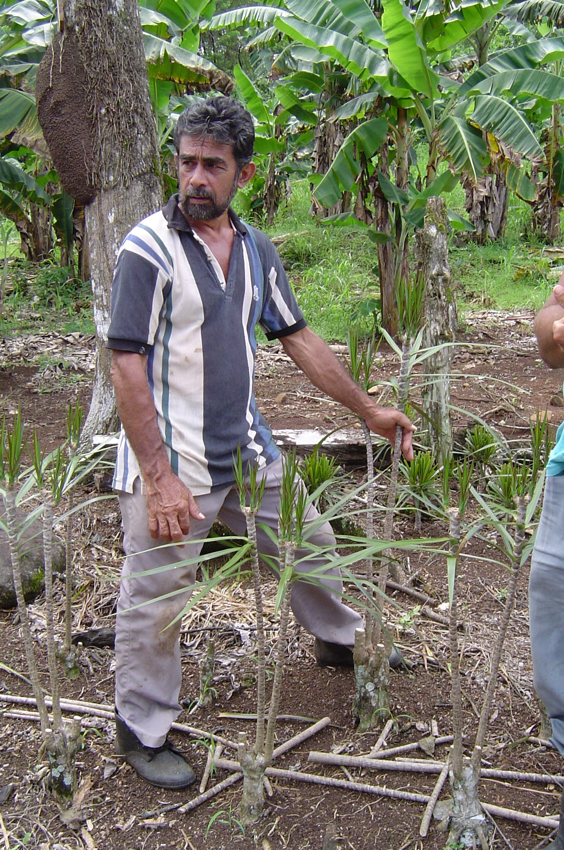
DeSIRA Objectives
FOSTER INNOVATION TROUGH RESEARCH TO CONTRIBUTE TO TRANSFORMATION OF AGRICULTURE AND FOOD SYSTEMS IN LOW AND MIDDLE-INCOMES COUNTRIES
Support innovation in agriculture for sustainable agricultural and food systems (productive, inclusive, climate-sensitive)
Strengthen research capacities and governance mechanisms for improved Agricultural Innovation Systems
Enhance evidence for innovation and advisory services policies design and monitoring

Slide 6
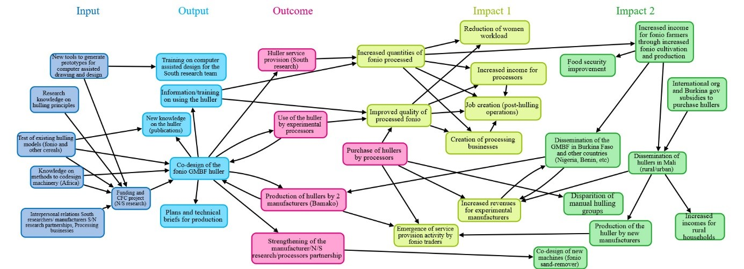
ANNOUNCED DECEMBER 2017
DeSIRA STRATEGY
Joint Construction of DeSIRA interventions in line with both EU and MS development agendas and national priorities on agriculture and food systems
Linking research and innovation to contribute to impacts at scale addressing climate change with clusters of projects funded by EU and EU MS
Strengthening national research capacities both at individual and organizational levels
Contributing to the African (FARA, CORAF, ASARECA, CCARDESA, AFAAS) and global governance of research (GFAR, TAP/FAO, CGIAR, AIRCA)
Building strong partnerships involving European, International and National research capacities
Fostering of Agricultural Innovation Systems and national innovation policies with a capacity to innovate based approach

Slide 7
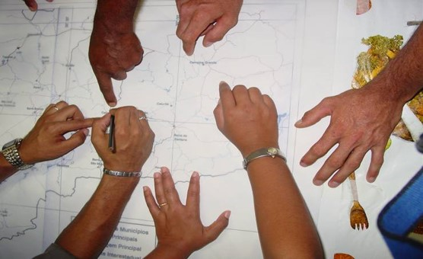
CHARACTERISTICS OF PROJECTS FOR RESEARCH AND INNOVATION INNOVATIONTYPOLOGIES
                Addressing key challenges to promote FNSSA with climate change perspective
                Designing and monitoring an impact pathway approach based on a plausible theory of change
                Implementing a multi-stakeholder approach mobilizing farmers, private sector, public sector, civil society and researchers to promote innovation processes
                Joint designing of innovation with local actors based on science and other source of knowledge to change behaviors, skills and agricultural/managerial practices
                Strengthening innovation support services including advisory services

Slide 8








CHARACTERISTICS OF PROJECTS FOR STRENGTHENING INSTITUTIONAL RESEARCH CAPACITIES
Contributing to the governance of agricultural research and innovation in Africa and at global level
Designing and monitoring an impact pathway approach for research institutions based on a plausible theory of change with climate change perspective
Support to projects for research and innovation

Slide 9


MANAGEMENT OF DESIRA
PROJECTS IDENTIFICATION
is carried out by
EU DELEGATIONS based on national or regional priorities;
MEMBER STATES under a co-funding framework;
Concertation with GLOBAL ACTORS, as CAADP, GFAR, TAP
PROJECTS MANAGEMENT
EU DELEGATIONS
GOVERNANCE
PLATFORM involving EU Member States and key strategic partners
TECHNICAL ADVISORY BOARD
EUROPEAN RESEARCH ORGANIZATIONS NETWORK
TROPICAL AGRICULTURE PLATFORM

Slide 10


SUPPORT AND KNOWLEDGE SHARING
SUPPORT, KNOWLEDGE SHARING, CAPITALISATION are to be provided through:
  WEBSITE : https://europa.eu/capacity4dev/desira/
  NEWSLETTERS
  AGRINATURA project to improve the culture of innovation, to draw lessons and design policy recommendations
  MONITORING and EVALUATION based upon key indicators

Slide 11

ANNOUNCED DECEMBER 2017
FUNDINGS
2018 CONTRACTS signed in 2019
  28 projects
  Including :upport to GFAR, TAP/FAO and CAADP organisations
  42 countries
  Including regional projects
  € 103,5 millions
  including co-funding of Member States
2019 CONTRACTS to be signed
  24 projects
  33 countries
  € 93,5 millions
  Including co-funding of Member States
  2020 – NEW CALL TO BE LAUNCHED

Slide 12
THANK YOU

