Slide 1
The new ROM:
Enhanced methodologies and confinement challenges
Meeting of the Heads of EU Evaluation Services for External/Development Cooperation (EU-HES)
DEVCO 04 – Evaluation and Results

Slide 2



The ROM system
Support to design of logframes and monitoring systems
A system and methodology for external support to monitoring, which accompanies EU-funded interventions throughout their lifecycle
Exists since 2001, latest revision in 2019 (ROM Handbook v.6). In the current version offers three services aiming at strengthening results-based management of operations
Learning and results data collection
Monitoring of ongoing operations

Slide 3
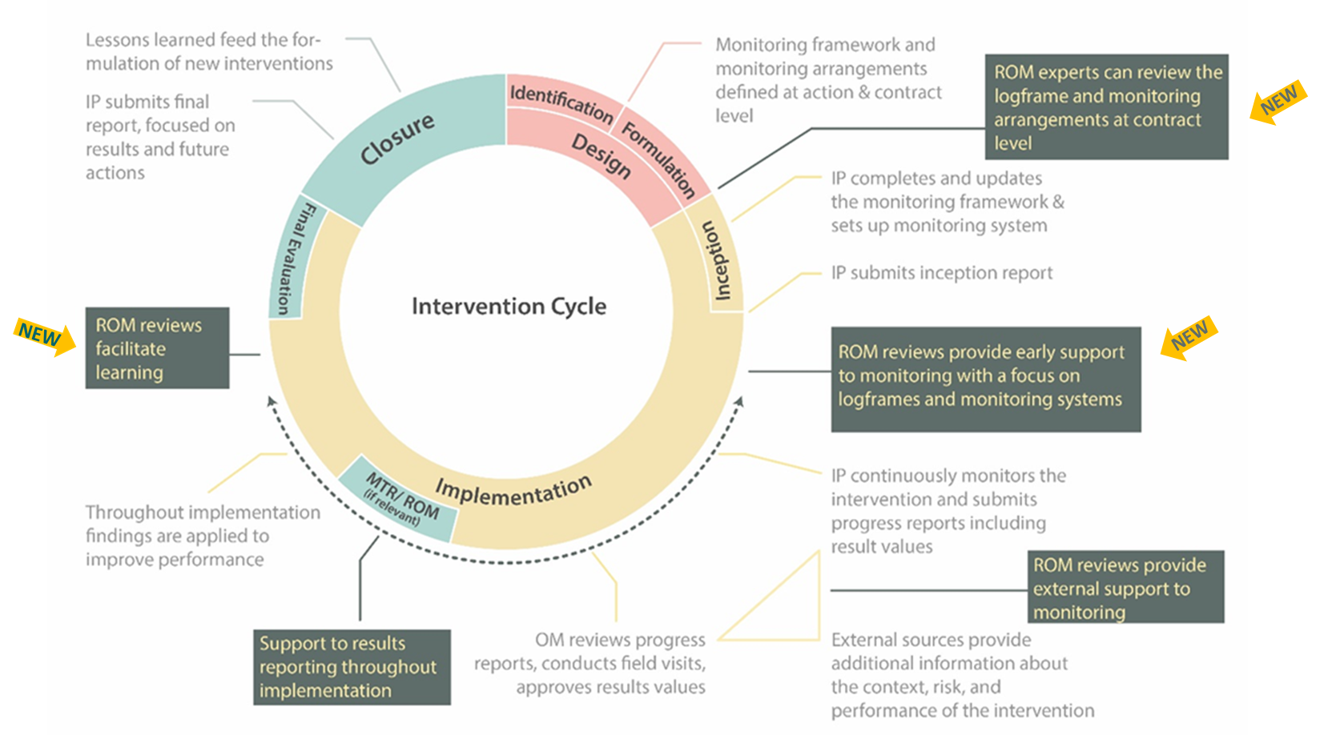
The ROM services along the project cycle

Slide 4
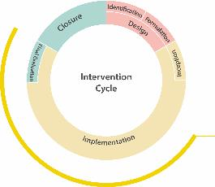
Zoom on ROM reviews
ROM reviews are a standardised external assessment of ongoing operations
The main outputs are a report and a set of monitoring question (working document, internal) as well as a lesson learning log (optional)
Based on OECD-DAC criteria (relevance, efficiency, effectiveness and sustainability) and EU own criteria: Coordination, complementarity and EU added value; Intervention Logic, Monitoring and Learning; Cross cutting issues; Communication and Visibility
Allocation of days | for single-country projects
Desk phase | 1,5
Field phase | 9
Reporting & QC | 2
Total | 12,5
Full details on allocation of working days for different type of reviews are available here

Slide 5
ROM during the COVID-19 crisis

Slide 6
Immediate challenges
82
Reviews completed (approx. 50% from home)
Decision to suspend or continue travelling taken case-by-case until complete stop on 18/03/2020 (total of 197 missions affected in DEVCO)
Experts in the field had to return
Adoption of ICT tools for remote meetings (e.g. G-Suite, Microsoft Teams but also simply Skype and Whatsapp)
54
Reviews to be done remotely
61
Reviews postponed
Notes:
Overview of the situation for ENI:
Out of the 75 ROM reviews that were left in our programme, 12 OMs opted for the full remote , 20 for the split and 43 OMs preferred to postpone the ROM review and keep the standard approach. 7 remote are already completed, all the rest is on going. OMs are satisfied from the way things have been organised but this sample is in our view too small to draw any conclusion.
Nevertheless we could do a survey, but would rather propose to do it when all the currently programmed ROM remote are completed.
Other observations:
We can see that Jordan, NEAR B2, NEAR C3, EUD Tunisia and EUD Ukraine have a higher percentage of Remote ROMs than others but again the numbers are too small to draw conclusions at the moment.
As regards sectors, we see that Agriculture & rural devt; Civil society; Employment, Invest. Climate and private sector development (incl. SMEs); HR,fundamental rights and Gender; investment climate and SMes; Migrations; are the sectors that preferred to keep a standard approach.
PAR, education, Democracy & rule of law; Border management; were more interested by remote or split.

Slide 7
New provisions
Full collaboration across contractors and services: decision to swiftly issue light guidance to be refined with learning.
Adapted formats of ROM reviews:
Hybrid: When the field visit has to be interrupted due to emergency reasons
In-Situ Field Phase
Remote interviews
Remote: Field visits are replaced with remote interviews and written exchanges with key actors
Remote interviews
Split: Remote interviews and submission of a preliminary ROM report is followed by a short field phase conducted within a reasonable timeframe
Remote interviews
In-Situ Field Phase

Slide 8
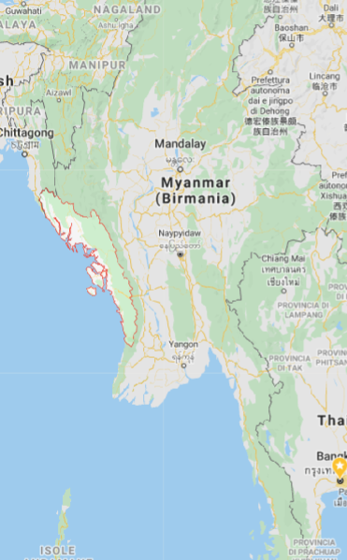

Case I: Myanmar (hybrid)
Expert had to leave after 4 days in the field because of the COVID-19 outbreak
Context: Due to government-imposed travel restrictions to Rakhine, interviews with beneficiaries from conflict-affected areas are conducted remotely. After the interruption of the mission, the communication with the IP continued and debriefings with both IP and the EU were conducted remotely.
Benefits: Even from remote, interviews with beneficiaries from conflict zones provided essential human rights information, in areas where donors cannot visit the projects directly. Access to such information is highly relevant for the Delegation given the political context with the ongoing genocide trial against Myanmar before the ICJ.
  Project: Enhancing Social and Economic Development through Civil Society and Local Authorities Engagement in Rakhine State (EU contribution: EUR 2,850,000) Map: Google Maps

Slide 9

Case II: Bolivia (split)
No travelling possible due to COVID-19 outbreak
Context: The project was not progressing as expected and the EU Delegation had to decide whether to cancel the grant or continue with it. They needed the expert focus on design, interviewing EU Delegation staff, implementing partner, and key stakeholders
Benefits: The EU Delegation could have a timely opinion on the project and practical recommendations. A short field mission is planned for Q4 2020, to check the implementation of recommendations and carry out additional interviews
Challenges: Implementation of the second part of the mission depended on the results of first and on the possibility to travel: uncertainty for the expert. Field mission will be short (combined with another visit in the same country)
  Project: Restoring Justice: promoviendo modelos de servicios de acceso a la justicia de grupos en situación de vulnerabilidad, procesos de reforma del sistema de Justicia y la difusión del enfoque restaurativo en Bolivia desde la sociedad civil (EU contribution: EUR 1,249,925). Picture: Udemy

Slide 10
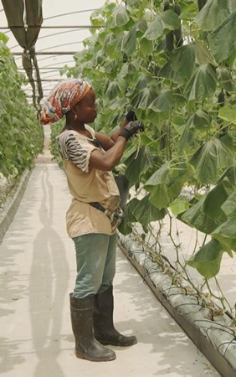
Case III: Angola (remote)
No travelling possible due to COVID-19 outbreak.
Context: Technical assistance to the Ministry of Commerce of Angola and to private sector business associations, run by UNCTAD. EU staff, UNCTAD and other stakeholders were highly committed to the monitoring exercise. The project had suspended its activities due to COVID-19.
Benefits: A total of 37 people were interviewed, including NAO staff, staff from the Ministry of Commerce and final beneficiaries. Although there were issues in connectivity, the amount of information collected is comparable to that of a standard field visit. The ROM review helped to start a revision of the logframe following the COVID-19 crisis. Further support is likely to be provided later, to finalise the revision.
Challenges: Interviews over 13 days
  Project: Train for Trade II (EU contribution: EUR 5,497,216). Picture: UNCTAD/Facebook

Slide 11
Preliminary observations
General good response by projects. ROM reviews could also address challenges raising from COVID-19
Remote meetings are short and intensive, and require thorough preparation: the desk (preparatory) phase takes longer
Remote reviews span over a longer period of time: interviewees take time to confirm their availability; sometimes more than one meeting is required for each stakeholder, up to daily check-ins with lead implementing partner
Lots of flexibility required on the experts’ side (calls outside of working hours, using various means of communications, challenges in using interpreters)

Slide 12




Feedback from Delegations
The implementing partner will be extremely busy in the upcoming months as French Red Cross is the main partner in Congo to deal with the Covid-19 emergency situation in the field. So it is not a good time for the exercise. EUD Congo
Though a peculiar exercise due to its remote nature […] which has of course limited the opportunity to grasp more policy dynamics, the report covers the main aspects and provides important findings/recommendations to support both the beneficiaries, the state authorities and the EU in build on those lessons to further support TVET in the renewable energy sector. […] EUD Malawi
The project has an education component involving teachers in each district. Schools are presently closed and because of that it'll prove difficult to mobilize any kind of communication
Opted for a split ROM review because resettlement has been the most difficult aspect of the operation, and through a remote mission it would not be possible to see the situation on the ground. EUD Kenya
Enhancing CSO's in Kenema District is coordinated by APT in the UK but implemented on the ground by 5 CSO's located in a COVID-19 hot spot with less access to connectivity. EUD Sierra Leone
Both the EUD and the IP consider the report of an excellent quality, which is a lot to say given the sudden closure of the mission due to COVID crisis. […] The expert connected well with the team
EUD Myanmar

Slide 13

Methodological challenges
The principles and structure of ROM reviews apply also to remote work
Many experts lack practical experience in remote monitoring and the methodology is being developed as we go
Experts have relatively short remote meetings with key stakeholders where they need to collect a lot of information
Difficult to show empathy, establish trust, share findings and knowledge
Higher dependency on implementing partners
Impartiality/external eye
High level of expertise in EU methodologies
Build pool of trained experts based in partner countries

Slide 14
Future perspectives
Learning through quality assurance of ongoing remote/split missions
Reflect on the use of external data and/or include this aspect in the standard ROM methodology (now it’s left to the discretion of the contractor/expert and project team including data in their reports). Longer term opportunities:
  Identify data needs / list available data
  Create alliances with organisations that hold relevant data
Recruit more experts based in partner countries and build capacity of IPs
Participate to the global discussion on remote monitoring and evaluation, including on Capacity4Dev

Slide 15

Thank you
© European Union 2020
Unless otherwise noted the reuse of this presentation is authorised under the CC BY 4.0 license. For any use or reproduction of elements that are not owned by the EU, permission may need to be sought directly from the respective right holders.

