Slide 1

AGENDA FOR CHANGE
Culture as a Resource for Regional Development Aid
Sergi Torres
European Commission, EuropeAid
13 -15 February 2012
Cairo, Egypt
Notes:
Embeddable BED
determIN (not determine)
AT that moment
Demographic – slow

Slide 2
examples
Case studies
Good practices

Slide 3
Culture & social cohesion
1.

Slide 4

Culture & social cohesion
Purpose
“bring people together from across the Mediterranean to improve mutual respect between cultures
and to support civil society working for a common
future of the Region.
“Arts For Social Change”
Q&A with Anna Lindh Foundation
Gemma Aubarell
Eleonora Insalaco
4
Notes:
4

Slide 5
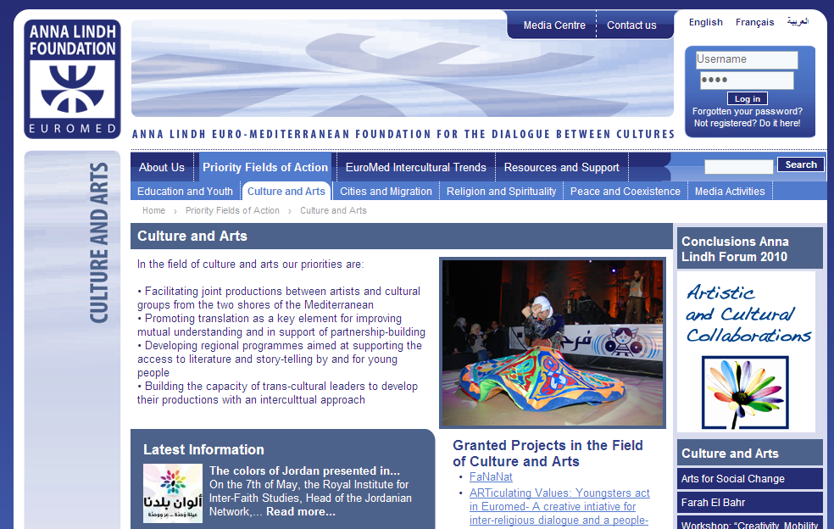
Culture & social cohesion
5
Notes:
5

Slide 6
Film, documentary and Human Rights
2.
Notes:
6

Slide 7
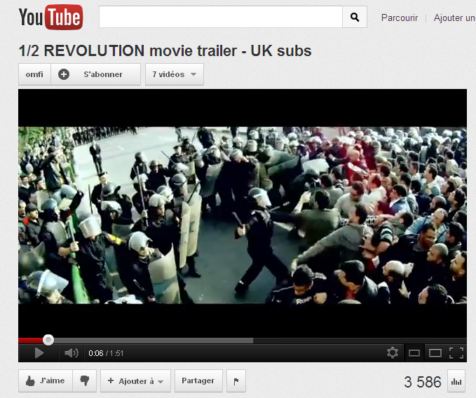
http://www.youtube.com/watch?v=9EiwKsgJQaw

Slide 8
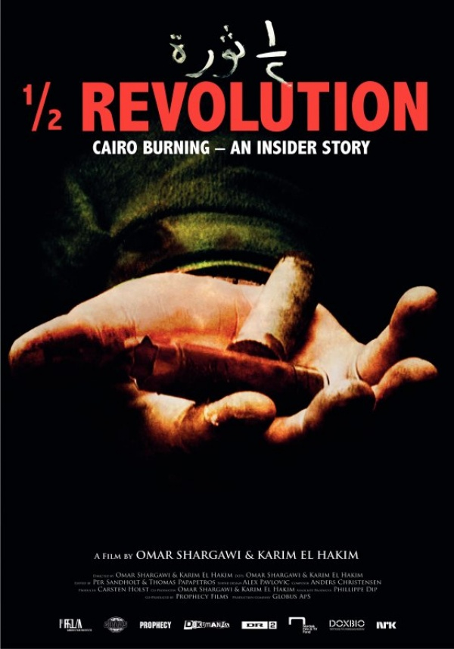
Film, documentary and Human Rights
Q&A with “½ Revolution” directors
Karim El Hakim
Omar Shargawi

Slide 9

Film, documentary and Human Rights
Project “Rising stars”
Alejandro Ramilo
Rising Stars aims to support 20 young Egyptian filmmakers in the domain of Documentary filmmaking.
Through 5 workshops on (I) Directing (II) Scriptwriting (III) Photography (IV) Sound and (V) Editing, the talented participants will get to create their own short documentary movies, supported by all the main advanced techniques and skills.
An Itinerant Cinema Event will conclude the 60 days workshops, including the screening of Egyptian and International short documentaries within an artistic cultural festival.
9
Notes:
9

Slide 10
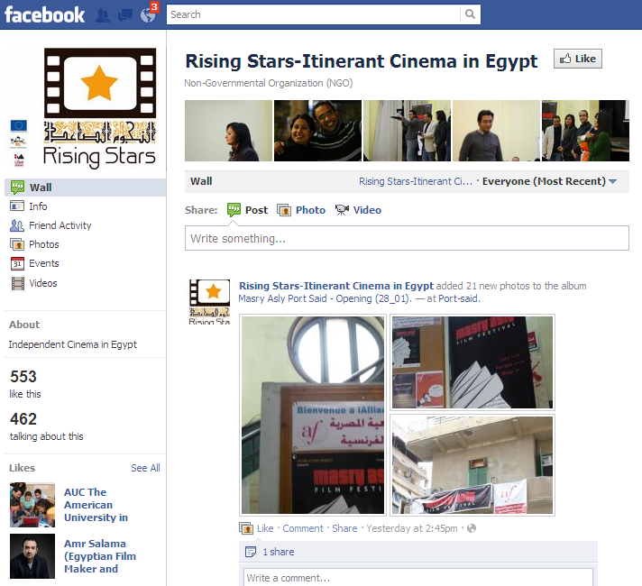
Film, documentary and Human Rights
10
Notes:
10

Slide 11
Performing arts
& civil society
3.
Notes:
11

Slide 12
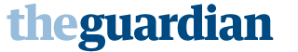
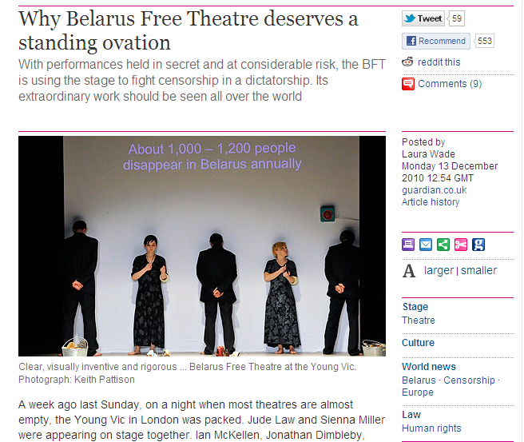
Performing arts & civil society
12
Notes:
12

Slide 13
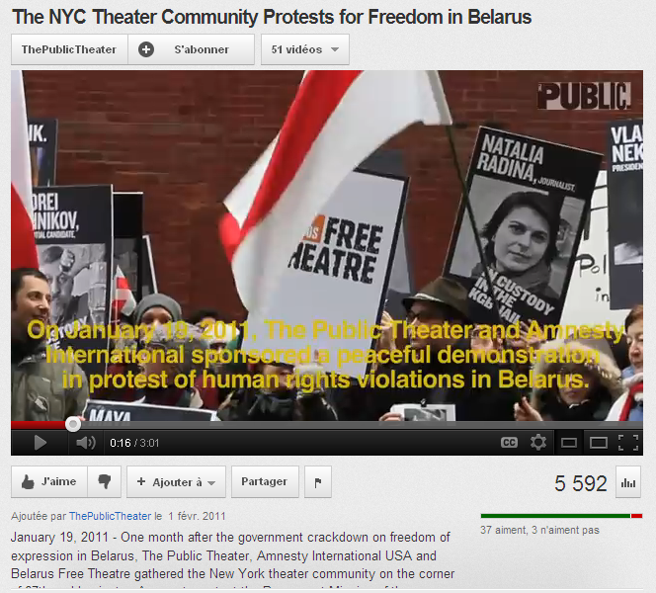
Performing arts & civil society
http://www.youtube.com/watch?v=IfhNYU5wxA0
13
Notes:
13

Slide 14
Performing arts & civil society
Belarus Free Theatre
Protection of freedom of expression
Empower civil society
Free movement of people
14
Notes:
14

Slide 15
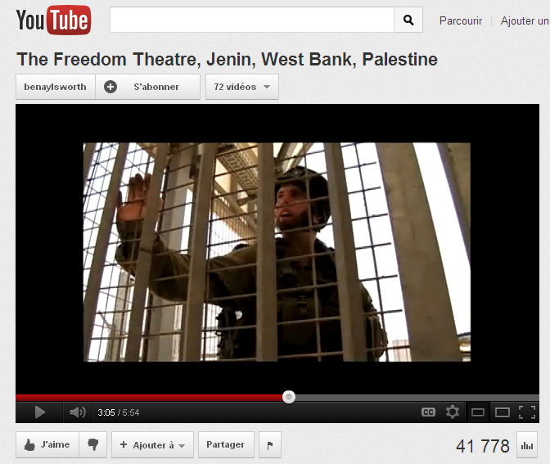
Performing arts & civil society
http://www.youtube.com/watch?v=OaSvnkRFRic
15
Notes:
15

Slide 16
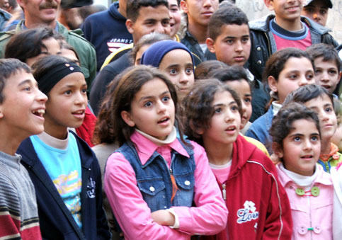
Performing arts & civil society
The Freedom Theatre, Palestine
Promoting freedom of expression
Empowering children, youth and adults
Breaking cultural isolation
16
Notes:
16

Slide 17
Intangible cultural heritage
& job creation
4.
Notes:
17

Slide 18
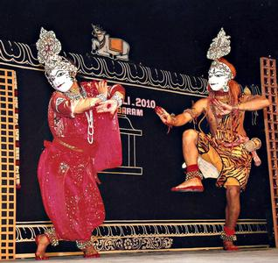
Intangible cultural heritage & job creation
“Art for Livelihood” in India
Capacity building project in West Bengal, one of the poorest rural areas in India.
3 200 artists in 50 villages
EU funding: 1.3M€ for phase 2
ACTIONS:
Cultural Mapping
Capacity building for artists
Microcredit
Marketing and promotion
Festivals and exchange
18
Notes:
18

Slide 19
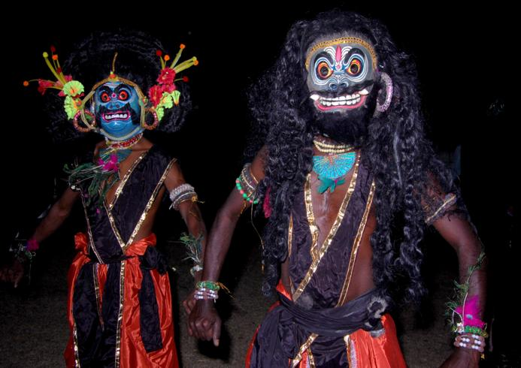
Intangible cultural heritage & job creation
“Art for Livelihood” in India
OUTCOMES AND RESULTS
(UNESCO Assessment Report 2011)
Average monthly income from 8€ to 40€
Sanitation/electricity: from 4% to 87%
Children attending school: from 3% to 94%
Identity: From unskilled labor to artists
Leading artist touring to UK, France, Tunisia, China, Japan…
19
Notes:
19

Slide 20
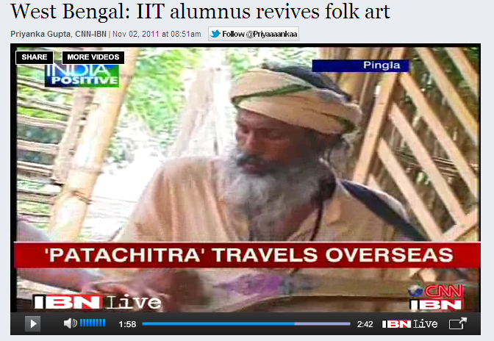
Intangible cultural heritage & job creation
http://ibnlive.in.com/videos/198340/west-bengal-iit-alumnus-revives-folk-art.html
20
Notes:
20

Slide 21
How to assess the contribution of culture?
5.

Slide 22
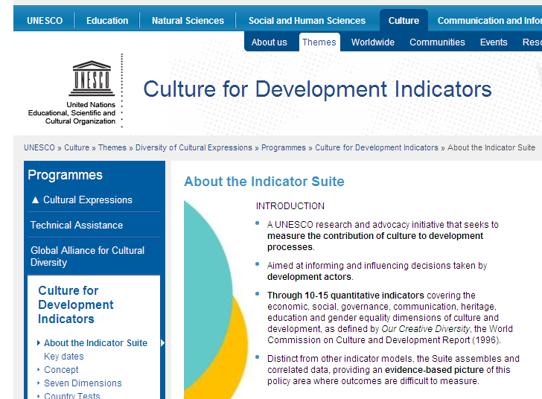
How to assess the contribution of culture?
www.unesco.org/culture/CDIS

Slide 23
How to assess the contribution of culture?
23
Notes:
23

Slide 24
Q&A
6.

Slide 25
Thank you.

