Slide 1

Overview of FLEGT processes: opportunities and challenges afforded by the process to build a VPA
January 10 2012
Julia Falconer, European Commission
Notes:
1

Slide 2
Strategies for Improving Governance framed by the VPA
Inclusion of stakeholders in clarifying &developing policy &law
Negotiated consensus between stakeholders
Clarity in legal framework
Simplified control systems- less opportunity for corruption
Verification (Evidence) of legal compliance linked to export
Independent audit
Complaints mechanisms
Link to law enforcement (eg. law case tracking in Cameroon)
Publication of information on contracts, fees paid, revenue disbursement, audit reports, legal cases, etc
Stakeholder oversight committees/ councils
Notes:
2

Slide 3
Steps in building Agreement
Opportunities for stakeholder input throughout process
Timing of inputs is important
Country consensus building
Information
Bilateral Negotiation
Negotiations with EC
Negotiations AMONG stakeholder groups in VPA producer country
Agreement Ratification
VPA initialed
Negotiations WITHIN stakeholder groups
Stakeholders structure for discussion
Country debate and analysis on challenges, problems, legality, legality, tracking systems etc
VPA Signed
System Development
Tracking systems created
Reforms adopted
Licensing created
Independent auditor selected
System
Operational
FLEGT Licenses
IA reports
JIC meetings
Timber controlled at EU borders
Impacts monitored
VPA ratified by EU + country Parliaments –
Capacity established
Enters in force
Notes:
3

Slide 4
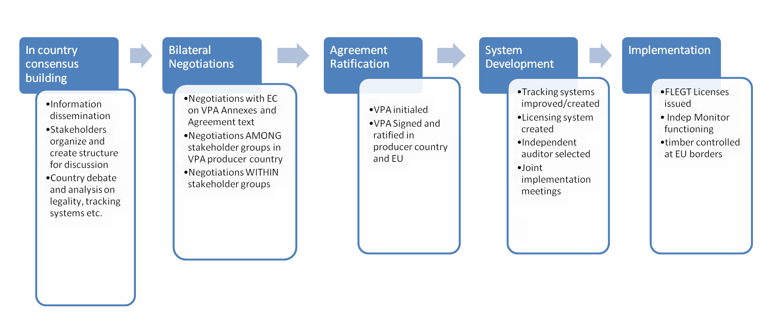
In country consensus building
Analysis forest sector, trade, governance challenges,
stakeholder identification and internal consensus building on key positions, national workshops, technical working groups, national platforms
Understanding of FLEGT and VPA process
National workshop ensuring VPA is the right tool & understanding the challenges to address
Establishment of a multi-stakeholder team / designation of representatives (preferably self-designated by CSO and PS)
Build from on going reform agenda and project work
Notes:
4

Slide 5
Negotiations
  Structured development of ideas and reforms framed in legally binding treaty
  Structures that inform negotiation : working groups, steering committees, negotiation sessions, national consultations, de briefing sessions, stakeholder platforms/ associations Roadmap – timing of discussions of issues
  Opportunities to interact and inform: legality definition, transparency, legality assurance system, monitoring and reporting.
  Timing important
Notes:
5

Slide 6
Systems development: start implementation
Establishing structure: Joint Implementation Committee, national committees, national stakeholder platforms,
Improve and develop systems: domestic market, technical IT systems significant challenges
Further reforms and legal
Raise awareness and visibility- focus on communication
Capacity building
Ratification may be slow… what actions can different actors take as framed by VPA
Be proactive in offering ideas and projects
Annual workplans & milestones
Notes:
6

Slide 7
Systems operational
Full implementation
JIC- meeting
FLEGT licenses
Independent audit
Transparency measures in place
Impact analysis
VPA monitoring & whistle-blowing
Managing complaints
Communication
VPA timber market promotion
Stakeholders involved in implementation
Notes:
7

Slide 8
Feuille de route de la négociation d’un accord de partenariat volontaire FLEGT entre la République Centrafricaine et la Communauté Européenne.
Negotiation roadmaps: set out stages in development
Action | Lieu | Échéance indicative
Ouverture officielle des négociations avec la CE. 1ère session de négociation : Définition des modalités de fonctionnement, de la communication, etc. A cette occasion la feuille de route est définie d’un commun accord. Débat sur les enjeux, l’architecture du SVL, etc. | Bangui | 14/10/2009
Session technique 1 sur la légalité | Vidéoconférence | 26/11/2009
Session technique 2 sur la légalité | Vidéoconférence | 22/12/2009
Session technique 3 sur la traçabilité et préparation de la 2ème session de négociation. | Vidéoconférence | 18/01/2010
Session technique 4 sur la légalité, la traçabilité dans le SVL. | Vidéoconférence | 15/02/2010
2ème session de négociation sur la légalité, la traçabilité dans le Système de Vérification de la Légalité (SVL) | Bruxelles | 04/03/2010
Réalisation d’un test « grandeur nature » de la grille de légalité | Terrain RCA | 03/2010
Notes:
8

Slide 9
Work plans and schedules to guide implementation and system development
Most VPA include an indicative implementation schedule
As VPA move into implementation a first task of the national committees and JIC is to develop & agree detailed workplans
Workplans indicate the timing of development of different elements of the Agreement, milestones and results anticipated and in some cases indicate who leads in what
Important to understand the timing and strategy for development framed in these plans and to seek to tailor project actions to advance and contribute to the key milestones where possible
Notes:
9

Slide 10
Timing and political savvy are critical
Projects engaged in one aspect or another of implementing the FLEGT Action Plan, there are many opportunities to influence and guide application and implementation of law and policy
For VPAs national political dynamics: elections, key people, business cycles all influence process
Understand process dynamics, negotiation vs implementation
Analysis and information should be tailored to the stages in process – there are many opportunities – but timing, quality and representation are key
….
Notes:
10

Slide 11
Reflections
Anticipate how the results of your projects and programmes are going to be used or influence national FLEGT processes timing- adding value to VPA process
People matter and are a key constraint (whether in government, business or civil society).
Capacity is a constraint for all – but very different from one context to another – we need tailored strategies for building across stakeholder constituencies
Could projects be working more coherently: challenges of joint work and coordination?
Notes:
11

Slide 12
Sources of info to follow process as they develop
Each country FLEGT VPA webspace
FLEGT Envoy and EU Delegation FLEGT contact in country
FLEGT team in Brussels:
Falconer: Ghana, Cameroon, Liberia
Bousquet: Congo, DRC, C Africa region
Bruneval: CAR, Guyana, C.Ivoire,
Saintraint: Gabon, Honduras, S America
Bazill: Indonesia, Malaysia, S America, China
Torta: Vietnam, Mekong Region
Sanmiguel: FLEGT projects
Atanasova: TEU Timber Regulation
Capacity4Dev
EFI FLEGT VPA team (Melissa Othman and Jussi Lounasvuori)
EFI FLEGT website
Logging off website (NGO Forum)

