Slide 1
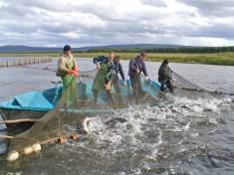
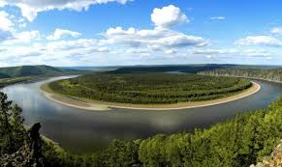
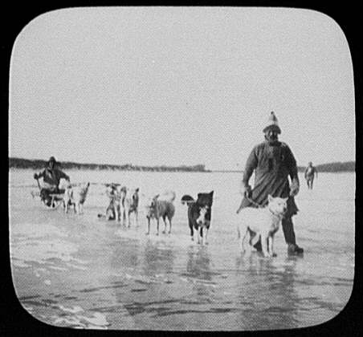
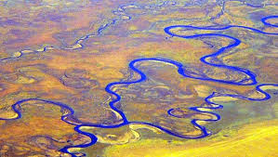
The Amur/Heilong River in China-Russia Relations: Conflict, Crisis, and Cooperation-Past, Present and Future
Gaye Christoffersen
Johns Hopkins University, SAIS, Nanjing Center

Slide 2
Thesis
Amur/Heilongjiang River unstable Sino-Russian boundary
Amur/Heilongjiang site of conflict, crisis & cooperation
Chinese and Russian different values & views of river boundaries, infrastructure, pollution, & water management
Differences have delayed construction of infrastructure
Moscow & Beijing make agreements; ask localities to implement but limited funding & resources
Russian center-local differences & Chinese center-local differences complicate cooperation
Memories of violent past slow down cooperation
environmental crises force better cooperation but also distrust

Slide 3
Amur River Watershed

Slide 4
Upper Amur River –Lake Baikal - Ulaanbaatar

Slide 5
Middle Amur River – Blagoveshchensk –Heihe -Khabarovsk

Slide 6
Lower Amur River

Slide 7
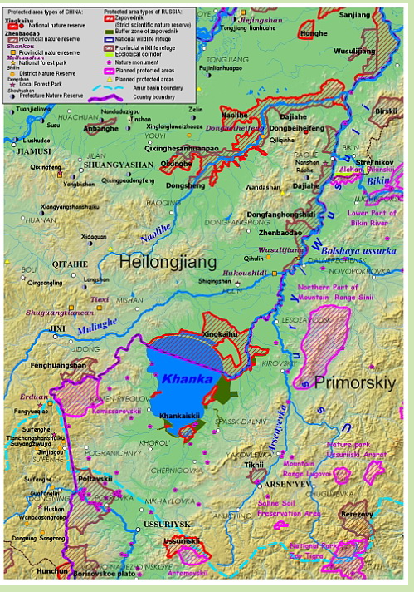
Ussuri River – Lake Khanka [L] – Lake Khanka protected areas [R]

Slide 8
Russian Far East- Dongbei population density

Slide 9
Cross-border power cooperation –Source:Melenteva - Energy Systems Institute

Slide 10
Moscow & Beijing negotiate Amur River Basin agreements
1956 Sino-Soviet Agreement on Development of Grand Amur Scheme
1986 Sino-Soviet Agreement on Development of Joint Comprehensive Scheme for Water Management on Amur and Argun Rivers
1994 Russia-China Agreement on Protection of Aquatic Bio-resources in Transboundary Amur and Ussuri Rivers
1994 Russia-China Cooperation in Protection of the Natural Environment
1996 Russia-China Agreement on Khanka/Xingkai Lake International Nature Reserve
2006 Sino-Russian Protocol on Common Approaches to Monitoring of Transboundary Waters
2008 Sino-Russian Agreement on Use and Protection of Transboundary Waters
2011 Sino-Russian Strategy for Development of Transboundary Protected Area Network in Amur River Basin
2014 Intergovernmental Memorandum of Intent on Flood Management Cooperation
1994-2004 most agreements non-binding; not tools for joint control over river

Slide 11
Blagoveshchensk – Heihe Bridge Vision

Slide 12
Amur/Heilongjiang Railroad Bridge –Nizhneleninskoye – Tongjiang Chinese side finished - Symbol of Russian Local Non-cooperation- Chinese Export-Import Bank allocated over $96.5 million to construct; agreed to 1988; planned completion 2016; Russia started 2018; may finish in 2019

Slide 13
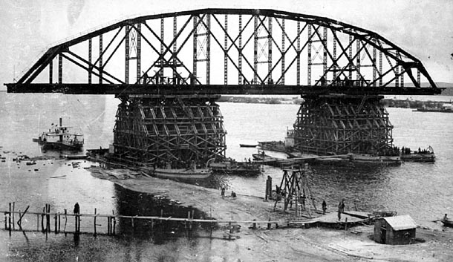
Russians capable of building bridges over the Amur Khabarovsk -old bridge opened Trans-Siberian Railway 1916 [L] new bridge over Amur River Khabarovsk (1999) [R]

Slide 14
Bridge to Russky Island in Vladivostok - built in 2012 for the APEC summit; crosses the Golden Horn Bay

Slide 15
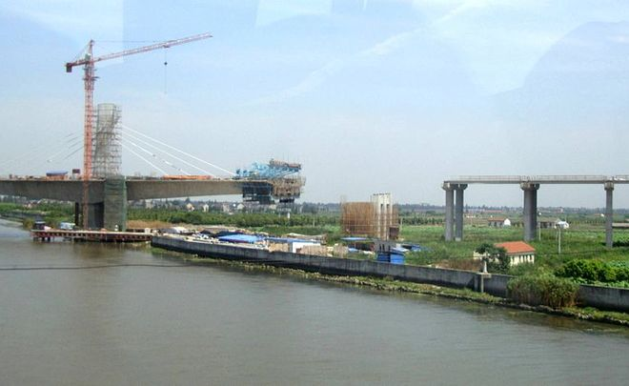
Amur/Heilongjiang Automobile Bridge -Blagoveshchensk–Heihe still under construction 1988 proposed but could not agree on terms until 2015

Slide 16
Military conflict: 1900; 1917-1920; 1929; 1969
conflicts preceded 1689 Treaty of Nerchinsk- 1st treaty between Russia & China; Russia recognized Chinese suzerainty over both sides of the Amur; R-C border on the Gorbitsa [Amur tributary]
Buryat, Sakha, Nanai, Nivkh, Udegey, & Orok on Amur north bank; Manchu & Mongol on Amur south bank
Russians gave up the area north of the Amur River as far as the Stanovoy Range and kept the area between the Argun River and Lake Baikal. This border along the Argun River and Stanovoy Range lasted until the Amur Annexation in 1860
1858 Treaty of Argun–Qing ceded north bank of the Amur to Russia; Qing subjects, 64 Manchu-inhabited villages, resident north of Amur could remain
1860 Treaty of Peking – Qing ceded land east of Ussuri River; Qing lost “Outer Manchuria”
1900 Boxer Rebellion - Qing forces blockaded Russian boat traffic on the Amur river near Argun; attacked Blagoveshchensk
1900 Blagoveshchensk massacre - 8,000 unarmed Chinese men, women, & children driven by bayonets used by Russian soldiers into the Amur and drowned

Slide 17
Boxer Rebellion 1900 -Russian troops in Blagoveshchensk starting incursion into Manchuria

Slide 18
Violence & Conflict: 1900; 1917-1920; 1929; 1969
Russian expanded influence to Harbin & Dairen [Dalian]
Honghuzi “Red Beards” 红胡子 – Han bandits along the Sino-Russian borderlands
guerrilla warfare against the Russian presence
participated in Boxer Rebellion & Russo-Japanese War on Japanese side,
1916-28 warlord of Manchuria Zhang Zuolin led a large army of Honghuzi; USSR blew up his train in 1928; blamed it on Japanese
Republic of China sent troops to Vladivostok in Siberian Intervention 1918-1920; fought against both Bolsheviks & Cossacks –protect Chinese business
1929 Sino-Soviet War over Chinese Eastern Railroad –shortcut across Manchuria for Trans-Siberian Railroad -border highly militarized zone
1931 Japanese control of Manchuria – border even more militarized
USSR Constitution of 1936 deprived local administrative bodies of any decision-making power related to neighboring countries

Slide 19
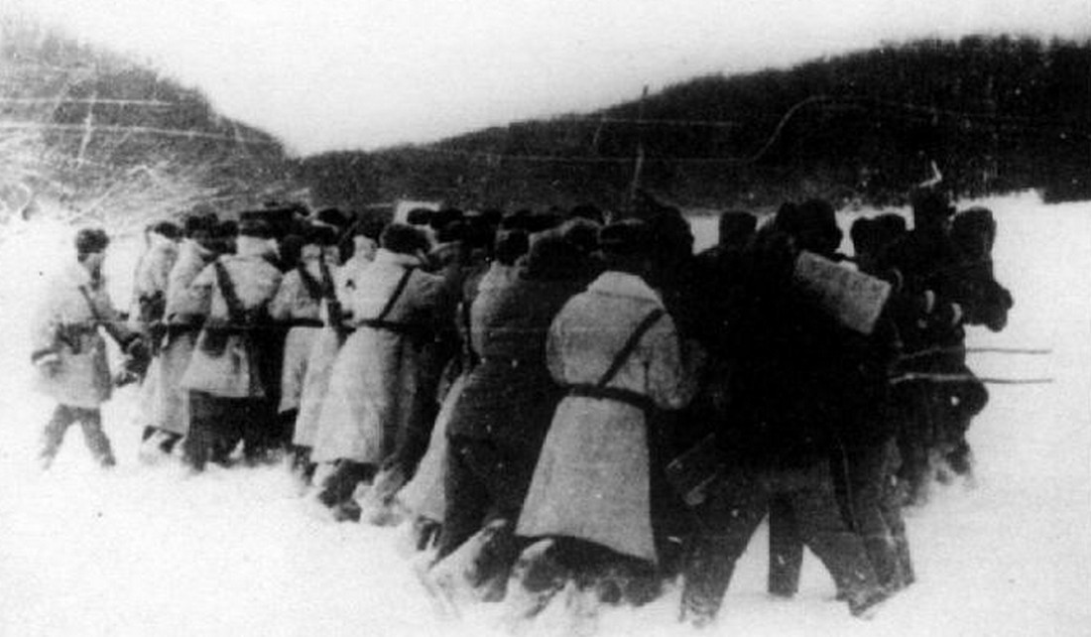
Sino-Soviet Ussuri River Clash 1969 –March 2 to September 11, 1969

Slide 20
Soviet ship uses a water cannon against a Chinese fisherman on the Ussuri River on 6 May 1969

Slide 21
1950s Sino-Soviet Friendship

Slide 22
Cultural Revolution - 1967 Chinese poster: Down with the Soviet Revisionists!

Slide 23
March1969 most serious clash near Zhenbao Island (珍宝岛) [Damansky Island] on the Ussuri River; PLA troops ambushed Soviet border guards on Zhenbao Island; Russians outnumbered; local Russian decision to fire 10,000 artillery rounds; Russia: 248 Chinese soldiers killed, 58 Soviets killed; Chinese estimated less killed; many atrocities; disagreement over who started conflict & who won

Slide 24
Sino-Soviet border – pink zones disputed areas

Slide 25
19th & 20th c. Amur Basin intergovernmental negotiations
bilateral government negotiations focus on immediate threats, creating order:
Border demarcation rules and related engineering practices
Navigation rights and sustaining navigable channels
Military security issues
Energy policies, primarily hydropower
Joint use of disputed islands
Russians more concerned about environmental impact than Chinese but not priority
1997 discussions began on framework agreement between Chinese & Russian water management agencies
narrowly focused on water resources; omitted environmental issues, water-use limits & mechanisms for regulating water flow
no binding requirements; just mutual information exchange & consultations
opened communication channels; not signed until 2008

Slide 26
Khabarovsk Promoted Cooperation
1956-1962: China & USSR cooperatively researched Amur River Basin in agriculture, industrial development, fisheries and wildlife management; planned for water infrastructure for flood prevention & hydropower generation
Gao Gang, power base in Dongbei, very close to USSR; 1940s suggested integrating Dongbei with USSR
1960s dispute: China & USSR aggressively developed water resources on their own side without coordination with the other side
Khabarovsk local Russians benefited from border trade; continued during hostilities till 1966
1969 Sino-Russian border talks began; continued for 3 decades
1972 Khabarovsk promoted re-opening border trade; Moscow didn’t open till 1983

Slide 27
Away from Conflict –Towards Cooperation
1989 Sino-Russian normalized relations
1986 signed Russia-China Joint Comprehensive Scheme for Water Development in Transboundary Waters of the Argun and Amur Rivers; same sectors as in 1950s
China prioritized hydropower; wanted 10 dams on Amur River & its tributaries
Russians disagreed: would block migrating fish, sedimentation patterns in the Lower Amur, alteration of wetland hydrological regime in Amur River Valley
concerned with environmental impact; joint scheme not implemented
1991 Sino-Soviet Border Agreement -PRC renounced sovereignty of the 64 Manchu villages
October 14, 2003 border agreement signed; Russia agreed to transfer Yinlong Island, Zhenbao Island & ½ Heixiazi Island to China
2008 Sino-Russian Border Line Agreement; acceptance of demarcation of the eastern portion of the Chinese-Russian border, east of Ussuri River

Slide 28
Mainstream Transboundary Dams "Joint Comprehensive Scheme on Amur and Argun rivers no agreement (Difference in figures in Russian version of the design shown in brackets); Source: Rivers without Boundaries

Slide 29
21st c. Heilongjiang’s Plans : RFE-Dongbei Integration
Heilongjiang’s efforts to create a single economic space, a Natural Economic Territory (NET), between Heilongjiang and the Russian Far East.
1998: Moscow & Beijing organized Russian-Chinese Coordinative Commission on Interregional and Border Trade and Economic Cooperation to facilitate the economic integration of Dongbei-RFE
2003:Beijing - Revitalization of the Northeast Industrial Base program; program included assumption of economic integration between RFE & Dongbei
2004: China-Russia Trade-Economic Forum; Gov. Darkin asked for Chinese investment in Primorye; help it enter Asia-Pacific economic, political, and cultural life; not towards Dongbei
Heilongjiang Gov Zhang Zuoji called for Russian investment in Heilongjiang; upgrade its rusting industrial base; needed transit via Primorye’s transportation system
2005 HLJ: would construct an industrial corridor linking Harbin, Daqing, & Qiqihar, the “Ha-Da-Qi” corridor, as part of the revitalization of Dongbei
Dongbei’s industrial revitalization depended on the realization of the NET that would allow exports of commodities, sold in Russian markets by Chinese traders, and imports of Russian oil for Ha-Da-Qi

Slide 30
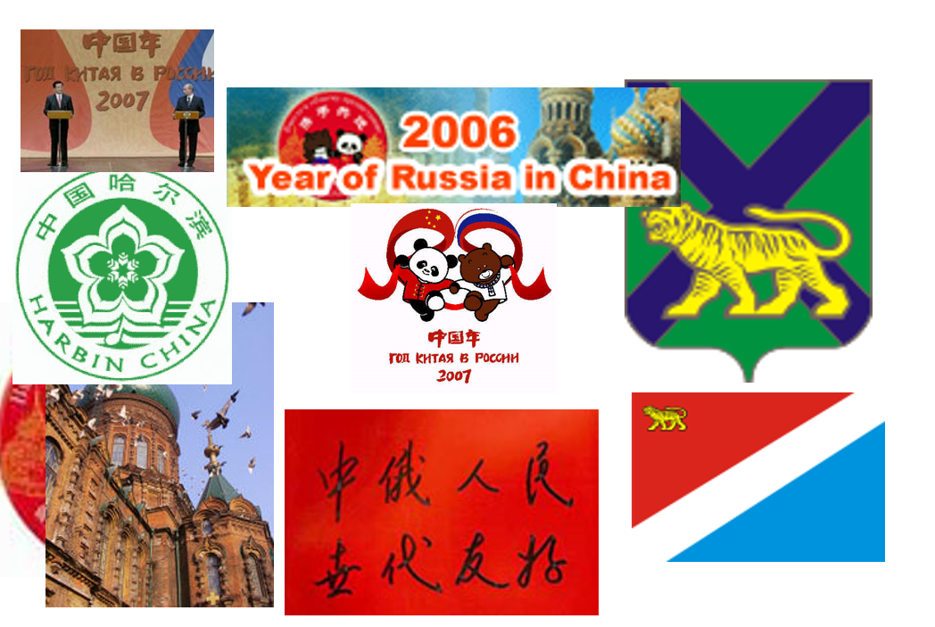
-1990s Vladivostok more xenophobic than Khabarovsk, -rejected Yeltsin’s border liberalization for Chinese trade -2006-2007 top-down programs to promote societal interaction

Slide 31
14th annual meeting Russian & Chinese prime ministers agreement on RFE-Dongbei coop, linked to progress on ESPO, Beijing Oct 2009 [Russia forced into RFE-Dongbei economic integration; local Russians never implemented]

Slide 32
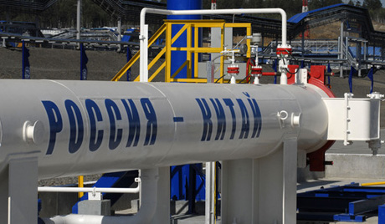
Sino-Russian oil pipeline

Slide 33
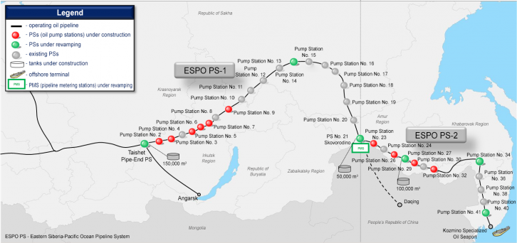
ESPO oil pipeline – crosses the Amur River

Slide 34
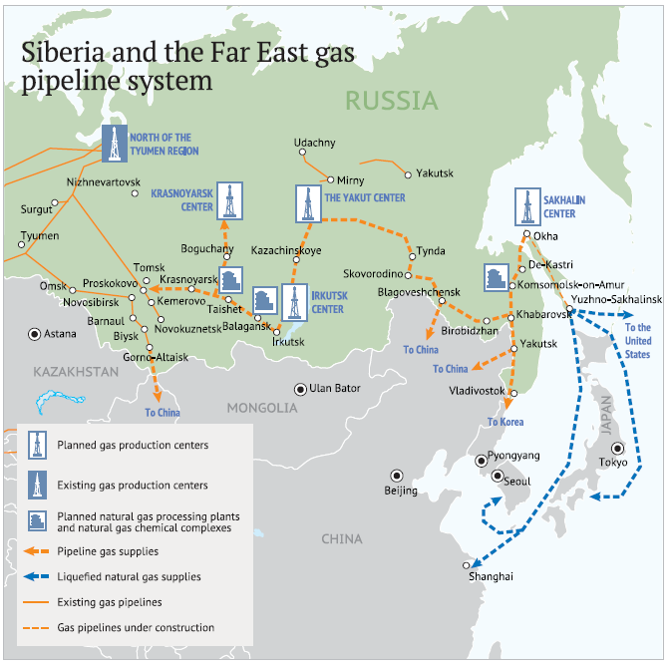

Slide 35
Amur River dams – hydropower plants

Slide 37
2012 Grid infrastructure planning in Russia’s East Siberia for electricity export to China -Eurosibenergo

Slide 38
Russian Far East –transport corridors – special economic zones –free ports

Slide 39
2005 Songhua River Toxic Spill Crisis
Chinese industry, petrochemicals & pulp plants, mining, heavy use of agricultural fertilizers & pesticides, discharge wastewater into Songhua River
impacts water quality in Argun, Amur & Ussuri; especially where Songhua River runs into Amur
Nov. 13, 2005: CNPC Jilin Petrochemicals plant in Jilin City exploded, spilling 100 tons of benzene, aniline, & nitrobenzene into Songhua River
Local officials had very poor emergency response capacity; tried to cover up; didn’t notify downstream Chinese cities; didn’t notify Beijing for 5 days; 80 km long toxic slick couldn’t be hidden
as toxic slick approached Harbin, gov’t. officials notified public & UNEP; Harbin’s drinking water from Songhua
SEPA coordinated emergency response; monitored, diluted with water from reservoirs, reduced pollution dumping in Songhua, banned fishing

Slide 40
2005 Songhua River Toxic Spill Crisis
SEPA notified Russia 11 days after spill; agreed on a joint monitoring protocol
Moscow authorities unprepared; frequented Khabarovsk in late November onward but with little coordination or purpose; called press-conferences & made political statements
Late Nov. 2005: Khabarovsk team visited Harbin; Russians lacked equipment to monitor; asked Chinese for info on pollution
Dec. 2005: toxic slick reached Amur River & Khabarovsk which depends on Amur for water supply
UNEP expert team on site did not have access to information; complained couldn’t help
Jan. 2006: SEPA announced to public & Russia water was safe; Russian side didn’t trust
Feb. 2006: Beijing & Moscow signed “On approaches to joint monitoring of cross-border rivers” – had talked about it for 13 years but not signed
Spring 2006: Khabarovsk continued to find benzene in fish from Amur river; Russians still waited for pollution info from Chinese side; Russian public negative view on China—always polluting
1st incident of bilateral cooperation in environmental crisis management
post-crisis: Moscow & Beijing, local research institutions, organized joint monitoring of water quality in transboundary waterways; hotline set up

Slide 41
ADB responded to 2015 Songhua toxic spill crisis –Heilongjiang Province

Slide 42
ADB responded to 2015 Songhua toxic spill crisis – Jilin Province

Slide 43
Conclusion - old issues persist
Amur River ecological condition stabilized due to Sino-Russian cooperation
1996-2010 Khabarovsk found increasing levels of toxic substances, as well as hydrocarbons, pesticides, & heavy metals exceeding Russian standards
2016 level of water pollution in Amur River changed from fourth to third class
Amur River pollution -contaminated fish; Russians eating chemically contaminated fish led to abnormally high levels of pathologies of the liver, circulatory system, & nervous system, plus increased levels of deformities
Amur River fish yield declining due to overfishing; 90% decline
Nanai, indigenous people living along Amur, depend on the river for their fish supply, consider it sacred; pray to the river, practicing shamanism, before they fish; contaminated fish caused posttraumatic stress disorder (PTSD) among the Nanai

Slide 44
Conclusion -old issues persist
China wants more dams on the Amur; Russians resist
Russians want less pollution in Amur & clean fish; Chinese continue to dump industrial waste into Songhua River
Heilongjiang Province persistently promotes RFE-Dongbei economic integration; includes bridges, pipelines, trade, investment; Russian Far East resists
Heilongjiang believes integration with Russian Far East necessary for “Revitalization of the Northeast Industrial Base program”
Chinese promote RFE-Dongbei economic integration as the key project for implementing Belt & Road Initiative with Russia; Russians resist
Russian & Chinese environmental standards very different; prevent integration

Slide 45
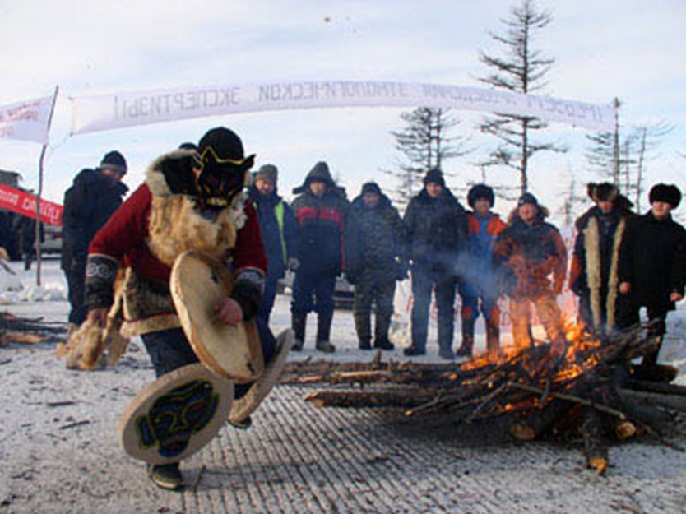
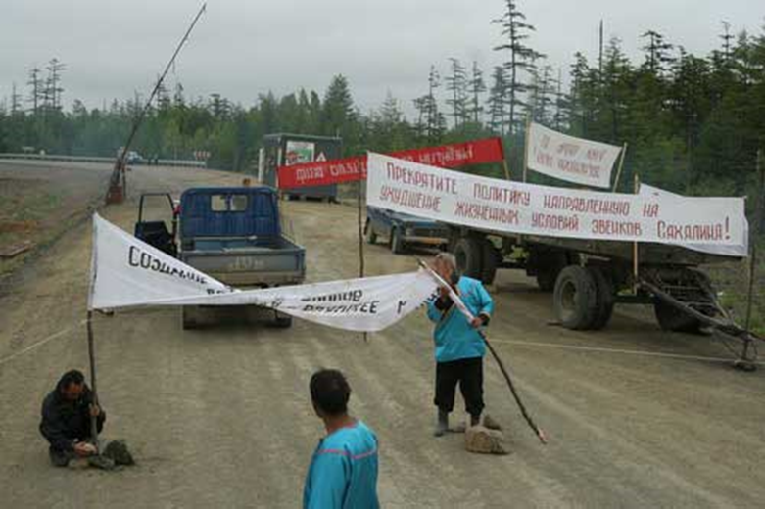
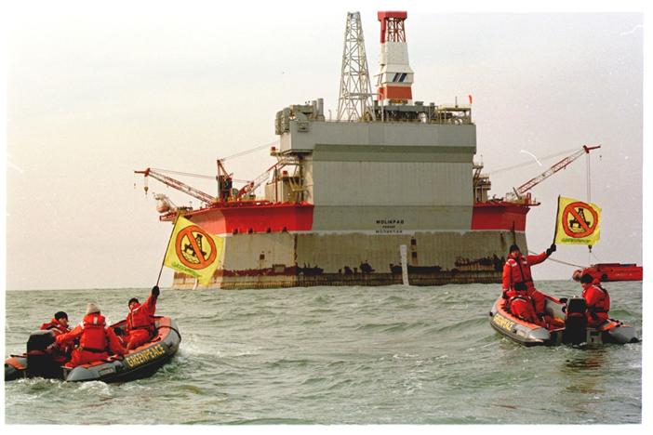
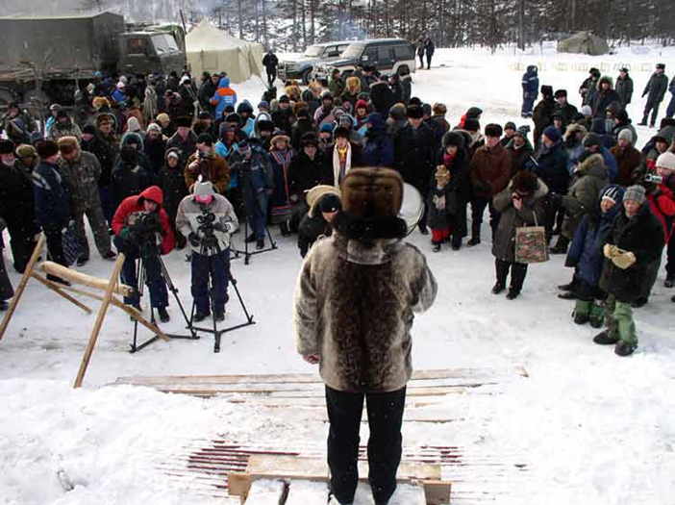
2004-07 - Sakhalin Association of Indigenous Peoples of the North, and Association of Indigenous Nations of North Sakhalin, with pickets of Nivkhi, Oroki, Nanais and Evenki protest international oil companies drilling [Shell, Exxon Mobil] Drilling disturbing fishing zones, breeding & spawning zones of valuable fish species, primarily salmon

Slide 46
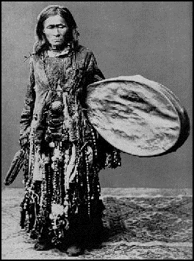
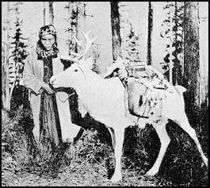
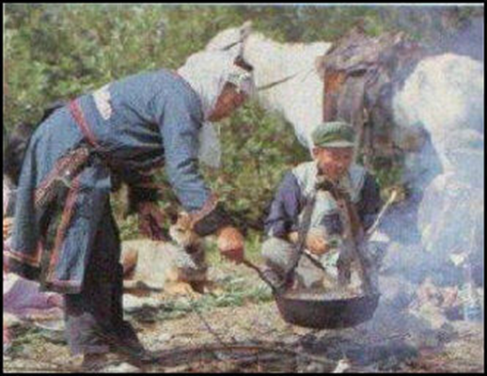
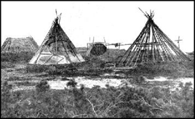
Oroqen [鄂伦春族] - indigenous minority in Russian Far East & Heilongjiang; Last Oroqen shaman, Chuonnasuan [1927-2000] on right; documentary film: http://v.youku.com/v_show/id_XNzkyMjUwMzY=.html Noll, Richard; Shi, Kun (2004). "Chuonnasuan (Meng Jin Fu). The Last Shaman of the Oroqen of Northeast China" (pdf). Journal of Korean Religions (6): 135–162

