Slide 1
Transboundary Environmental Impact Assessment on the Utilization of International Rivers
Yongmin Bian
Law School, University of International Business and Economics
bianyongmin@uibe.edu.cn

Slide 2
Environmental impact assessment is an obligation under the rule of due diligence
ICJ ruling in the case of Pulp Mills on the River of Uruguay (Argentina v. Uruguay, 2010)
“a requirement under general international law to undertake environmental impact assessment where there is a risk that the proposed industrial activity may have a significant adverse impact in a transboundary context, in particular, on a shared resource.”
Indus Waters Kishenganga Arbitration (Pakistan v. India, 2013)

Slide 3
EIA law has been implemented by China in her management of rivers
Learning by doing approach
Law on Environmental Impact Assessment (2002, revised in 2016)
Provisional Measures on Public Participation in EIA (2006, revised in 2018)
Regulation on EIA of Plans (2009)
Technical Guidelines to Environmental Impact Assessment in 2011
Notification to Enhance the Protection of Aquatic Organisms and Tighten the Administration of Environmental Impact Assessment (2013)
qualifications of EIA (consultancy) institutions (2015)

Slide 4
Trans-boundary EIA has been conducted especially on the international rivers in the north
Memorandum of Understanding on Environmental Principles Governing the Tumen River Economic Development Area and Northeast Asia (1995)
Memorandum Between China and the Russian on Joint Monitoring of the Quality of Waters of Transboundary Rivers (2006)
Agreement Between China and Mongol on Protection and Utilization of Border Waters (1994)
Cooperation Agreement Between China and Kazakhstan on the Utilization and Protection of Transboundary Rivers(2001)
In the south, with India and Mekong riparian states, hydrological information of rain season. More cooperation needed

Slide 5
TEIA shall not only focus on environment
Recent researches provide us a holistic view of the value of international rivers
Economic value: fishery v. cost to switch to alternative protein sources
Example of low Mekong: 2.3 million tons of fish harvest annually, 17 billions USD
Aquaculture: may rely on the natural flow of waters, include normal flood
Energy, irrigation, navigation, ecosystem service, religion, culture diversity
Not only the livelihood of human beings rely on healthy rivers, but also the fauna and flora in the river basin
Impact and trade-offs often mean variously for different stakeholders, including upstream and downstream states, banks, projectors, indigenous people, woman, future generations, ecosystem…

Slide 6
TEIA needs more cooperation
TEIA can be conducted by one state independently or states jointly
Information collection and disclosure, data-sharing
Hindu Kush Himalayan Monitoring and Assessment Programme: India, China, Bhutan, Nepal, Bangladesh, Afghanistan, Myanmar
Knowledge-sharing: such as the impact of climate change to rivers
Trust-building
Who is public? The participation of foreign NGOs, foreign residents potentially affected, media and international organizations
Natural resources are becoming scarce and the remains deserve our highest attention for a best plan.

Slide 7
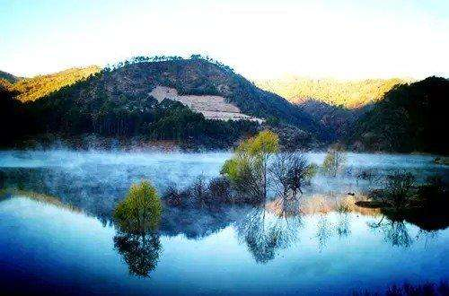
Thank you!

