Slide 1
Introduction of China Water Exchange
Wu Yue
Notes:
brief introduction of China Water Exchange

Slide 2
1. Basic Information
Notes:
基本情况8点

Slide 3
1.1 Company Profile
Launched by the Ministry of Water Resources and the Beijing Municipal Government
Approved by the State Council
the first national water rights trading platform
Located in Xicheng district, Beijing
Notes:
China Water Rights Exchange Co., Ltd. (hereinafter as “China Water Exchange”) is the first national water rights trading platform that jointly launched by the Ministry of water resources and the Beijing Municipal Government with the approval of the State Council. It is an implement of the Party Central Committee and the State Councils’ decision on the deployment and construction of water market. Located in Xicheng district, Beijing.

Slide 4
1.2 Operational Objectives
Establish market in water resources allocation
Formulate and conduct water rights trading norms
Foster efficiency and effectiveness of water resources utilization
Achieve sustainable utilization of water resources
Develop economy of society
Notes:
The aim of China Water Exchange is to give full play to the market in water resources allocation, and to enhance the efficiency and effectiveness of water resources utilization and ultimately provide strong support for sustainable utilization of water resources and sustainable development of economy and society.

Slide 5
1.3 Supervision
China Water Exchange
Financial Supervision: China Securities Regulatory Commission Beijing Office, Beijing Municipal Bureau of Financial Work
Industrial Supervision: Divisions of the Ministry of Water Resources
Notes:
The operation of CWEX is supervisied by the Misitry of Water Resources in terms of governmental administration and Beijing Municipal Bureau of Financial Work in terms of financial regulation.

Slide 6
1.4 Ownership Structure
Shareholders | Registered Capital (Million in RMB) | Shareholding Percentage
Cathay Xinhua Industrial | 186 | 31%
Beijing Water Investment | 180 | 30%
Xinhua Water Holdings | 60 | 10%
China Water Investment | 60 | 10%
Yangtze River Development | 24 | 4%
Sanmenxia the Yellow River Mingzhu Group | 24 | 4%
Beijing Financial Street | 24 | 4%
Huaihe Water Planning | 12 | 2%
North China Water Group | 12 | 2%
Pearl Water Planing | 6 | 1%
Jilin Songliao Water Development | 6 | 1%
Shanghai Taihu Hydropower Development | 6 | 1%
Total | 600 | 100%
12 initiators
3 companies -the Ministry of Water Resources
2 companies -Beijing Municipal Government
7 companies -seven basin authorities
Notes:
China Water Exchange is a joint stock limited company with registered capital of RMB 600 million. The 12 initiators include 3 companies representing the Ministry of Water Resources, 2 companies representing Beijing Municipal Government and 7 companies respectively representing seven main basin authorities in China.

Slide 7
2. Water Rights Trading

Slide 8
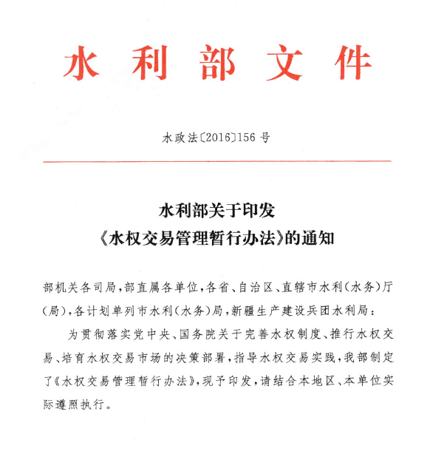
2.1 Three types of water trading
3 types of water rights trading authorized by <Interim Measures for the Water Rights Trading Administration>, which is issued by the Ministry of Water Resources in 2016.
<Interim Measures for the Water Rights Trading Administration>
Regional Water Rights Trading
Water Withdraw Rights Trading
Irrigation Water Rights Trading
Notes:
in 2016, the Ministry of Water Resources released <interim Measures for the Water Rights Trading Administration>, by which 3 types of water rights trading are defined and regulated.

Slide 9
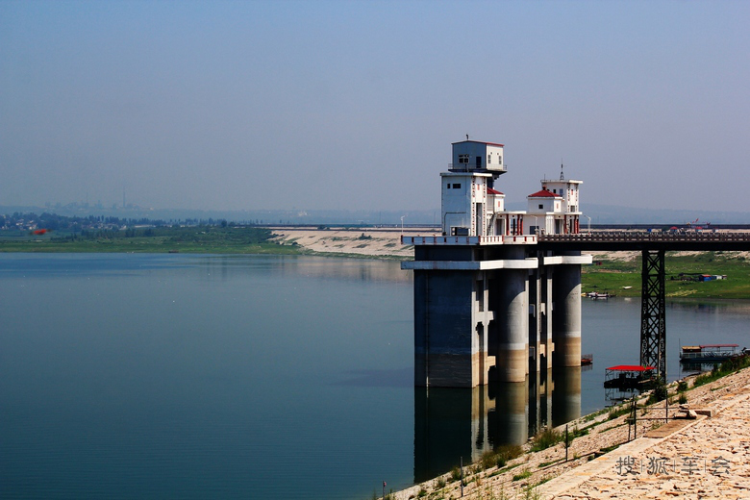
2.2 Regional Water Rights Trading
Regional water rights trading can be taken by administrative regions within the same basin or across basins with channel connection. Regional water rights refer to the surplus water under the control of total water consumption or the regional allocation of water volume.
Notes:
Regional Water Rights Trading
Regional water rights trading can be taken by administrative regions within the same basin or across basins with channel connection. Regional water rights refer to the surplus water under the control of total water consumption or the regional allocation of water volume.
典型案例：平顶山市—新密市跨流域水权交易
2016年6月28日，河南省内首宗跨流域区域水权交易暨平顶山市—新密市区域水权交易在中国水权交易所开业活动上正式签约。交易总水量2400万立方米，期限3年，交易采用协议转让的方式。同时，新密市投资3.9亿元修建引水入密工程，将交易的水量从尖岗水库输送到新密市城区。本次交易实现了新密市通过水权交易引用南水北调来水，缓解了新密市水资源短缺，为河南省南水北调受水地区优化水资源配置开创了市场化水权交易的先例。
Case: Cross-basin water rights trading between Pingdingshan City and Xinmi City
On June 28, 2016, a cross-basin water rights trading agreement between Pingdingshan and Xinmi was signed at the China Water Exchange opening ceremony, which is the first cross-basin water rights trading deal in Henan Province. The total transaction volume is 24 million cubic meters and the trading duration is 3 years. To back the deal, the buyer invested RMB 390 million to bring water from the Jiangang Reservoir to the downtown area of Xinmi. The transaction enabled Xinmi to benefit from the South-to-North Water Diversion Project and eased the problem of water shortage. It is also a leading example of the market-oriented water rights trading for optimizing allocation for the South-to-North Water Diversion Project in Henan Province. This deal is realized in the form of negotiation.

Slide 10
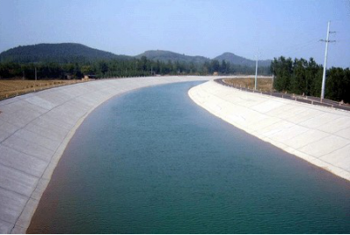
2.3 Water Withdraw Rights Trading
Water withdraw rights trading are transactions of water withdraw rights saved from industrial adjustment or process improvements between qualified companies or individuals under the approved conditions, duration and quantity.
Notes:
Water Withdraw Rights Trading
Water withdraw rights trading are transactions of water withdraw rights saved from industrial adjustment or process improvements between qualified companies or individuals under the approved conditions, duration and quantity.
典型案例：内蒙古盟市间获得了共计2000万立方米每年水权交易
2016年11月30日，内蒙古荣信化工有限公司、乌海神雾煤化科技有限公司等5家企业，通过中国水权交易所，从内蒙古水权收储转让中心2000万立方米每年的取水权，期限为25年。通过本次交易探索出了利用工业企业投资，对黄河流域近200万亩引黄灌溉面积进行节水改造，同时加强了水资源配置和管理，不仅解决了55个大型工业项目3亿立方米用水需求，还实现了引黄耗水量的逐年减少。
Case: Water withdraw rights trading of 20 million cubic meters per year in Inner Mongolia
November 30, 2016, Inner Mongolia Rongxin Chemical Co., Ltd., Wuhai Shenwu Coal Chemical Technology Co., Ltd. and other three companies purchased water withdraw rights of 20 million cubic meters per year (total 25 years), from the Inner Mongolia Water Resources Purchasing and Storage Center through China Water Rights Exchange.
There transactions were typical cases of obtaining water rights from investing in water saving projects. The model has enhanced water conservation of the irrigation area for nearly two million mu (1333 km²) in the Yellow River basin, while fulfilled the needs of 55 large-scale industrial projects, namely 300 million cubic meters of water, which have strengthened water resources allocation and management in Inner Mongolia and realized the annual reduction of water diverted from the Yellow River.

Slide 11
2.4 Irrigation Water Rights Trading
Irrigation water rights trading refers to water rights trading among irrigation water users or associations of water users, whose water use rights have been confirmed by local authorities.
Notes:
Irrigation Water Rights Trading
Irrigation water rights trading refers to water rights trading among irrigation water users or associations of water users, whose water use rights have been confirmed by local authorities.
典型案例：成安县政府回购
中国水权交易所积极与河北省水利厅开展合作，2016年11月，选定邯郸市成安县先行开展政府回购农业用水户2016年度节余水权额度，使用政府专项资金引导用水户参与到农业水权交易。截止2017年3月31日，在四个村（分别为行尹村、长巷营村、南甘罗村、王耳营村）完成了政府回购节余水权额度，总计回购水权额度为310865.23立方米，回购总金额为62173.046元，通过政府回购提高农业用水户交易意识，培育农业水权交易市场。
Case: Government repurchase by Cheng’ an County
In November 2016, as a part of cooperation with Department of Water Resources of Hebei Province, Cheng’an County in the city of Handan initiated the repurchase of 2016 annual irrigation water rights from farming households, with funding from fiscal funds. Until March 31, 2017, four villages (Xingyin Village, Chang Xiangying Village, Nan Ganluo Village, Wang Erying Village, respectively) have completed 310,865.23 cubic meters repurchase with a total cost of RMB 62,173.046. Government repurchase has increased the transaction awareness among agricultural water users and helped to the development of agricultural water rights market.

Slide 12
2.5 Trading Volume
92 deals relating to seven provinces with volume of 2.77 billionn m³ and value of RMB 1.68billion.
Regional Water Rights Trading
Water Withdraw Rights Trading
Irrigation Water Rights Trading
Shanxi and Hebei with Beijing of Yongding River
Jingneng Power Plant with Zhongning Government Capital Co.
Water Resources Bureau of Cheng’an County with Village’s Water User Association
Pingdingshan with Xinmi, of South Water to North Middle Line
Zhongshe Casting Co. with Huaiquan Irrigated Area
Ningxia Wuzhong City Litong District Agriculture Deals
Hebei Yunzhou Reservoir with Beijing Guanting Reservoir
Inner Mongolia Water Rights Reassigning to Local Companies
Xinjiang Changji Prefecture Hutubi County Wugongtai Town Deals Among Village’s Water User Association
Nanyang with Xinzheng and with Dengfeng, of South Water to North Middle Line
Notes:
Since opening, the China Water Exchange has successively settled 92 deals relating to seven provinces with accumulative trading volume of 2.77 billionn m³ and value of RMB 1.68billion.

Slide 13
3. Business Development
Notes:
业务进展5点

Slide 14
3.1 Trading Rules
Water Rights Trading Rules
Rules of Participant Protection and Appropriateness Management
Rules of Risk Control and Management
Rules of Information Publication Management
Trading Rules & Regulations of China Water Exchange
Rules of Trading Fund Settlement Management
Rules of Member Management
Rules of Emergency Disposal
Rules of Dispute mediation
Rules of fair transaction protection
Rules of confidentiality of information
Notes:
Interim Measures for the Water Rights Trading Administration
Trading Rules & Regulations of China Water Exchange
Water Rights Trading Rules (Trial)
Rules of Participant Protection and Appropriateness Management (Trial)
Rules of Risk Control and Management (Trial)
Rules of Information Publication Management (Trial)
Rules of Trading Fund Settlement Management (Trial)
Rules of Member Management (Trial)
Rules of Emergency Disposal (Trial)

Slide 15
3.2 Trading System
Three online processes cover three types of water rights trading.
Regional Water Rights Trading
Process of Public Listing Transfer
Open transactions
Water Withdraw Rights Trading
Regional Water Rights Trading
Process of Negotiation
Water Rights Trading System
Water Withdraw Rights Trading
Process of Smartphone APP Transfer
Irrigation Water Rights Trading

Slide 16
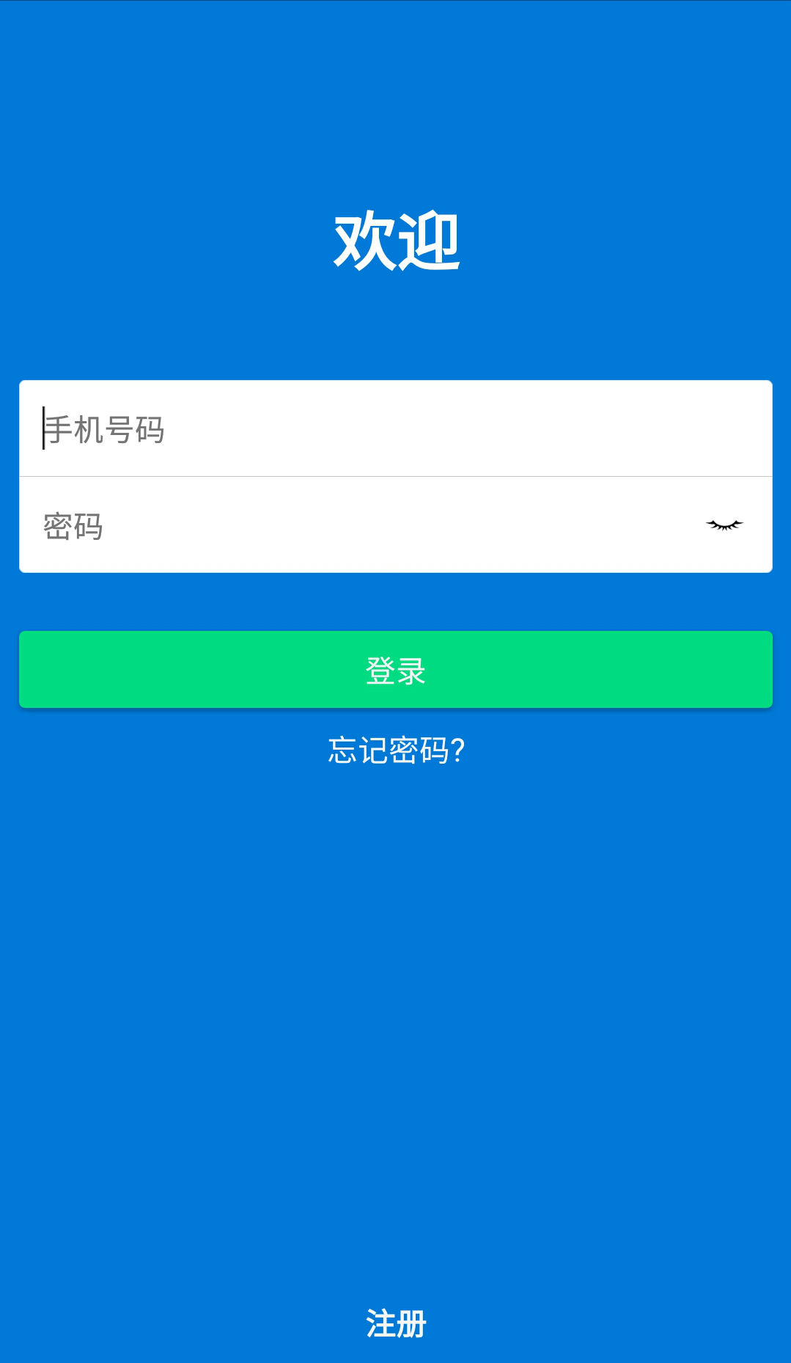
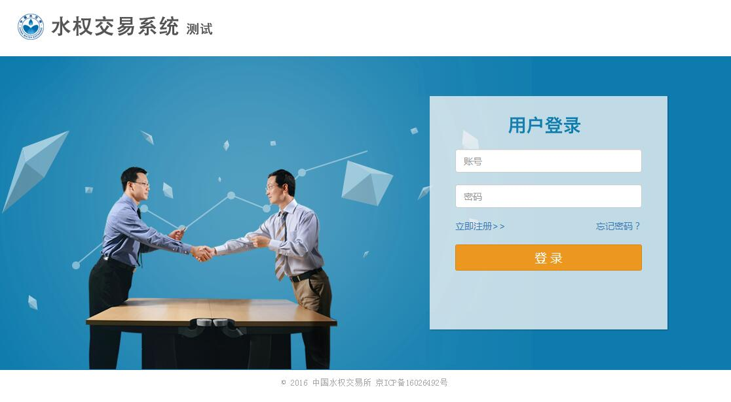
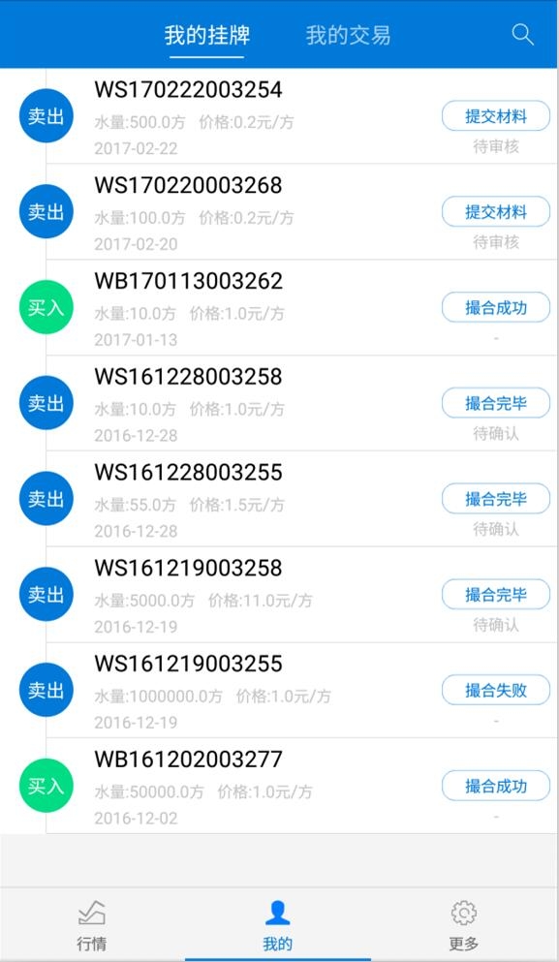
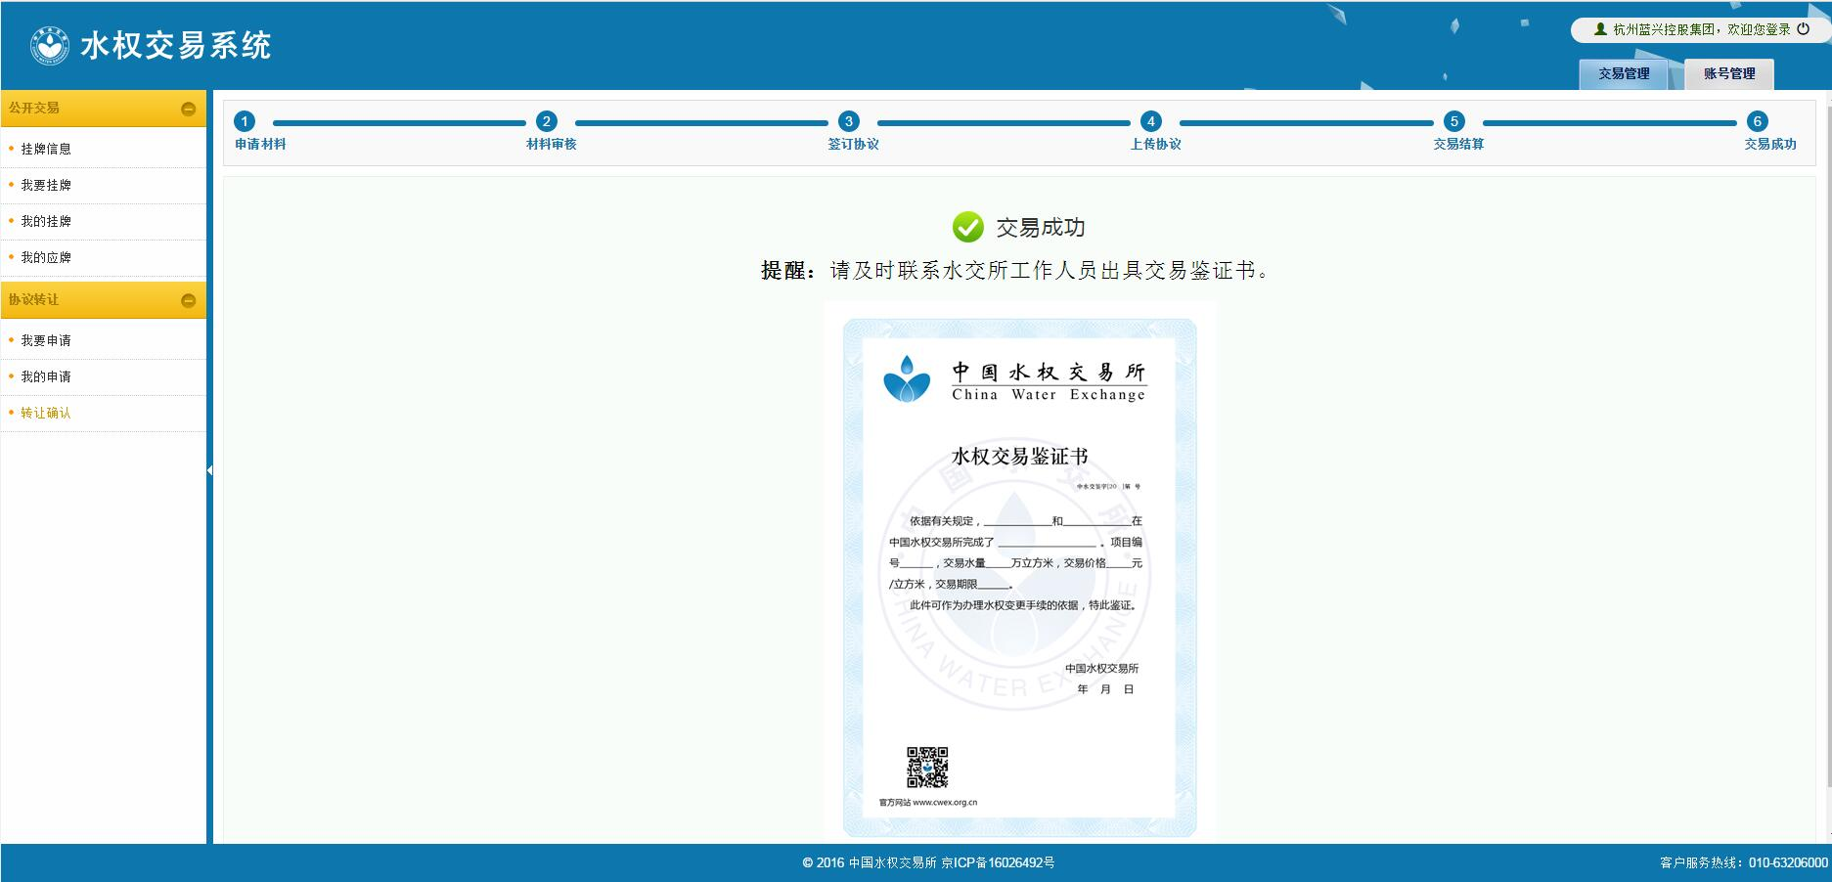
Login page of water rights trading smartphone APP
Login page of online water rights trading system
Trading process of online water rights trading system
Listing page of water trading smartphone APP
Notes:
水权交易系统登录界面
水权交易系统交易流程
手机APP登录界面
手机APP交易挂牌界面

Slide 17
3.3 Membership System
27 members including water investment, water conservancy informatization, water equipment manufacture and water study, etc.
CWEX Member System
Strategic Member
Strategic Partner Member
Strategic Cooperation Member
Strategic Development Member
Honorary Member
Notes:
China Water Exchange relies on its members to carry out business, and therefore emphasis member development. The membership system of China Water Exchange contains both nominate and strategic members to attract different types of water market participants.
Together with China Water Exchange, its members will explore water trading opportunities across regions and industries, and promote the rapid development of the water market in China.
Member Rights
China Water Exchange provide members with project developing, trading system usage, technical training, business promotion, customized trading information and product development to fully guarantee the rights of its members.
Member Activities
China Water Exchange regularly organizes various activities for its members to analyze water market policies, exchange business practices and give follow-ups to its membership work, with the aim of building opening channels of information and create a good work atmosphere for members.

Slide 18
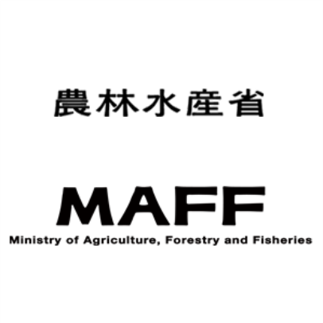
3.4 International Cooperation
CWEX has the willingness to enhance international communication and cooperations with both public and private sectors around the globe to exchange knowledge of water trading and deepen the understanding of water trading practice.
Notes:
澳大利亚：
官方-通过水利部国际合作与科技司，联系Australian Government, Department of Agriculture and Water Resources联系，正努力建立两国水权交易领域交流
民间-与水务咨询公司Aither合作，探讨合作申请Australian Water Partnership的可能
日本：参加2017年度中日农田水利交流会，介绍中国灌溉用水户水权交易现状

Slide 19
Thanks!

Slide 20
Case: Regional Water Rights Trading
Cross-basin water rights trading between Pingdingshan City and Xinmi City
First cross-basin water rights trading deal in Henan Province
Total trading volume: 24 million m³
Trading duration: 3 years
Market-oriented water rights trading for optimizing allocation
Notes:
Case: Cross-basin water rights trading between Pingdingshan City and Xinmi City
On June 28, 2016, a cross-basin water rights trading agreement between Pingdingshan and Xinmi was signed at the China Water Exchange opening ceremony, which is the first cross-basin water rights trading deal in Henan Province. The total transaction volume is 24 million cubic meters and the trading duration is 3 years. To back the deal, the buyer invested RMB 390 million to bring water from the Jiangang Reservoir to the downtown area of Xinmi. The transaction enabled Xinmi to benefit from the South-to-North Water Diversion Project and eased the problem of water shortage. It is also a leading example of the market-oriented water rights trading for optimizing allocation for the South-to-North Water Diversion Project in Henan Province. This deal is realized in the form of negotiation.

Slide 21
Case: Water Withdraw Rights Trading
Water withdraw rights trading of 20 million m³ per year in Inner Mongolia
Typical cases of obtaining water rights from investing in water saving projects
Enhanced water conservation of the irrigation area
Fulfilled the needs of industrial projects
Notes:
Case: Water withdraw rights trading of 20 million cubic meters per year in Inner Mongolia
November 30, 2016, Inner Mongolia Rongxin Chemical Co., Ltd., Wuhai Shenwu Coal Chemical Technology Co., Ltd. and other three companies purchased water withdraw rights of 20 million cubic meters per year (total 25 years), from the Inner Mongolia Water Resources Purchasing and Storage Center through China Water Rights Exchange.
There transactions were typical cases of obtaining water rights from investing in water saving projects. The model has enhanced water conservation of the irrigation area for nearly two million mu (1333 km²) in the Yellow River basin, while fulfilled the needs of 55 large-scale industrial projects, namely 300 million cubic meters of water, which have strengthened water resources allocation and management in Inner Mongolia and realized the annual reduction of water diverted from the Yellow River.

Slide 22
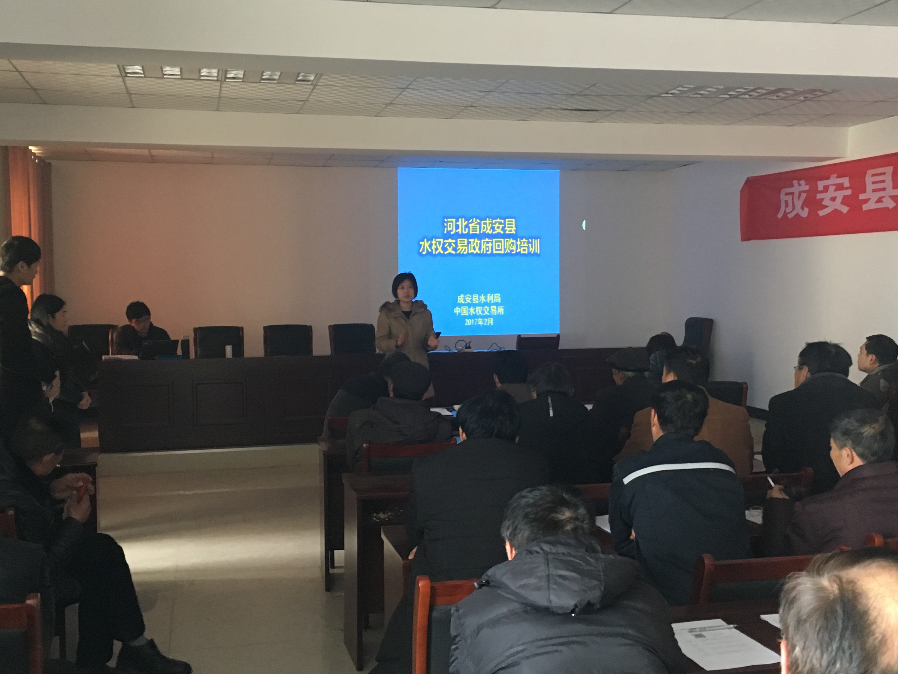
Case: Irrigation Water Rights Trading
Government repurchase by Cheng’an County
Repurchase of annual irrigation water rights from farming households
Four villages 310,865.23 m³ repurchased
RMB 62,173.046 from fiscal funds
Increased the transaction awareness among agricultural water users
Developed agricultural water rights market
Notes:
Case: Government repurchase by Cheng’ an County
In November 2016, as a part of cooperation with Department of Water Resources of Hebei Province, Cheng’an County in the city of Handan initiated the repurchase of 2016 annual irrigation water rights from farming households, with funding from fiscal funds. Until March 31, 2017, four villages (Xingyin Village, Chang Xiangying Village, Nan Ganluo Village, Wang Erying Village, respectively) have completed 310,865.23 cubic meters repurchase with a total cost of RMB 62,173.046. Government repurchase has increased the transaction awareness among agricultural water users and helped to the development of agricultural water rights market.

