Slide 1
Basin Rights of International River
WANG Zhijian, Hohai University, China
Hopkins Nanjing Center, China
December 17, 2018
Notes:
I am Wang from Hohai University in China, and now acting as a visiting scholar in CEOAS following Professor Aaron Wolf. Please just call me Wang

Slide 2
Outline
1.ERU as customary and conventional International Law
2.How to enforce that?
3.Basin Rights approach
2
Notes:
Today, My topic could be divided into 3 parts.
The first is why International river law; just give a debrief of field of water law and why not international water law?
The second part is basic rule of IRL, we will stem the river utilization history principle.
This part would link to the third part. How to enforce this rule, just give some brief introduction of my research recently, if yo like that, you can search from internet and cooperate with me in the future.

Slide 3
Part 1:
ERU as customary and
conventional International Law
Notes:
now , part one,
You are very welcome to raise any questions during or after the presentation. If you happened touch the question I had prepared before hand, please just wait till the end of the presentation. I will try to give all my respond to all the question.

Slide 4
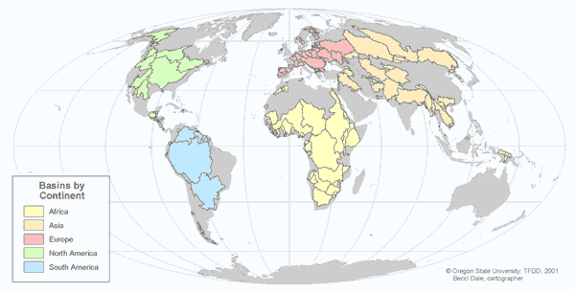
International River Basins
. In 1978 there
were 214 international basins. Today there are 263.
UNDP. human development t report 2006 p.205,
http://hdr.undp.org/en/media/HDR_2006_Chapter_6.pdf
6
Notes:
Let us move to international river law. Today the definition of international river basin had involved both international rivers and international lakes. (just imagine transboundary, several countries share the water)
In 1978 ninety seventy eight there were 214 two hundreds and fourteen international basins. Today there are 263. Europe has the largest number of international basins (69), followed by Africa (59), Asia (57), North America (40), and South America (38).
Why Europe has the most number? Near 70
What is the source of this map? OSU
It originate from OSU and Maybe Todd.

Slide 6
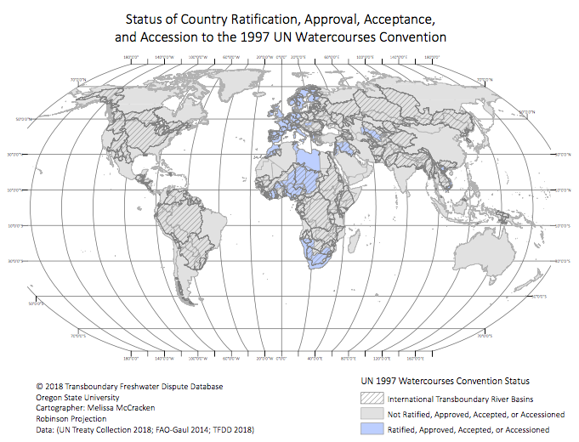

Slide 7
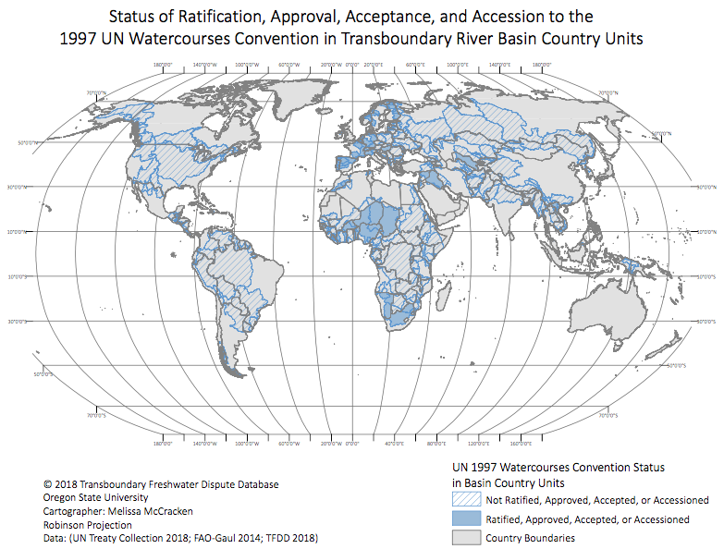

Slide 9
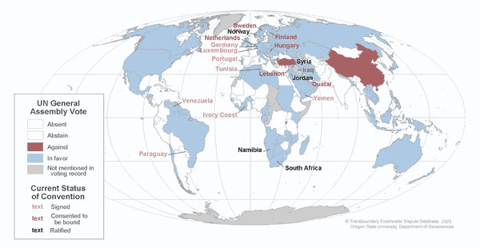
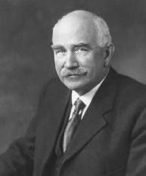
两个绝对的理论
103in favor，3against，27abstain
绝对主权论
绝对领土完整论（河流完整论）
“equitable and reasonable utilization
Notes:
103票赞成in favor，3票反对against，27票弃权abstain
106票赞成，3票反对，26票弃权。1997年5月21日
Convention on the Law of the Non-Navigational Uses of International Watercourses, 21 May 1997
UN General Assembly resolution 51/229

Slide 10
Notes:
Forthcoming by Wang

Slide 11
Part 2:
How to enforce that?
Notes:
now , part one,
You are very welcome to raise any questions during or after the presentation. If you happened touch the question I had prepared before hand, please just wait till the end of the presentation. I will try to give all my respond to all the question.

Slide 14
Part 3:
Basin Rights approach

Slide 15
Basin rights
L=Living rights for the river life (30% of flow)
H= human rights for basin people (1700 m³/cap/yr)
C=Water rights for each basin country
=(whole discharge-L-H )×contribution rate
Notes:
Each countries basin rights=H*population+W+CBA rate* L
to assessment the historical treaty. allocation water quota

Slide 16
IRLN
Notes:
even for a river within a country!
for decision making.

Slide 17
Thanks!
Xiexie!
谢谢！
lawaid@hotmail.com
21

