Slide 1
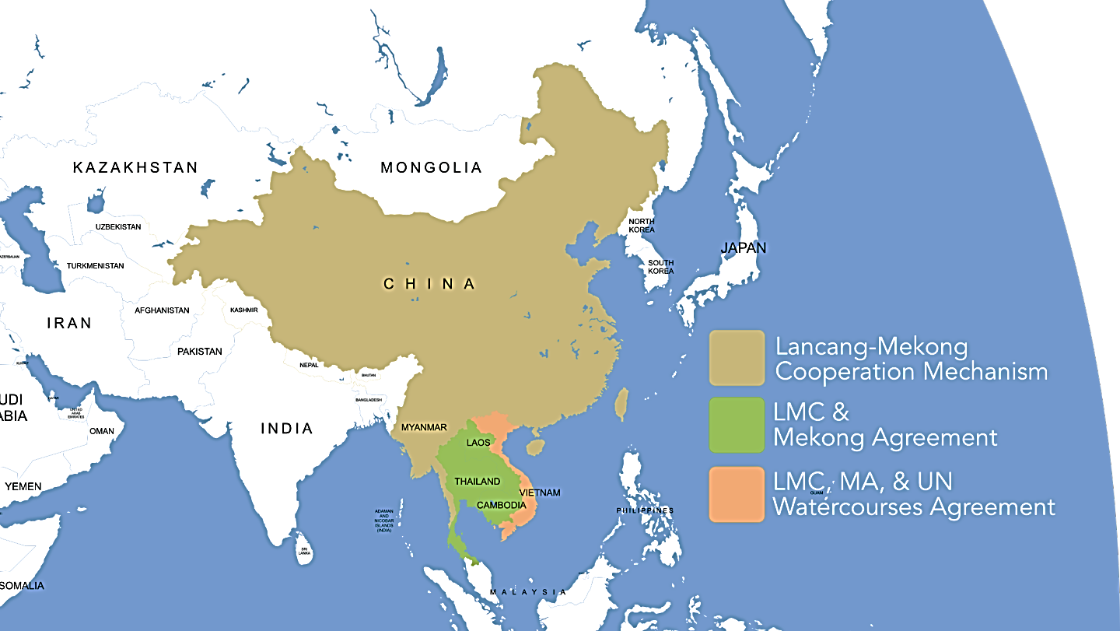
2018, December 16th – 18th
2018年12月16-18日
HOHAI UNIVERSITY, NANJING
河海大学，南京
The 1st International Water Rights Forum
第一届国际水权论坛
Transboundary Waters Governance Framework
for Sustainable Development:
a case study in Mekong River Basin
马天松
Mr Theerapon THAMMAHORA
*College of Hydrology and Water Resources,
HOHAI University, PRC
**Department of Water Resources,
Ministry of Natural Resources and Environment
The Kingdom of THAILAND

Slide 2
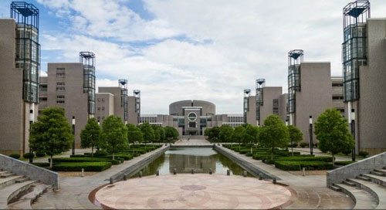
2018 年春天 Spring
The class of special topic on the international river law
王志坚
Professor WANG Zhijian
School of Law
HOHAI University

Slide 3
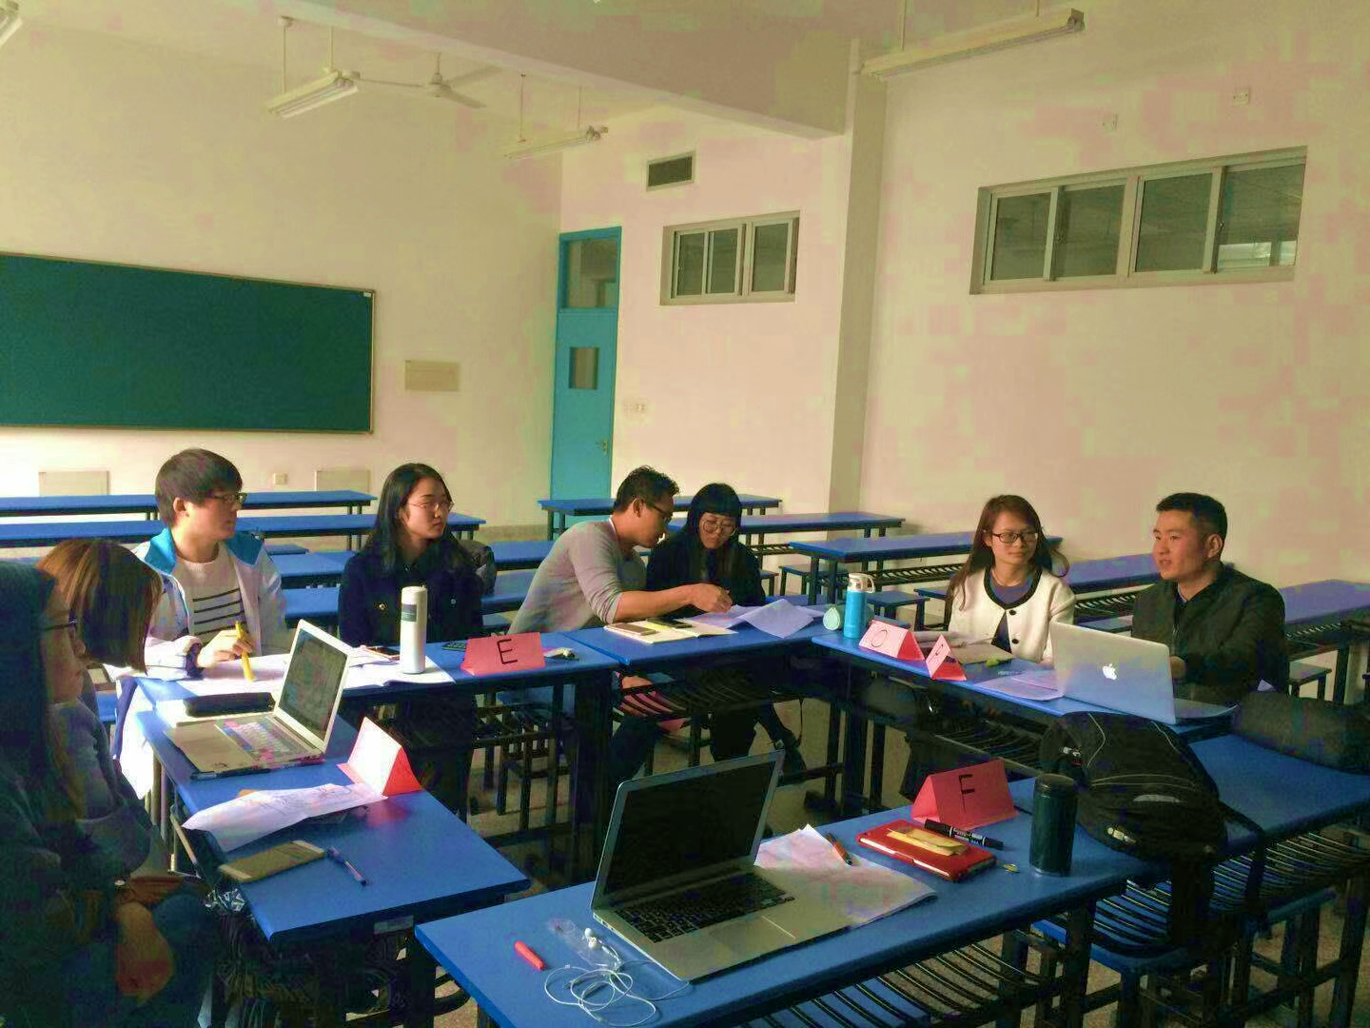
designated

Slide 4
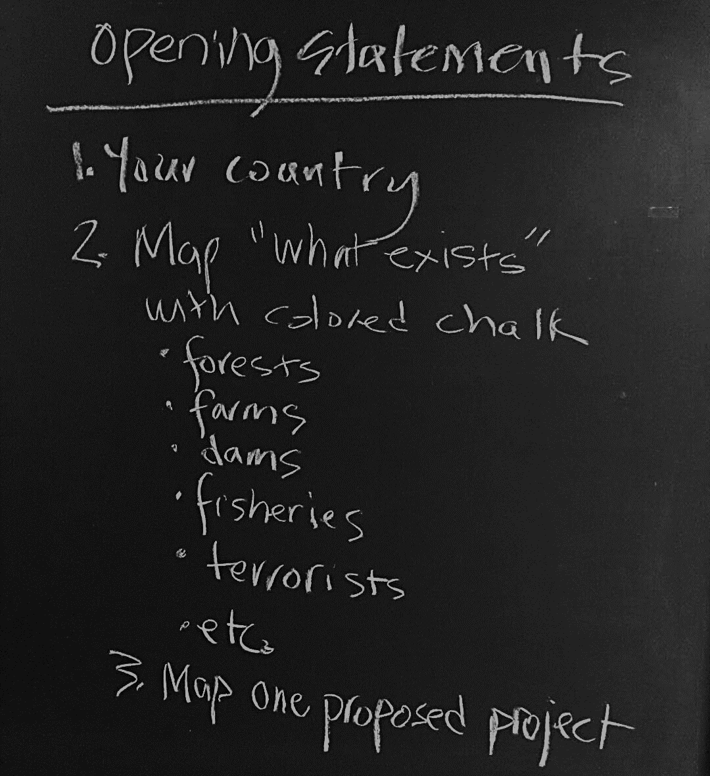
Learn
Discuss

Slide 5
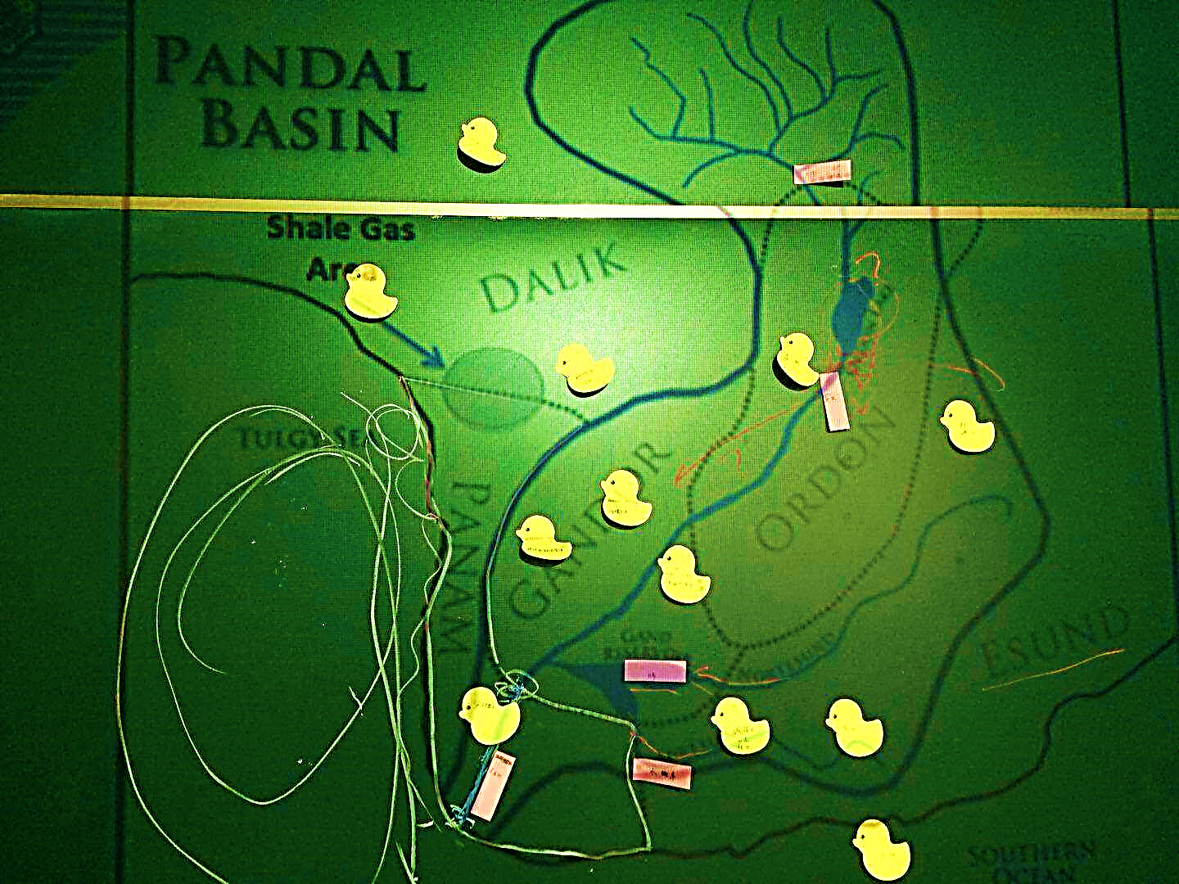
Idea sharing

Slide 6
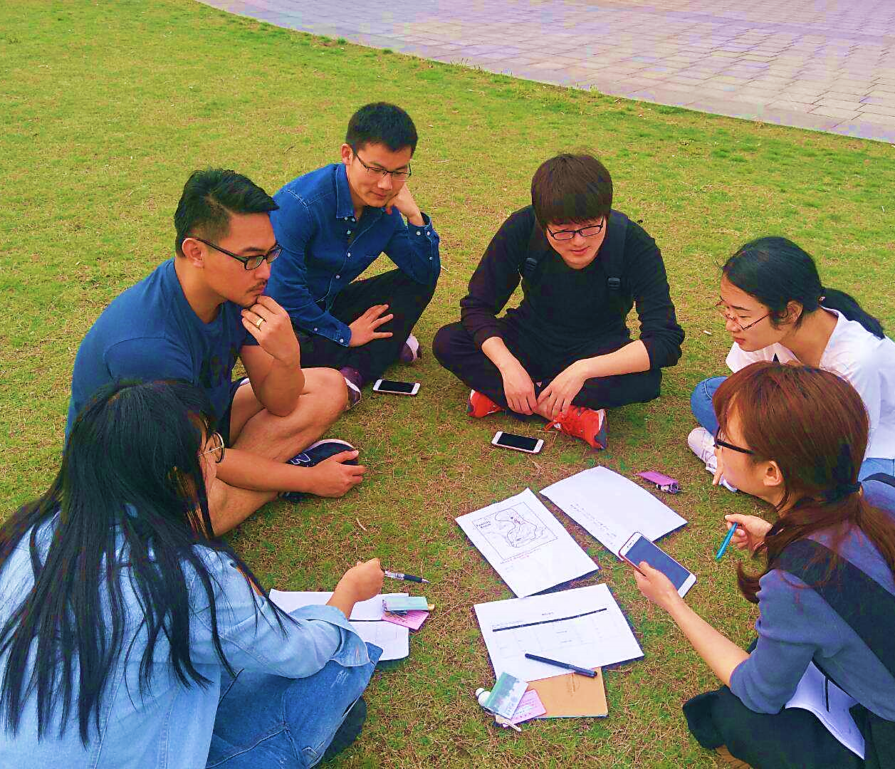
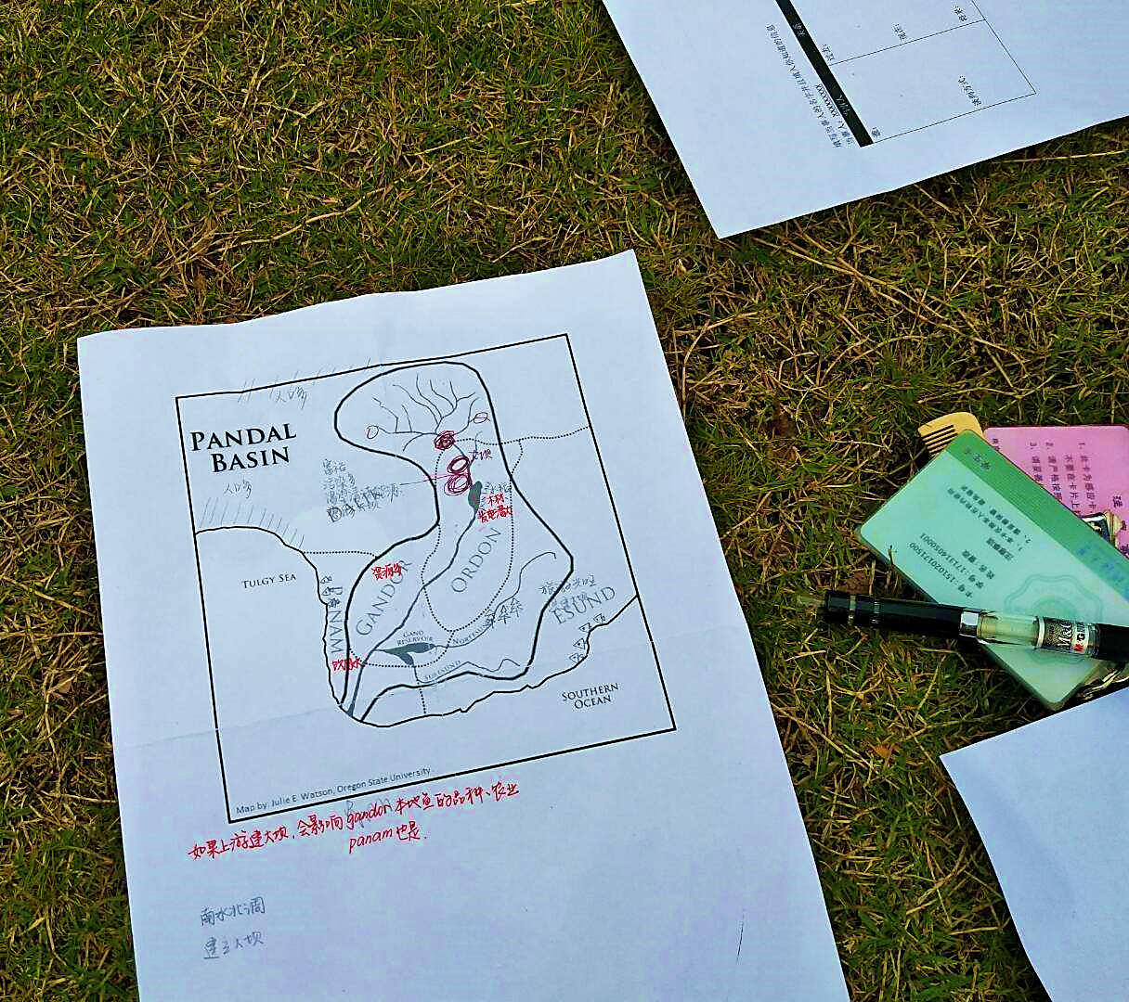
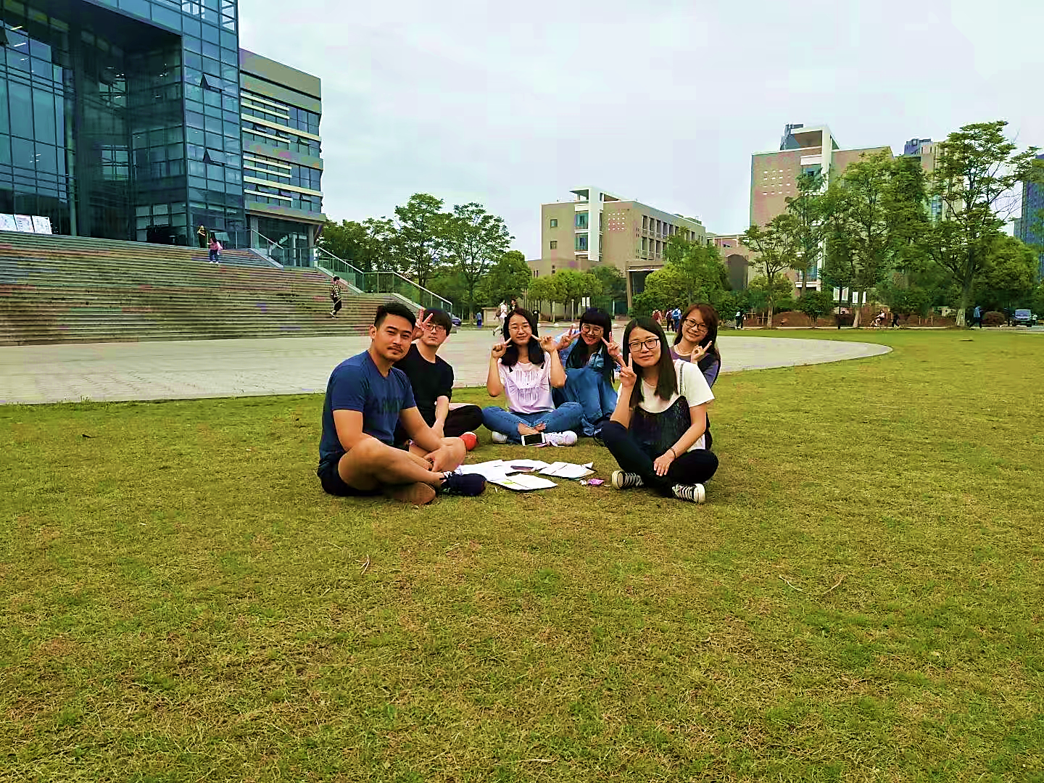
Coordinate

Slide 7
“RULES”
play

Slide 8
General Assembly
(rehearsal)

Slide 9
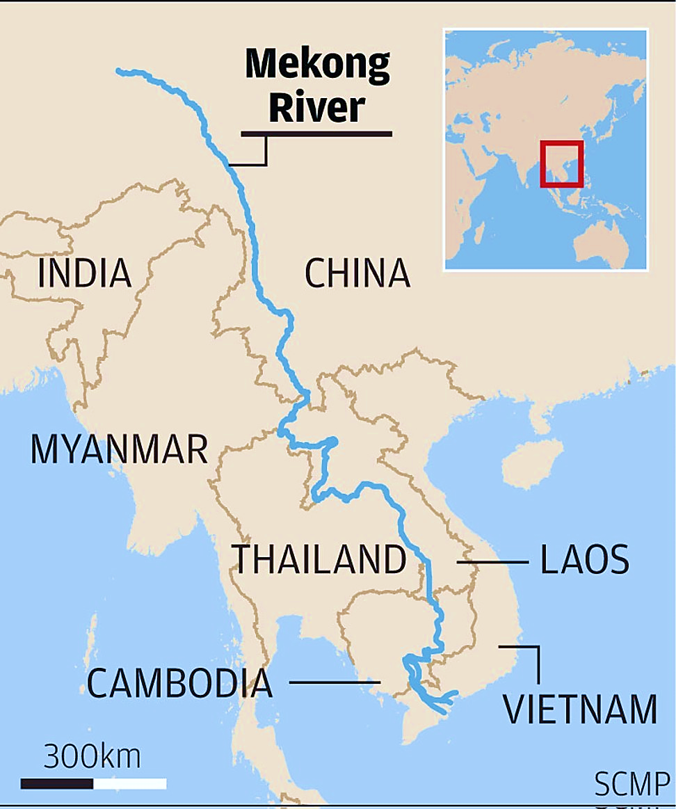
Lancang River
Mekong River

Slide 11
PROVISIONS
CHAPTER I PREAMBLE
CHAPTER II DEFINITION OF TERMS
CHAPTER III OBJECTIVES AND PRINCIPLE OF COOPERATION
Article 1 - 10
CHAPTER IV INSTITUTIONAL FRAMEWORK
Article 11 - 33
CHAPTER V ADDRESSING DIFFERENCES AND DISPUTES
Article 34 - 35
CHAPTER VI FINAL PROVISIONS
Article 36 – 42
DONE on 5 April 1995 at Chiang Rai, Thailand

Slide 12
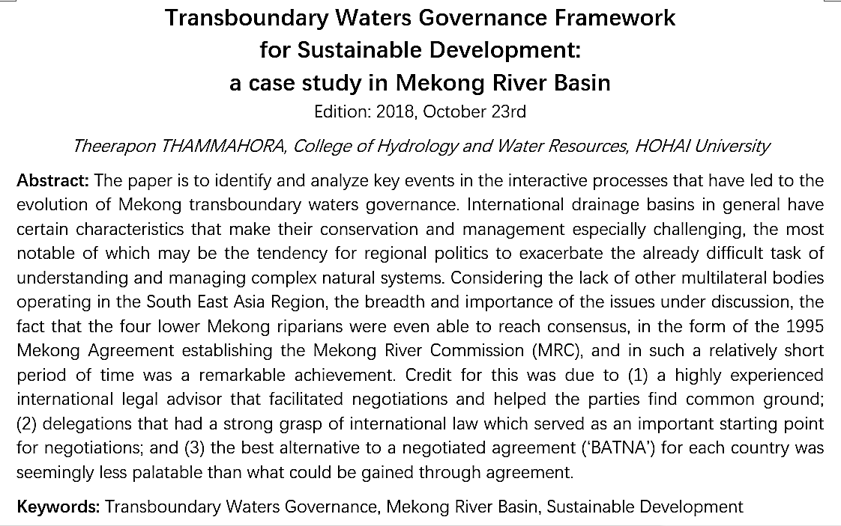

Slide 13
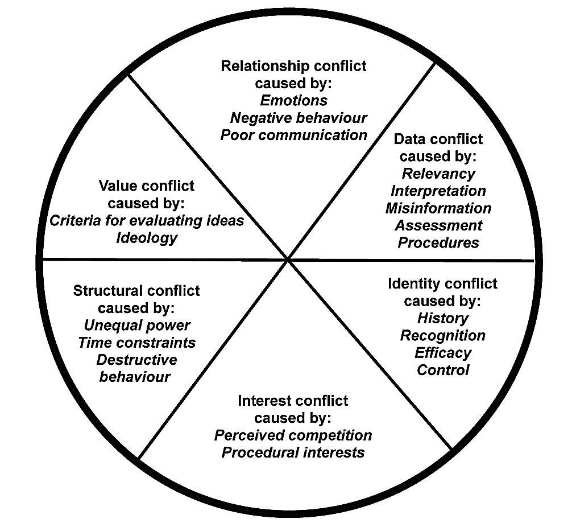
“Circle of conflict”
Source: adapted from Jarvis, 2008.
Todd Jarvis, and Aaron Wolf. ‘Managing Water Negotiations and Conflicts in Concept and in Practice’, Transboundary Water Management Principles and Practice / Edited by Anton Earle, Anders Jägerskog, Joakim Öjendal., (2010), p. 125-141.

Slide 14
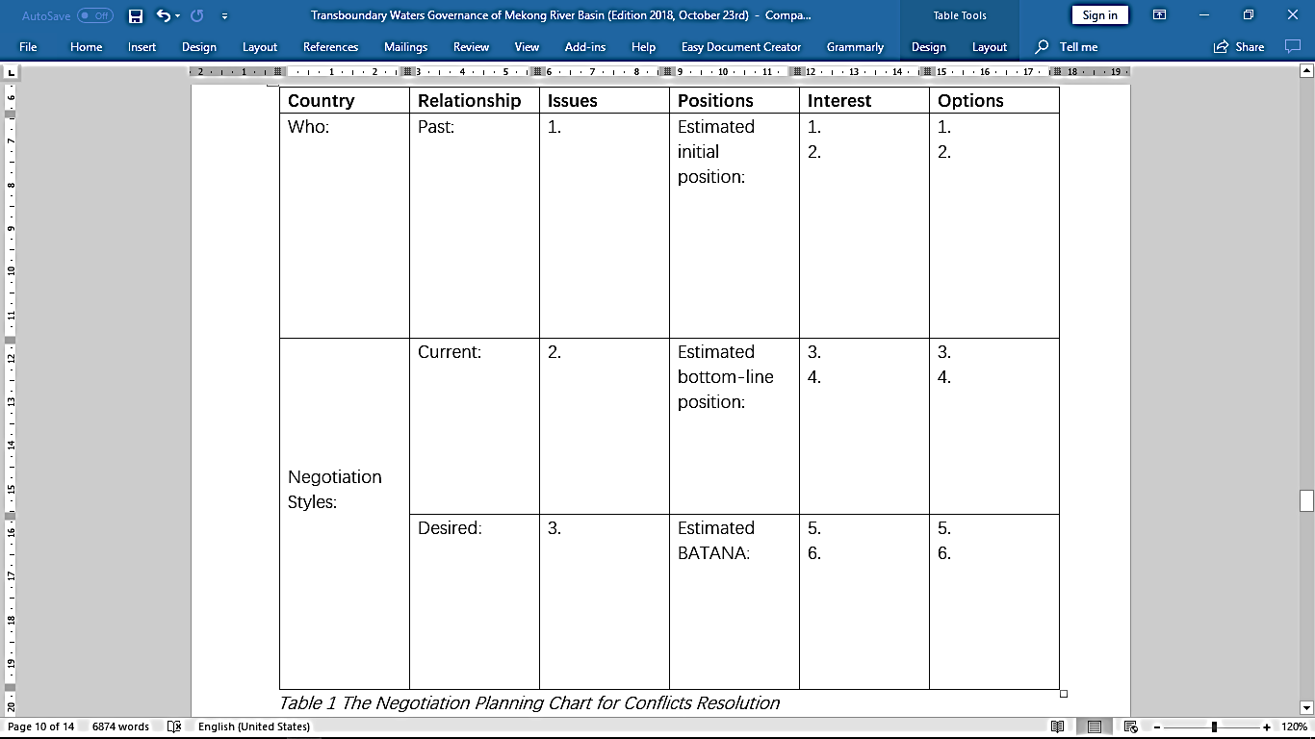
'BATANA’
⸺ the best alternative to a negotiated agreement
'BATANA’ (the best alternative to a negotiated agreement) Table gives the negotiation planning chart for the conflicts (disputes) resolution between MRC-members’.
The conclusions of negotiation are as follows:
1. Develop border areas into border markets and MOUs for people’s necessary living.
2. Increase public connectivity (such as number of flights, border roads improvement, etc.) to lead and boost up the economy.
3. Boost up the industrial area and make benefit on electricity trading.

Slide 15
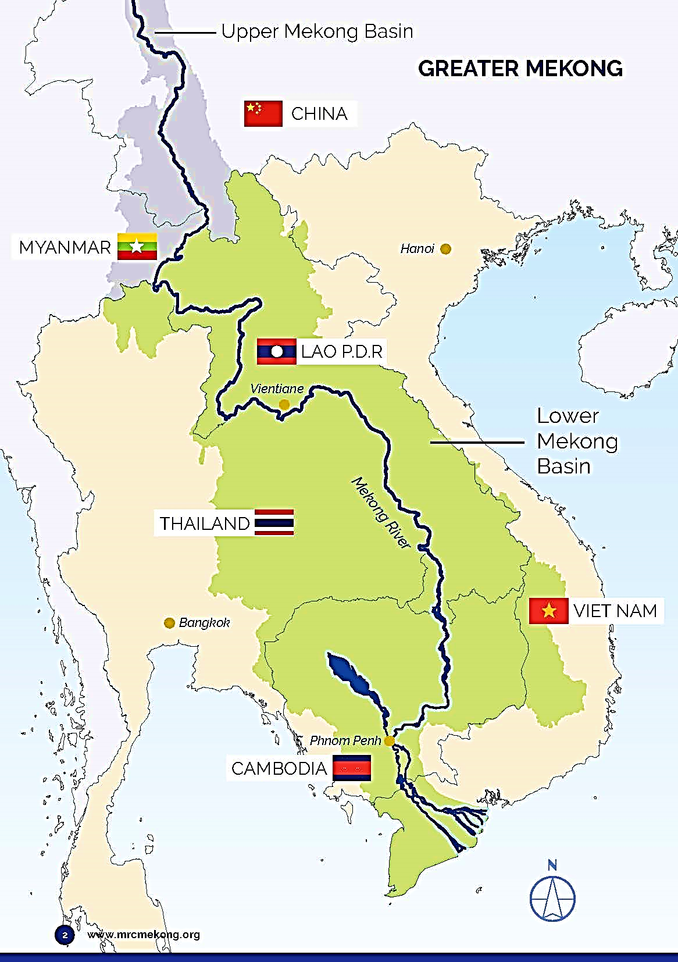
Over the years, the MRC and its member countries have developed five sets of procedural rules and associated technical guidelines on data sharing, water use monitoring, water use cooperation, flow maintenance, and water quality. The first three establish the process of water cooperation, while the rest set the criteria to assess water conditions. These rules, known as the MRC Procedures, provide a systematic and unified instrument for the implementation of the Mekong Agreement.

Slide 16
Procedures for Data and Information Exchange and Sharing (PDIES), approved in 2001 to operationalise data and information exchange of vital water-related indicators among the four Mekong countries.
Procedures for Water Use Monitoring (PWUM), approved in 2003 to establish an effective monitoring system of water use of the Mekong and tributaries by various sectors, including domestic supply, irrigation and hydropower.
Procedures for Notification, Prior Consultation and Agreement (PNPCA), approved in 2003 to facilitate the cooperation on water use and development with a set of three specific processes for proposed water infrastructure projects.
Procedures for the Maintenance of Flows on the Mainstream (PMFM), approved in 2006 to set out assessment criteria and a process to monitor and maintain adequate water flow in the Mekong and Tonle Sap rivers.
Procedures for Water Quality (PWQ), approved in 2011 to strengthen a cooperative framework to monitor and safeguard water quality of the Mekong and Bassac rivers with agreed sets of assessment criteria

Slide 17
Mekong Agreement and MRC Procedures set a cooperation framework
The 1995 Mekong Agreement provides a legal framework for the four countries to cooperate for better development and management of water resources that could bring them economic benefits while protecting the environment. It defines the mission and goals of the organisation, and sets out the roles and responsibilities of its three bodies;- (1) the Council, (2) the Joint Committee, and (3) the Secretariat – and the strategic objectives of cooperation.
Ultimately, the agreement tasks the MRC to promote optimal use of water and well-balanced development of the basin, and support the achievement of the Mekong’s full potential through the formulation of a basin development plan.

Slide 18
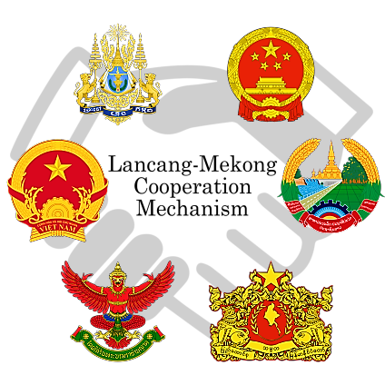

Slide 19
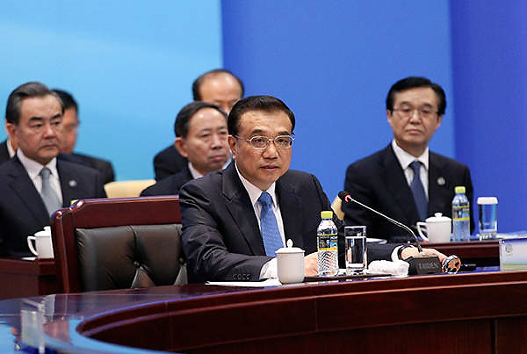
请看《中国日报》的报道：“The Lancang-Mekong Cooperation (LMC) mechanism comes as a natural result of our existing cooperation, and will take full advantage of our close geographic proximity, traditional friendship, and complementary economies,"
Chinese Premier Li Keqiang told the meeting. 《 国务院总理李克强表示，“澜沧江—湄公河合作机制可以说是水到渠成，有利于发挥六国地缘相近、人文相亲、经济互补性强的优势。” 》
Premier Li Keqiang speaks at the first Lancang-Mekong cooperation leaders' meeting in Sanya, Hainan province, on March 23, 2016. [Photo provided to chinadaily.com.cn]

Slide 20
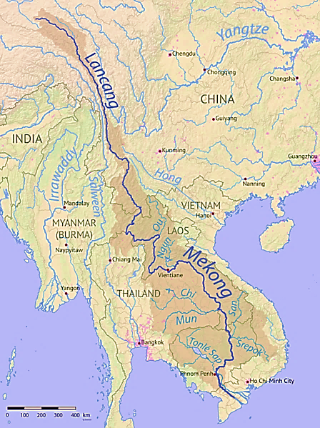

Slide 21
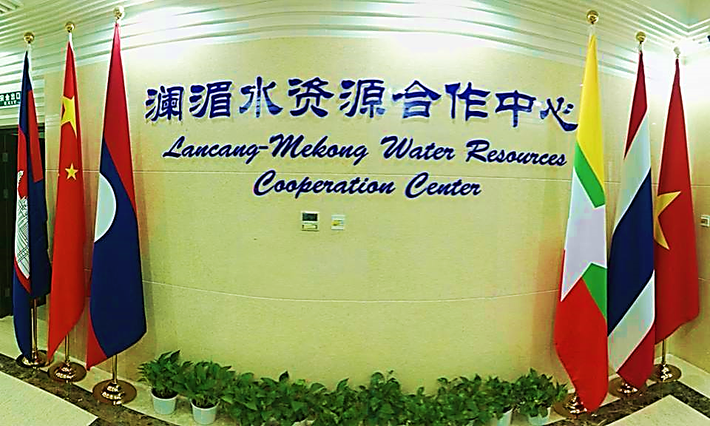
Professor Dr ZHONG Yong (钟勇)
Secretary General of LMWRCC
LANCANG – MEKONG
Water Resources Cooperation Center (Beijing, PRC)

