Slide 1


Motivation Analysis of Water Rights Trading among Wet Areas in China
Hohai University WU Fengping

Slide 2
Outline
1. Background analysis;
2. Survey area - overview of Taihu basin in China;
3. Case analysis of water rights trading in the Taihu basin;
4. Analysis of the motives of water rights trading in China's wet areas;
5. Water rights trading in China's wet areas need to deal with four major relationships.

Slide 3
1. Background analysis
Since 2000, the Chinese government has issued a series of normative documents and departmental regulations on water rights management, which provides a system basis for developing water rights trading. Including:
“Several Opinions on Water Rights Transfer by the Ministry of Water Resources” (2005)
“The Framework of Water Rights System Construction”’ (2005)
“The Interim Management Measures of Water Rights Trading” (2016)
“The Guidance on Enhancing Water Use Manners Control” (2016)

Slide 4
1. Background analysis
In addition, the Ministry of water resources has carried out many pilot projects of the water rights management system nationwide and explored the experience of building water rights market with Chinese characteristics.
In 2003, along the Yellow River ，from Ningxia autonomous region to Inner Mongolia , explored the transfer of surplus agricultural water rights to the industrial .

Slide 5
1. Background analysis
In 2014, the Ministry of Water Resources of China launched a nationwide pilot project on water rights trading. Seven provinces and autonomous regions were selected to carry out regional pilot projects in water rights registration, water rights trading and water rights management system construction .

Slide 6
1. Background analysis
China's water rights trading is mainly concentrated in the north water shortage areas, such as Zhangye city, Inner Mongolia province.
Some trading is distributed in the abundant water area in the south of China, such as the permanent water rights trading between Dongyang city and Yiwu city and the water rights transfer between Yuyao city and Cixi city.

Slide 7
1. Background analysis
Compared to the water-deficient regions in the north of China, the regional total indicator of water use is surplus in the wet areas, and the contradiction between the water demand and water shortage in economic development is still unknown. Therefore, the motivation to conduct water rights trading is lower than that in the north. So, what are the motives for developing water rights trading in China's wet areas?
Through the investigation of water rights trading cases in the Taihu basin in typical wet areas of China, we found that water rights trading in wet areas of China have obvious regional characteristics.

Slide 8
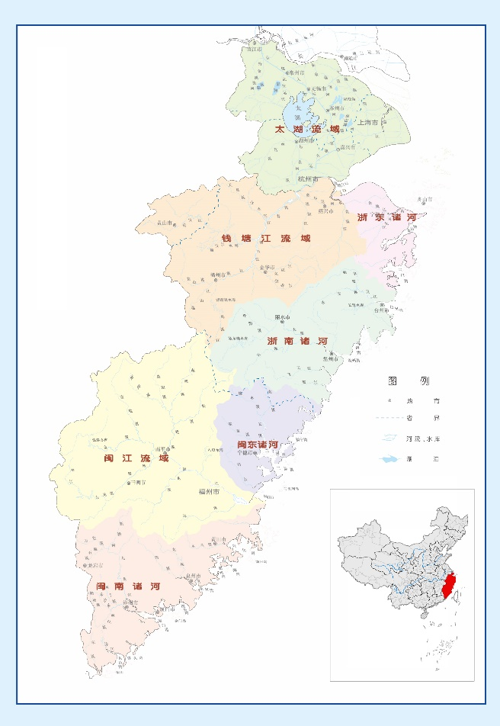
2. Survey area - overview of Taihu Basin in China
2.1. Location and social economic profile of Taihu basin
Taihu basin area covers the Taihu basin itself along with the southeastern river basins, located in the southeast coastal area of China (figure 1).
Fig 1: Distribution of the Taihu Basin

Slide 9
2. Survey area - overview of Taihu Basin in China
2.1. Location and social economic profile of Taihu basin
It is a region of rapid economic development .There are some foundation data about the Taihu basin:
Total area is 245,000 square kilometer（km²）. In 2017，the total population of river basins is about 142 million, accounting for 10.2% of the total population of China. Regional GDP is about 14.99 trillion yuan, accounting for 18.1% of China's total GDP; per capita GDP is about 133,000 yuan, 2.2 times of China.

Slide 10
2. Survey area - overview of Taihu Basin in China
2.2 water resources in Taihu basin
In 2017, the annual precipitation in the basin was 1501 millimeter（mm）, the total precipitation is 368.2 billion cubic meter(m³), the total water resources are 201.4 billion cubic meter(m³), the total water supply is 65.3 billion cubic meter(m³), and the total water consumption is about 24.04 billion cubic meter(m³). In 2017, 73.1% of the evaluated river water quality reached or exceeded category III, and 386 of the 614 water functional zones met the standard, reaching the standard rate of 62.9%.

Slide 11
2. Survey area - overview of Taihu Basin in China
2.3 Taihu Basin belongs to the typical wet area of China.
The characteristics of China's wet areas including:
(1) Annual rainfall exceed 800 millimeter（mm）;
(2) Available water resources are abundant, and regional economic development level is relatively high;
(3) Regional water network is dense, and there are many rivers and lakes.
Taihu basin can meet every conditions ,so we can see that the Taihu basin belongs to the typical wet area of China.

Slide 12
3. Case Analysis of Water Rights Trading in the Taihu Basin
3.1 Case 1- Water Rights Transfer between Dongyang City and Yiwu City.
（1）Case Description
Before 2000, the shortage of water resources in Yiwu has become a bottleneck restricting its rapid economic development. Dongyang City and Yiwu City reached an agreement on water rights transfer in 2000.According to the agreement, Yiwu city invested a one-time sum of 200 million yuan to purchase the right to use the near 50,000,000 cubic meter(m³)/ year water volume of Hengjin reservoir in Dongyang city and was responsible for planning and funding the construction of the diversion pipeline project.

Slide 13
3. Case Analysis of Water Rights Trading in the Taihu Basin
（2）Case Commentary
Form this case, we can get the following enlightenment:
First, it set a precedent for water rights trading in China. The trading object is the right to use water resources of Hengjin Reservoir.
Second, using institutional innovation to achieve win-win results for both sides. Yiwu City has obtained the water rights , and Dongyang City has obtained 200 million yuan of construction funds through water rights trading.

Slide 14
3. Case Analysis of Water Rights Trading in the Taihu Basin
（2）Case Commentary
Third, urges the government to speed up the establishment and improvement of water rights management system. After the practice of water rights trading in the two cities, the Chinese government was forced to speed up the promulgation of normative documents and departmental regulations on water rights management system.

Slide 15
3. Case Analysis of Water Rights Trading in the Taihu Basin
3.2 Case 2-Interbasin water diversion of Dayan Keng Hydropower Station
（1）Case Description
At the end of 2000 year, the Dayankeng hydropower station was built in Qingyuan County in Zhejiang province. The specific location is shown in the Figure 2.

Slide 16
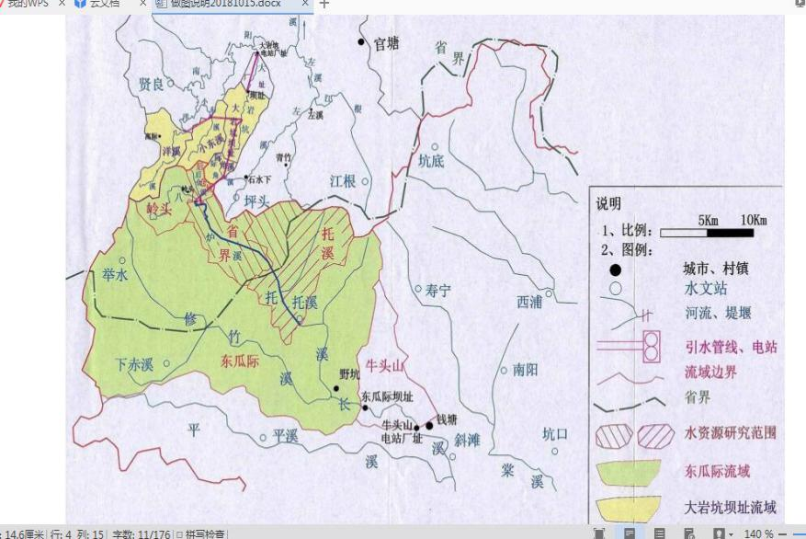
3. Case Analysis of Water Rights Trading in the Taihu Basin
Figure 2. Cross-basin diversion area of dayankeng hydropower station

Slide 17
3. Case Analysis of Water Rights Trading in the Taihu Basin
（1）Case Description
This project caused the opposition in Shouning County, Fujian Province.
Under the coordination of the Taihu Basin Management Bureau of the Ministry of Water Resources of China, an inter-basin water diversion compensation agreement was finally reached: the maximum diversion amount of Dayankeng Hydropower Station is 26.22 million cubic meter(m³)/year: Dayankeng Hydropower Station pays 3 million yuan to Shouning County of Fujian Province to compensate for the construction funds of reservoirs in downstream areas.

Slide 18
3. Case Analysis of Water Rights Trading in the Taihu Basin
（2）Case Commentary
Form this case, we can get the following enlightenment:
First, carry out inter-provincial water rights trading. The inter basin diversion of DayanKeng hydropower station is actually the diversion of part of the water intake right in the Tuoxi watershed. The transferor of water rights is Shouning County, Fujian Province, and the transferee is Qingyuan County, Zhejiang Province. The trading target is 26.22 million cubic meter(m³) water intake per year.

Slide 19
3. Case Analysis of Water Rights Trading in the Taihu Basin
Second, establish inter-provincial water dispute adjustment mechanism. Based on the influence of many factors in water resources development, the consultation mechanism and prevention mechanism of water disputes is established, reducing the influence of uncontrollable external factors on water resources construction.
Third, establish the calculate standard of the volume of tradable water. The compensation agreement stipulates that it shall be implemented by “Provincial Section Flow 0.14 cubic meter(m³/s)”, “River Development Utilization Rate shall not exceed 40%”, Water Transfer Quantity shall not exceed 20% of the total amount of water transferred out of rivers”.

Slide 20
3. Case Analysis of Water Rights Trading in the Taihu Basin
3.3 Case 3- Fuqing Nuclear Power Co., Ltd obtain the usage rights of Beilin Reservoir.
（1）Case Description
To ensure the safe operation of nuclear power equipment, Fuqing Nuclear Power and the government of Sanshan town of Fuqing city signed the purchase agreement to obtain the permanent right to use the water resources of the Beilin reservoir at a cost of approximately 20.341 million yuan. The management right of the reservoir was transferred to the Fuqing Nuclear Power. The specific cost structure of the purchase agreement is shown in Table 1.

Slide 21
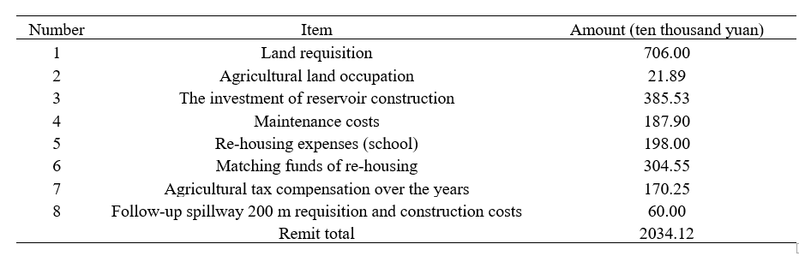
3. Case Analysis of Water Rights Trading in the Taihu Basin
Table 1. The cost structure of purchase agreement of the Beilin Reservoir

Slide 22
3. Case Analysis of Water Rights Trading in the Taihu Basin
（2）Case Commentary
Form this case, we can get the following enlightenment:
First, calculate the purchase price of small reservoirs. In the process of purchase of reservoirs, the trading price is easy to be accepted by both sides through refining the various costs, which provides the accounting standard for the overall water rights transfer and purchase cost of small reservoirs in wet areas.

Slide 23
3. Case Analysis of Water Rights Trading in the Taihu Basin
（2）Case Commentary
Second, safeguard the interests of third parties in water rights trading. The residents around Beilin Reservoir depend on the source of water for production and living, which belongs to the third party. The purchase agreement makes it clear that the water safety of residents near the reservoir must be guaranteed.
Third, optimize the allocation of resources through market mechanism. This case provides a reference for the wet areas use the market mechanism to solve the new water demand of new construction projects and the circulation of water use right of small reservoirs.

Slide 24
4. Analysis of the motives of water rights trading in China's wet areas
We analyzed the three main motives of water rights trading.

Slide 25
4. Analysis of the motives of water rights trading in China's wet areas
4.1 Mitigate the water shortage in the regional economic development
The total amount of water available in wet areas was abundant, but there were still regional water shortage problems caused by uneven spatial and temporal distribution of water resources and different levels of regional water efficiency.

Slide 26
4. Analysis of the motives of water rights trading in China's wet areas
Through water rights transfer, Yiwu city solved the water demand for sustainable economic development and Dongyang city obtained financial funds to promote economic development. These solutions were driven by the motivation to conduct water rights trading in wet areas, optimize the allocation of water resources and solve the problem of water shortage for regional economic development.

Slide 27
4. Analysis of the motives of water rights trading in China's wet areas
4.2 Coordinating Cross-border Water Disputes
In the shortage of available water resources, the development of water resources in the border regions becomes an possible choice, which is also likely to cause water disputes across the jurisdiction areas.

Slide 28
4. Analysis of the motives of water rights trading in China's wet areas
China urgently needs both the government and the market to improve its water resources management capacity and coordinate water disputes across provincial jurisdictions. In the water disputes of inter-basin diversion of Dayankeng Hydropower Station,
Through the joint efforts of both sides, the two provinces reasonably solve the water use interests of upstream and downstream by water rights trading, realize the optimal allocation of water resources in the basin, and resolve water disputes. Therefore, the abundant water area has the motivation to coordinate the water disputes in cross border area through water rights trading.

Slide 29
4. Analysis of the motives of water rights trading in China's wet areas
4.3 Solving the Water Demand of Large-scale New Projects
In the situation of insufficient supply of local water resources and high investment costs related to construction of diversion projects, it is the best choice for enterprises to obtain allocation share of water rights market through water rights trading for large-scale newly-built projects, particularly for nuclear power enterprises with high water supply guarantee rate.

Slide 30
4. Analysis of the motives of water rights trading in China's wet areas
Fuqing Nuclear Power obtained the permanent rights of water resource use and management by purchasing the Beilin reservoir.
Therefore, the abundant-water area has the motivation to use water rights trading to solve the water demand of large-scale new projects and optimize the allocation of water resources.

Slide 31
5. Water rights trading in China's wet areas need to deal with four major relationships
There are four relationships must be properly handled.

Slide 32
5. Water rights trading in China's wet areas need to deal with four major relationships
5.1 The relationship between the government regulation and market mechanism.
Due to the lack of water rights trading system at the national level in China and the imperfect market mechanism of water rights, the process of water rights trading in wet areas is not standardized. In fact, the market has not yet played a part in regulating the price of water rights trading and optimizing the resources allocation.

Slide 33
5. Water rights trading in China's wet areas need to deal with four major relationships
Therefore, water rights trading in China's wet areas should transform the government-sponsored water rights trading mode into a government-led and market-oriented pricing mode, give full play to the advantages of the government and the market "two-handed efforts" to optimize the allocation of water resources, so as to form an organic integration of government regulation and market mechanism.

Slide 34
5. Water rights trading in China's wet areas need to deal with four major relationships
5.2 The relationship between the water right confirmation and water intake permit.
There is a functional complementary relationship between water rights confirmation and water intake permit, which can play the macro-regulation function of the government and the micro-allocation function of the market, and promote the sound and orderly development of the water right market.
Combining with the water intake permit system, water users' water rights confirmation in wet areas can stimulate the trade demand of water users, excavate the value of water rights assets.

Slide 35
5. Water rights trading in China's wet areas need to deal with four major relationships
5.3 The relationship between macro institutional arrangement and micro trading system
In China, we should explore the connection between macro-institutional arrangements and regional water rights trading characteristics, as well as the integration of formal and informal systems , so that water rights trading in wet areas under the market economy system with Chinese characteristics play a role of mutual support between the macro institutional arrangement and the micro-transaction system.

Slide 36
5. Water rights trading in China's wet areas need to deal with four major relationships
5.4 The relationship between basic pricing of water rights trading and price adjustment.
At present, water rights trading prices in China's wet areas are mainly arranged by the government, and some even permanent prices, which bring hidden dangers to the long-term trading of water rights. Therefore, on the basis of controlling the basic price of water rights trading and combining with market factors, the dynamic adjustment mechanism of water rights price should be established in wet areas to reflect the utility value of water rights reasonably and maintain the stability of water rights market.

Slide 37
Conclusion
(1) China's wet areas should make full use of the advantages of water resources natural endowment and the characteristics of rapid economic development, promote the transfer of idle indicators of agricultural water use to industry and services, and optimize the allocation of water resources.
(2) China's wet areas need combine with the characteristics of regional water rights trading, to improve the macro and micro systems of water rights trading. Through macro and micro system design, the direction of water rights trading is determined, and through micro system design, the process of water rights trading is optimized.

Slide 38
Thank you ！

