Slide 1

Application of economic tools
in China’s environmental management
R. Raufer
International Water Rights Forum
Hohai University
Nanjing, P.R. China
17 December 2018

Slide 2
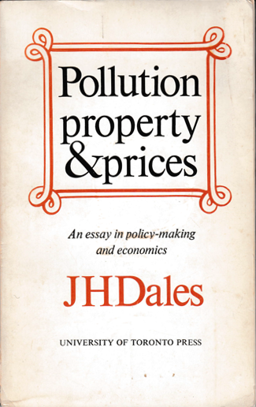
Pioneering environmental market classic
Used Province of Ontario water pollution as example:
‘Table of equivalents’ needed to deal with different effluent wastes;
Needed to ‘defer the run-off [i.e., non-point-source] problem’;
Needed to define smaller, sub-Provincial ‘water control regions’:
“I haven’t said how many water control regions
there should be because I don’t know how many
there should be.”
If it is feasible to establish a market to implement a policy, no policy-maker can afford to do without one.
-- J.H. Dales, 1968, p. 100
1968

Slide 3
Engineering vs. Economic Worldviews
Engineering
Economics
Goals
EQ Standards
MAC = MSB
Regulatory Means
Technology-Based Standards
Economic Mechanisms
Input/Fuel Stds.
X
Pollution Taxes
(Price-based)
Pollution Markets
(Quantity-based)
Design Stds.
X
Pigouvian taxation
Emissions Trading
Emission/Effluent Stds.
X
Performance Stds.
  P
X
Q

Slide 4
First significant attempt to determine MAC & MSB
  “…the first study to embody at least a rudimentary ecological model into an economic optimization framework”
--A. Kneese, 1977
Delaware Estuary Comprehensive Study (DECS)
U.S. Public Health Service/Dept. Of Interior
1961-1966
  Needed to link pollution levels to
  physical environment
  Delaware is estuary, not regular
  river – so needed new physical
  model (R. Thomann’s Ph.D.)
  Model established five “objective
  sets”, with varying levels of
  dissolved oxygen
Source: http://www.mdpi.com/2077-1312/2/2/386/htm; Raufer, Pollution Markets in a Green Country Town, 1998

Slide 5
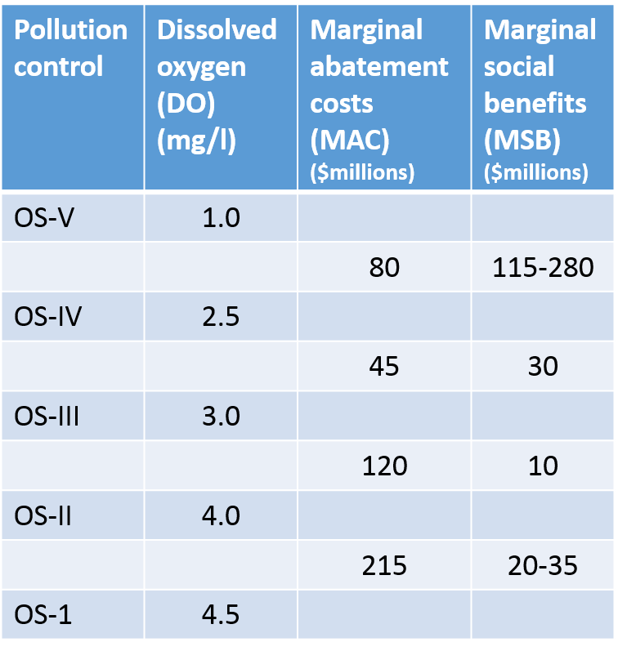

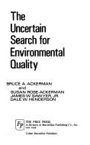
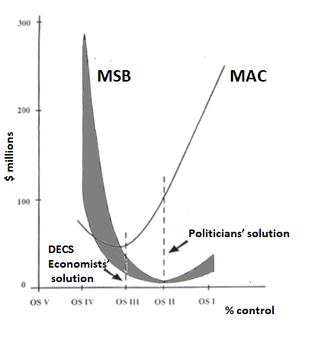
DECS results & Ackerman et al’s review
Sterling Professor of Law and Political Science,
Yale Law School
Winner of the Henderson Prize awarded by the Harvard Law School in 1982 for the best book in administrative law
Source: DECS, 1966; Raufer, Pollution Markets in a Green Country Town, 1998

Slide 6

The ‘Uncertain Search’ (cont.)
Government could use MAC & MSB for ‘enlightened’ command/control, but DECS results: “An outstanding example of decision by cliché.”
DECS researchers assumed a price-based approach (i.e., effluent charge) if economic instruments employed;
But Ackerman et al introduced a new idea: the quantity-based approach
              following Dales’ work (six years earlier);
              lessened governmental information-
              gathering tasks;
              eliminated potential gov’t mistake in
              judging marginal cost of control;
              put growth onus on industry, not
              government.
Photo credit: https://delawarerivertowns.com/

Slide 7

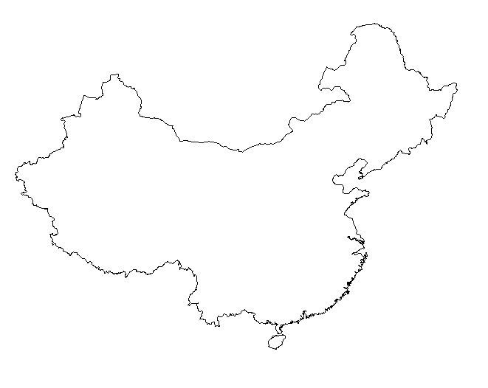

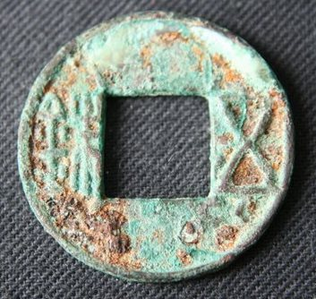

China’s P-based experience
Taxation before there was money
Millennia of experience
At least 25 different types of tax
(e.g., VAT, consumption, business,
income, property, behavior, etc.)
Resource/energy taxes
Price-based pollution levy system
Current Environmental Protection Tax
Law
Forthcoming 2020 MOF-supported
carbon tax (on non-ETS sectors)

Slide 8
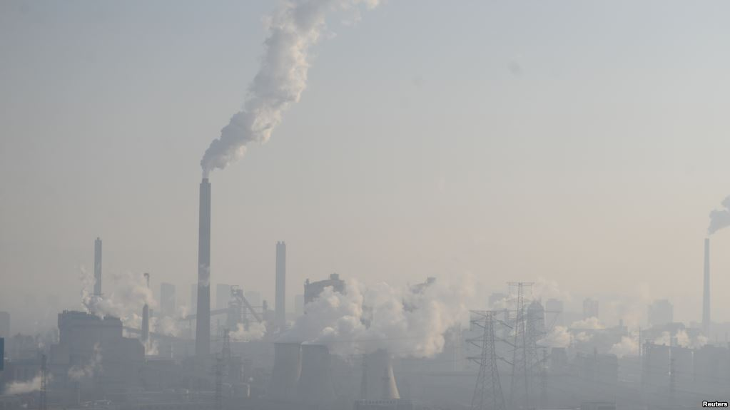
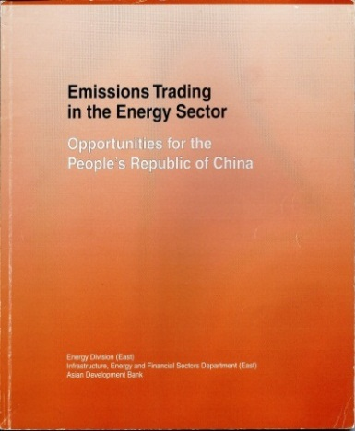
China’s Q-based experience
1980s/early 1990s – academic/
government interest
1996 – Total Amount Control (TAC)
introduced
1999 – SEPA & US EPA study
1999 – ADB listed 10 trading
case studies
2001 – ADB-sponsored SO₂ effort
in Taiyuan
Today
  10 Province MEP SO₂ trading program
  7 NDRC-supported pilots for GHG
  National ETS under development
  (2017-2020)
  RECs, CCERs, energy consumption
  quotas, etc., etc.
Taiyuan, Shanxi Province
Taiyuan photo: http://www.voanews.com/a/china-war-on-pollution/3653801.html

Slide 9
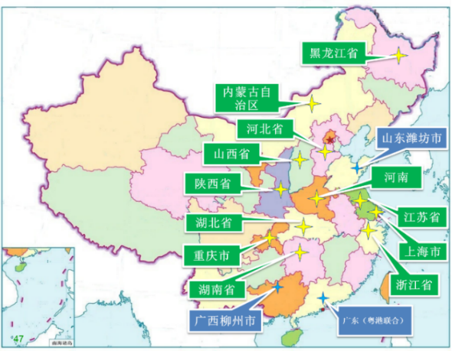
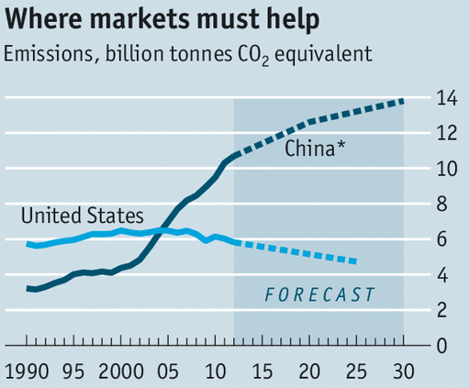

Larger role for markets in “ecological reform”
INTEGRATED REFORM PLAN FOR PROMOTING ECOLOGICAL PROGRESS
September 21, 2015
CPC Central Committee and State Council
SO₂ markets
Reform Plan calls for “…a market system which allows economic levers to play a greater role in environmental governance”
Source: CO2 markets from The Economist, 3 Oct 2015; citing WRI; Green & Stern, 2015; * “Optimistic” emissions reduction scenario; COD prices from Zhang, B. et al, Environmental Politics, 2016;
SO2 markets from Chang, Tsinghua U., May 2013; http://english.gov.cn/policies/latest_releases/2015/09/22/content_281475195492066.htm; Other graphics: https://china.ahk.de/market-info/

Slide 10

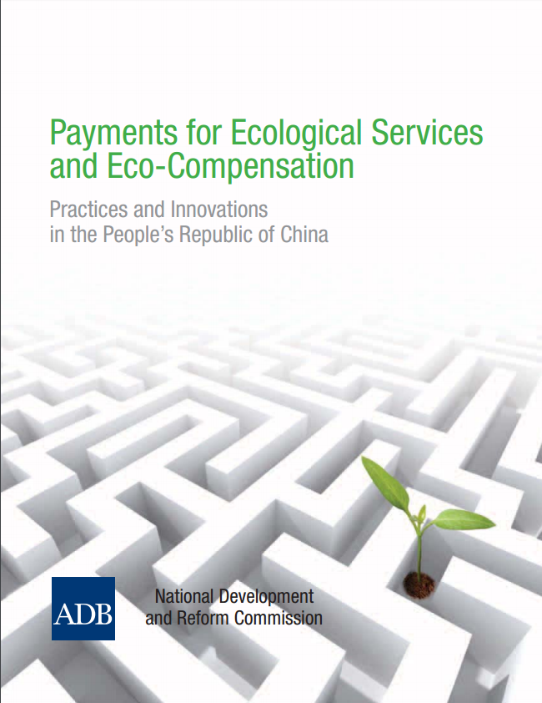
Too much, too soon?

Slide 11
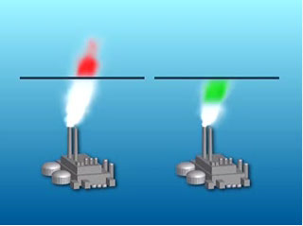
First step in C/C to economic transition:
Credit trading (1976)
Goals
Environmental Quality Standards
Regulatory
Means
1. Prohibitions
2. Technology-Based Standards
US EPA’s
Emissions Trading
Program (ETP)
Input/Fuel Stds.
X
Design Stds.
X
X
Emission Stds.
Performance Stds.
X
Brokerage
Opportunities
Emission Reduction
Credits (ERCs)

Slide 12
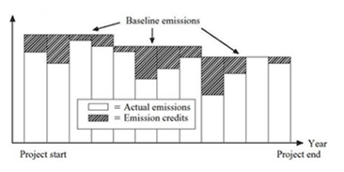
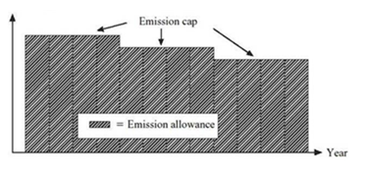
Two different environmental market approaches

Slide 13
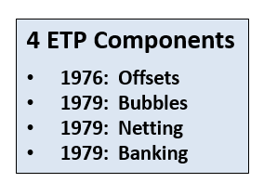
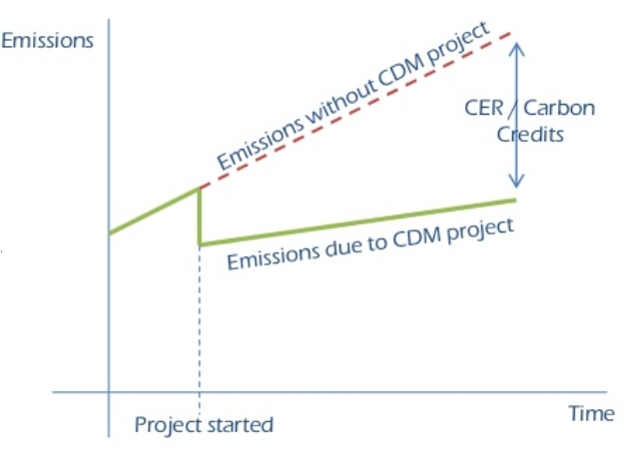
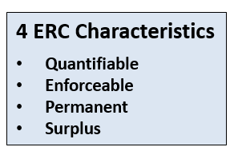
Emission Trading Program (ETP)
& Emission Reduction Credits (ERC)
….became counterfactual ‘additionality’
in 1997 Kyoto Protocol’s CDM
In water quality trading (WQT):
Total Maximum Daily Loads (TMDLs) serve as cap (i.e., Q);
Waste Load Allocations (WLAs, for point sources) & Load Allocations (LAs, for non-point sources) serve as baseline;
Point source ‘surplus’ based upon water-quality based effluent limitations (WQBEL), not technology (i.e., no credit trading to meet TBEL);
Non-point source ‘additionality’ based on Best Management Practices (BMP), usually with high trading ratio.
ERC’s ‘command/control’
‘surplus’ in the ETP….
Source: efficientcarbon.com; at: https://www.slideshare.net/harshayadav/clean-development-mechanism-basics

Slide 14

U.S. WQT highlights
Fox River (Wisconsin) point-point source effluent
trading (1981)
Dillon Reservoir (Colorado) point-nonpoint source
effluent trading (1984).
U.S. EPA sets draft framework for WQT (1996)
          U.S. EPA releases its Water Quality Trading Policy (2003)
          U.S. EPA publishes Water Quality Trading Assessment Handbook (2004)
          U.S. EPA publishes Water Quality Trading Toolkit for Permit Writers (2007)

Slide 15
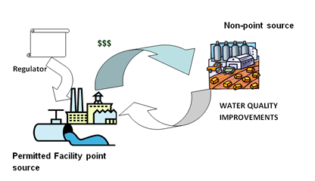
WQT more difficult than air emissions trading
WQT difficulties:
Linear & mono-directional nature of transport/dissipation;
Limited geographically within watersheds of various scales (e.g., streams, estuaries, etc.);
Less expensive control sources (i.e., non-point-sources) often not regulated;
Can constrain trading to upstream-only sources for buyers;
Limits market size & reduces liquidity
Ranking of key elements of WQT:
Location
Baseline
Trade ratio calculation
Trade duration
Compliance/enforcement
Monitoring/quantifying credits
Trade administration
Legislation, legal issues & rules
Difficulties: http://www.ecosystemmarketplace.com/articles/water-quality-trading-in-the-united-states/; Ranking: https://www.epa.gov/sites/production/files/2015-10/documents/day2_2bkirsch.pdf;
Figure: http://bearriverinfo.org/water-quality-trading/trading-conclusions

Slide 16
China has had difficulties in air markets…
Major problems in three areas of governance capacities:
  State
  Policy
  Administrative
Resulted in development of State-led ‘pseudo-market’
Extremely limited role for independent 3rd parties:
Revenue source for gov’t research institutes
Loss of control of information
Reluctance to give over regulatory function to market

Slide 17
…& environmental market performance has
so far proven “disappointing”
Three key factors:
“the design is flawed…. and enforcement is porous…”
“governmental intervention is often excessive and inappropriate”
“other policies often do not coordinate well with emissions trading”

Slide 18
Concerns about China’s environmental markets
Very opaque data collection systems
Goal-setting also opaque (no BAU or complementary
policy analyses)
Tightly regulated SOEs
  Non-cost-minimizing behavior
  No cost recovery (e.g., electricity pricing tightly
  controlled, hence no allowance pricing pass-through);
Legal status not fully tested
Potential conflicts with economic development
  Promotion policies of officials
  Financial system still underdeveloped
  (e.g., spot vs futures trading, low liquidity, etc.)

Slide 19

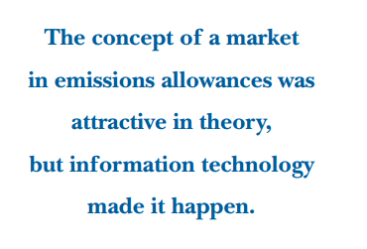
Environmental markets now depend
upon digital infrastructure
Air markets depend upon:
  Continuous Emissions Monitoring System (CEMS);
  Emissions Tracking System (ETS);
  Allowance Tracking System (ATS)
Monitoring, Reporting & Verification (MRV):
  Jurisdictional (e.g., country; administrative region; city)
  Entity scale (e.g., business; facility)
  Project level (e.g., emission reduction project)
B.P. Henriquez, Resources, Fall/Winter 2004

Slide 20
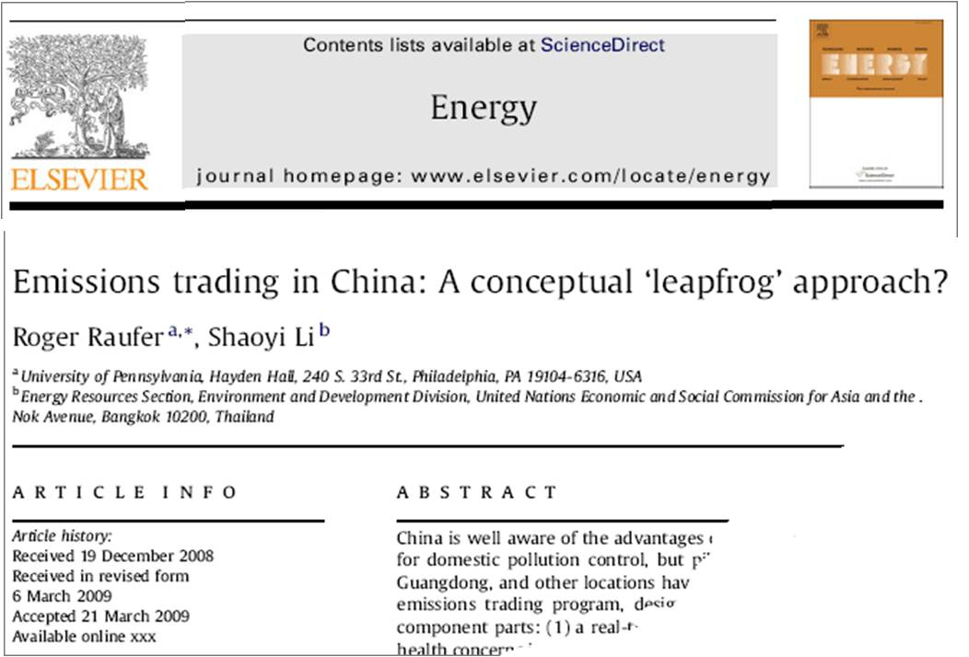

Role of Information Technology:
‘Big Data’ is coming!

Slide 21
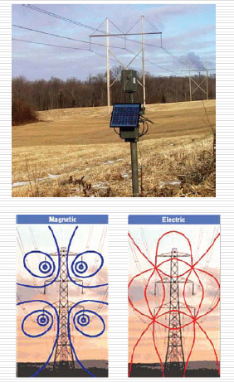
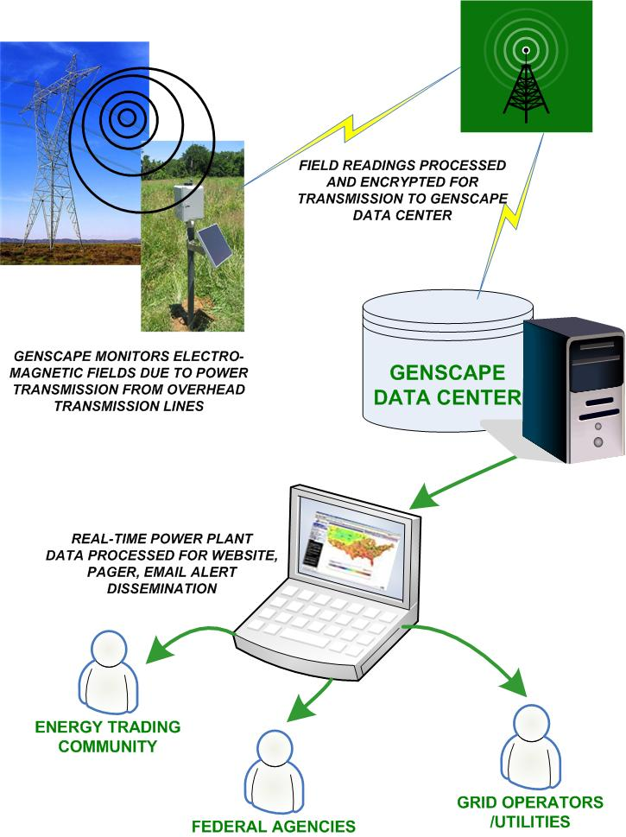
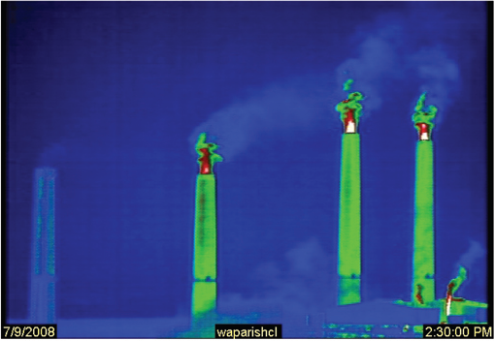
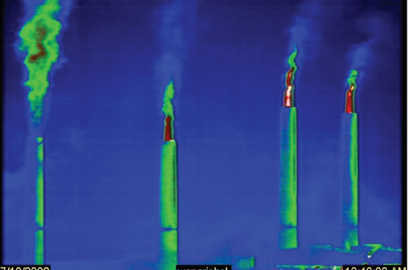
Independent, third-party, real-time monitoring
for emissions
Source: Alphenaar, 2007; EPA Solutions, 2008
Source: Genscape, Inc., 2010

Slide 22
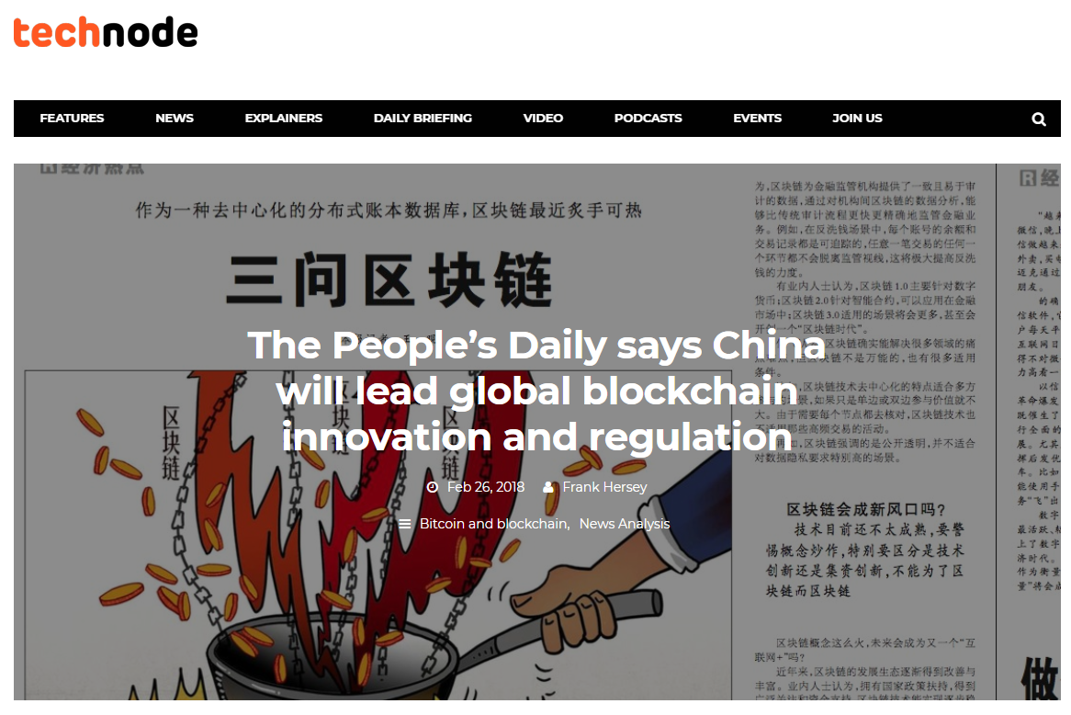

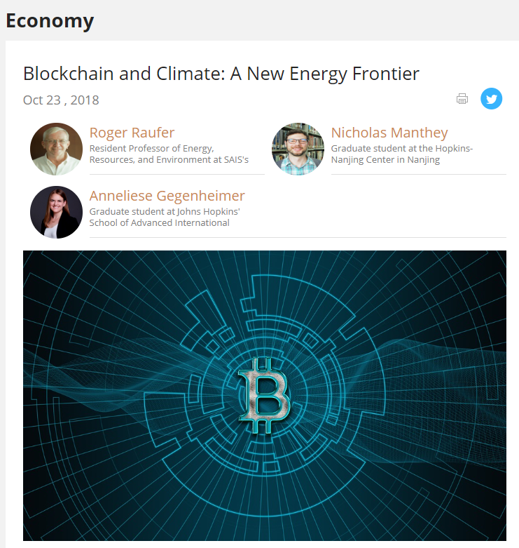
Blockchain apps: carbon credits & distributed energy
https://technode.com/2018/02/26/peoples-daily-blockchain/

Slide 23
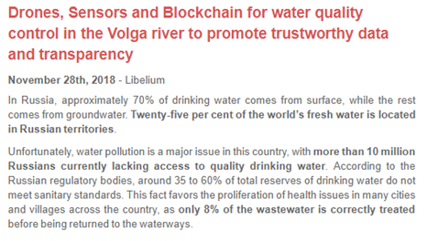
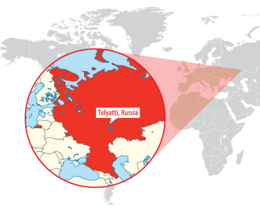

Comparable real-time apps for WQT?
http://www.libelium.com/drones-sensors-and-blockchain-for-water-quality-control-in-the-volga-river-to-promote-trustworthy-data-and-transparency/

Slide 24
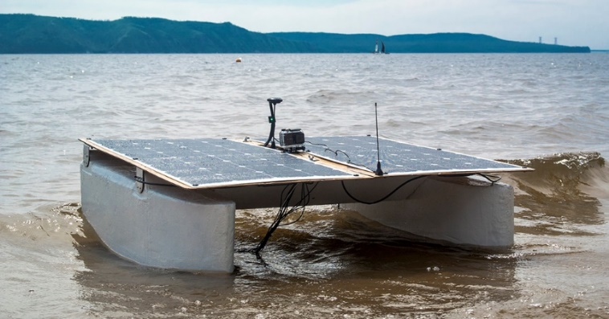
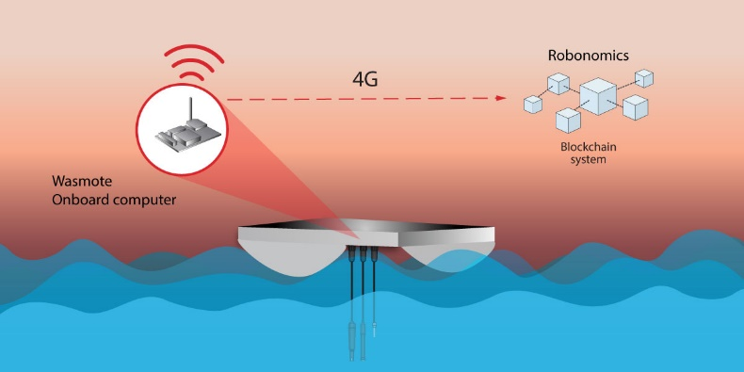
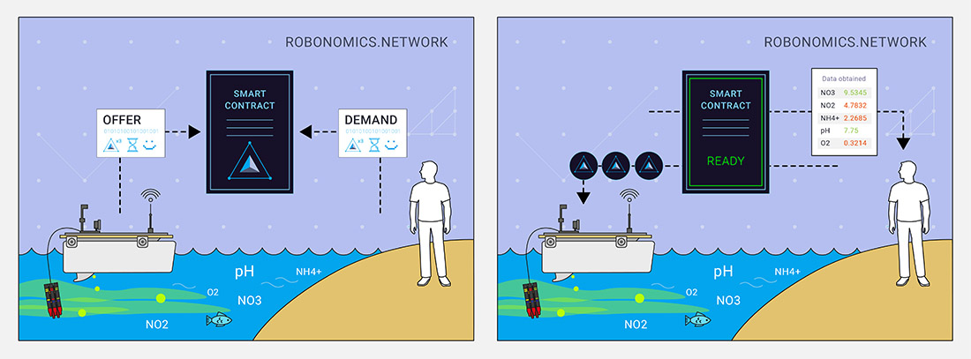
Smart contracts for WQT: the future?
http://www.libelium.com/drones-sensors-and-blockchain-for-water-quality-control-in-the-volga-river-to-promote-trustworthy-data-and-transparency/

Slide 25

谢谢
RMB/
tonne
removed
MSB
MAC
P
MAC=MSB
Q
% removal

