Slide 1
Water Diplomacy and International Water Rights: Theory and Practice in the Mekong River Basin
Fudan University
ZHANG Li
December 17, 2018

Slide 2
What is the nature of transboundary water issues?
Environmental Issues—Ethical Issues—Issues of livelihoods—Political Issues

Slide 3
CONTENTS
1
The Origin and Content of Water Diplomacy
2
The Status and Content of International Water Rights in Water Diplomacy
3
The Cases of International Water Rights Issues in the Mekong River Basin
4
The Solution of International Water Rights Issues in the Mekong River Basin

Slide 4
1. The Origin and Content of Water Diplomacy
1.1 The Origin of Water Diplomacy
The first phase: Before 2010, the term Water Diplomacy was hardly mentioned. In this phase, the analysis of water conflicts was mainly developed from the perspective of ecology, technology.
The second phase: After 2010, a few scholars all over the world study the theory and cases of Water Diplomacy.

Slide 5
Water Diplomacy focuses on establishing novel solutions founded on a scientific basis and sensitive to societal constraints to a wide range of water problems.
—Shafigul Islam
Water Diplomacy involves negotiation, bargaining and exchange all aimed at conflict mitigation and resolution over the access and use of water resources between countries. Water Diplomacy is a way to ease and solve the conflicts among countries on the issue of access and usage of water resource through negotiation, transaction and exchange.
—— Indianna D. Minto-Coy
Water Diplomacy is a kind of diplomacy by means of political, economic, technical and social forces concerning (transboundary or not) collaborative projects on water as well as development and exploitation of Soft Water Products.
—— ZHANG Li

Slide 6
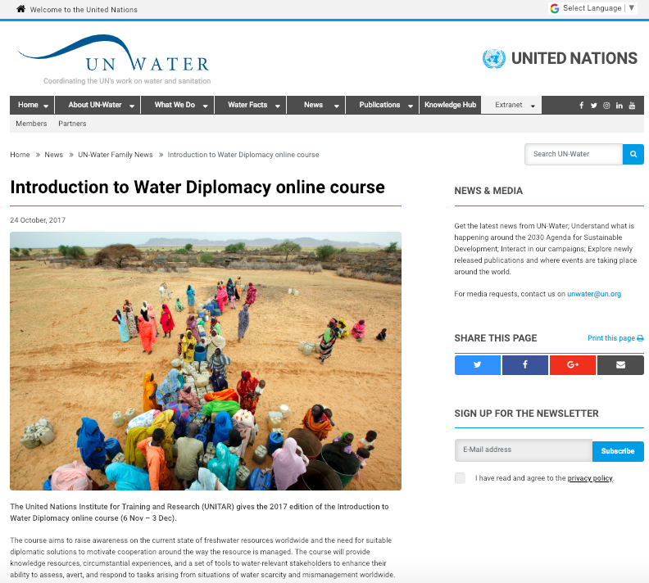
In 2011, United Nations proposed Water Diplomacy.

Slide 7
1.2 The Content of Water Diplomacy: The Subject, Purpose and Attributes
The Subject: Central government
（Local governments, Companies, Think Tanks, NGOs, etc. ）
The Purpose: Solve the water issues and promote regional stability and cooperation.
The Attributes: Social attribute, Regional attribute, Binding attribute.
Source: Zhang, L., & Lu, G. S. (2015). Transboundary Water Cooperation between China and the Lower Mekong Countries from the Perspective of Water Diplomacy. Southeast Asian Studies, 1, 51-68.

Slide 8
Social attribute refers to that Water Diplomacy should pay attention to social subjects like those in Mekong Countries, including domestic water development strategies, water development competition with other countries outside the region, social customs along water development regions, NGOs and behavior of the media.
Regional attribute refers to the implementation objects of Water Diplomacy generally share common rivers geopolitically.
Binding attribute refers to that implementation of Water Diplomacy aims at boosting water source development, improving economic interest, consolidating the relationship among countries by negotiation, consultation and compromise between member countries, to promote mutual interests.

Slide 9
2. The Status and Content of International Water Rights in Water Diplomacy
2.1 The Status of International Water Rights in Water Diplomacy: The Core
The core of water diplomacy is water rights.
2.2 The Goal of International Water Rights in Water Diplomacy
Table 1: The condition and function of the school of water right theory
School | Absolute territorial sovereignty theory | Absolute territorial integrity theory | Preoccupation theory | Limited territorial sovereignty theory | Shared interest theory
Terms | No restrictions of developmentand downstream impacts are not considered | No changes shall be made to the water | Development and utilization are limited by time and national power | The right to development and utilization is restricted by the coastal states | Establish common consciousness and adopt common management
Effect | Upstream countries have an absolute advantage | The downstream country has veto power over the upstream country | It is advantageous to the first developing country and powerful country | Coastal states are equal and fair | The coastal states are harmonious and unified

Slide 10
2.3 The Content of International Water Rights in Water Diplomacy
Jurisdiction
Use Rights
Distribution Rights
Compensation Rights

Slide 11
3.The Cases of International Water Rights Issues in the Mekong River Basin
3.1 The Category of International Water Rights Issues in the Mekong River Basin
Political Class
Natural Resources Class
Source: Benjamin Pohl et al., "The Rise of Hydro-Diplomacy: Strengthening Foreign Policy for Transboundary Waters." Adelphi, 2014, p. 8.

Slide 12
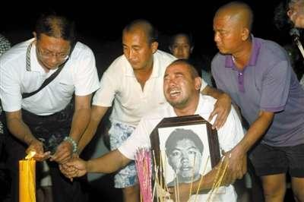
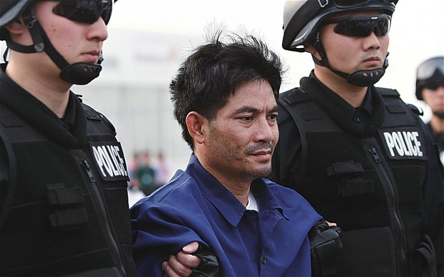
3.2 The Cases of International Water Rights Issues in the Mekong River Basin
Water Management and Cooperation Mechanism
Mekong Waterway
Mekong Massacre on 5 October, 2011.
Naw Kham, a 44-year-old ethnic Shan from Burma, has terrorised the Golden Triangle between Burma, Thailand and Laos for the last five years with a gang of up to 100 men.

Slide 13
The Mekong Countries has not yet signed with China the Agreement on Law Enforcement Security Cooperation in the Mekong River Basin.
China believes that it has provided the most public goods and costs in the process of joint security enforcement, and that waterway security construction also contributes to the development of shipping trade in the entire Mekong River basin.

Slide 14
4. The Solution of International Water Rights Issues in the Mekong River Basin
4.1 The Relation of Sovereignty Transfer and International Water Rights Transfer
International Water Rights is one part of Sovereignty.
When the mechanism has been established, every member countries should transfer the part of sovereignty.
If we would fix water issues especially water rights issues, Lancang-Mekong Countries (Cambodia, China, Laos, Myanmar, Thailand and Vietnam) should transfer the part of international water rights.
Transfer to where?

Slide 15
4.2 The Content and Ways of Part of International Water Rights Transfer in the Mekong River Basin
In 2016, Lancang-Mekong Cooperation Mechanism.
In 2017, Lancang-Mekong Water Resources Cooperation Center.

Slide 16
In 2018,
The First Lancang-Mekong Water Resources Cooperation Forum.
The Kunming Initiative.
Five-Year Action Plan on Water Resources Cooperation will be published soon.

Slide 18
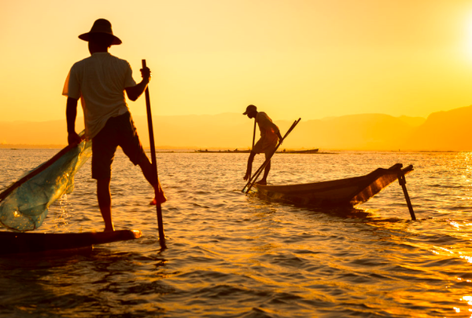
I live in the upstream and you live in the downstream,
Our friendship flows with the river we both drink.
——Chen Yi, the former Chinese Foreign Minister

Slide 19
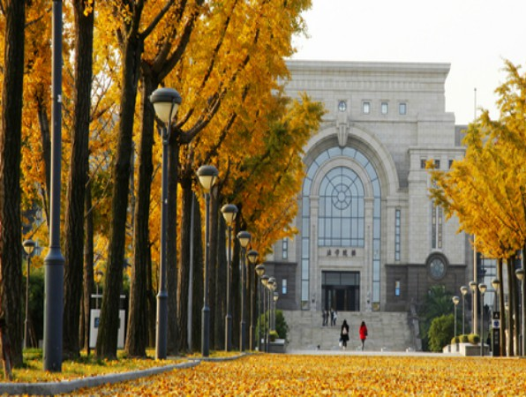
Zhang L. 2018 (Forthcoming). Trust Crisis and Trust Building in Transboundary Water Cooperation in the Lancang-Mekong River. In Mart A. Stewart and Peter A. Coclanis (Eds.), Water and Power: Environmental Governance and Strategies for Sustainability in the Lower Mekong Basin (March, 2019), Springer.
Zhang, L., & Lu, G. S. (2015). Transboundary Water Cooperation between China and the Lower Mekong Countries from the Perspective of Water Diplomacy. Southeast Asian Studies, 1, 51-68.
Thank You
Email: zhl@fudan.edu.cn

