Slide 1
To Promote Water Resources Administration Regime Through River Chief System
Speaker : Gu Xiangyi
Law School of
Hohai University

Slide 2
01 |
C
Brief Introduction（简介）
02 |
The Necessity to Establish the River Chief System
（建立河长制的必要性）
ONTENTS
03 |
The Arrangement to River Chief System in Detail
（河长制的优化）

Slide 3
P
art 01
Introduction

Slide 4

Introduction
1.1. Case Introduction
（案例引入）

Slide 5
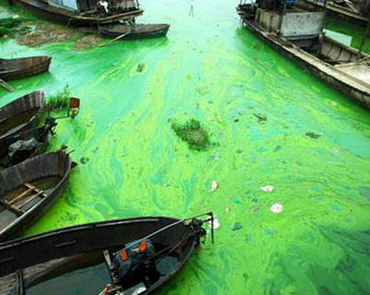
Introduction
Taihu Lake cyanobacteria event（太湖蓝藻事件）
Severe cyanobacteria pollution was discovered in Taihu Lake, Jiangsu Province in 2007, which caused citywide water pollution in Wuxi. Serious shortage of domestic and drinking water ensued; bottled water in supermarket was sold out.
The reasons of this incident lie in the lack of ecological control and administration of public resource.

Slide 6
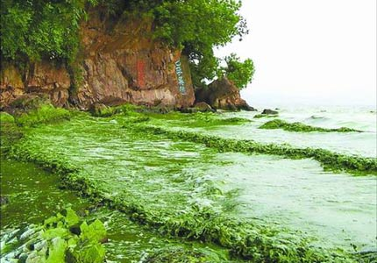
Introduction
Causes of the Event：
1.High-speed Economic Development
2.Agricultural Pollution
3.Poor Wastewater Treatment
4.The Rapid Expansion of the scale of the Fishing Industry

Slide 7
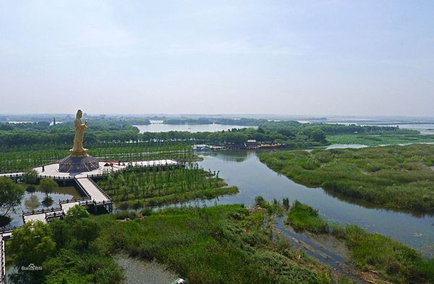
Introduction
Da Zong Lake Retreats to the Lake(大纵湖退圩还湖)：
For a long time, problems such as lake reclamation and over-cultivation have become increasingly serious. The fish and crab feed increased the eutrophication（富营养化） of the water and degraded the water quality.
Problems such as cofferdams(围堰） and excessive aquaculture are serious, and the function of the lake and the ecological environment have been seriously degraded.
In 2011, along with the opportunities for coastal development, the “Retreat to the Lake” project was incorporated into the coastal development strategy by the Yancheng City.

Slide 8
Introduction
1.2. Introduction on River Chief system
（河长制的介绍）

Slide 9
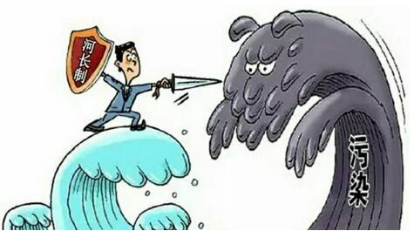
Introduction
Through the "River Chief System", main leaders at all tiers of party committee and government are appointed as a the river chief, to fulfill the responsibility of governance and protection of the river.
According to the scale of a river area, there will set River Chief in four tiers, from the Province to the town corresponding to the party committee and government level.
The River Chief is only responsible for the river's environmental management and protection in certain length of the river.

Slide 10
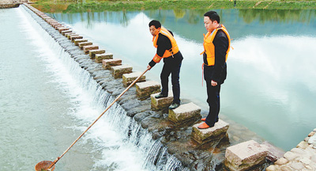
Introduction
"Environmental Protection Law" provides that local people's governments at all tiers should be responsible for the environmental quality of their administrative areas. But actually, the local environmental protection bureaus are often responsible for environmental issues and the government's statutory duties are difficult to implement.

Slide 11
P
art 02
The Necessity to Establish the River Chief system

Slide 12
The Necessity to Establish the River Chief system
2.1. Non-sufficiency Supply of Water Resources
（水资源供应不足）
点击编辑

Slide 13
The Necessity to Establish the River Chief system
As public resources, the non- sufficiency supply is one of causes of the Taihu Lake environmental crisis. Taihu Lake will remain polluted until the water structure changes, such as the eutrophic state, the outbreak of cyanobacteria, and drinking water shortage for residents.
The domestic sewage and industrial emissions, especially long-term industrial wastewater discharge, which led to ecological crisis.
点击编辑

Slide 14
The Necessity to Establish the River Chief system
2.2. Lack of Legal Regulations
（缺乏法律依据）
4

Slide 15
The Necessity to Establish the River Chief system
In the process of comprehensive promotion of “River Chief System”, there are also the issues in the application of law: the authorization and regulation of the“River Chief” by laws and regulations is insufficient.
Although the establishment of the “river chief system” has certain laws and regulations as the basis, the source of its powers and obligations is not directly stipulated, only relying on the “Views on the Full Implementation of the River Chief“(关于全面推广河长制的意见） issued by the State Council and the offices of local governments.
Because the administrative norms have not undergone strict legislative procedures, the power and obligation of the river chief are not effectively awarded by the law.
4

Slide 16
The Necessity to Establish the River Chief system
2.3. Dual Power and Obligations of River Chiefs
（河长的双重权力与义务）
4

Slide 17
The Necessity to Establish the River Chief system
The regime of the four tiers of "River Chief System" is based on the existing administrative divisions. However, the river flows through various administrative divisions, such as Qin Huai River, the Yangtze River and other rivers in Nanjing City.
In this region, the two River Chiefs’ power must overlap, especially the Qin Huai River or the tributaries of the Yangtze River. So the protection of the mainstream will affect the protection of tributaries.
4

Slide 18
The Necessity to Establish the River Chief system
2.4. The Supervising Power of the River Chief
（河长的监督权）
4

Slide 19
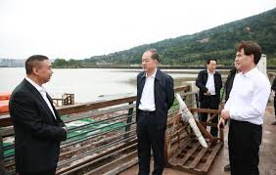
The Necessity to Establish the River Chief system
According to the “Views on the Full Implementation of the ‘River Chief’ System ”, four tiers of the river chief system was found in the local governments .
Generally, the provincial governors appointed as the river chief responsible for the supervision of the water protection.
the Mayor
4

Slide 20
The Necessity to Establish the River Chief system
2.5. Ignoring the Water Ecosphere and Citizens’ rights
（对水生态和公民权利的忽视）
4

Slide 21
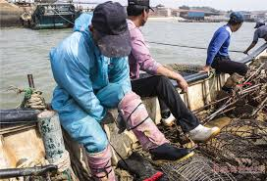
The Necessity to Establish the River Chief system
In current, the government paid little in compensation to people who live along the rivers and lakes. The government just asked residents to leave for other places instead of thinking about their basic requirements.
In fact, citizens had the rights to get compensations and lived in their hometown. It would not only bring about conflicts but also increase the dissatisfaction with the government if the government does not care about the people.
4

Slide 22
P
art 03
The Arrangement to
River Chief System in Detail

Slide 23
The Arrangement to River Chief System in Detail
3.1. Decentralization of the Authority
（权力下移）

Slide 24
First, the System should ensure that the River Chief's power to be exercised and implemented. The River Chief at all tiers should have the power to mobilize the departments in their respective areas. At the same time, other departments who do not cooperate with their work in the ecological protection of water resources should be blamed.
Second, we should amplify the extent of the public participation and expand the social effect of the River System.
4

Slide 25
The Arrangement to River Chief System in Detail
3.2. The Optimal Allocation of the Internal Power
（内部权力的优化）

Slide 26
According to the regulation, the River Chief office is responsible for the operation of the river system and to strengthen the guidance, coordination, supervision, assessment of the river .
At the same time, the office also establish the working mechanism and account expense, to set up supervision and complaints system, to promote the implementation of the River Chief System.
4

Slide 27
The Arrangement to River Chief System in Detail
3.3. Construction of Supervision Mechanisms
（监督机制的建设）

Slide 28
The Necessity to Establish the River Chief system
First, it is important to establish an Assessment system for the General River Chief in the following aspect: leading the specific organizations of the River Chief office, the joint participation of relevant departments, the third-party monitoring and evaluation, etc.
Second, the provincial “River Chief” should supervise the annual work and performance of duties in each city or district .
4

Slide 29
The Arrangement to River Chief System in Detail
3.4. Cross-regional Legislative Cooperation
（跨区域立法合作）

Slide 30
The Necessity to Establish the River Chief system
Regarding to the “Constitution” and “Legislation Law”, to promote local cooperation in the rule of law and break down barrier of the regional ecological protection of water resources. The regional barriers should be removed so that better cooperation can be promoted.
For example: “Enshi Tujia and Miao Autonomous State--Youshui River Protection Regulations” (恩施土家族苗族自治州酋水河保护条例）was promulgated in 2016, which has taken a step forward in the legislative cooperation of local people's congresses and national autonomous areas.
4

Slide 31
The Arrangement to River Chief System in Detail
3.5. Focusing on the Ecological Function of Lakes and Rivers
（注重河湖的生态服务功能）

Slide 32
The Necessity to Establish the River Chief system
The “River into the lake” project dredges the river in the west of Da Zong Lake, the goal of the project is to restore the capacity of flood control, improve the water quality of the river and lake, gradually repair and enhance the ecological service function of lakes and rivers, establish an optimized water resources protection and development mode, and change the pollution situation.
4

Slide 33
The Arrangement to River Chief System in Detail
3.6. Emphasizing the Citizens’ Rights and Livelihood Project
（强调公民权利和民生项目）

Slide 34
The Necessity to Establish the River Chief system
This livelihood project aims to maintain the healthy life of citizens around the lake as a prerequisite, focusing on regional flood control and waterlogging, water supply needs, which also makes efforts to protect the ecological environment, both aquaculture and wetland tourism, guides the development and utilizes the Da Zong Lake to promote regional economic development.
4

Slide 35
Conclusion

Slide 36
The Necessity to Establish the River Chief system
To promote water resources administration regime through river chief system, which is declared by Chairman Xi Jinping and gradually implementing in whole country.
From the above discussion, The River Chief System is a kind of reallocation of the government’s power.
4

Slide 37
Thanks

