Slide 1
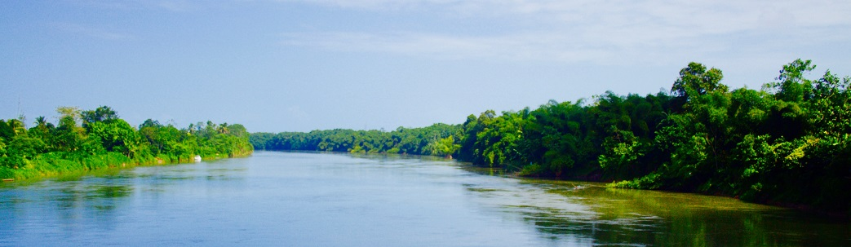

Defining “Effective” Transboundary Water Cooperation: A Preliminary Look
Melissa McCracken
Oregon State University
mccrackm@oregonstate.edu
International Water Rights Forum
Hohai University
17-18 December 2018

Slide 2

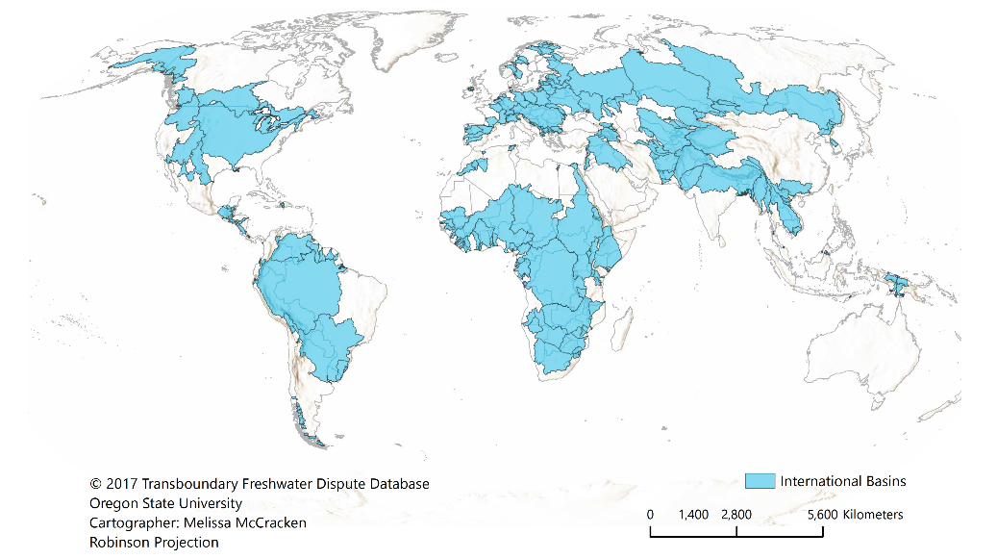
International River Basins

Slide 3
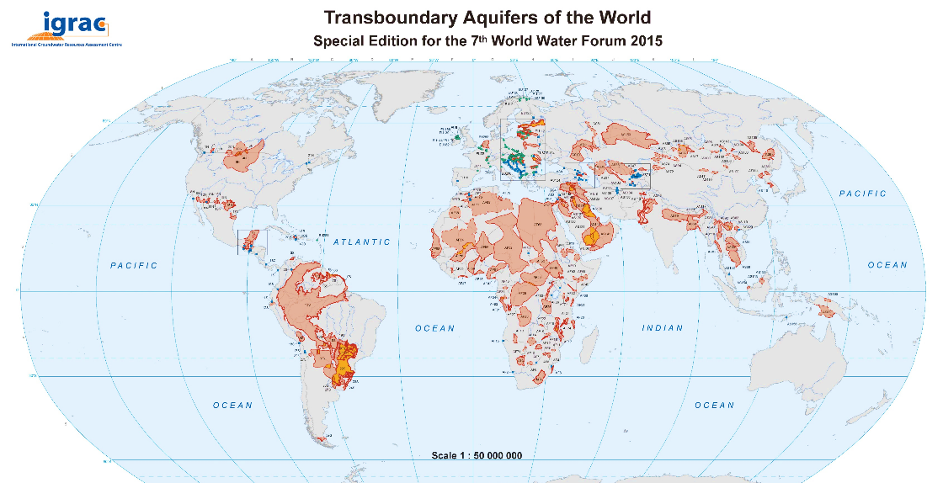
International Aquifers

Slide 4

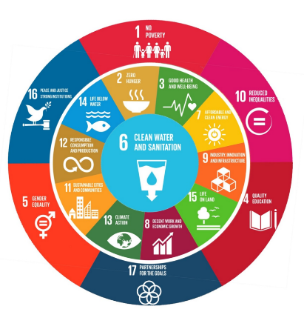
SDG Indicator 6.5.2: Operational Arrangement for Cooperation
Goal 6: Ensure availability and sustainable management of water and sanitation for all
Target 6.5: By 2030, implement integrated water resources management at all levels, including through transboundary cooperation as appropriate
  Indicator 6.5.1: Degree of integrated water resources management implementation
  Indicator 6.5.2: Proportion of transboundary basin area with an operational arrangement for water cooperation

Slide 5
Challenge: Defining Cooperation
Term | Definition/Criteria
Transboundary water cooperation¹ | Measured by the presence of a transboundary water agreement
Transboundary water cooperation² | “any action or set of actions by riparian states that leads to the enhanced management or development of the transboundary water body to their mutual satisfaction.”
However, no matter the definition; cooperation over shared waters should be effective.
Notes:
there are two challenges that can be identified: 1. defining transboundary water cooperation and 2 defining effectiveness.
There is no single definition of transboundary water cooperation. A general definition is the coordination and collaboration between riparian states that achieves a common interest, this duty to cooperation is a central aspect of international law. When we attempt to operationalize cooperation’s definition there are complications in the understanding of what actually constitutes cooperation. Cooperation can range from procedural to substantive criteria, objective to subjective, normative to place-based, paper vs practices, hard vs soft, input vs output. The differences in how tb water cooperation is conceptualized can challenge consistent monitoring efforts in accurately reflecting the extent of cooperation.
When considering the promotion of transboundary cooperation through and by the SDGs, it is important that cooperation variability be reflected and that the cooperation being measured is actually effective.

Slide 6
Challenge: Defining Effective Cooperation
Term | Definition/Criteria
Effective cooperation³ | Provides measurable benefits to riparians that promote water security
Effectiveness⁴ | Ability of treaties or institutions to address and manage water disputes peacefully
Notes:
This variability in defining and measuring tb cooperation has led to efforts that measure cooperation based on outputs – which ultimately translates into the cooperation that is effective and produces measurable benefits. But effective can also have a range of meaning that depend on the point or focus of the study. Often, effective is not defined in a study which can lead to multiple interpretations.

Slide 7

Two Main Questions:
How is “transboundary water cooperation” defined?
What is “effective transboundary water cooperation”?

Slide 8
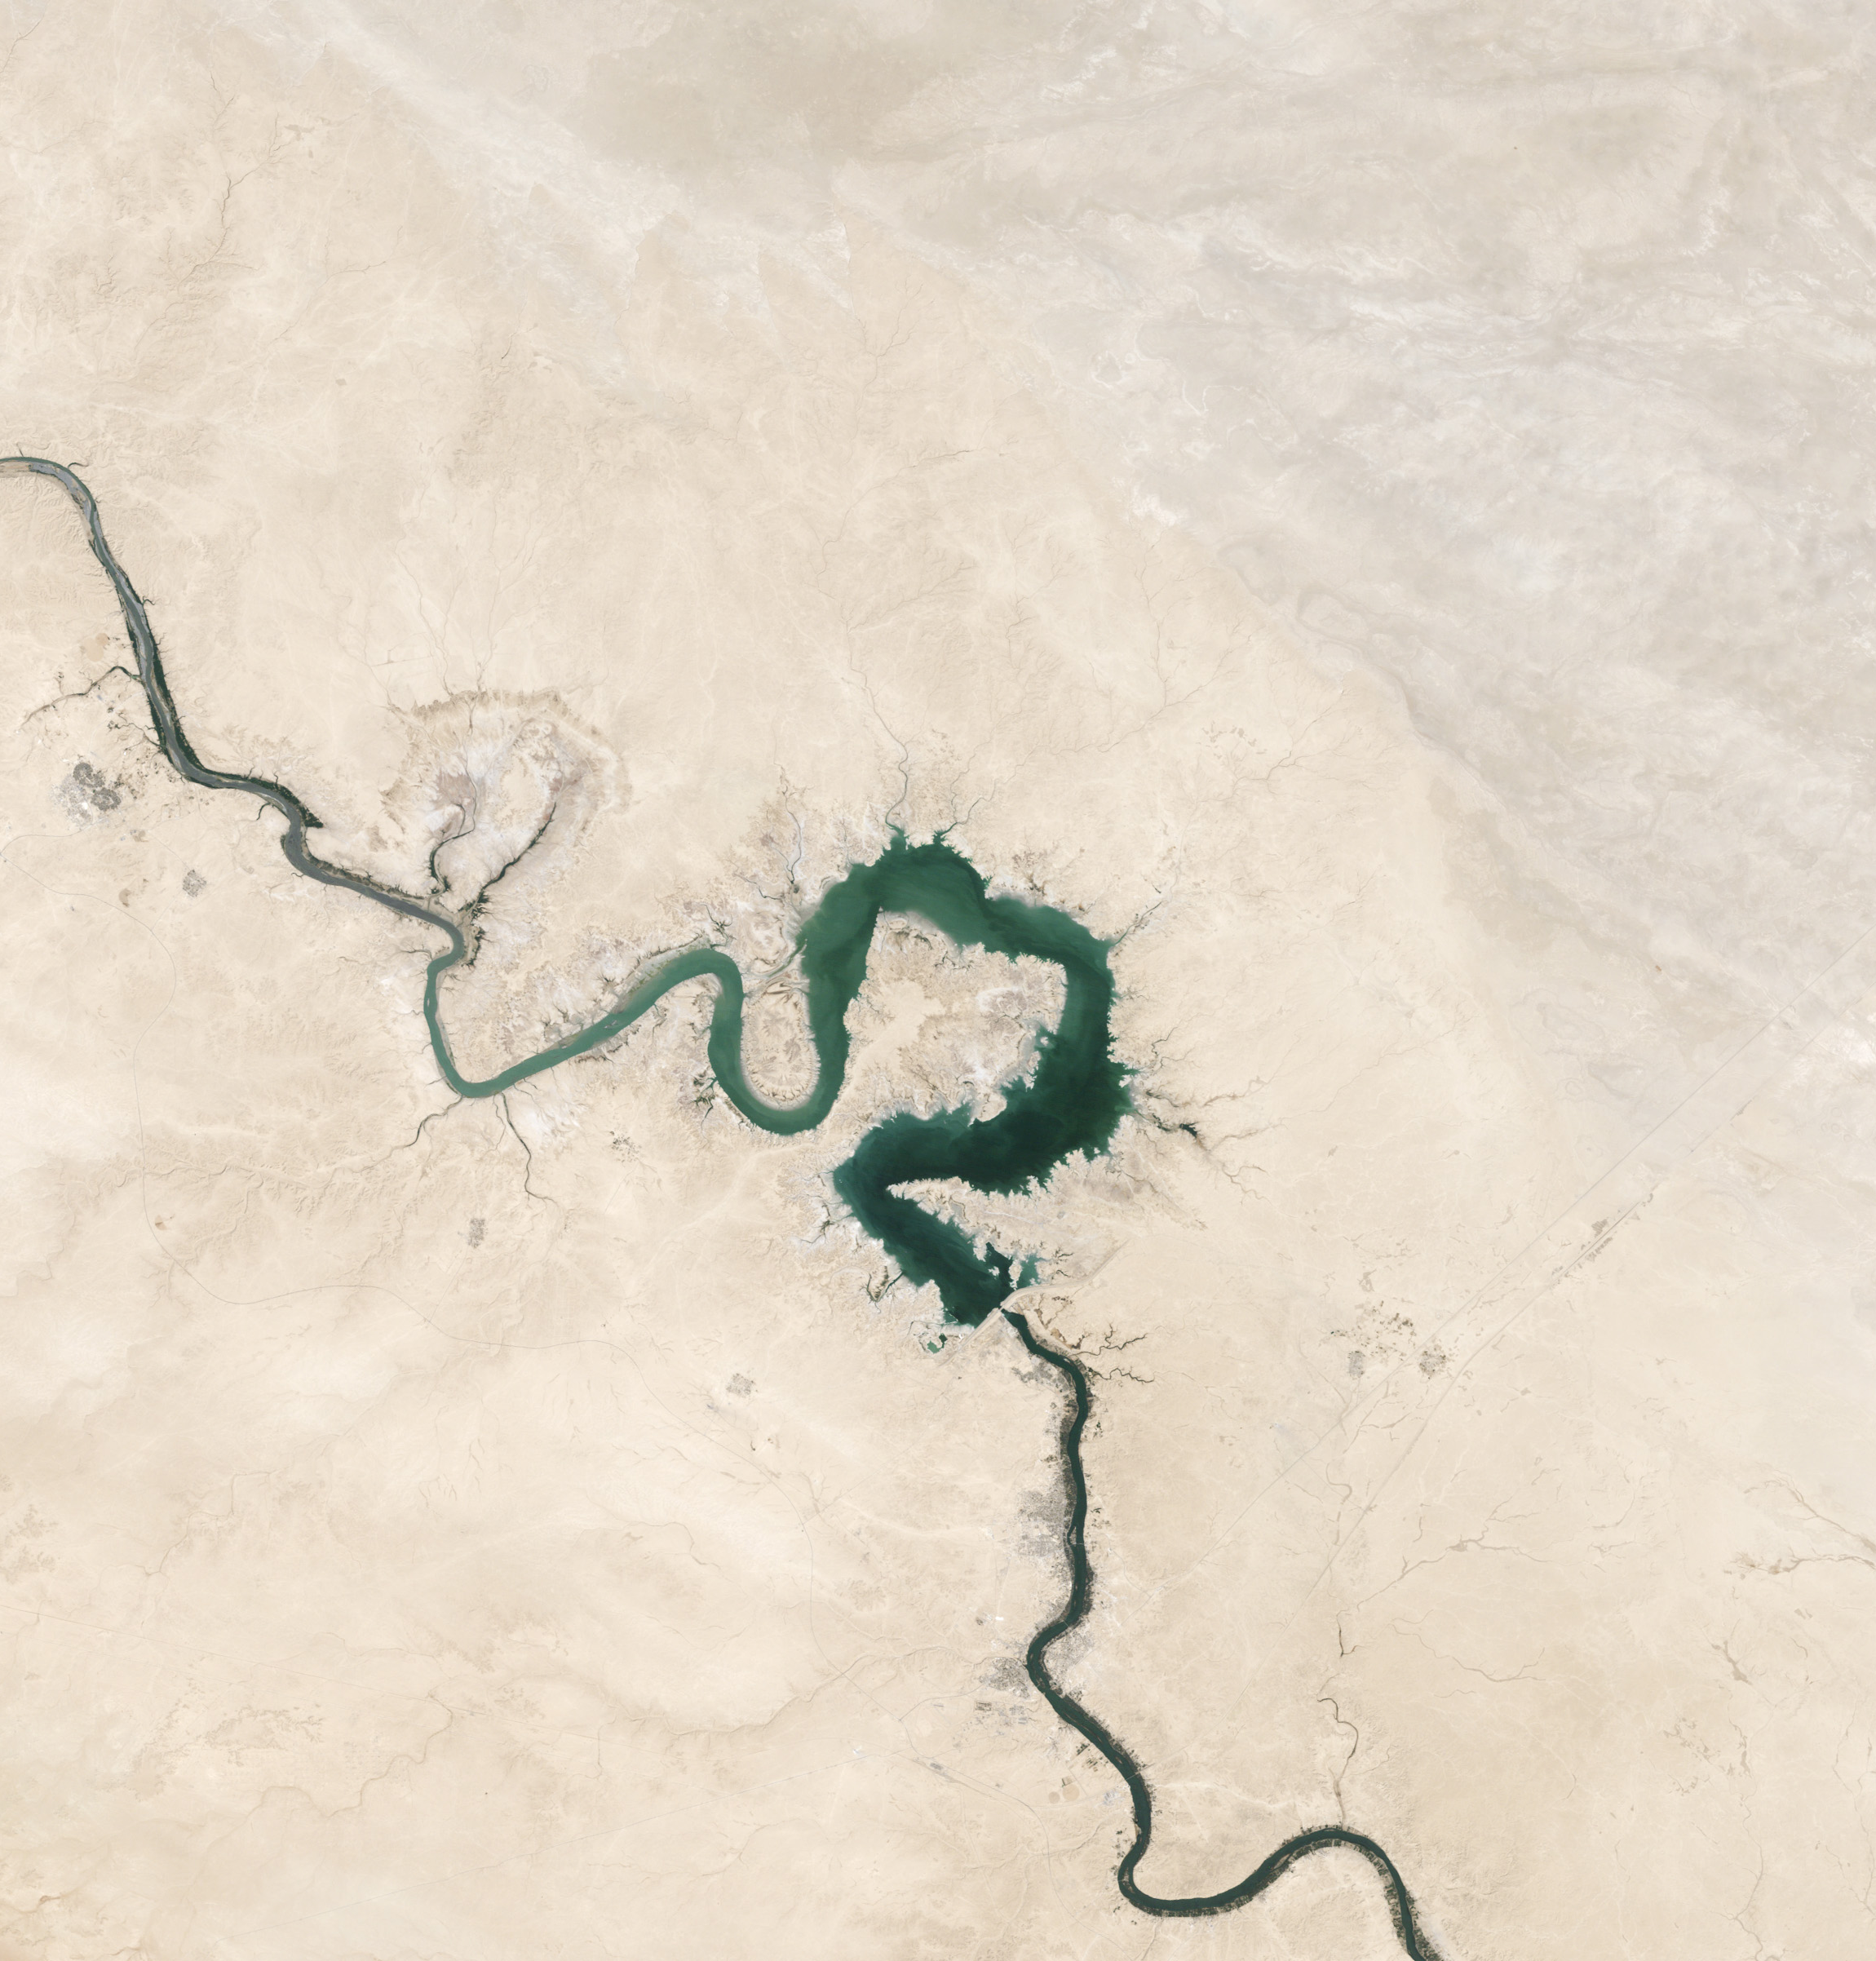
Methods
Interview academics, practitioners, basin managers, NGOs, etc.
Analyze literature on transboundary water cooperation and effectiveness

Slide 9
Preliminary Results
Defining Transboundary Water Cooperation:
“its the absence of a lot of conflict.”
“the highest form of cooperation is data sharing”
“the cooperation can take so many different forms…but trust, I think is one of the key elements”

Slide 10
Preliminary Results
Defining Effective Transboundary Water Cooperation:
“institutional features… like good public participation, resolution of conflict,…or mechanism that science can help influence or feed into decision-making”
“there is willingness to have a joint management plan, and it actually comes about”
“Effective cooperation is one that achieves set objectives”

Slide 11
Preliminary Results
Defining Effective Transboundary Water Cooperation:
A theme in the interviews is that…
Effective transboundary water cooperation yields outcomes or results.

Slide 12
Preliminary Results
Effective transboundary water cooperation yields outcomes or results.
Leads to two questions:
  What outcomes?
  How to achieve these outcomes?

Slide 13
Preliminary Results
Effective transboundary water cooperation yields outcomes or results.
  What outcomes?
  How to achieve these outcomes?
To answer these, we must consider:
  Context
  Process
  Scale
  Time

Slide 14
Preliminary Results
Preliminary four-dimensional framework of effective cooperation:
Process
Scale
Time
Context
Outcomes

Slide 15
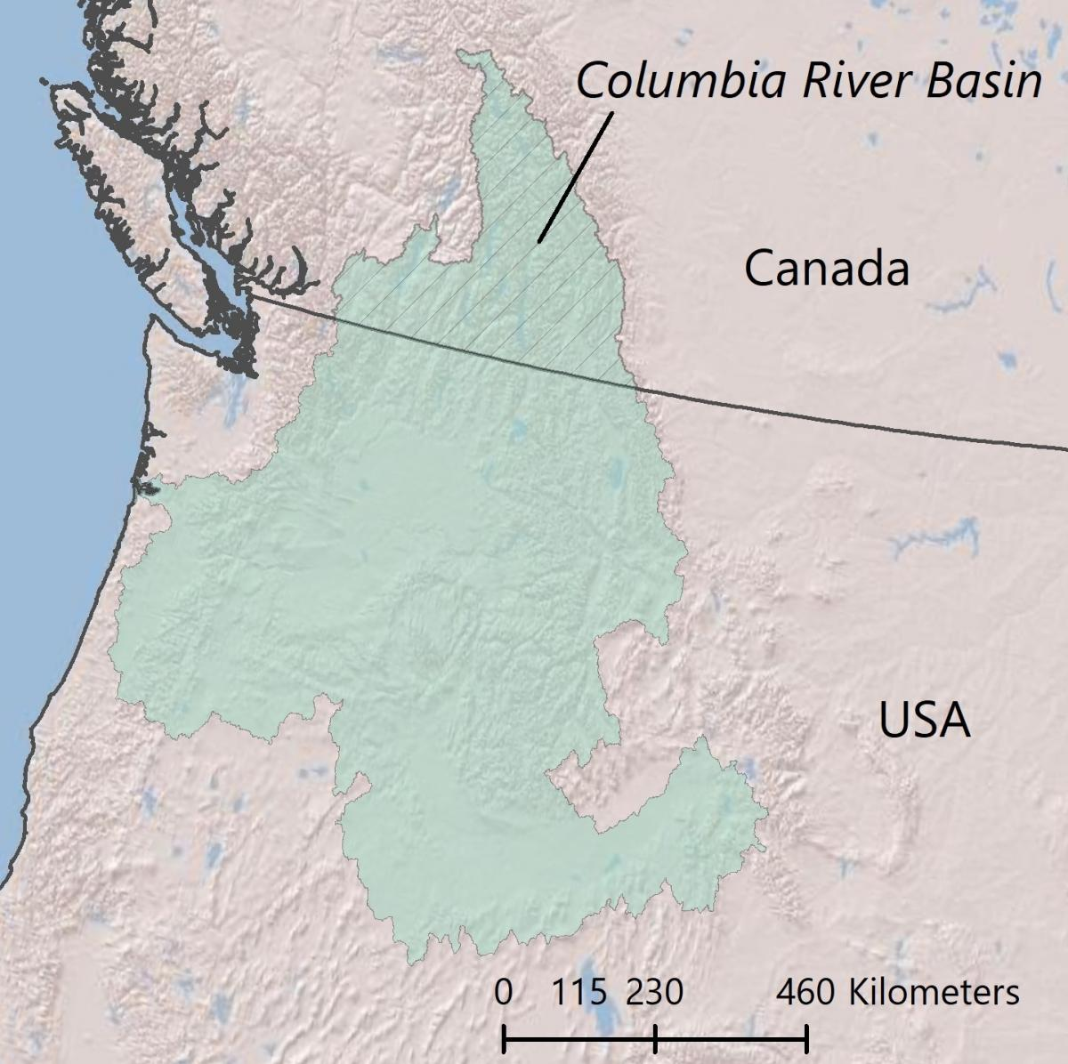
Preliminary Results
Time
When are we evaluating the cooperation?
Process
Scale
Time
Context
Timeline
Outcomes
Past
1964
2018
Future
Notes:
How does time impact, effect, influence the effectiveness of cooporation.
When are we evaluating the cooperation?
Ex. Columbia after treaty was signed or now?
How long has the cooperation occurred?
Has trust developed? Is it effective, has it been tested?
Ex, agreement signed on the Guarani Aquifer – agreement is positive, but to soon to see if its effective. Do it address all the right issues? Does it achieve the outcomes is set out to achieve.

Slide 16
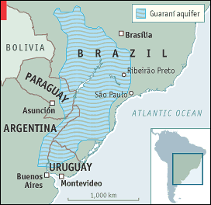
Preliminary Results
Time
When are we evaluating the cooperation?
How long has the cooperation occurred?
Process
Scale
Time
Context
Timeline
Outcomes
Past
2010
2018
Future
(The Economist, 2003)
Notes:
How does time impact, effect, influence the effectiveness of cooporation.
How long has the cooperation occurred?
Has trust developed? Is it effective, has it been tested?
Ex, agreement signed on the Guarani Aquifer – agreement is positive, but to soon to see if its effective. Do it address all the right issues? Does it achieve the outcomes is set out to achieve.
The signing of the Guarani Aquifer Agreement (Portuguese / Spanish / English [unofficial]) on August 2, 2010, by Argentina, Brazil, Paraguay and Uruguay was received by the water community with excitement due to the few number of treaties dedicated to transboundary aquifer cooperation, the absence of a water conflict, and the short time it took to secure the signatures after the end of the Guarani Aquifer System Project. In 2012, Argentina and Uruguay ratified the treaty with the promulgation of Law n° 26.780/2012 and Law n° 18.913/2012, respectively. Thereafter, the Agreement faced a period of stagnation until May 2017 when Brazil ratified it with Legislative Decree n° 52/2017. Almost a year later, in April 2018, Paraguay ratified the Agreement when it approved Law nº 6037/2018.
After almost 8 years, the Agreement is in the final stage of coming into force, although Paraguay has yet to deposit its instrument of ratification with Brazil, which is the official depository for the Agreement. According to Article 21, the Agreement will officially enter into force on the thirtieth day after that deposit occurs.
https://www.internationalwaterlaw.org/blog/2018/06/18/countdown-to-the-guarani-aquifer-agreement-coming-into-force-will-it-be-effective-in-promoting-transboundary-groundwater-governance/

Slide 17
Preliminary Results
Scale:
At what geographic scale does cooperation take place at?
At what level of governance does cooperation take place at?
Process
Scale
Time
Context
Geographic Scale
Outcomes
Point
Tributary
Basin
Inter-Basin
Governance Scale
Local
Technical
Sub-state
International
Notes:
Scale can also influence effective cooperation
We can consider scale in two ways: 1. geographic scale
Is the cooperation occurring at a point scale, tributary scale, basin scale?

Slide 18
Preliminary Results
Process:
What actions or elements enable the outcomes to be achieved?
Process
Scale
Time
Context
Negotiation
Agreement
Implementation
Monitoring
Revision
Outcomes
How the process occurs is dependent on the context…

Slide 19
Preliminary Results
Outcomes:
What outcomes should be achieved for cooperation to be considered effective?
Process
Scale
Time
Context
Outcomes
Defined by the Parties
Standardized
Process
Outcomes
The context, point in time, and scale define the outcomes to measure effectiveness of the cooperation.

Slide 20
To Conclude:
Key Points
There is a need for a clear understanding of transboundary water cooperation and effective cooperation
Preliminary results suggest that effective cooperation yields outcomes or results
Effective cooperation to achieve outcomes is dependent on time, scale, process, and context
Research in progress, and still collecting data, would welcome comments and contributions.
Process
Scale
Time
Context
Outcomes
Effective Transboundary Water Cooperation

Slide 21
Thank you! Questions?
Melissa McCracken
Oregon State University
mccrackm@oregonstate.edu
International Water Rights Forum
Hohai University
17-18 December 2018

Slide 22
Works cited
UN-Water, 2014. A post-2015 global goal for water: Synthesis of key findings and recommendations from UN-Water, UN-Water. Available at: http://www.un.org/waterforlifedecade/pdf/27_01_2014_un-water_paper_on_a_post2015_global_goal_for_water.pdf [Accessed November 1, 2016]. Schweizerische Eidgenossenschaft, 2013. Swiss Position Paper on Water in the Post-2015 Agenda, Schweizerische Eidgenossenschaft. Available at: http://www.swisswaterpartnership.ch/wp-content/uploads/2014/07/2013.12.20_Swiss_Position_on_Water_in_Post2015_Agenda.pdf [Accessed November 1, 2016].
UNECE, 2015. Policy Guidance Note on the Benefits of Transboundary Water Cooperation, Geneva: UNECE. Available at: https://www.unece.org/fileadmin/DAM/env/water/publications/WAT_Benefits_of_Transboundary_Cooperation/ECE_MP.WAT_47_PolicyGuidanceNote_BenefitsCooperation_1522750_E_pdf_web.pdf [Accessed November 1, 2016].
Tarlock, D., 2015. Promoting Effective Water Management Cooperation Among Riparian Nations. TEC Background Papers, (21). Available at: http://www.gwp.org/Global/ToolBox/Publications/Background%20papers/GWP_TEC21_web.pdf [Accessed October 3, 2016].
Mitchell, S.M. & Zawahri, N.A., 2015. The effectiveness of treaty design in addressing water disputes. Journal of Peace Research, 52(2), pp.187–200

Slide 23
Preliminary Results
Transboundary water cooperation is defined through several perspectives
  Legal
  Intangible
Include one quote or phrase from each

