Slide 1
Knowledge Co-Production in THE Lancang-mekong basin
Implementing Inclusive and Ecological Reciprocity
Sam Smith
Hopkins Nanjing Center
ssmit311@jhu.edu
Notes:
Challenges: ’Stakeholder fatigue’ or ‘overload’
Lower *apparent* efficiency
Longer timelines for development projects
Acknowledge an interdisciplinary approach to basin management, requires humility from all participants
OPPORTUNITIES: Bring multiple stakeholders together to create new, comprehensive ‘knowledge-scapes’.
Acknowledge and embrace differences of opinion and outlook
Make clear the risks and opportunities inherent in different development plans
Improving credibility, salience, and legitimacy of development projects

Slide 2
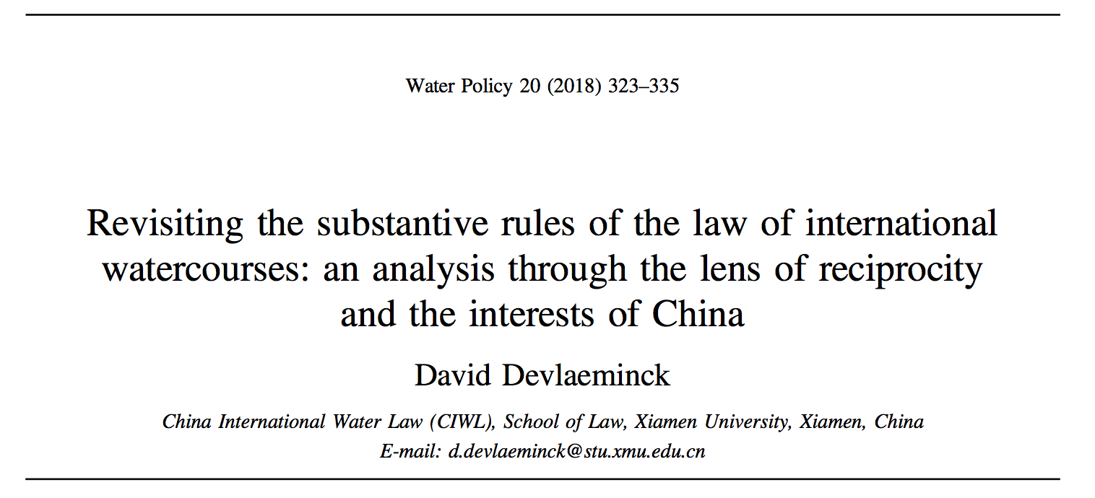
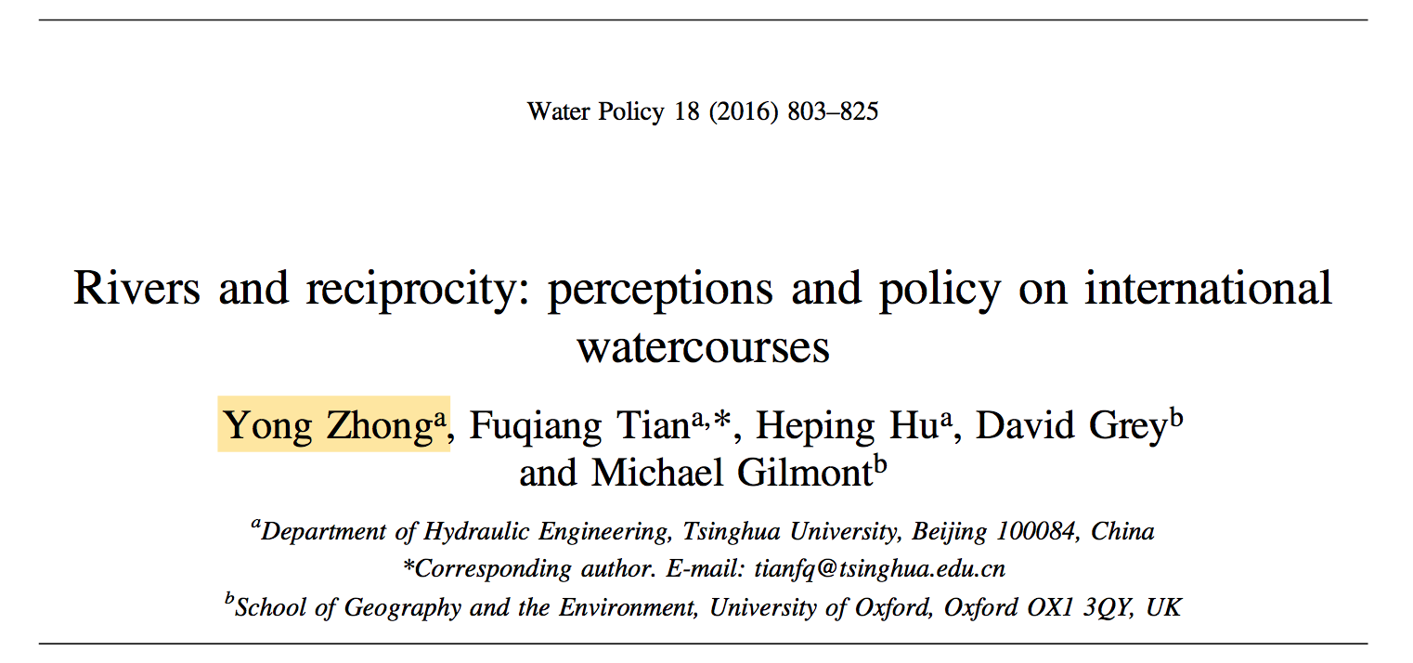
A ‘Reciprocity’ Agreement for the LMB?
How to go from here…
…to here?
Upstream
Downstream
Respects that harm to downstream riparian is usually unidirectional and physical
Respects that harm to upstream riparian is generally geopolitical and economic
Downstream States
Art. 7: No Significant Harm
Appears to provide protection against impact from upstream activities
Upstream States
Art. 5: Equitable and Reasonable Utilization
Appears to provide space for utilization in ways that may harm downstream neighbors.
UNWC
Theory…
Practice?
UNWC w/ ‘Reciprocity’
Notes:
According to Lee (2015, p. 140), benefit sharing can therefore be regarded as a ‘practical tool that can be utilized to promote cooperation between countries with trans- boundary rivers’ because this mechanism emphasizes a state of ‘hydro-interdependency’ between the different stakeholders. It is, however, not only a ‘practical tool’. In fact, it can also be said to include a normative, even an idealistic, angle. This is because riparian countries sharing a basin do not always freely acknowledge that they are in a state of hydro-interdependency.
What is more, several Chinese scholars doing research on the country’s river politics have explicitly mentioned benefit sharing as a potential way to move things between China and its riparian neighbours forward (personal communications, July–August 2016).

Slide 3
Two Definitions
Knowledge Production: the process of collecting, analyzing, and synthesizing information into tangible products for use in decision-making.
Benefit Sharing:
How outputs from water use can be optimally allocated to various actors for different objectives.

Slide 4
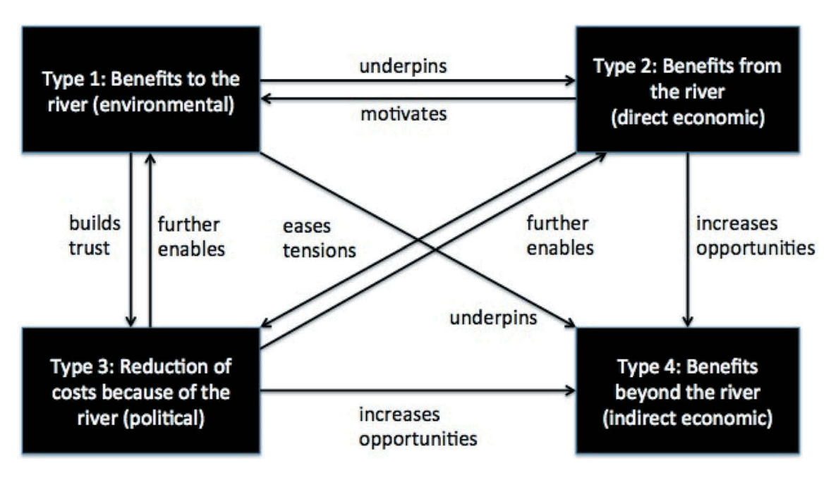
KNOWLEDGE PRODUCTION and benefit sharing
Reciprocity Begins Here – Acknowledgment of Interdependency
Lancang-Mekong Basin
Key Questions:
“Whose knowledge matters?”
“Whose benefits count?”
Traditional Outcomes
Hydrological Models
Conservation Plans
Environmental/Social Impact Assessment
Environmental Management Plan
Resettlement Action Plan
Recurring Problems
Watercourse-centric modelling
‘Private consultant’ mentality
Consultation viewed as formality
Perception of external influence
Civil society disputes result
(Biba , 2018)
Notes:
Cross-Sectoral, Cumulative Impacts
Thus, the extent to which companies in the Mekong Region are subject to such standards and have actually incorporated comprehensive cumulative impact assessments has been quite limited

Slide 5
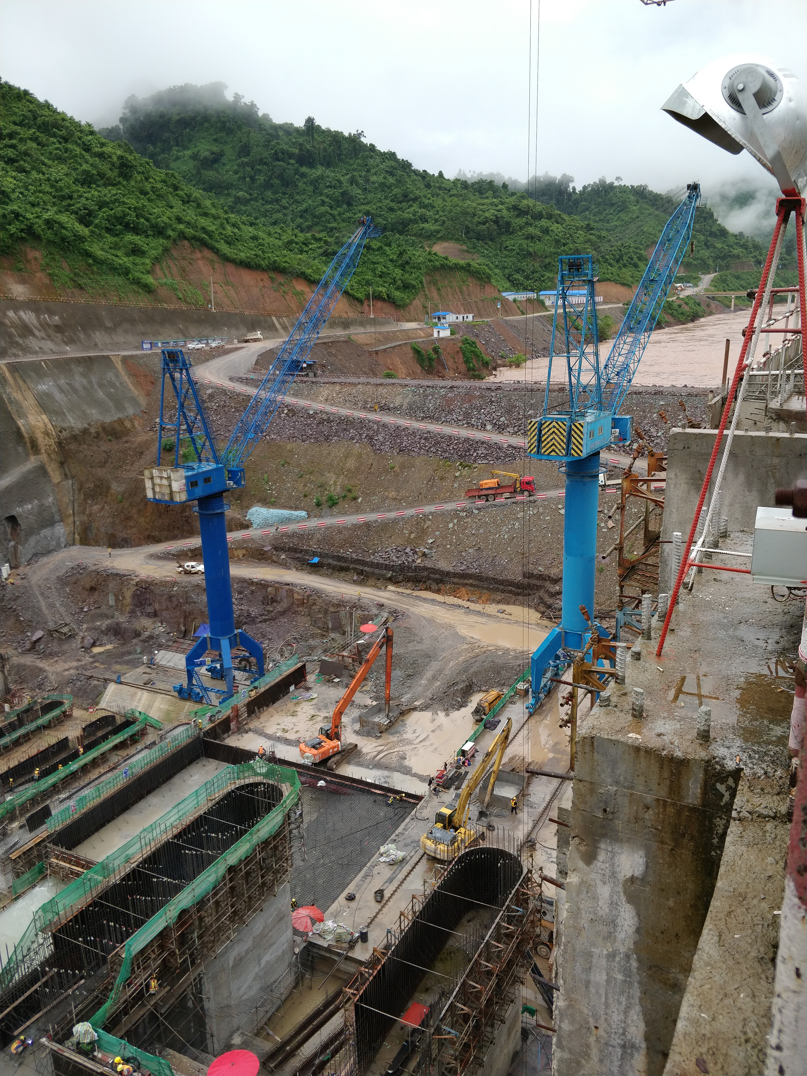
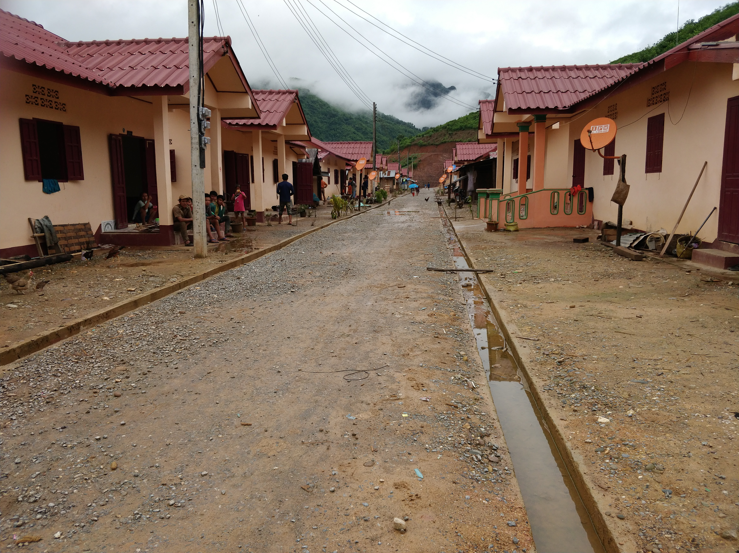
Lower Mekong Basin Hydropower (Nam Ou Cascade) Project, Laos PDR
Method: Site visit, interviews with locals, officials, developers (2014, 2016, 2018)
KNOWLEDGE PRODUCTION
EIA／SIA – final version not publicly available, no mention of transboundary impacts
‘Town hall’－style meetings (women barred from attending)
Questionnaires - Small sample size (30 people)
OUTCOMES/FINDINGS
Conflicting information from developer and local government
Unclear cumulative impacts on fishing, agriculture, land use, etc.
Resettlement harmful to social and economic development
Little evidence of systematic risk reporting and information sharing with local communities
International Rivers, 2018
CONCLUSION: Knowledge Production did NOT produce a complete picture of benefits and costs
International Rivers, 2018

Slide 6
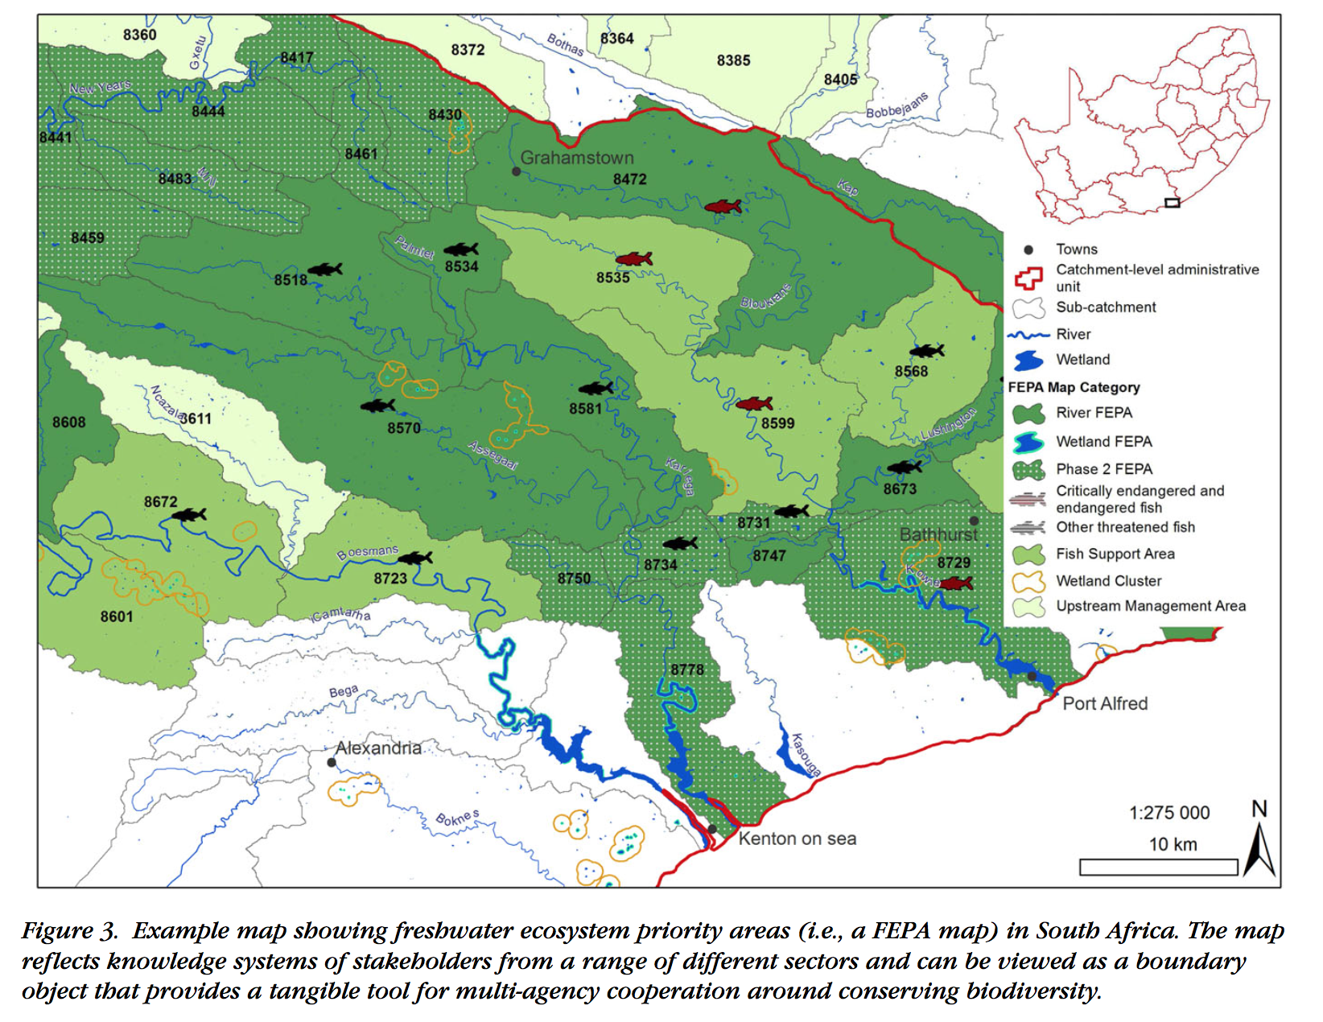
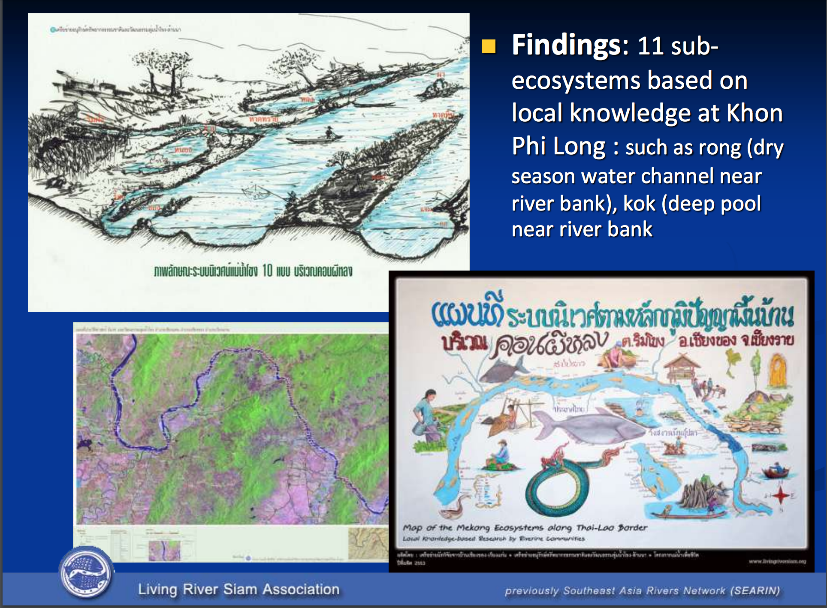
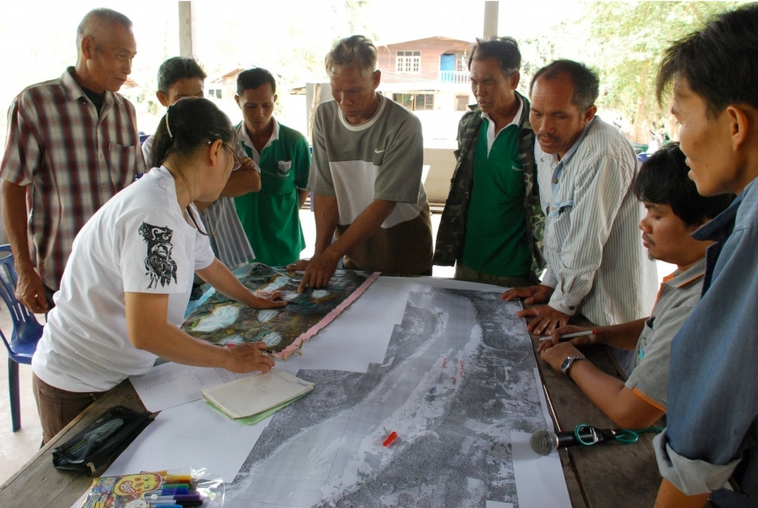
Knowledge Co-Production
Goal: Improving the saliency, credibility, and legitimacy of water governance decisions for all stakeholders.
Breaking down entrenched power imbalances
Integrating different types and scales of knowledge
Dealing with multiple and contested normative agendas
Negotiating the products or deliverables – creating ‘boundary objects’
(Adapted from SARUA, 2017)
Thai Baan Village Research (International Rivers)
Nel, et. al, 2012.
Notes:
Breaking down entrenched power imbalances regarding who gets to steer and shape the research agenda and knowledge economy;
Integrating different types and scales of knowledge and worldviews across multiple boundaries – between science, policy and practice, between disciplines, across organizational levels, between the public and private sectors, and between formalized, codified and informal, tacit forms of local knowledge;
Dealing with multiple and contested normative agendas, in the sense that each actor holds a view on what they consider to be the desirable outcome or goal of producing knowledge and the correct or most appropriate way of doing so, and this will differ between individuals and groups participating in a knowledge co-production process;
Negotiating the products or deliverables of a knowledge co-production process – often participants have their own requirements for what these might be, for example a scientific journal paper, a policy or strategy, a practical handbook, or a decision-support tool, and so an important step in the process is agreeing to how the jointly produced knowledge can and will be used, by whom, using what resources and to what end.
SARUA, 2017
“It is also important to acknowledge the knowledge of river-side communities and various civil society research initiatives. Only through sharing and deliberating these multiple forms of knowledge can a more complete picture of the Lancang-Mekong River and its diverse economic, social and cultural value be attained.” – Carl Middleton, thethirdpole.net

Slide 7
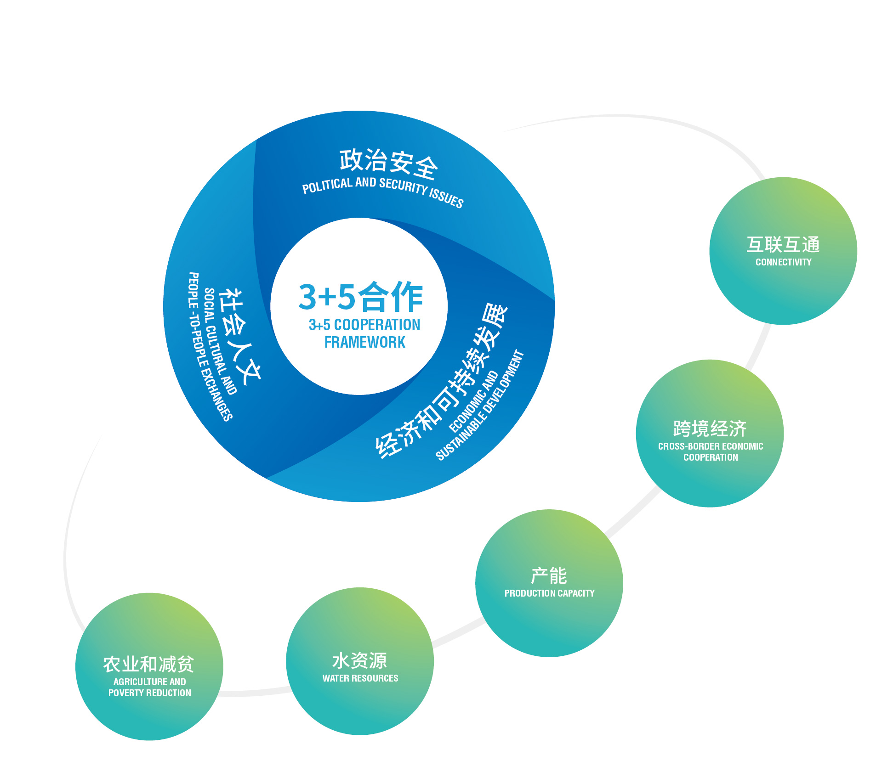
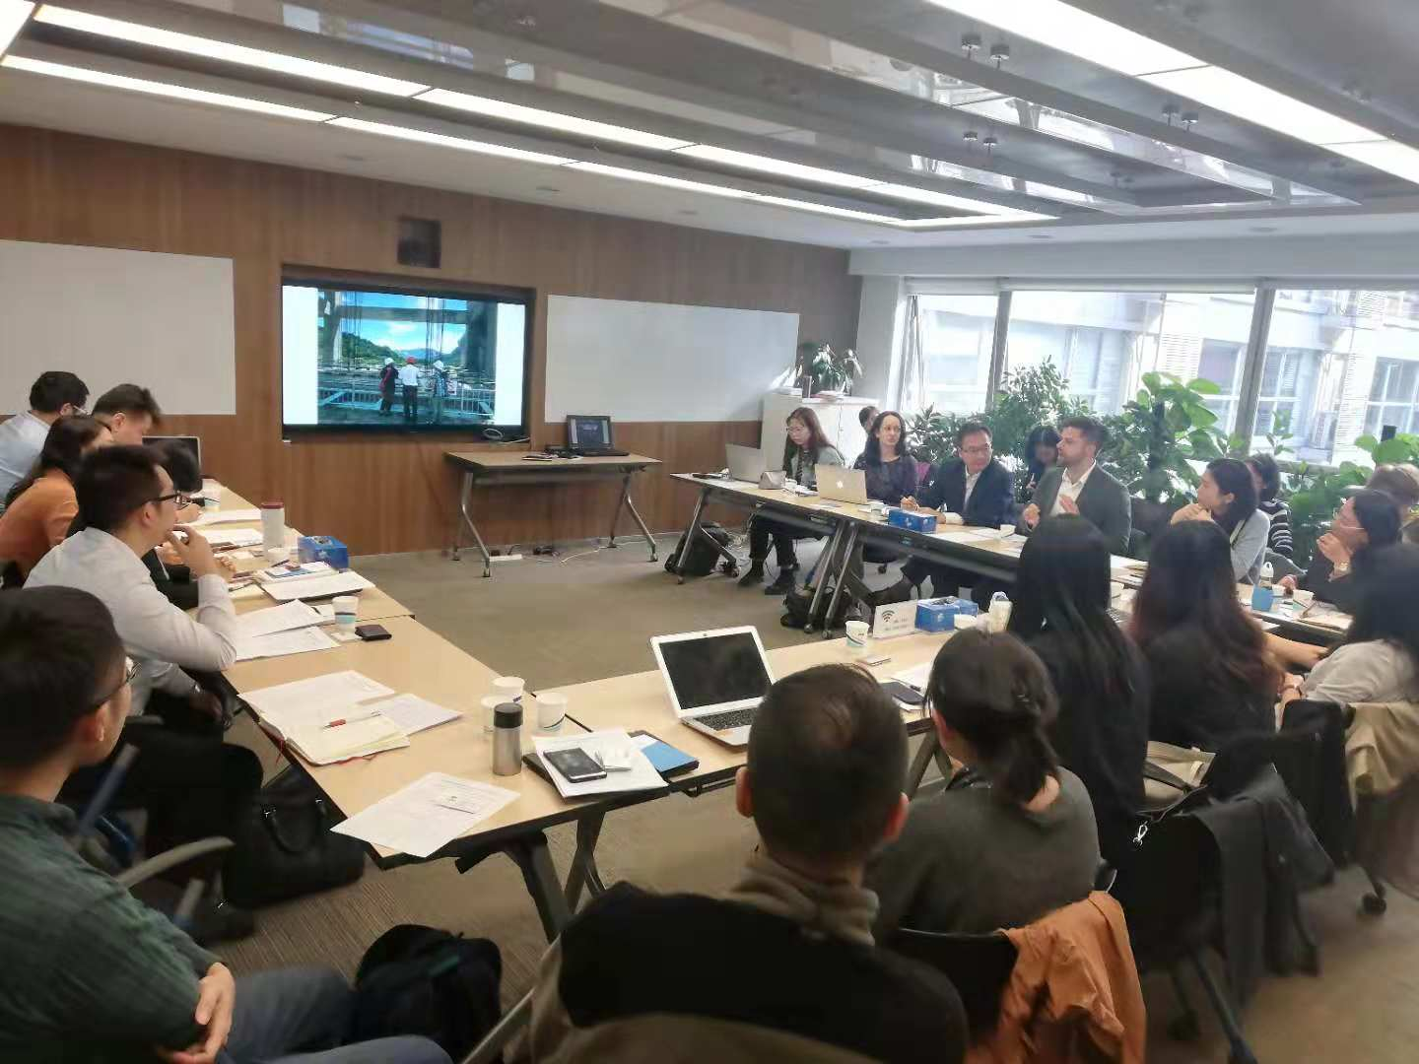
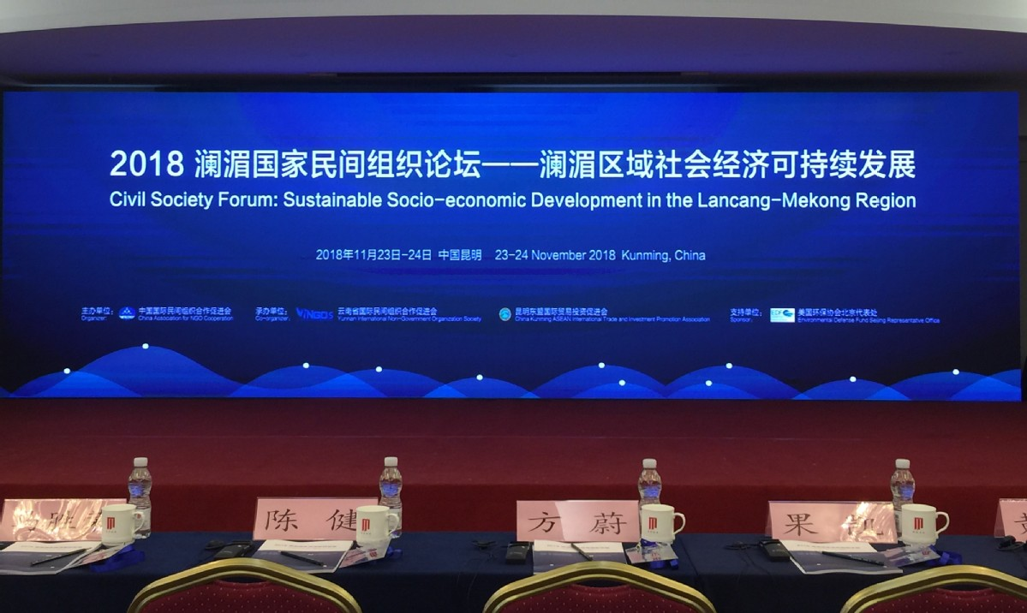
Looking ahead: RECIPROCITY in the LMCM
Whose knowledge counts?
Whose benefits matter?
INCLUSIVE
AND
ECOLOGICAL
RECIPROCITY
FIRST STEPS
‘State of knowledge’ survey of LMB
Build rules for identifying stakeholders, avoid fatigue/overload
Engage productively with MRC
Resolve question of ‘retrospective reciprocity’
November 2018 – CANGO Workshop in Kunming
July 2018 － IR／CANGO visit with Laotian community leaders

