Slide 1
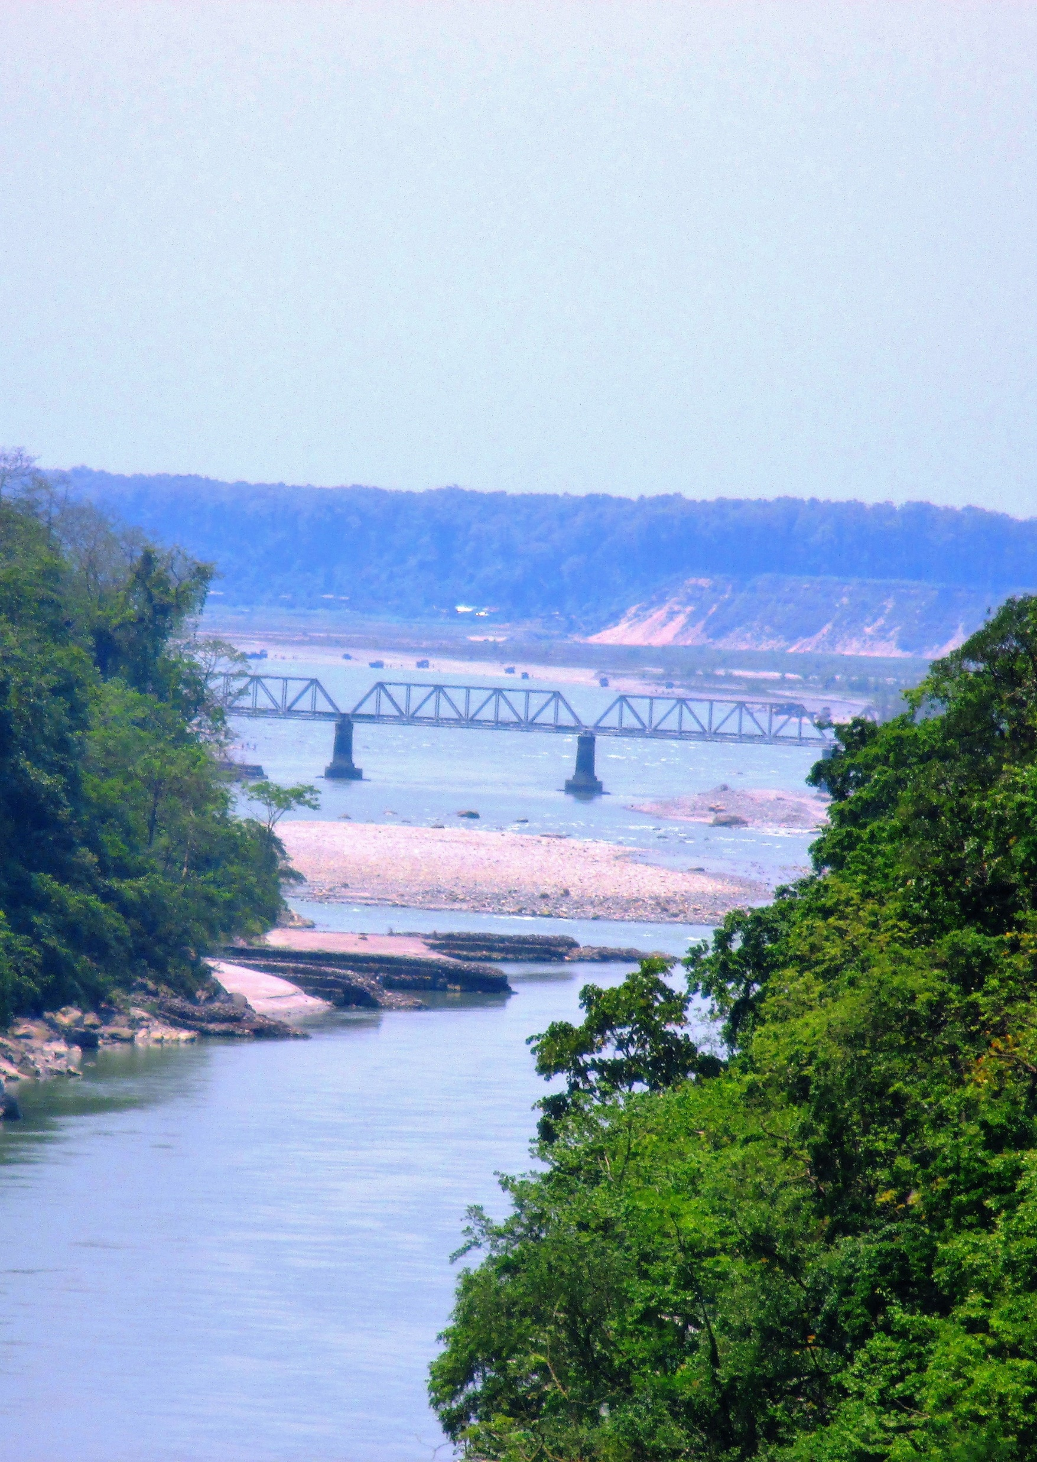
Transboundary Water Conflicts and Cooperation in South Asia
Gauri Noolkar-Oak

Slide 2
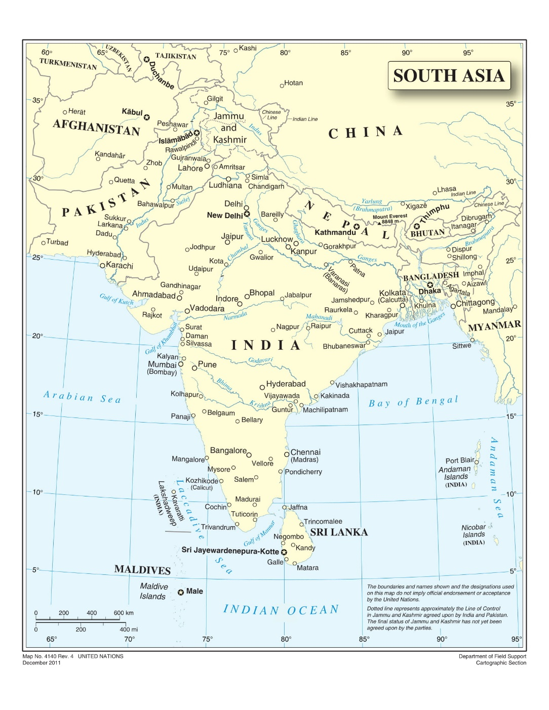
South Asia
Eight Nations: Afghanistan, Bangladesh, Bhutan, India, Maldives, Nepal, Pakistan, Sri Lanka
Area of 4.48 Million sq. kms
1.67 Billion people
Biggest Rivers of South Asia: Indus, Ganga, Brahmaputra
Originate in Himalayas
Cover 55% of South Asia

Slide 3
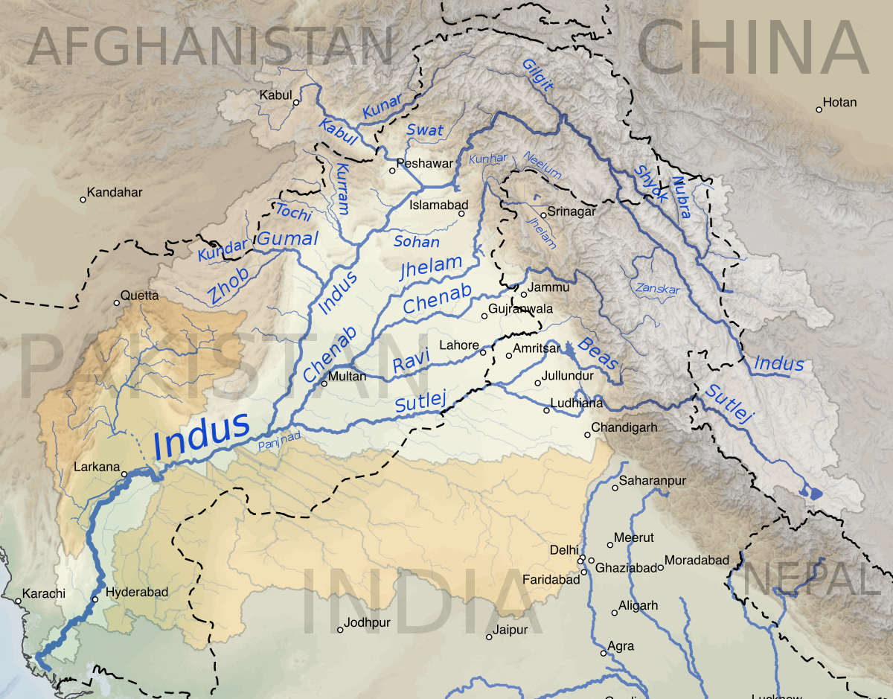
Indus River Basin
Four countries: China, Afghanistan, India, Pakistan
Area: 1.12 Million sq kms
300 Million+ people
Indus Valley Civilisation: Over 5000 years old
India gets its name from Indus River

Slide 4
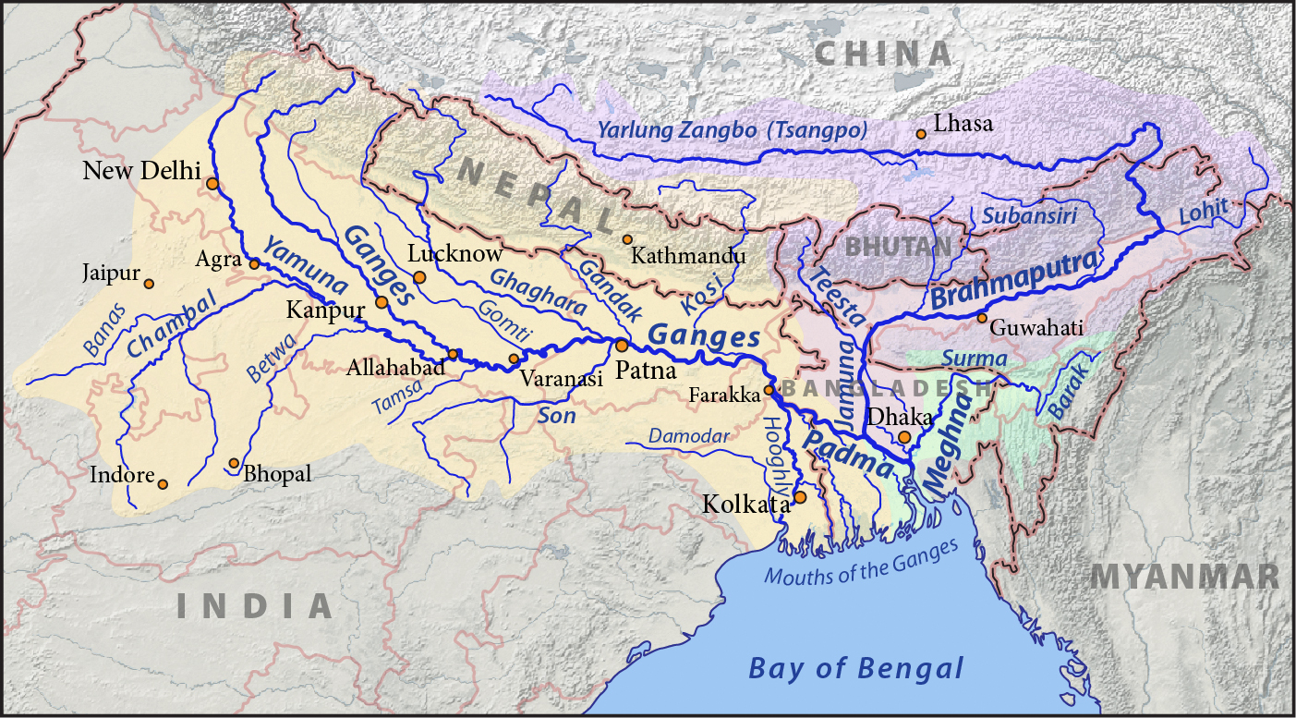
Ganga – Brahmaputra – Meghana (GBM) River Basin
Five countries: China, Bhutan, Nepal, India, Bangladesh
Area: 1.71 Million sq. kms
630 Million+ people

Slide 5
South Asia - Challenges
South Asia is experiencing growing populations, rapid industrialisation, consequent natural resource crunch and climate change effects.
It faces challenges such as poverty, environmental degradation, and border issues, but more importantly, lack of integration – according to World Bank, it is among the least integrated regions in the world.
There is mutual distrust among South Asian nations.
Constantly changing borders lead to political uncertainty, impact on socio-economic fabric of the region, and impact on commitment to resource development.

Slide 6
Overpopulation
Rapid Industrialisation
Resource Crunch
Climate Change
Poverty
Environmental degradation
Lack of Integration
Changing borders
Mutual Distrust
All of this reflects on transboundary water cooperation – limited focus, state-centric, excessive securitisation of transboundary waters data.
China is not a part of South Asia, but crucial for South Asia water security, because of its upper riparian status.

Slide 7
South Asian Transboundary Water Conflicts
India – Pakistan: Indus river tributaries
India – Bangladesh: Ganga river, Teesta river
India – Nepal: Mahakali river, Kosi river
India – China: Brahmaputra river
Afghanistan – Pakistan: Kabul river
Domestic conflicts on rivers and groundwater in all countries – impact on transboundary conflicts and cooperation.

Slide 8
South Asian Transboundary Water Conflicts (contd.)
Are these really conflicts? Or are they disputes?
Conflict: “long-term with deeply rooted issues that are seen as ‘non-negotiable’”.
Dispute: “short-term disagreement that can result in the disputants reaching some sort of resolution”.
South Asian nations have reached some sort of agreement on almost all major transboundary rivers.
They have abided by the agreements even during political instability and times of hostilities - most famous example of Indus Water Treaty which has survived three Indo-Pak wars.
Dialogue on transboundary water is state-centric, techno-centric and limited, but it exists.
Hence, South Asian water “conflicts” are more like “disputes”.

Slide 9
South Asian Transboundary Water Agreements
India – Pakistan: Indus Water Treaty (1960)
India – Bangladesh: Ganga Water Sharing Treaty (1996)
India – Nepal: Kosi Agreement (1954, amended 1966), Gandak Agreement (1959, amended 1964), Mahakali Treaty (1996).
India – Bhutan: hydropower projects agreements, Agreement on Cooperation in Hydropower (2006), Inter-Governmental Agreement (JV Model) (2014).
India – China: MoU for sharing hydrological data on Brahmaputra and Sutlej rivers during flood season (2003, 2005, 2013, 2014, 2018), MoU for sharing conservation and clean water technologies (2011).
Nepal – India – Bangladesh and Bhutan – India – Bangladesh: waterways development.
China – Bangladesh and China – Nepal: Hydrological data sharing agreements.

Slide 10
South Asia and UN Convention on the Law of the Non-Navigational Uses of International Watercourses (UNWC) 1997
UNWC was built on the Helsinki Rules of 1966.
It was drafted and adopted by UN in 1997.
It came in force in 2014 after Vietnam was the 35th country to ratify it.
UNWC 1997 and South Asia –
Afghanistan, Bhutan, Sri Lanka were Absent.
Maldives, Nepal and Bangladesh voted in Favour, but did not Ratify.
India, Pakistan Abstained.
China, the upstream riparian to major South Asian rivers, voted Against the UNWC.

Slide 11
UNWC 1997 – India’s Stand
India objected to UNWC 1997 and abstained because of the following:
Article 3: issues of ‘freedom’, autonomy… right to conclude agreements without constraints of UNWC 1997.
Article 5: “equitable and reasonable utilization and participation” – vague, ambiguous, difficult to implement.
Article 32: on non-discrimination – difficult to implement as it “presupposes political and economic integration among States of the region” which is not the case with South Asian nations.
Article 33: disputing parties should be able to choose freely and with mutual consent the procedures of solving their disputes.
However, Mahakali Treaty (India-Nepal) and Ganga Treaty (India-Bangladesh contain many principles from the UNWC 1997 (e.g. equitable and reasonable utilization; obligation not to cause significant harm; limited territorial sovereignty; cooperation, consultation and notification; information exchange).

Slide 12
Limited largely to water allocation, hydropower and irrigation. Does not include groundwater, socio-economic development, navigation, tourism, heritage conservation, environmental flows, disaster mitigation and climate change resilience.
State-centric, not inclusive of all stakeholders. Near absence of track II or multitrack water diplomacy.
Technical, with less focus on socio-economic aspects, cultural values, biodiversity and environment.
Divisive. Focus on dividing river courses and river water for development and use, not on joint management.
Weakly implemented. Huge cost and time overruns for projects, regulatory authorities not strong or influential, spirit of comprehensive cooperation not visible.
Easily affected and even stalled by domestic water politics.
South Asian Transboundary Water Cooperation (TWC)

Slide 13
Growing awareness about water issues across civil societies in South Asia.
Growing importance of water cooperation in policy and political circles – renewed focus on agreements (e.g. Teesta), building inland waterways, cooperation on combating climate change (Thimphu Statement on Climate Change).
Greater emphasis on and celebration of shared cultural and historical values of rivers in South Asian communities.
Wider media coverage to transboundary water issues.
Growing academic and policy research on transboundary water issues.
And there are also some positives…

Slide 14
Geographically, India lies at the heart of South Asia.
It is the largest country in the region, not only in terms of territory and population, but also in terms of economy, military, technology and global political power.
Its geographical location makes it the middle riparian in both Indus and GBM river basins. It is downstream to Nepal, Bhutan and China, and upstream to Pakistan and Bangladesh.
This is a unique position which requires India to have a unique transboundary water policy which is –
Flexible
Optimising the status of upstream riparian
Securing rights as downstream riparian
It is not in India’s interests, and hence also not its intent, to be ‘hydro hegemon’.
The Unique Position of India

Slide 15
Rivers are Beautiful;
Don’t just Study them,
Explore and Enjoy them!

Slide 16
BRAHMAPUTRA (BANGLADESH)

Slide 17
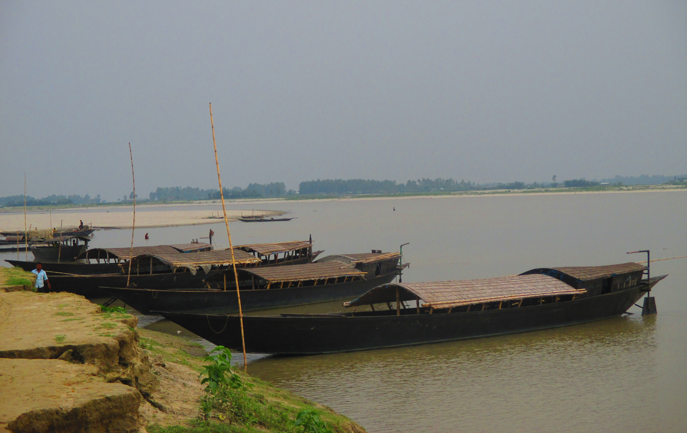

Slide 18
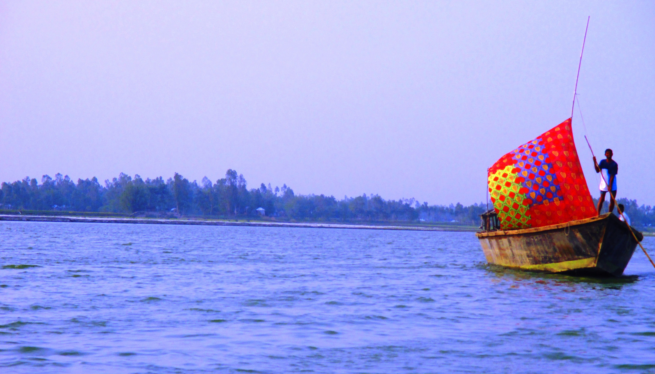

Slide 19
TEESTA (BANGLADESH, INDIA)

Slide 20
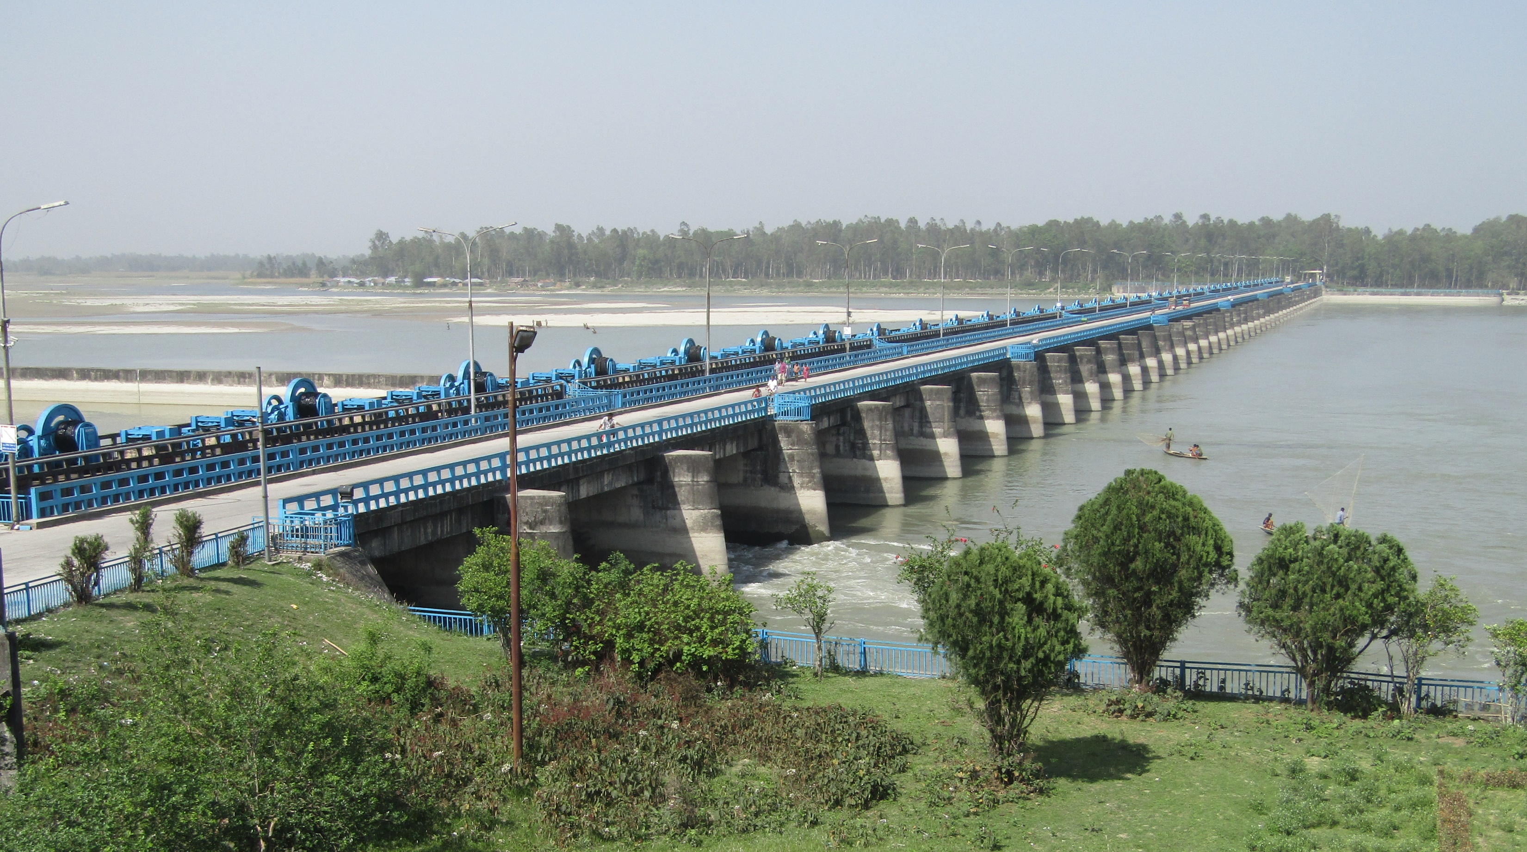

Slide 21
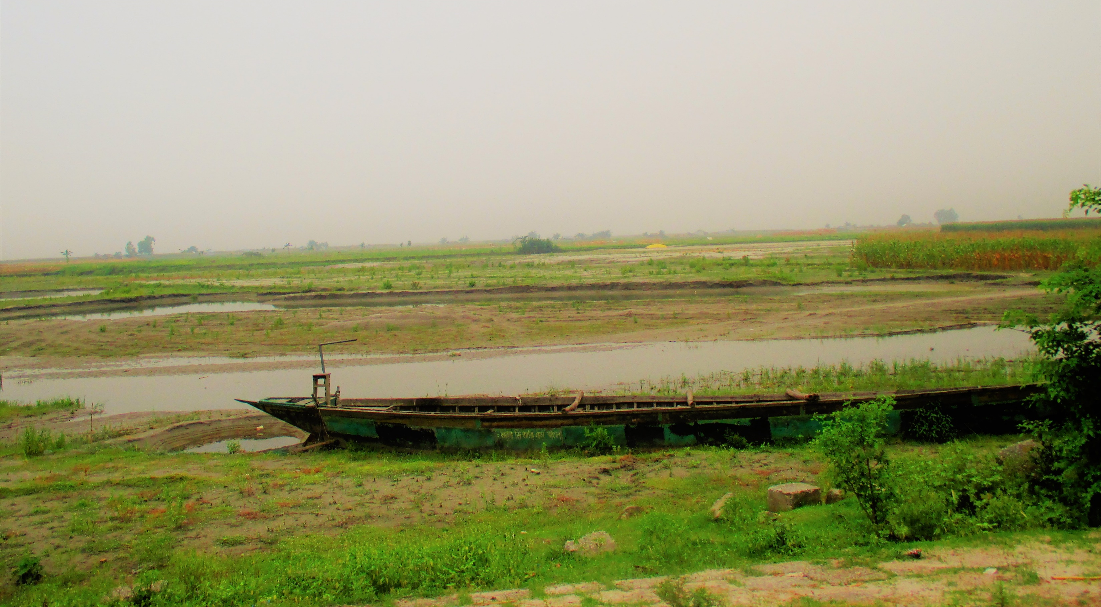

Slide 22
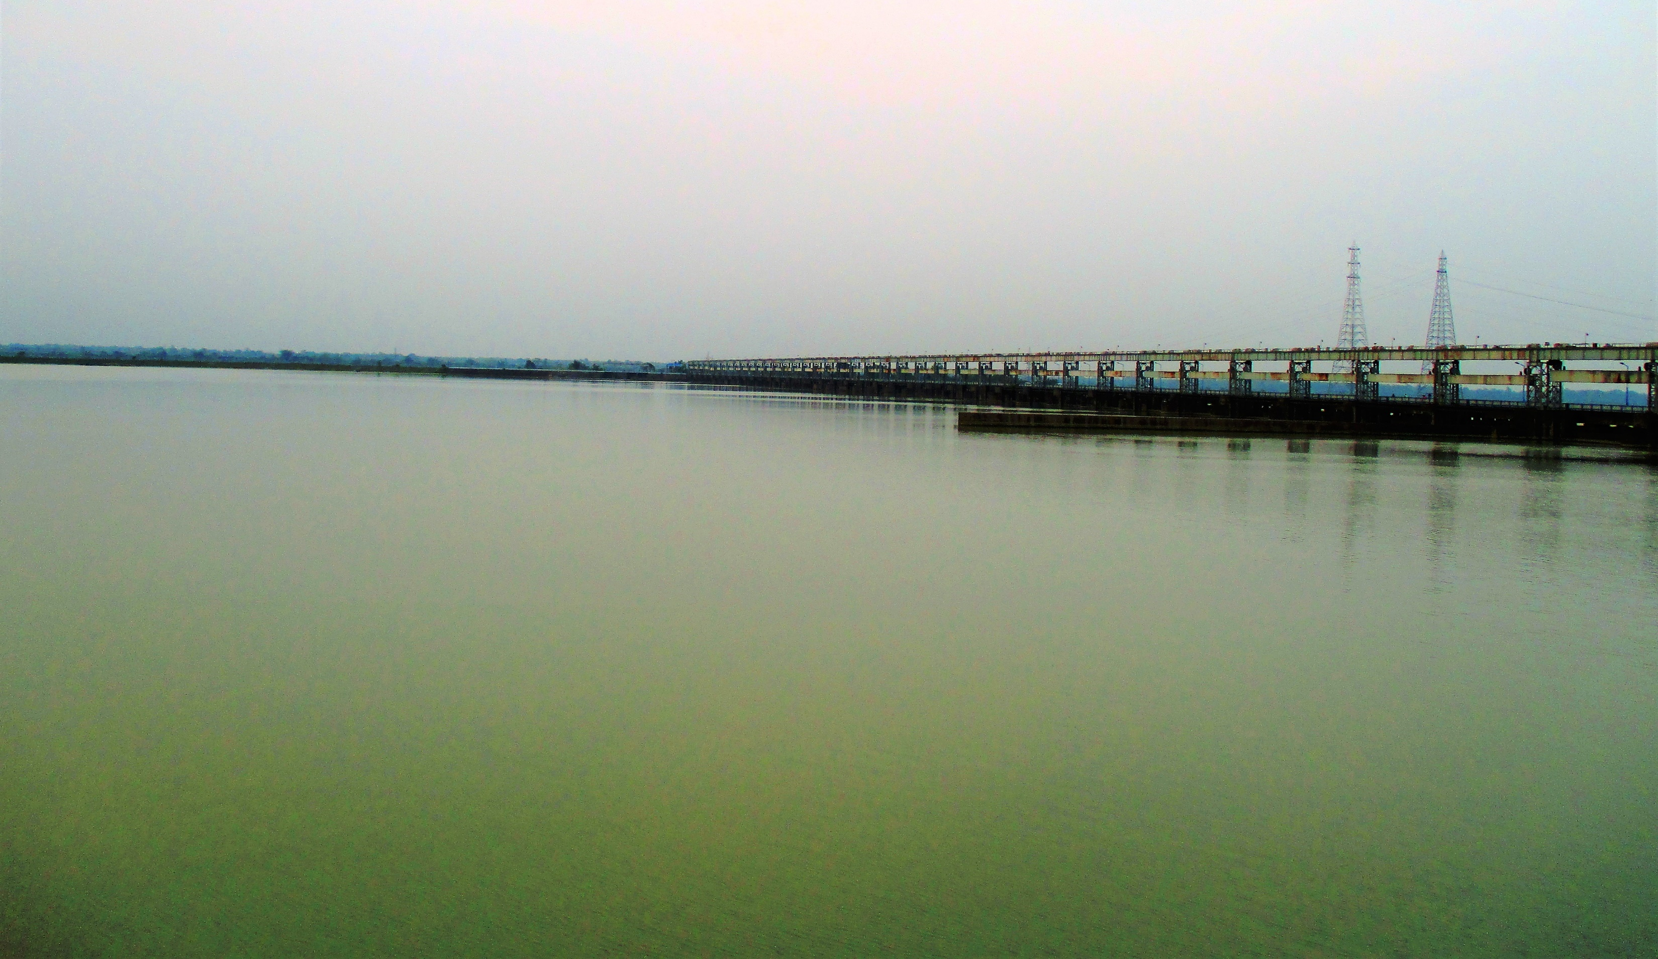

Slide 23
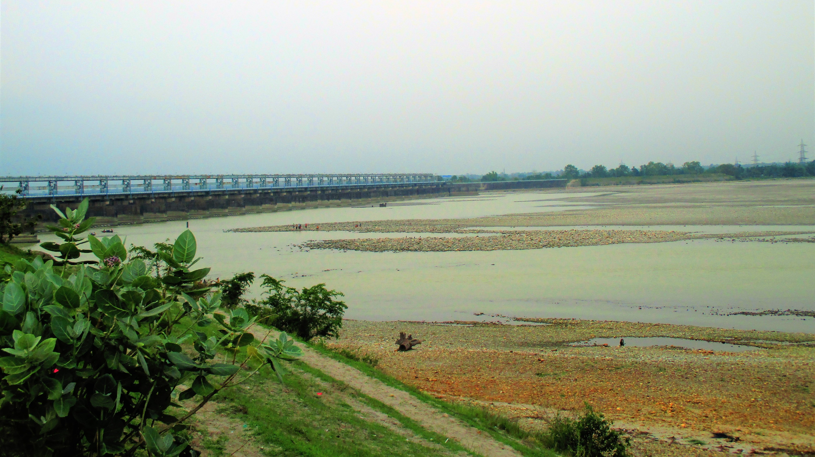

Slide 24
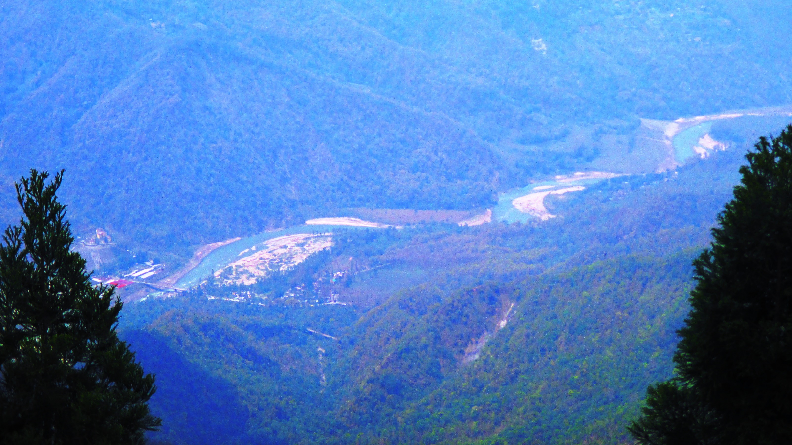

Slide 25
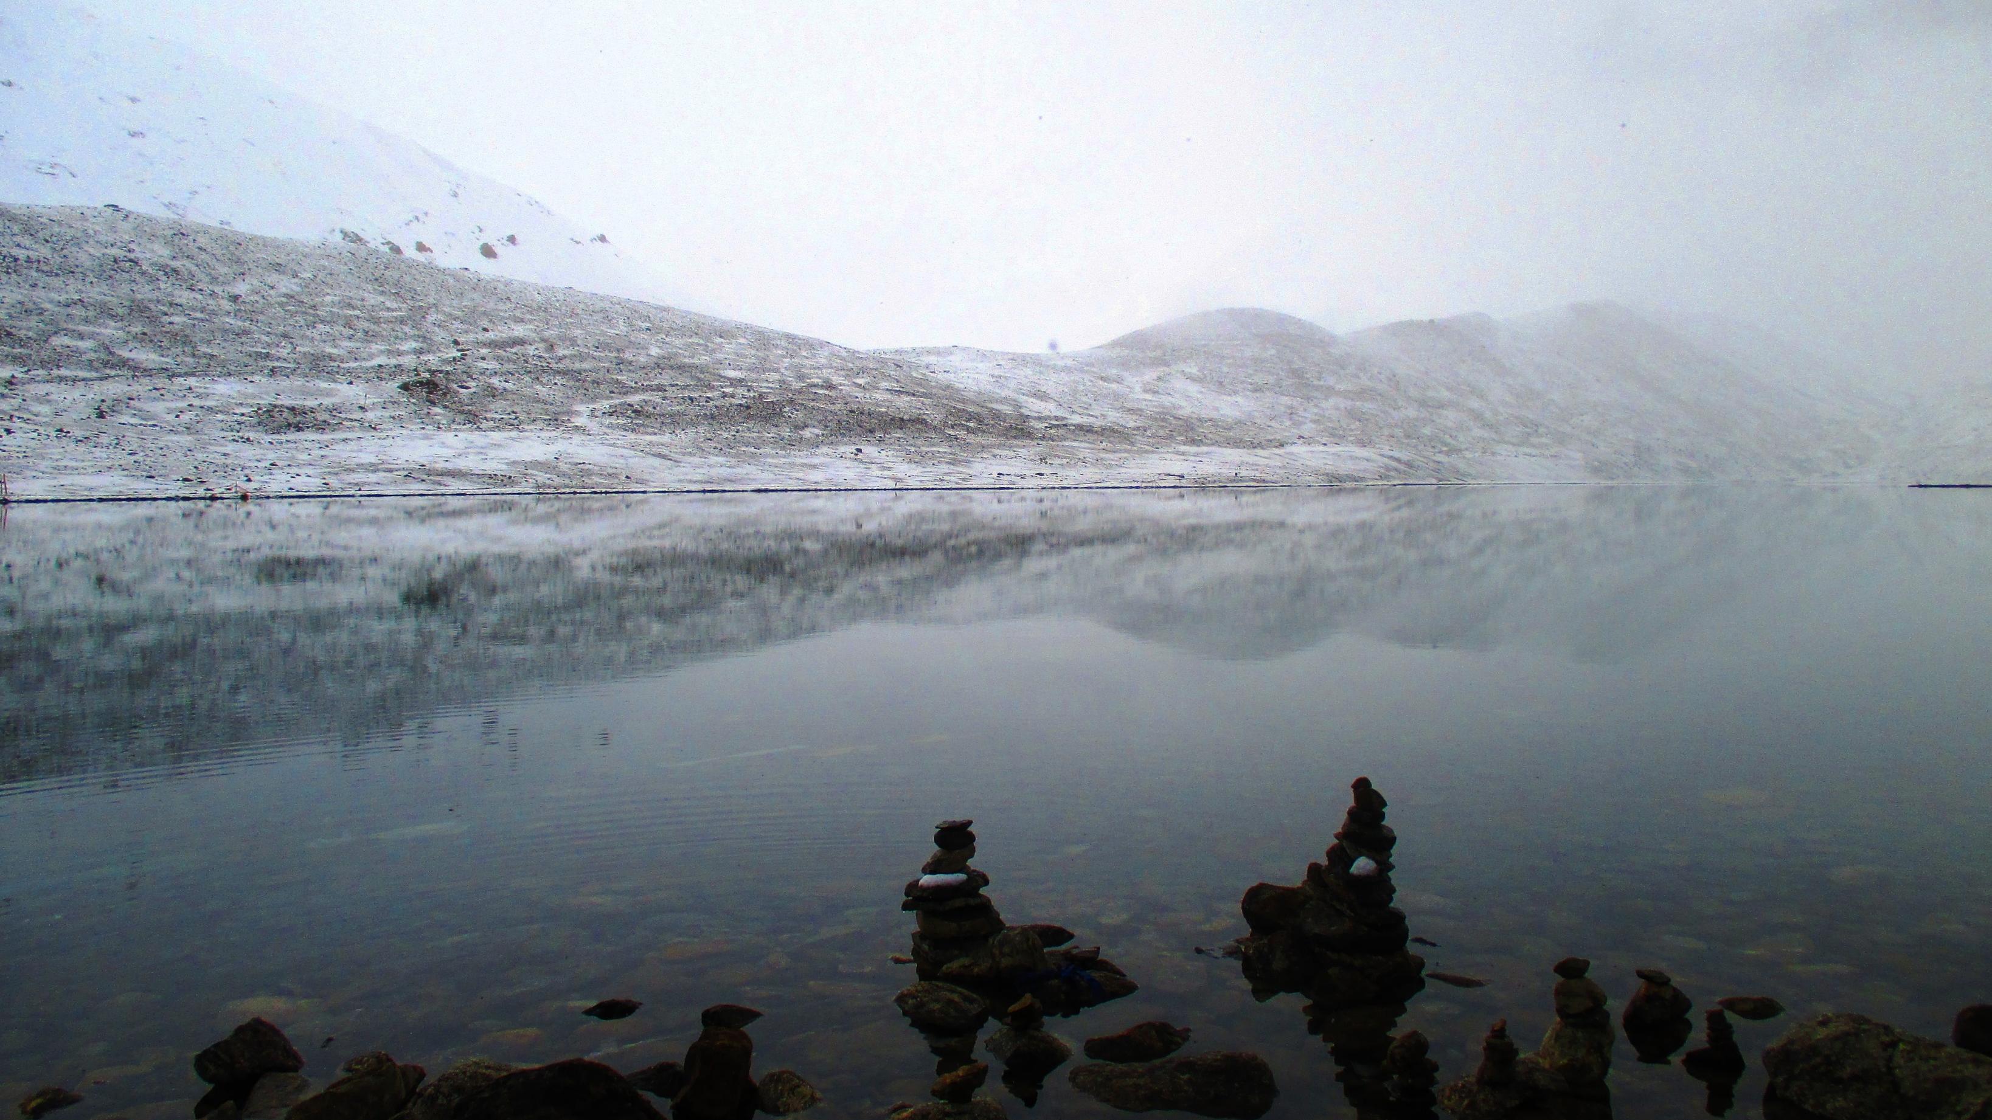

Slide 26
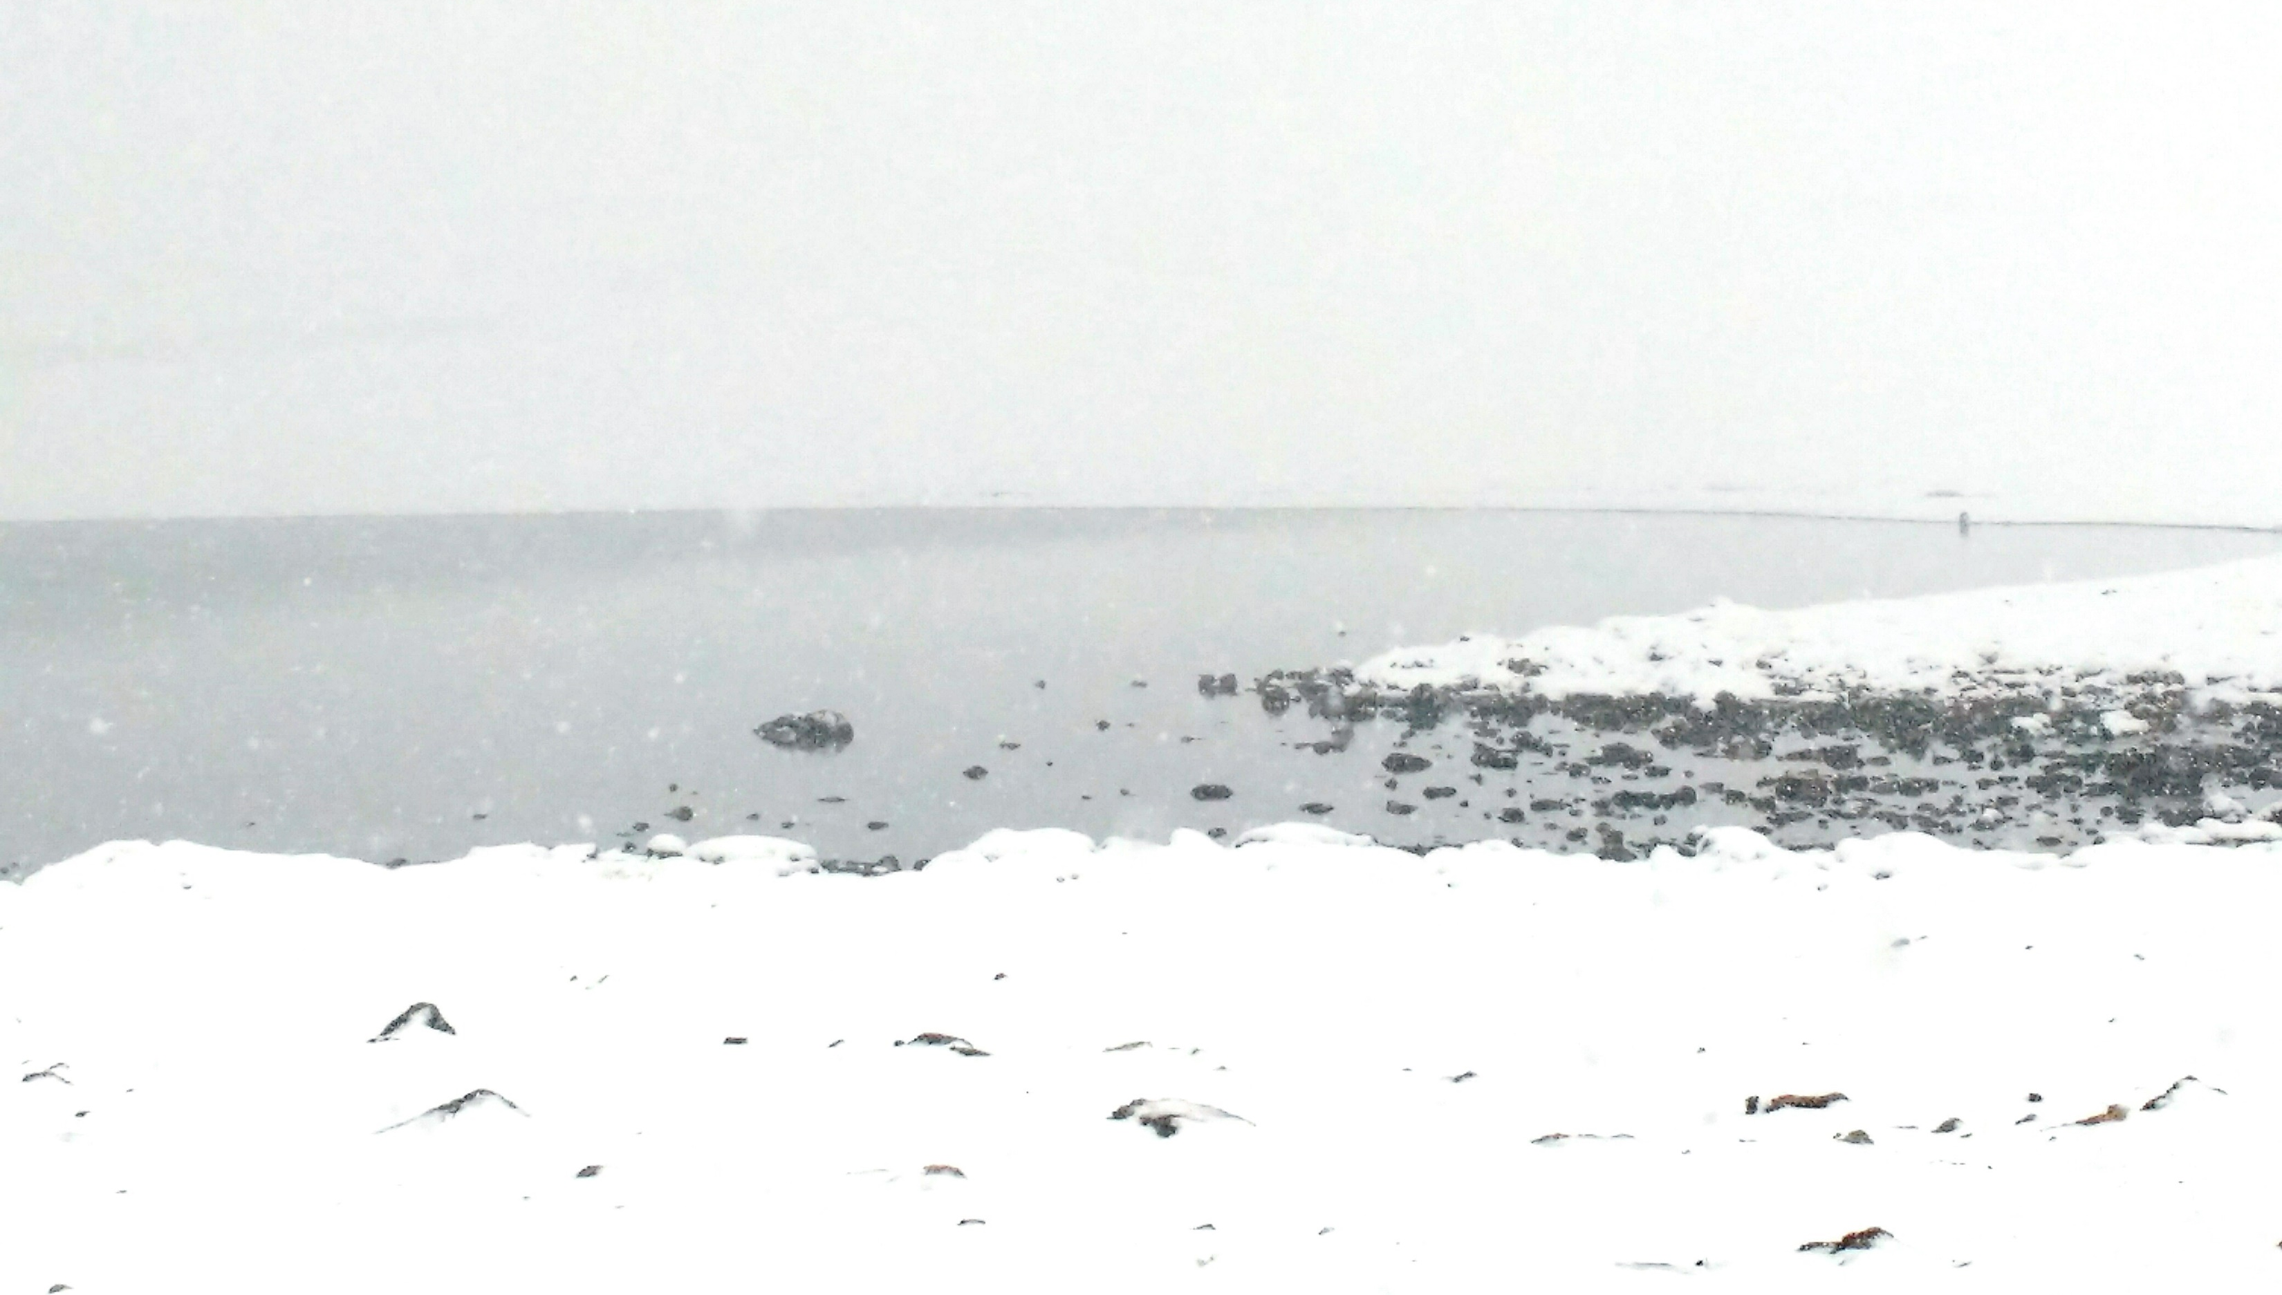

Slide 27
HIRANYAKESHI (PENINSULAR INDIA)

Slide 28
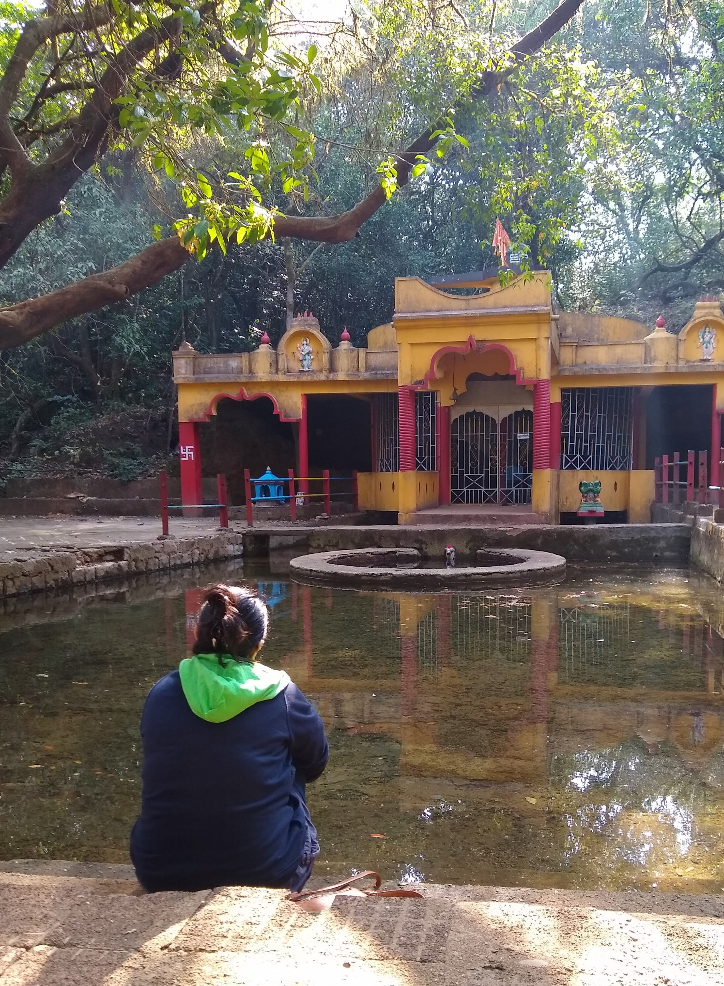

Slide 29
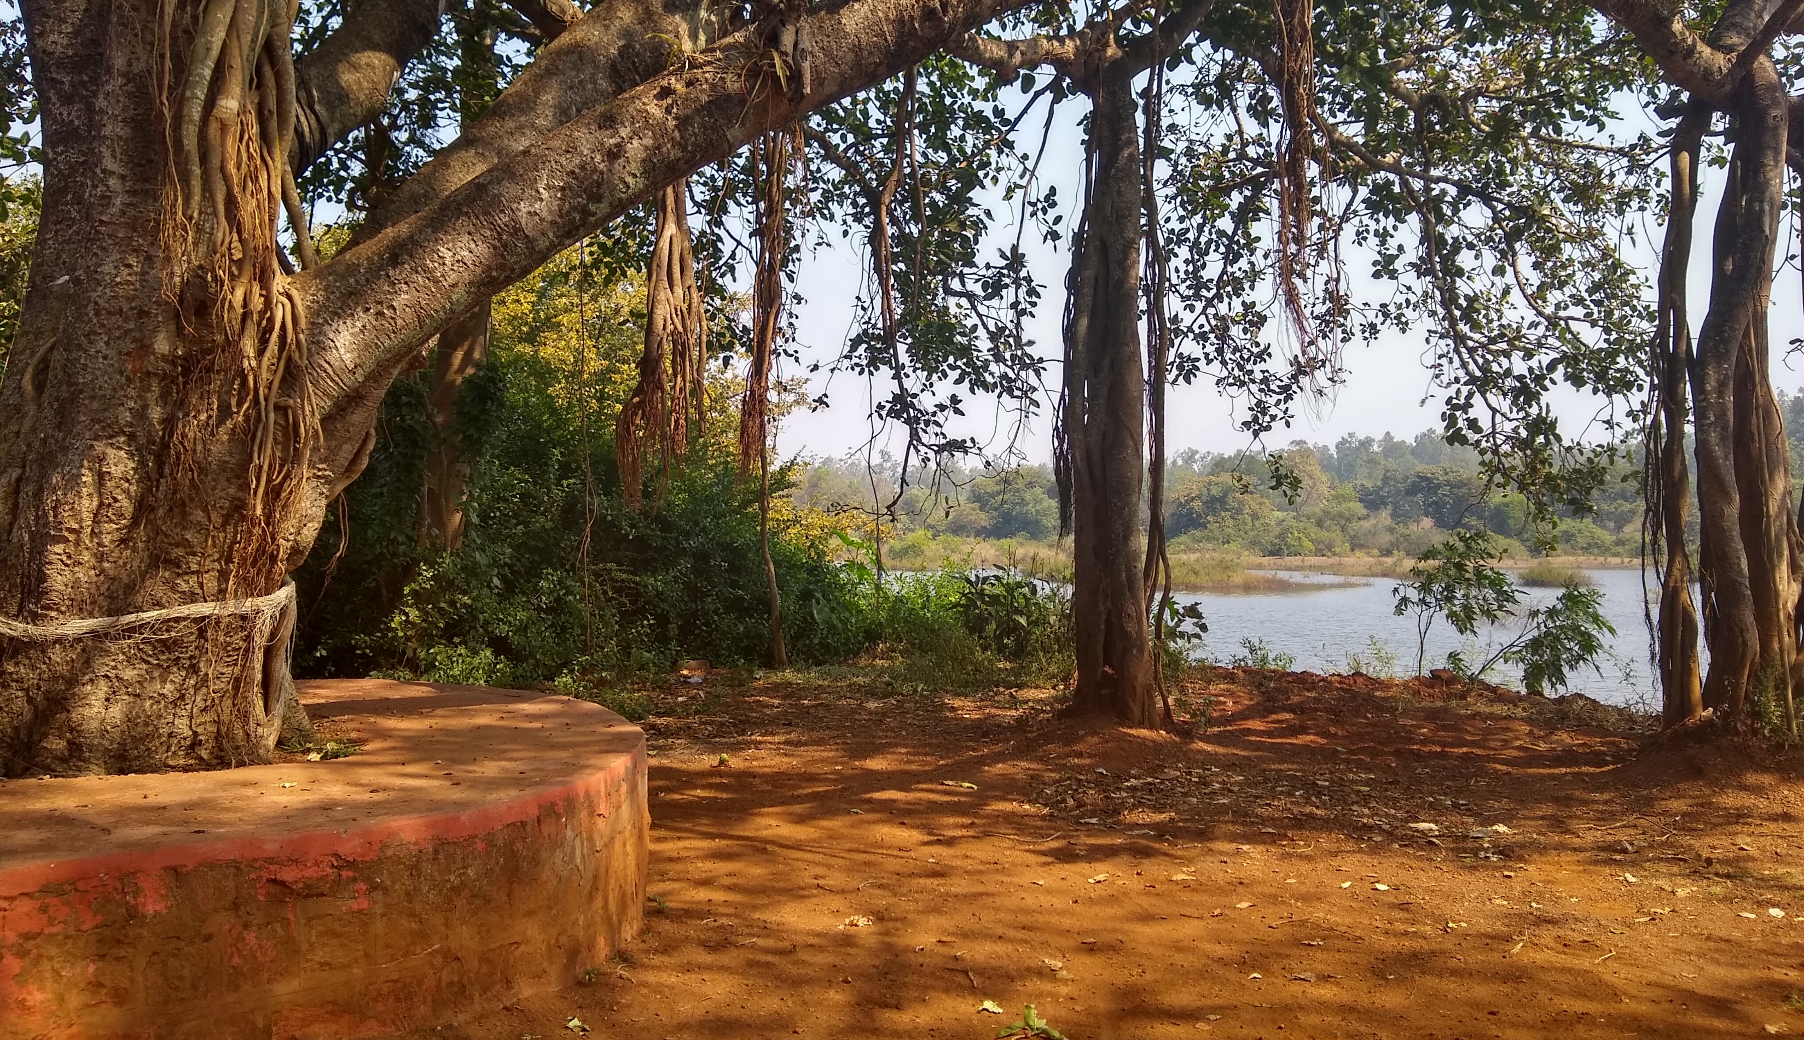

Slide 30
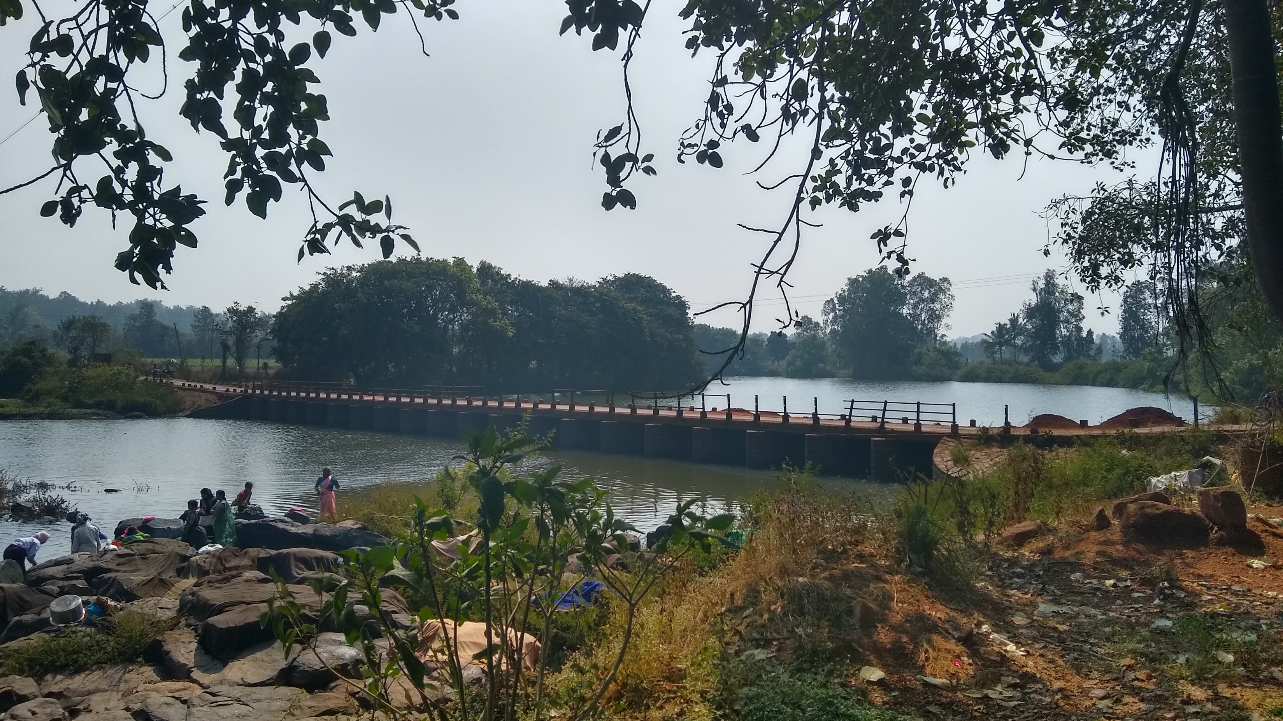

Slide 31
GANGA (INDIA)

Slide 33
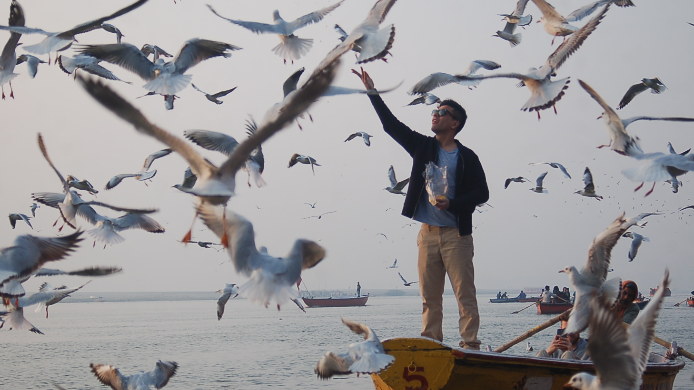

Slide 34
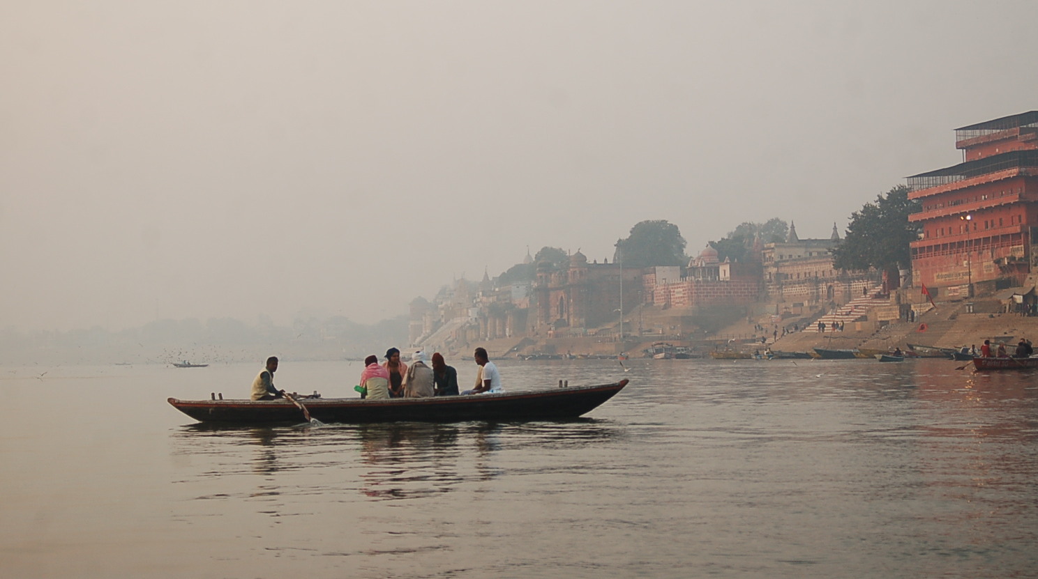

Slide 35
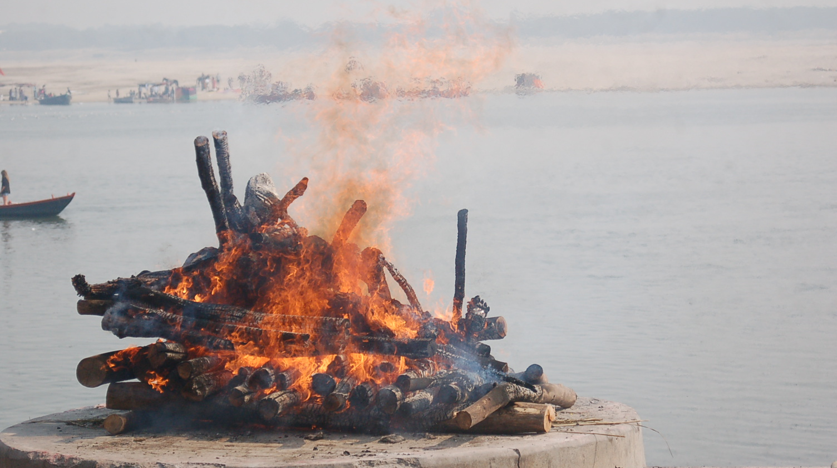

Slide 36
INDUS (INDIA)

Slide 37
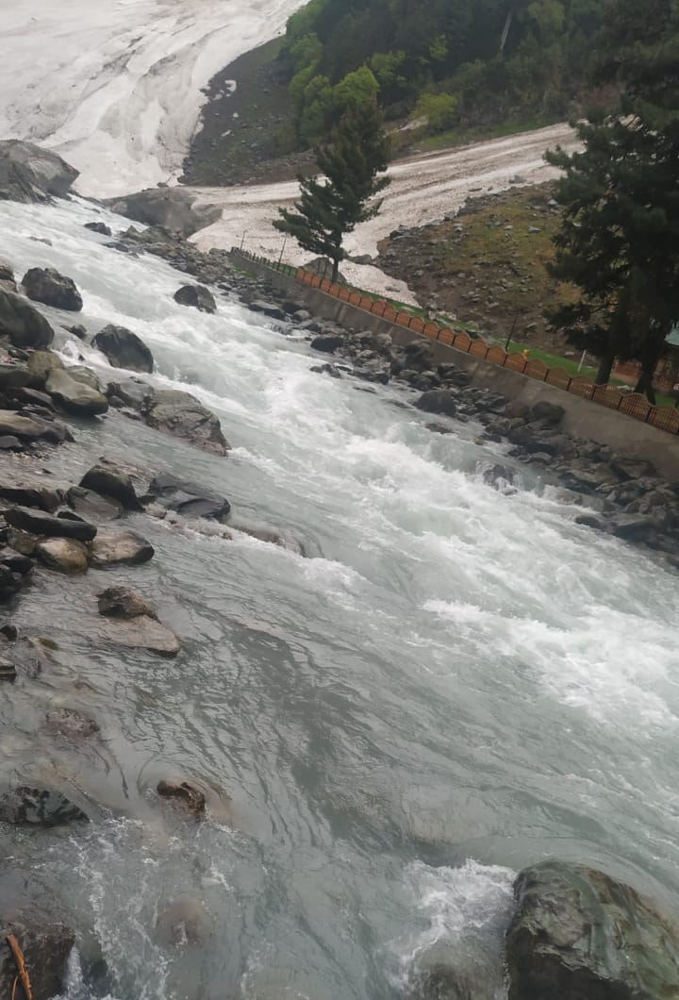

Slide 38
Thank You!
www.gaurinoolkar.wordpress.com
@curiousriparian
https://www.linkedin.com/in/gaurinoolkar/
www.thetilakchronicle.com

Slide 39
Sources
“UN Watercourses Convention is good for South Asia”. https://www.thethirdpole.net/en/2014/08/18/un-watercourses-convention-is-good-for-south-asia/
United Nations Treaty Collection https://treaties.un.org/Pages/ViewDetails.aspx?src=TREATY&mtdsg_no=XXVII-12&chapter=27&lang=en
UN Watercourses Convention – Online Users’ Guide https://www.unwatercoursesconvention.org/
“Engaging with the Global: Prospects for the 1997 UN Watercourse Convention being adopted in the Ganga region.” https://asiafoundation.org/resources/pdfs/ORFIssuebrief64ShawahiqSiddiquiformail.pdf
Indus and GBM River Basin Maps: Wikimedia Commons
Indus River Basin Statistics: Aquastat, FAO, UN
South Asia Map: United Nations
South Asia Statistics: World Bank, Aquastat, “Freshwater Under Threat – South Asia. https://www.preventionweb.net/files/7989_southasiareport1.pdf
Definition of ‘conflict’ and ‘dispute’: Burton, John (1990) Conflict: Resolution and Prevention.

