Slide 1

Financial Regulations: the principles for 2018 CfP DEAR projects
Markus Pirchner, DEVCO B1 DEAR Sector
24th September 2020

Slide 2
Overview
PRAG Practical Guide -
concrete procedures to be used by
  the EU
  ‘implementers’
The Guidelines for the 2018 CfP –
information about
  duration
  eligibility
  which PRAG is applicable (version 2018.0)
Contract –
  Specific Conditions (who, what, how much, when)
  A I: ToR
  A II: General Conditions
  A III: Budget
  A IV: procurement

Slide 3
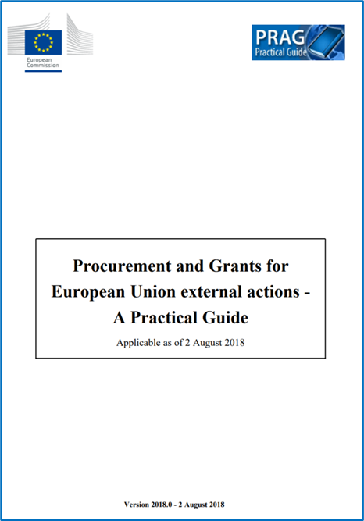
PRAG
Only
Section 1 Introduction
Section 2 Basic Rules and
Section 6 Grants
apply.

Slide 4
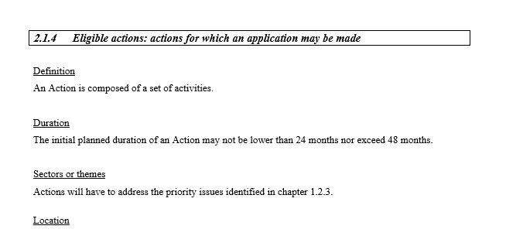
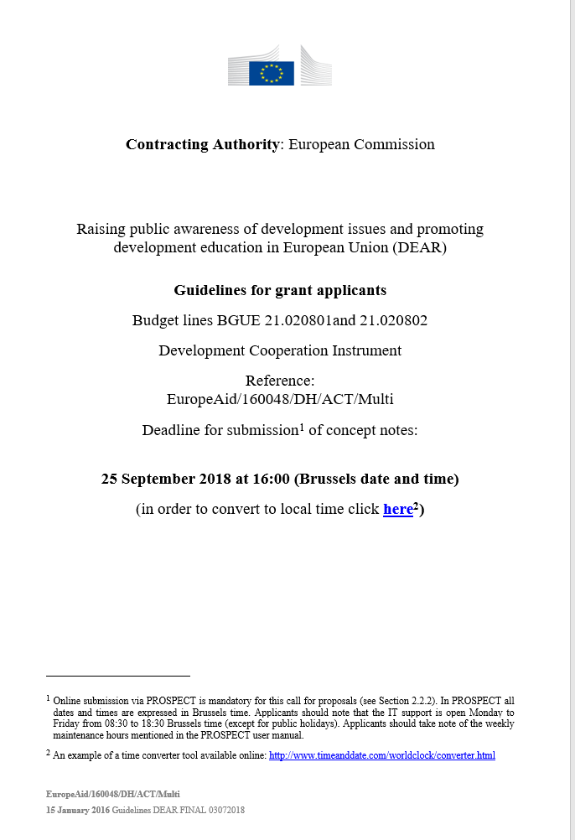
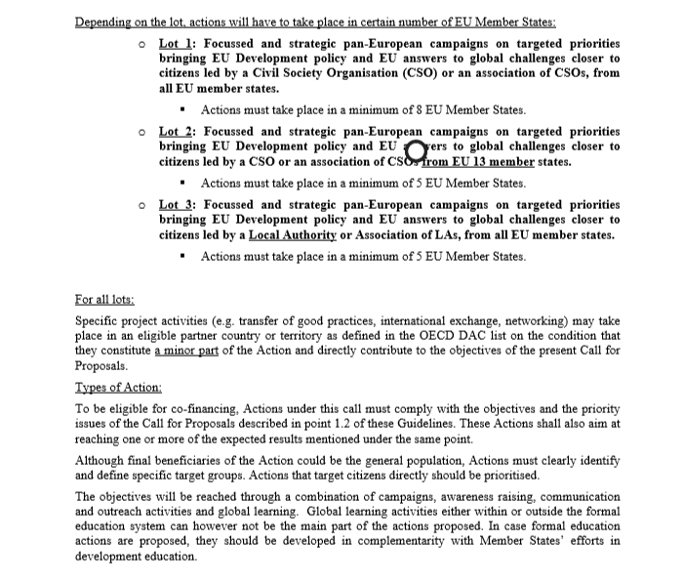
Guidelines for the CfP

Slide 5
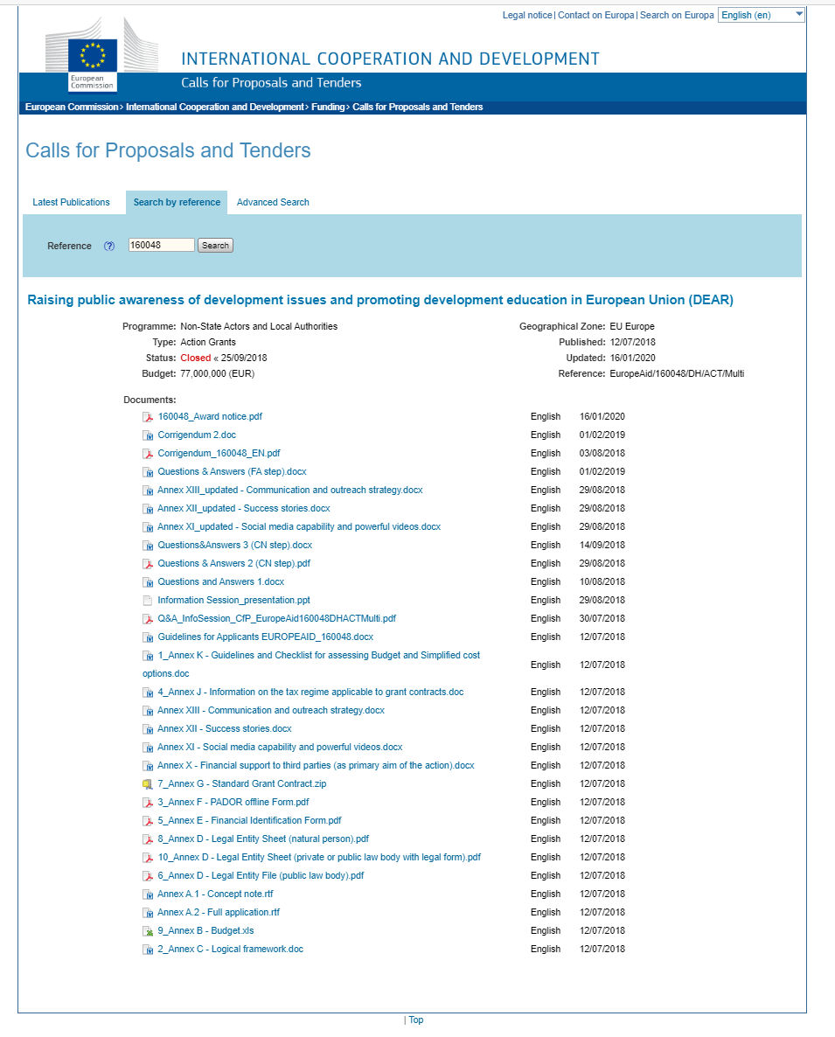
Guidelines to the CfP (II): relevant documents see: https://webgate.ec.europa.eu/europeaid/online-services/index.cfm?do=publi.welcome&orderby=upd&orderbyad=Desc&searchtype=RS&apply=N&aofr=160048&userlanguage=en

Slide 6
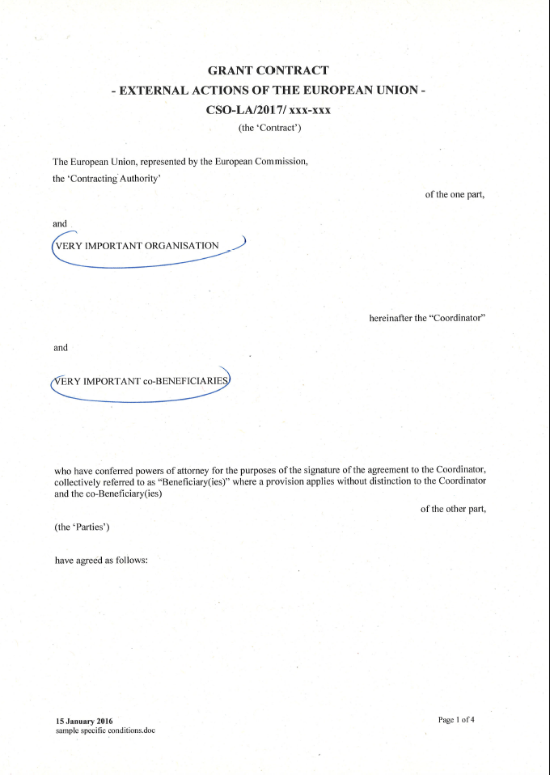
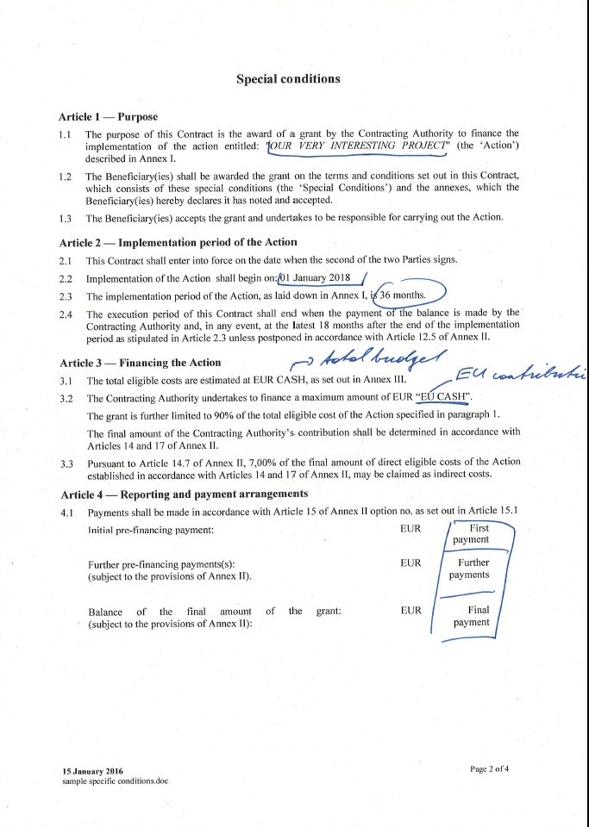
Contract specific conditions (I)

Slide 7
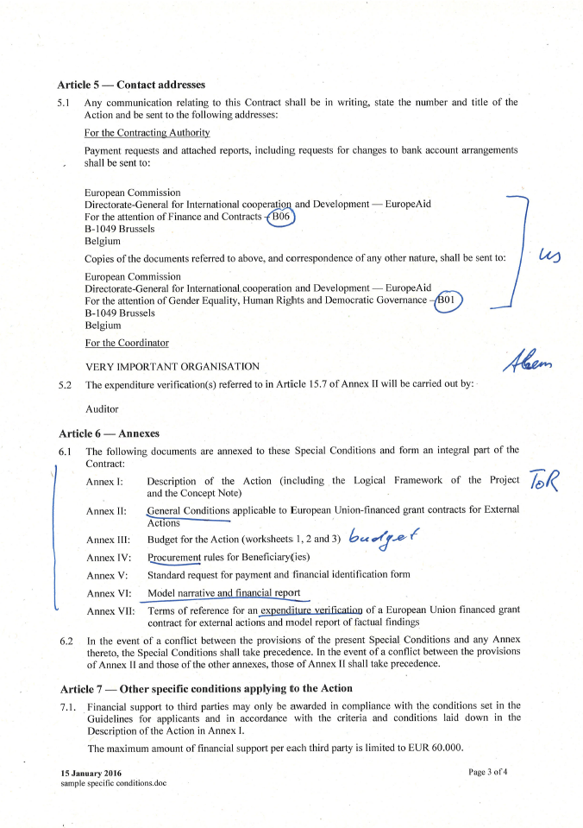
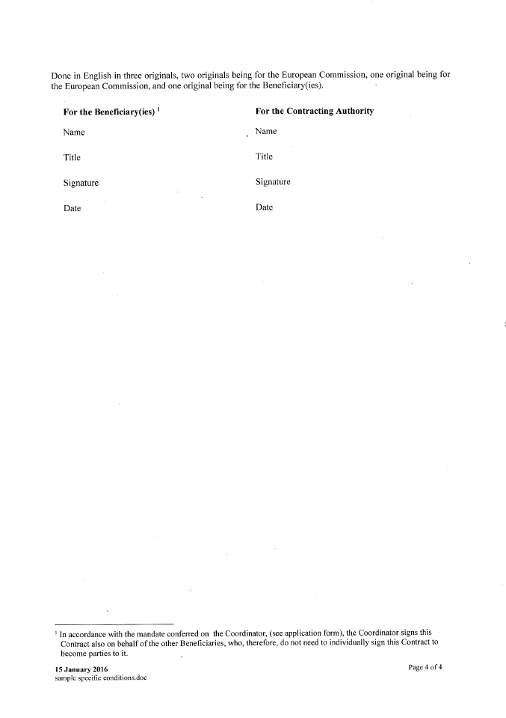
Contract specific conditions (II)

Slide 8
General conditions (I)

Slide 9
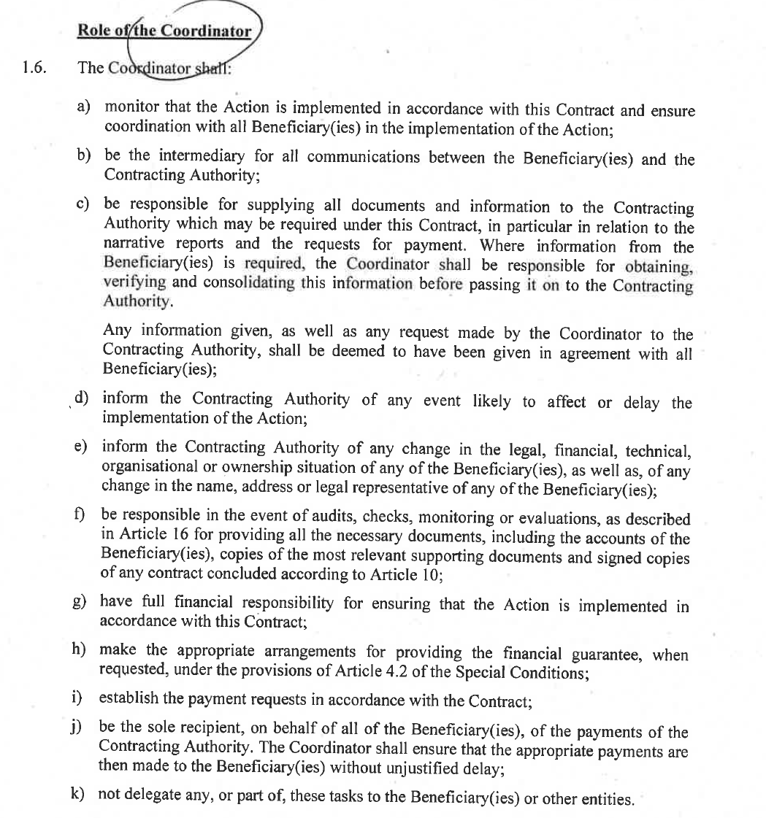
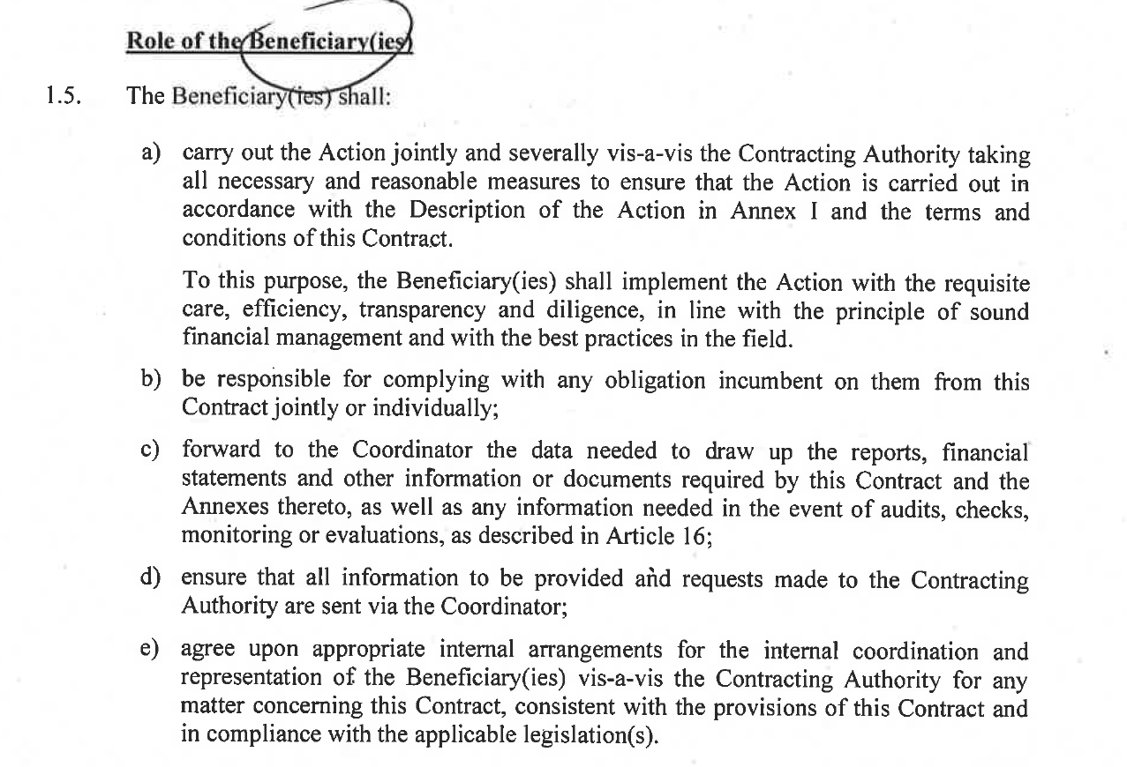
General conditions (II)

Slide 10
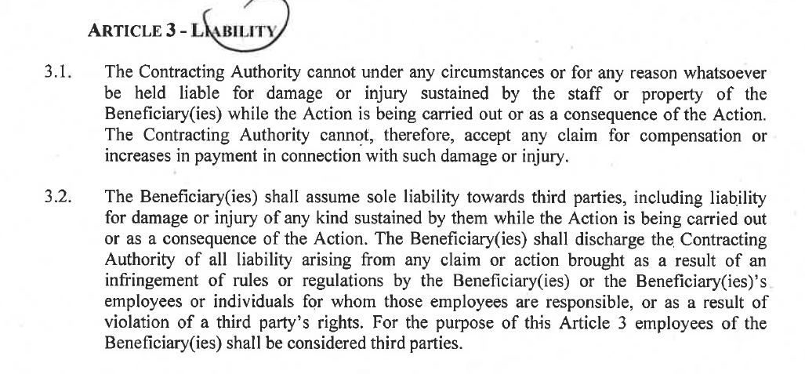
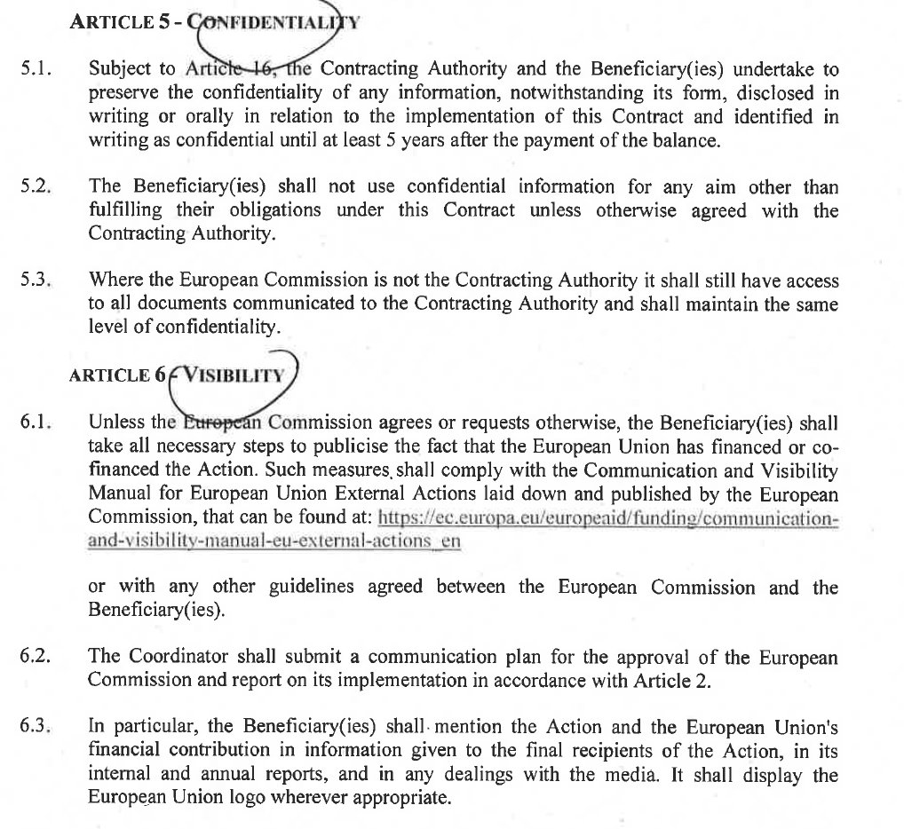
General conditions (III)

Slide 11
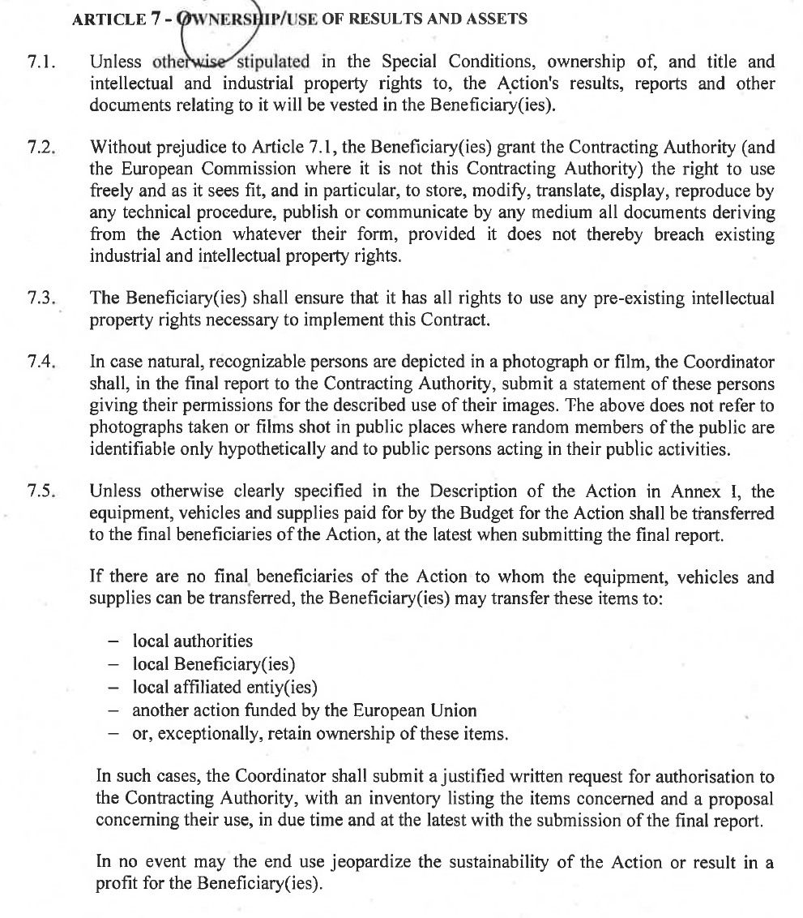
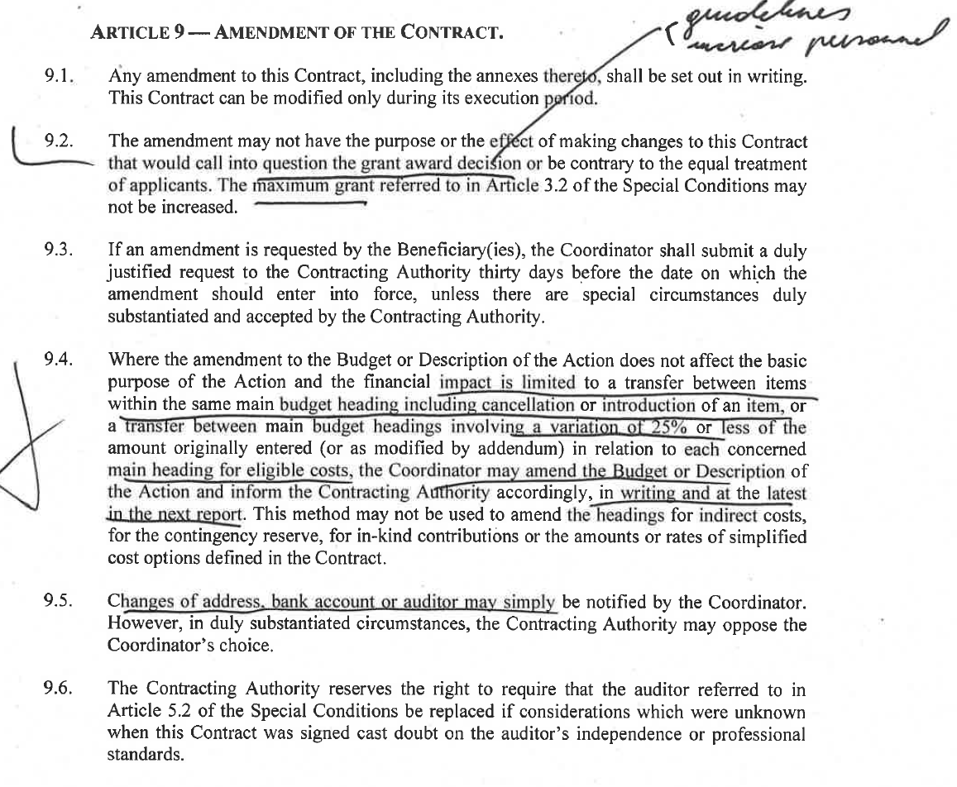
General conditions (III)

Slide 12
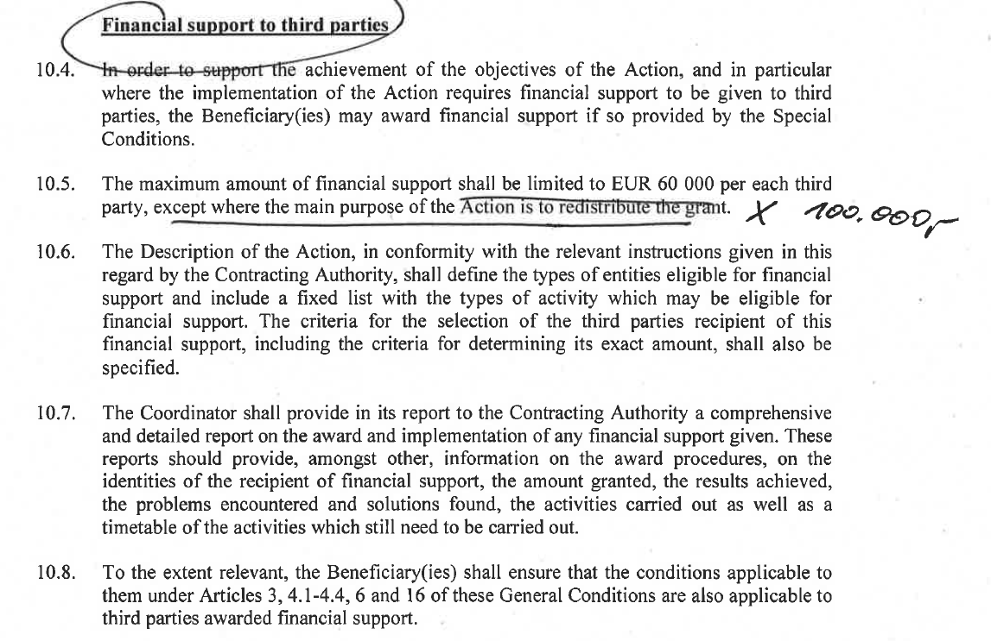
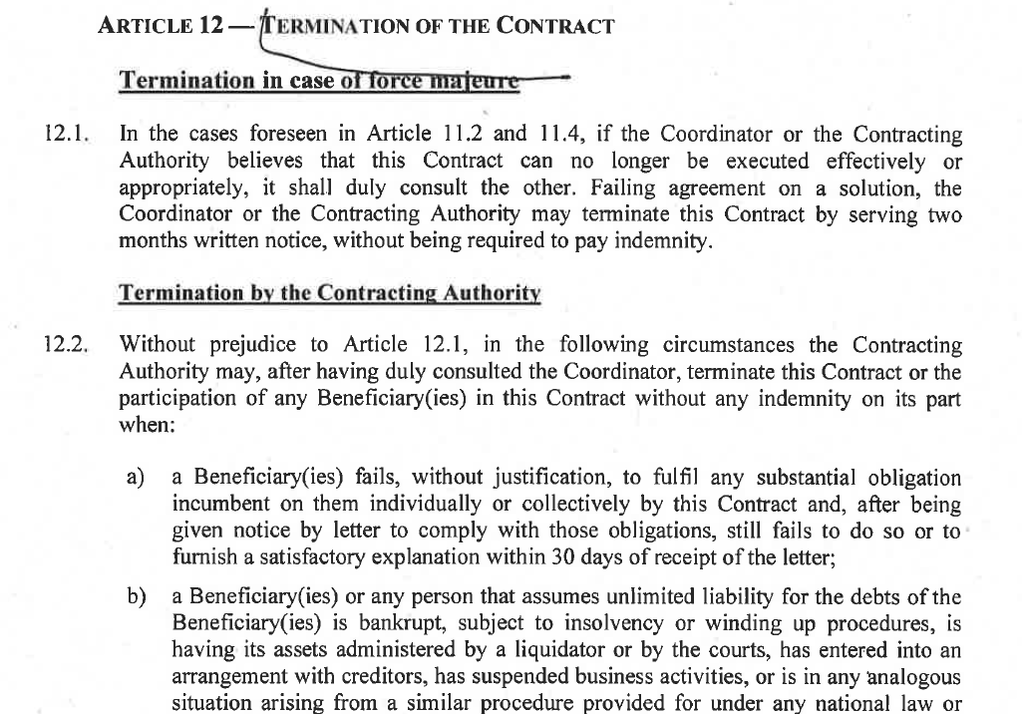
General conditions (IV)

Slide 13
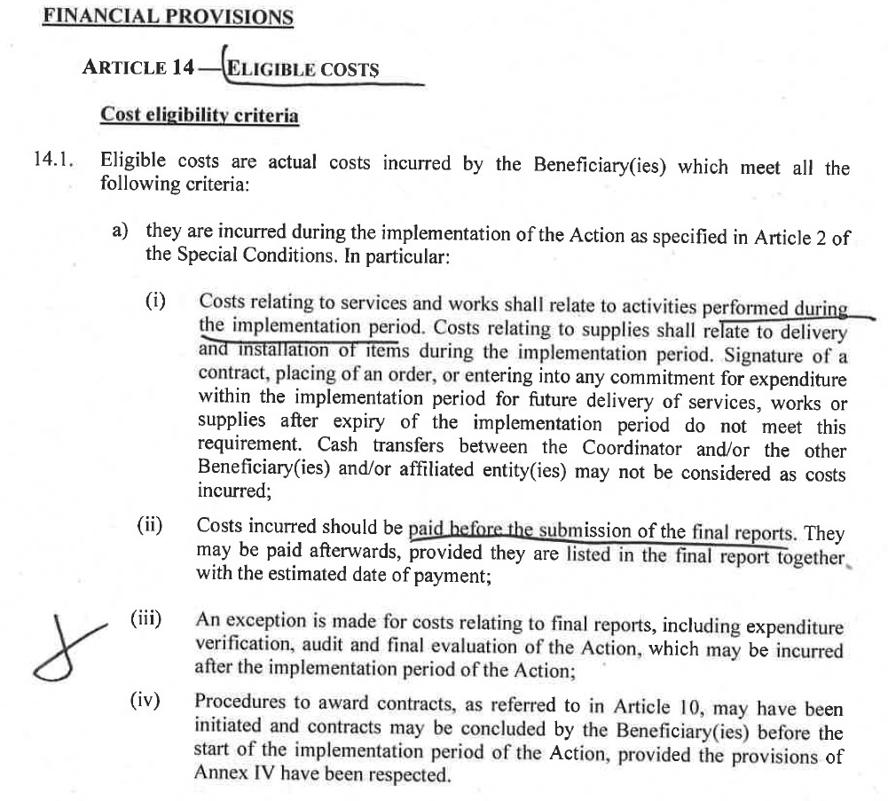
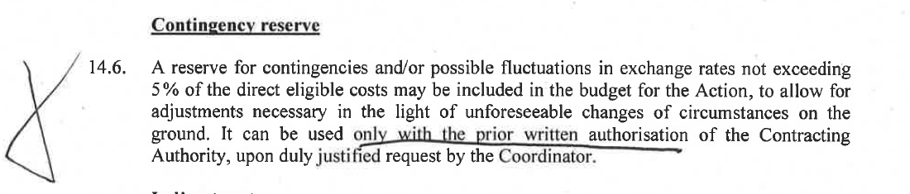
General conditions (V)
Sub-granting (where that is the main purpose):
see Annex X (link via https://webgate.ec.europa.eu/europeaid/online-services/index.cfm?do=publi.welcome&orderby=upd&orderbyad=Desc&searchtype=RS&apply=N&aofr=160048&userlanguage=en)

Slide 14
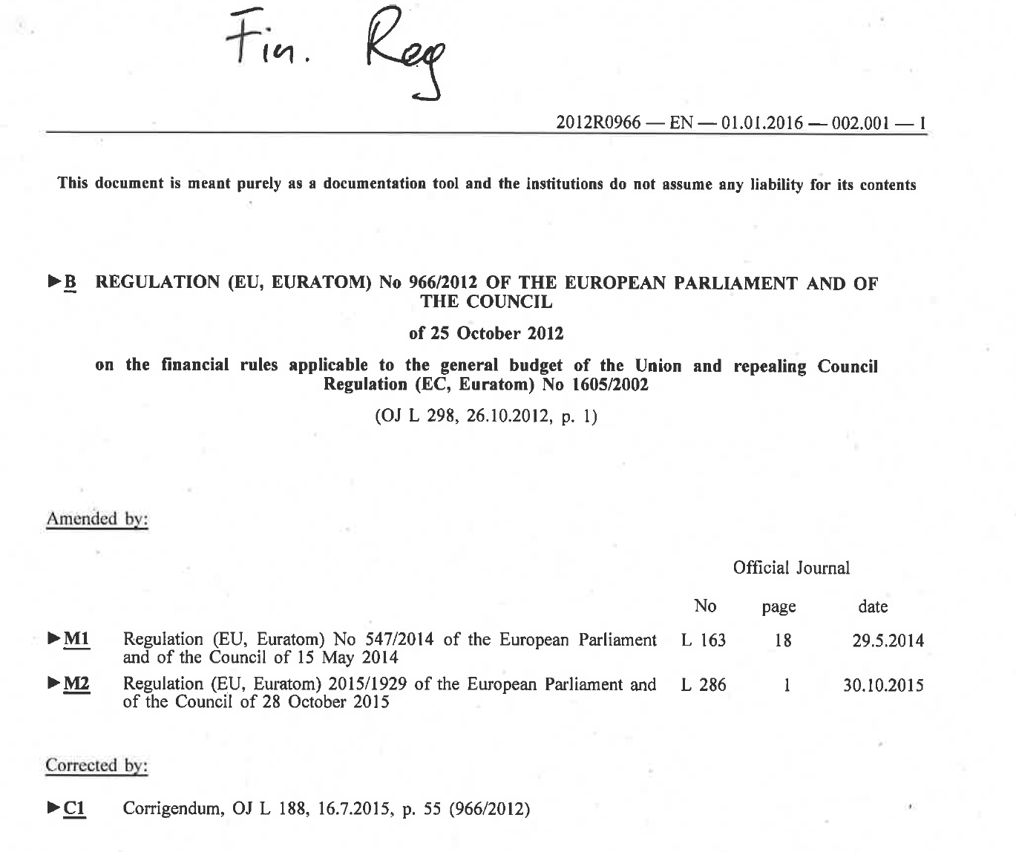
Financial regulations
I couldn’t find the latest version of the document you used in 2018 which looked like this:

