Slide 1

Making your projects’ finances work
Learning from past experience

Slide 2
In our agenda
Guided tour through reference documentation (as per IS2018)
Group work training and navigation through reference documentation
A DEAR project financial management case: with Sabine Gisch-Boie and Stewart Page, FishForward 2 project
Summary of key issues and harvesting further doubts for updating FAQ

Slide 3
Useful information
Report on Inception Seminar for CfP2016 projects and annexes of the report: PPT presentations, Prag and 'Finding answers in the documentation', March 2018
FAQ Financial and contractual questions answered Inception Seminar 2018
Report on 'The use of Sub-granting ('Financial support to Third Parties') in DEAR projects', May 2017
Questions & Answers: Covid-19 adaptations
Create a plan of actio and review

Slide 4
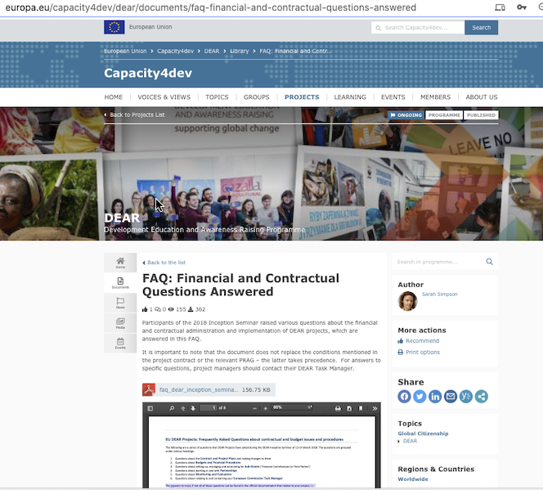
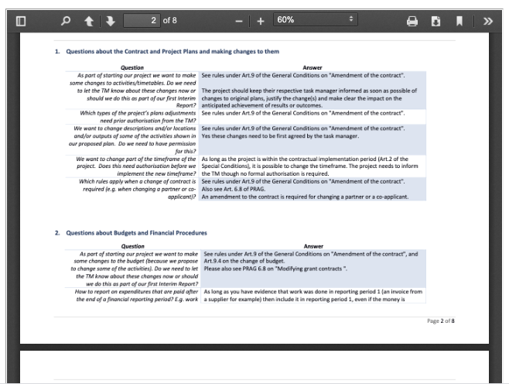
Most frequent questions?
Questions about the Contract and Project Plans and making changes to them
Questions about Budgets and Financial Procedures
Questions about setting up, managing and accounting for Sub-Grants (‘Financial support to Third Parties’)
Questions about working in and with Partnerships
Questions about Monitoring and Evaluation
Questions about relating to and contacting your European Commission Task Manager

Slide 5
Key doubts you might have:
Eligibility
Changes - when amendments are required; what is covered by 25% budget change; unforeseen activities and their costs
Procurement
Sub-granting / Financial support to third parties
Covid-19 amendments

