Slide 1
Managing a DEAR project:
reflections and suggestions
Robert Ach-Hübner

Slide 2
Reflections

Slide 3
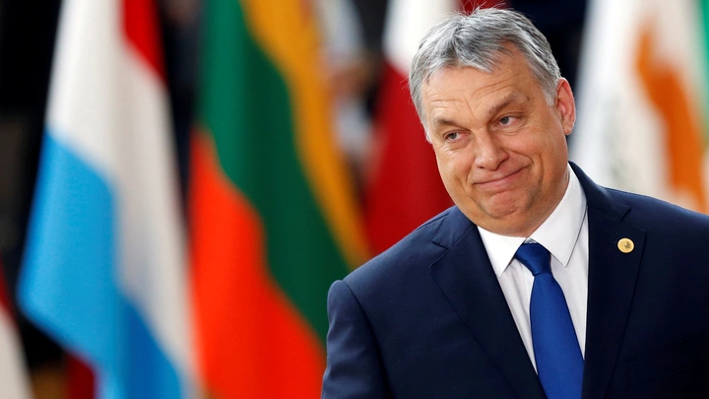
Situation can change anytime

Slide 4

Project consortium is not an organization

Slide 5
Suggestions

Slide 6

Be flexible in the management

Slide 7
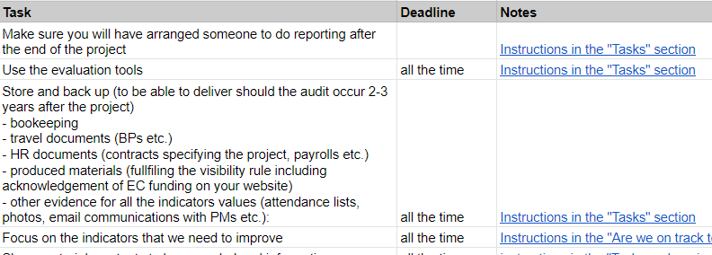
Keep it simple

Slide 8

Don’t expect too much from common work

Slide 9
Reflection on suggestions from other projects

Slide 10
Plan time for planning (only 2 years of work)
Assume that your proposal is out-of-date
What do your project partners hope to gain from the project?
What change do you want, from who and why? (the result matters, not the activities)
Which project management approach will you use?

Slide 11
Thank you for your attention

