Slide 1


Communicating and Engaging: pitfalls & solutions
EC DEAR Inception Seminar – 17 September 2020

Slide 2


Trade Fair, Live Fair consortium
21 organizations in 12 EU countries working in 17 EU MS
Fair Trade & Ethical Fashion movement
Specific Objective
The European public increases awareness of sustainable consumption and engages in driving changes in public policies and private sector practices that contribute to the achievement of SDG 12 (responsible consumption and production), and other correlated SDGs (1, 2, 5, 8, 13 & 15).

Slide 3





Strengthen government, business and consumer action on responsible consumption & production (SDG12) across the EU
Understand changing consumer attitudes to responsible consumption – (Fashion Revolution)
Co-ordinated advocacy & public awareness raising – whole consortium
Adapting to climate change, externality costs
(PFCE)
Reaching living wages and living income (Fairtrade UK)
Unsustainable supply chains, current and future policy options (FTAO)
Integrated analysis of impacts for farmers & workers
(Traidcraft)
Empowerment for women & girls (WFTO)
Evidence-based analysis of challenges to responsible production for farmers and workers in developing countries

Slide 4
Dear Project - ToC
Workers and farmers earn fairer returns in supply chains.
Change in overall business practice and regulatory regime
Shift in overall market and political incentives
Consortium
influence directly through evidence
Businesses / Private Sector
Policymakers
‘Coalitions of willing’ will be developed around common targets and moments
Consumers influence indirectly through purchasing practices showing demand for ‘fair trade’ products and potential support for political interventions
Consumers campaign directly to individual businesses for change in specific practice and policy – showing brand benefit/threat
Citizens campaign directly to individual policymakers for change in specific practice and policy - showing political benefit/threat
Consumers-citizens AWARE powerful take larger and unfair share of the profits/benefits of trade, consequences of this and their role in sustaining and changing this
Consortium
communicates evidence through public comms

Slide 5



FAST FASHION CRISIS CAMPAIGN by Traidcraft Exchange

Slide 6

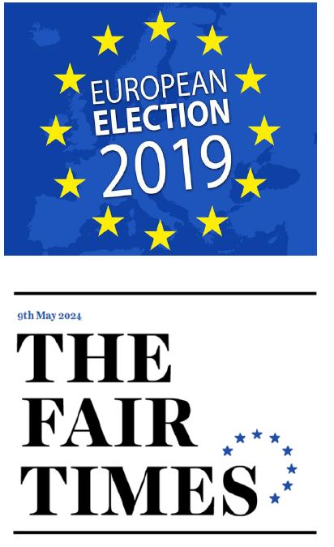

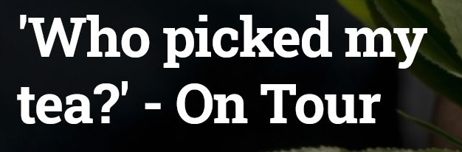


PUBLIC MOBILISATION WORKING GROUP
In Year 3 DIRECT engagements
1mln citizens
4,000 policy makers
2,000 companies
Quarterly coordination meetings for capacity building and Aligning & adapting campaign asks to national contexts
Free online courses
Displays at the Paris metro

Slide 7
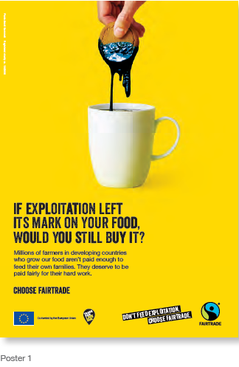
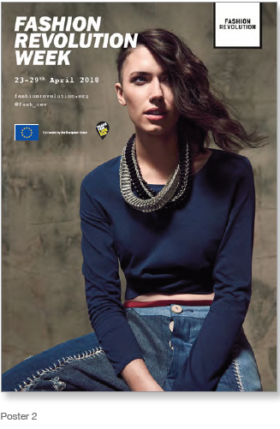
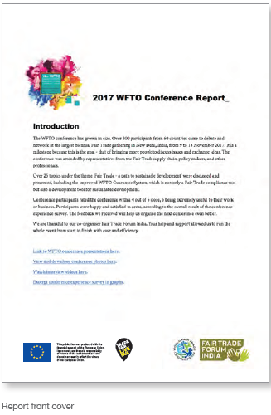
PROJECT BRANDING

Slide 8
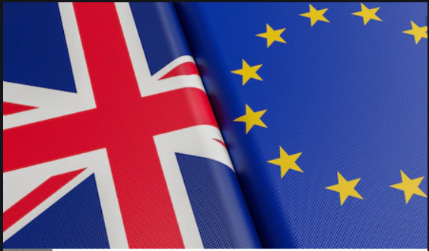
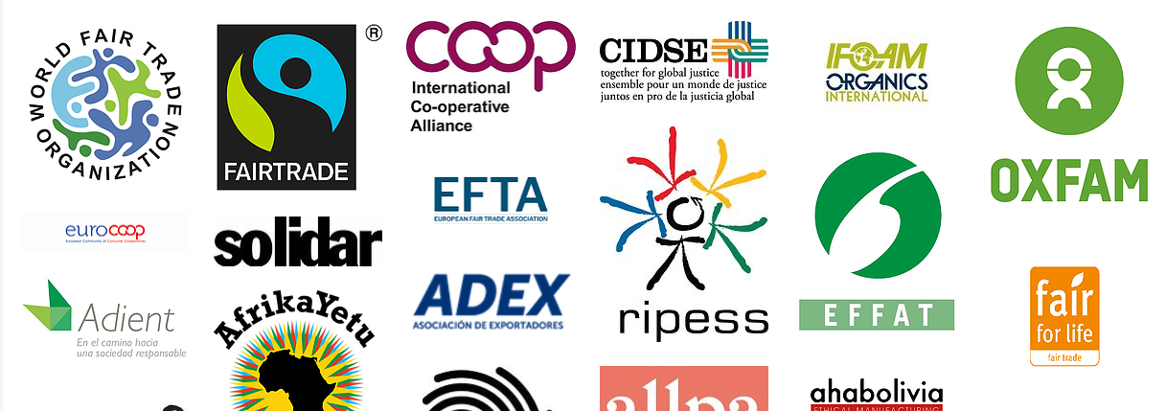
BREXIT!
EVENTs with multiple
sponsors, donors, partners

Slide 9
CONTACT US
Guzal Matniyazova, Project Manager, Fairtrade International
g.matniyazova@fairtrade.net
Project info:
https://www.fairtrade.net/about/projects/trade-fair-live-fair

