Slide 1



Monitoring and Evaluation
1 big and 200 small DEAR projects.
The case of
FRAME, VOICE, REPORT!
Maria Molde
DEAR Inception Seminar,
2020-09-22

Slide 2
What is FRAME, VOICE, REPORT!
DEAR project with main focus on sub granting for small and medium sized CSOs.
Sub granting goes hand in hand with coaching, networking and capacity building.
6 partners, 7 countries
177 projects, 220 organisations
Reached 14.676.923 EU citizens, out of whom 172.013 have been engaged.

Slide 3
What is our M&E system
- and how did we develop it?
For the application - really simple ToC and LFA
Engagement of EU citizens
Outreach of third parties
Quality of communication of third parties
Learning among partners
Project start up – hired M&E expert
Developed M&E questions – a learning approach!
Adjusted the LFA
Developed methods and tools

Slide 4
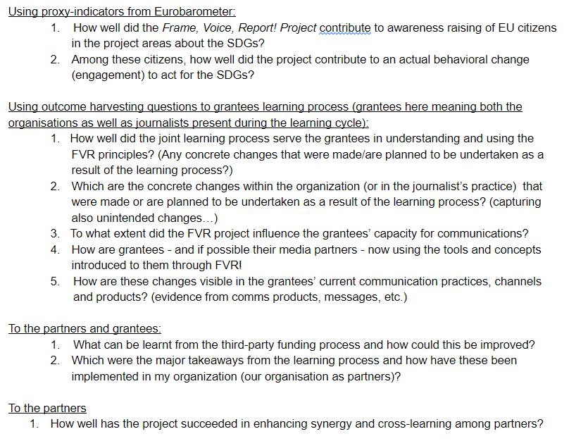

Slide 5
The system
ToC and LFA
M&E questions
Reports (third parties, partners, lead)
Meetings (Yearly physical meetings, bi-weekly online meetings, learning meetings, workshops with third parties)
Tools (Learning log, self assesment survey, feedback survey from trainings and workshops, qualitative product analysis)

Slide 6
What worked well?
Partner meetings
Yearly: Bigger discussions and adjustements
Outcome harvesting
Relation building!!
Bi-weekly: Round of general update
Admin, reporting, budget, corona, etc….
Reports Third parties
Partners
Lead
Tools Feedback survey from trainings and workshops
Qualitative product analysis
ROM visit Enhanced our focus on sustainability and dissemination

Slide 7
What did not work that well?
Self assesment surveys
National SDG survey
The learning log
The balance between the grants and the requirements for third parties

Slide 8
Third party reports – questions that might be useful for bigger
DEAR projects as well?
3.1 Please state how many people have been reached through the intervention (compare with the expected numbers stated in the application).
As a guide to divide between numbers of engaged versus informed beneficiaries please see the table of informed vs.engaged at the end of this reporting format.
3.2 If it’s possible for you to also estimate the number of indirect beneficiaries, please insert the number and an explanation it here (e.g. if an article has been published in a newspaper, the indirect beneficiaries would be the total number of readers of the newspaper, and the number of informed beneficiaries would be an estimated percentage of this number)
3.3 In what way has the project distinguished between awareness raising and engagement? Please explain have you have worked with both and what you have done to move from awareness raising to engagement with your target group.

Slide 9
From third parties reports
 | Expected numbers as stated in the application | Informed | Engaged
Indicate number of people reached through the intervention divided in informed and engaged: |  | exact data or estimation - please indicate if it is unique numbers or not | exact data or estimation - please indicate if it is unique numbers or notnot
If possible, indicate how many of these were female/male/other? (if exact numbers are not available estimations in % can be used) |  | eg. 50% female/50% male | eg. 70% female/30% male
If possible indicate the primary age range of this target group (0-15, 16-25, 26-39, 40-59, over 60) |  | eg. 40-59 | eg. 16-25

Slide 10
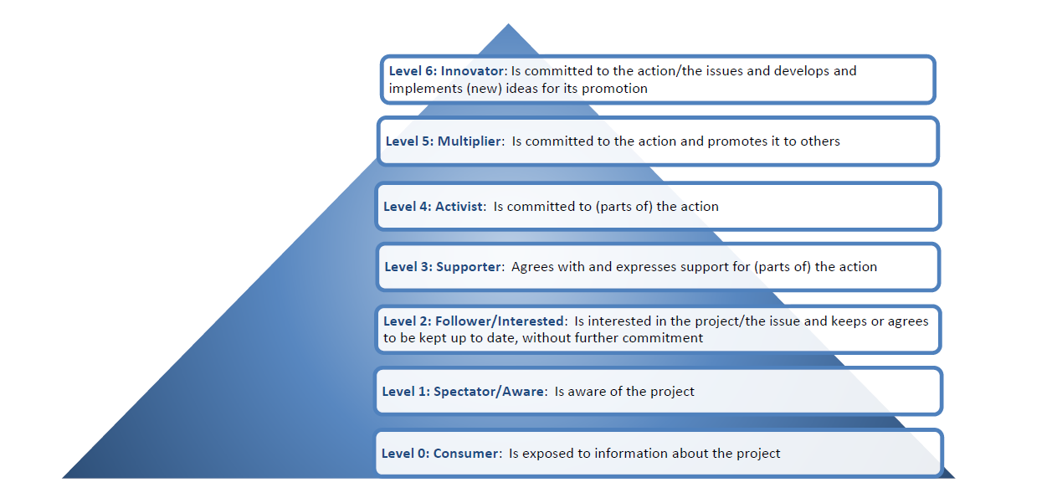
Specifically for third parties – engagement!
Engagement
Awareness
Indirect

Slide 11
Specifically for third parties – engagement!
Beneficiaries | Level | Monitoring tools (not exhaustive)
I N D I R E C T | LEVEL 0: CONSUMER (OF INFORMATION ABOUT THE PROJECT OR ITS ISSUES) Contact with the action is by chance, through coming across it e.g. via * a media report/article, * a public/street event, * promotional materials, * an advert, | Press review Materials distributed Estimate of participants to an event in which a project activity is implemented
I N F F O R M E D | LEVEL 1: SPECTATOR/AWARE Is aware of the action and the issue it is concerned with Engagement is erratic, e.g. through occasional, possibly a one-off, visit to a project website, blog, or Facebook page, or through access to a report, a lesson or session in school | Visits to the project website Social media data (clicks, showings, etc.) Download of documents related to the project
 | LEVEL 2: FOLLOWER/INTERESTED Is interested in the action/the issue and keeps, or agrees to be kept, up to date, without further commitment Contact is via direct communications from the project or one of its multipliers (e.g. via email subscription, Twitter follower, Facebook likes). However, beyond possibly attending a free public event (such as an exhibition, theatre performance, public discussion), a free one-off briefing or other event, this may not lead to further follow up. | Estimate of people attending an event (e.g. street action) Reactions on social media posts (likes) Data about social network’s posts about the project Registration sheet of conferences

Slide 12
Specifically for third parties
Beneficiaries | Level | Monitoring tools (not exhaustive)
E N G A G E D | LEVEL 3: SUPPORTER Agrees with and expresses support for (parts of) the action Agrees to carry out a simple action after contact/invitation from the project, e.g. * signs a petition, * endorses and forwards an electronic message or link about the project, * joins in an event that has an entrance fee, * takes part in a discussion meeting of the project, * attends a one-off workshop, seminar, or conference session, * changes purchasing behaviour relating to one or a similar range of items, *voluntary participation to a session (e.g. workshop) organised at school | Socail media reactions (sharings, comments) Registration sheet of workshops, trainings Signatures for a petition Request to analyze the project for a thesis or research
 | LEVEL 4: ACTIVIST Is committed to (parts of) the action Participates, for example in * a series of workshop-seminars or a conference, * helping at a project event, * attending a public hearing, * trying out ideas or resources from the project, * making a public statement of personal support (e.g. writes a letter), * changing purchasing behaviour relating to a wide range of items. | Availability to become a volunteer for the project or the CSOs Interviews, focus groups Most significant change
 | LEVEL 5: MULTIPLIER Is committed to the action and promotes it to others Systematically promotes the issues raised by the project in his/her own social or work environment, for example * promotes involvement in the project’s issues and ideas to friends and acquaintances, to people in the local community or in the workplace. * Takes part in a study tour and disseminates the experience | Interviews, focus groups Most significant change Outcome harvesting
 | LEVEL 6: INNOVATOR Is committed to the action/the issues and develops and implements (new) ideas for its promotion Works with and targets others to develop and implement new ideas for actions (e.g. introduces whole-school approaches, initiates creative activities/media events, initiates lobby meetings with decision-makers, develops new policy formulations, etc.) | List of events/initiatives organised by beneficiary(ies) autonomously Interviews, focus groups Most significant change Outcome harvesting

Slide 13
From third parties’ reports – most significant change and outcome harvesting questions
4.1 Describe the most significant lessons that you have learned and experiences that you have gained by
implementing the intervention. (i.e. in relation to project planning, reaching and engaging people or
any other organisational learning).
4.2 Please provide one or two examples of the most significant changes that have happened in your
organization thanks to your participation in the learning cycle, including from your networking with
other FVR grantees and/or journalists – if any. Most significant changes can be change in knowledge,
attitudes, skills, and/or behaviors.
4.3 Can you identify a change in the way your organisation communicates about the SDGs? If so, please
provide an example
2.2 Please describe any unexpected results that may have come out of the project?

Slide 14

Guide:
Global Citizenship Education
How to measure and improve the impact

Slide 15
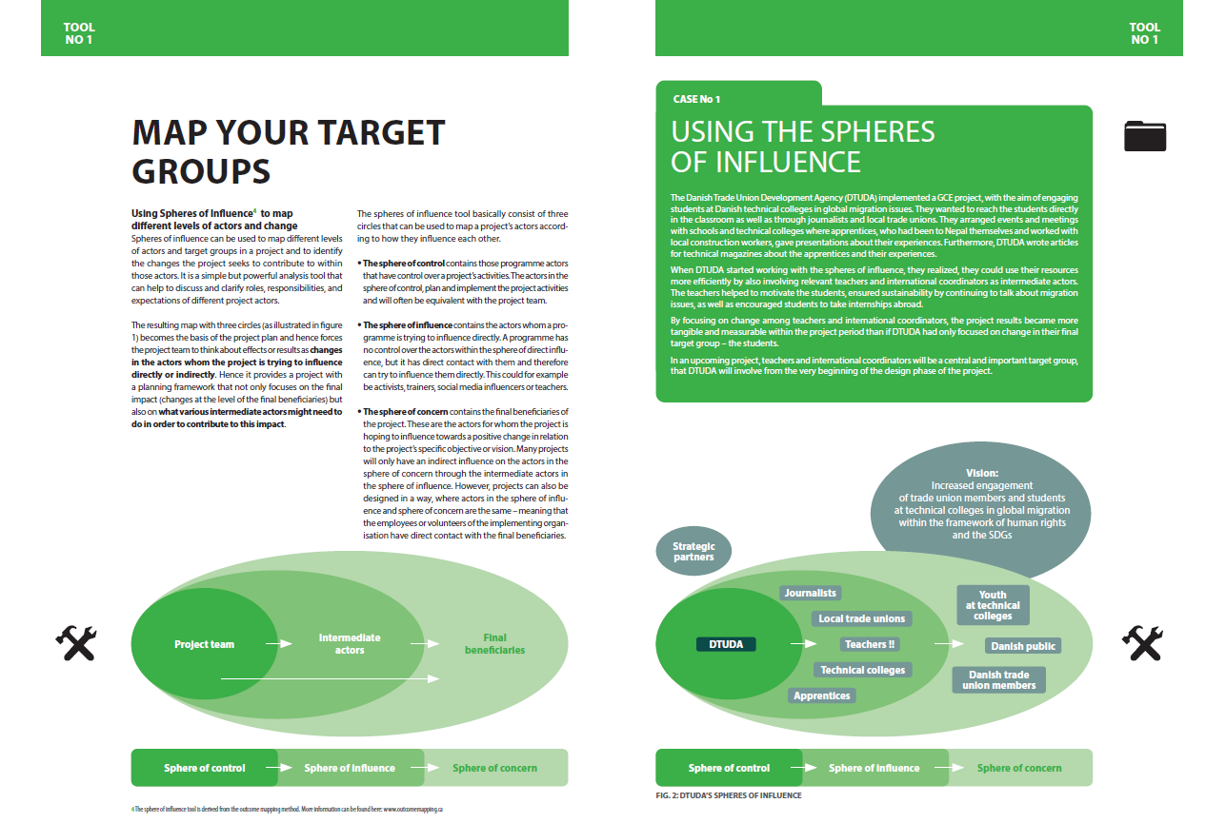
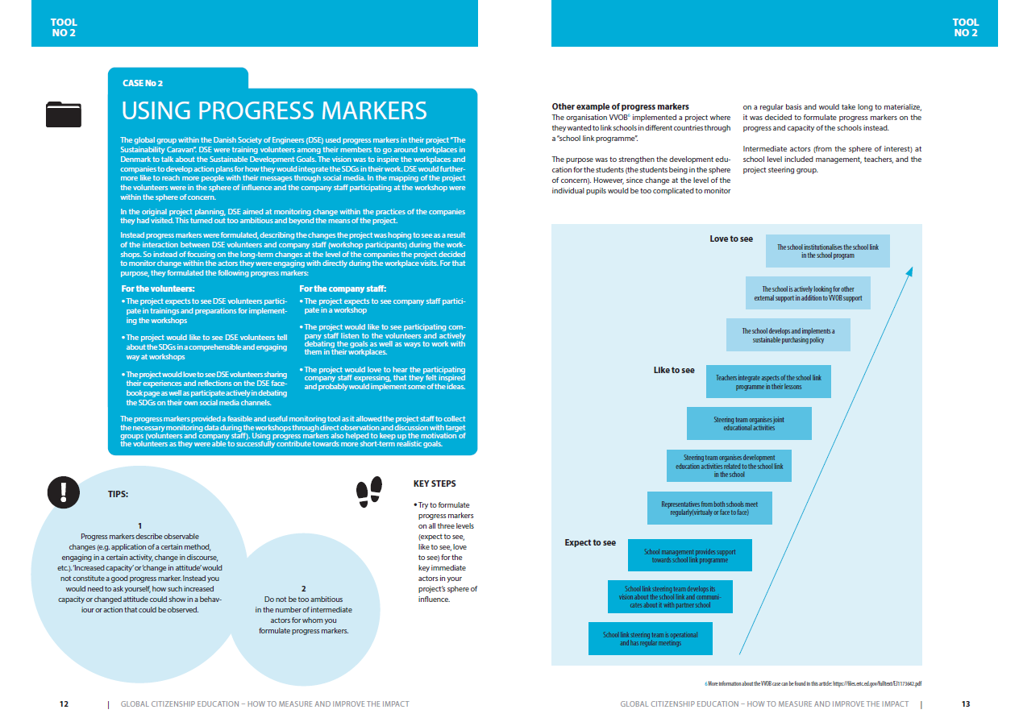
Find it at
www.framevoicereport.org

Slide 16
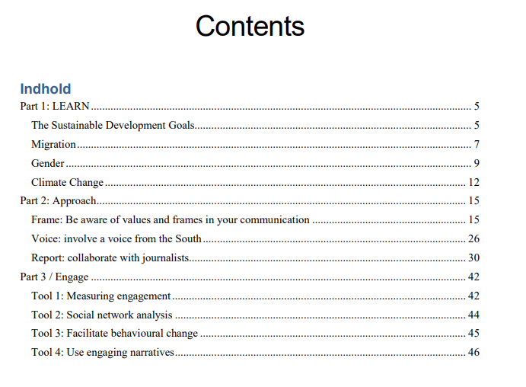
Frame, Voice, Report! Toolkit
Find it at www.framevoicereport.org

Slide 17
Evaluation:
European Evaluation and Exchange event
An english/french online evaluation, learning and exchange event
with grantees from all countries
Evaluation questions, open space and online cocktail party

Slide 18
GOOD LUCK WITH YOUR PROJECTS!
And feel free to contact me for any clarifying questions at mm@cisu.dk

