Slide 1
Introduction to basic concepts of Artificial Intelligence
Webinar on AI, Dec. 11th 2020

Slide 2
Hello!
I am Anne
I work at DG CNECT (A1) e-Mail: anne.flint@ec.europa.eu LinkedIn: /anne-flint
Education: Information Systems (B.Sc.) Health Informatics (M.med.Sc.)

Slide 3
How
0’s and 1’s
predict _______
(- please insert -)
Technical
Business
Future of
AI
Take-Aways

Slide 4
History of AI (1/2)
Watson wins Jeopardy!
1956
1997
today?
Not much is happening Hardware is catching up
Artificial Intelligence
(Dartmouth conference)
DeepBlue wins against Gerri Kasperow
AlphaFold predicts
Protein folds
2016
Outlook: later in the pptx

Slide 5
History of AI (2/2)
2016
2018
2021
„With Watson winning Jeopardy!, IBM ended the latest so-called „AI Winter“ (…) The land rush in AI is on – including a lot of hype (IBM,2016)
White Paper on Artificial Intelligence
Updated
Coordinated Plan on Artificial Intelligence
Coordinated Plan on Artificial Intelligence
AI Regulation
„The big trends are not that hard to spot (they get talked and written about a lot), but they can be strangely hard for large cooperations to embrace. We‘re in the middle of an obvious one right now: machine learning and AI“ (Amazon, 2016)
FP7, Horizon 2020, Horizon Europe; Digital Europe; RRF

Slide 6
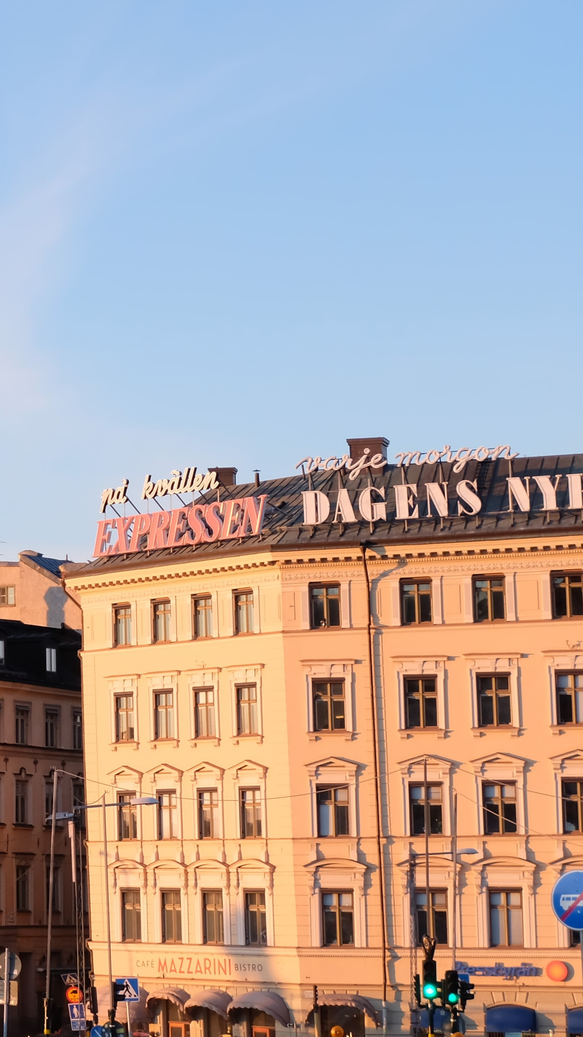
Technical aspects
1
TOP3 things to shine in (semi-professional) discussions about AI

Slide 7
TOP1 – Grasping (computational) intelligence
calculate f(x)
input
output
closer look
(1/3)
Mcculloch-Pitts artificial neuron (1956)
Human decision making
Computational decision making

Slide 8
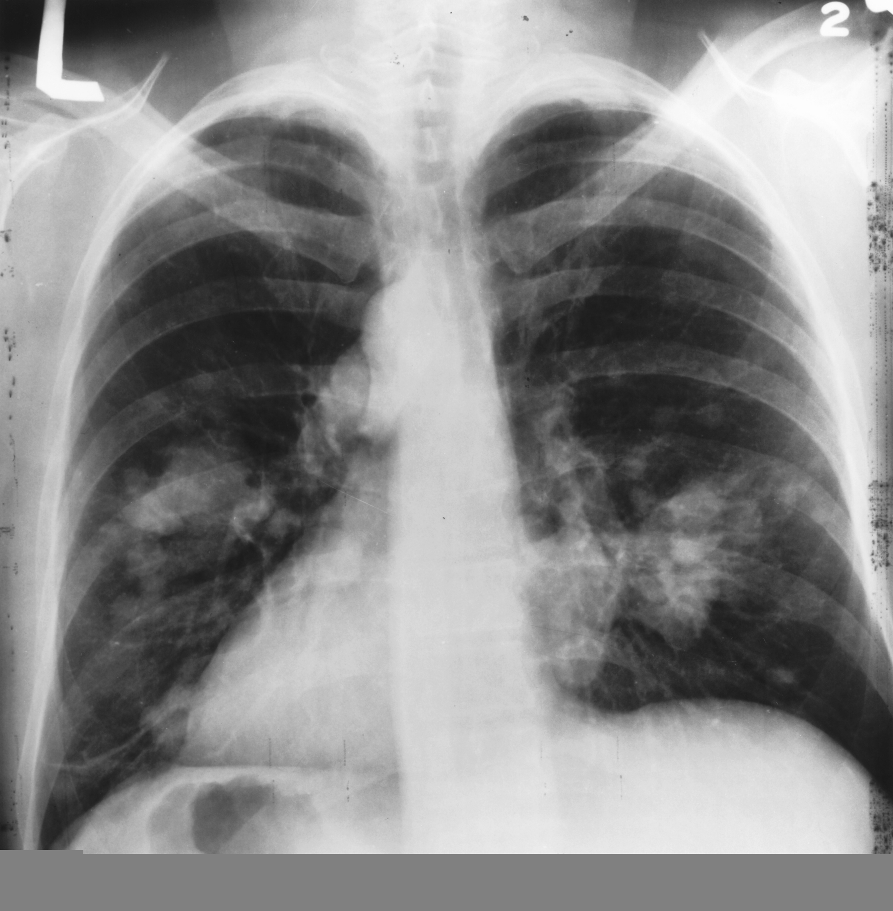
Why neural networks are „Black-Boxes“
99% sure it is Pleural Effusion
Image source: https://images.app.goo.gl/AzeWRPE7wJCH2zxd9

Slide 9
TOP 2 – Knowing different types of AI
Machine Learning scientific study of computer algorithms that improve automatically through experience
Supervised Learning
Unsupervised Learning
Deep Neural Networks,
Convolutional Neural Networks,
Decision Trees
k-means Clustering
…
Lung Leison
No label
closer look
(2/3)
Robotics
Augmented Reality; Virtual Reality
Supercomputing; Quantumcomputing
………

Slide 10
TOP3 – Understanding if an AI system is doing the „right thing“
All correctly identified objects
---------------------------------------- All objects
Accuracy =
Training
Set
Test
Set
Training
Set
Test
Set
closer look
(3/3)

Slide 11
AI in daily life
2
How to get a feeling what type of AI you are interacting with

Slide 12
Step 1 – Categorizing the AI system (Broad)
Humans
Rationality
ANI
AGI ASI
Systems that think like humans
Systems that think rationally
Reasoning
Systems that act like humans
Systems that act rationally
Behaviour
Russel and Norvig (1995)

Slide 13
Step 2 – Categorizing the AI system (Narrow)
Augment
Unstructured, Volatile,
High-Volume
Effectiveness Model Support seamless integration and collaboration
Innovation Model
Enable creativity and ideation
Data Complexity
Efficiency Model
Provide consistent, low-cost performance
Expert Model
Leverage specialized expertise
Structured, Stable,
Low-Volume
Automate
Work Complexity
Routine, Predictable,
Rule-based
Ad-hoc, unpredictable,
Judgement-based
Bataller and Harris (2016)

Slide 14
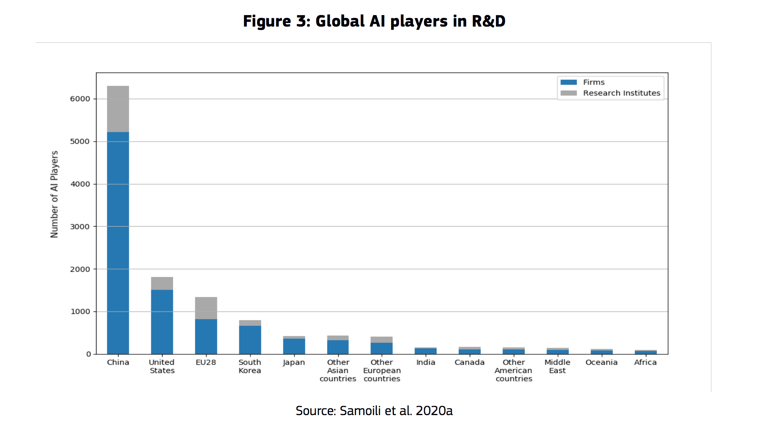
Trustworthy AI, AI regulation
Europa
USA
Open Source Code, Big names (industry)
China
Biometrics, Surveillance

Slide 15
The future of AI
3
Where do we go from here

Slide 16
The Future of AI
Human-centered AI (trustworthy, privacy-preserving, inclusive)
Ease burden of workforce, increase of positive impact for all
More and more AI excitement (e.g. AlphaFold)

Slide 17
The Future of AI
Regulation while not limiting innovation
Fostering/Maintaining Talent
Fostering AI (technological) literacy (Leave no one behind)

Slide 18
Outlook
Pushing for the right research and collaboration (AI Networks of Excellence)
AI made in Europe
AI does not work „just like magic“ or is „the magic fix“. When is AI the right tool to use or are there other „construction sights“ we need to tend to first? (e.g. Interoperability, Data availability)
Sustainable Development Goals Commitment of the AI community to the bigger picture

Slide 19
Thanks!
Any questions?
Mail: anne.flint@ec.europa.eu LinkedIn: /anne-flint

