Slide 1
The Commission’s approach to artificial intelligence
Martin Ulbrich, CNECT.A.2
Brussels, 11 Deceember 2020

Slide 2
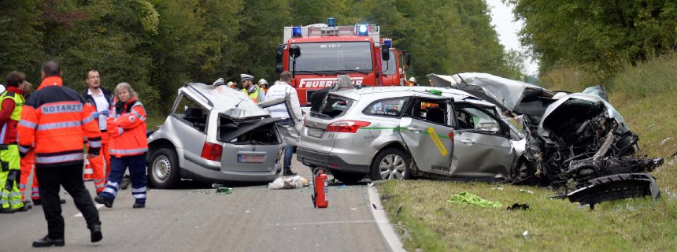
AI will improve our lives

Slide 3
Challenge 3:
Address the ethical dimension

Slide 4
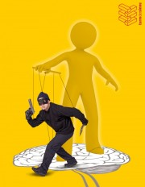
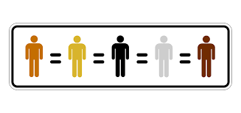
Respect of ethical principles
Action 5

Slide 5
C
Challenge 1:
Ensure strong European presence in AI

Slide 6
Recall: baseline argument
AI is good …
… but creates some risks
For consumers
For business
For the public interest
For safety of consumers and users
For fundamental rights

Slide 7
The White Paper is not alone
Increase availability of data → Data Strategy
Ecosystem of excellence
Ecosystem of trust
→
White Paper

Slide 8
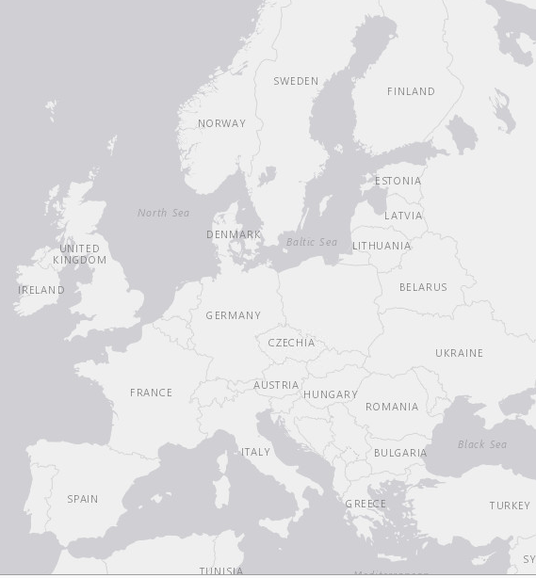
Worldwide participation with focus on Europe
30
30
10
84% of responses came from EU27
Other countries include India, China, Japan, Syria, Iraq, Brazil, Mexico, Canada, the US and the UK
3
2
26
5
406 citizens
18
60 NETHERLANDS
20 POLAND
251
352 business and industry
162 BELGIUM
4 LUXEMBOURG
7
4 SLOVAKIA
160 civil society
117
33
8
18
4 SLOVENIA
152 academia
60
5
73 public authorities
4 CROATIA
105
13
26
PORTUGAL
72 other
5 MALTA
3 CYPRUS

Slide 9
Foster an “ecosystem of excellence”
Build on the coordinated plan (December 2018):
→ leverage EU strengths in e.g.
low power systems
neuromorphic solutions
quantum computing
Streamline research
Foster collaboration
Increase investment
Facilitate take-up

Slide 10
Public consultation: Ecosystem of excellence

Slide 11
Digital Europe Programme
Digital transformation
& Interoperability
€1.3 billion
€9.2 billion
in total
Advanced
digital skills
€0.7 billion
High performance
computing
Cybersecurity
& trust
€2.7 billion
Artificial
intelligence
€2 billion
€2.5 billion
#EUBudget
#DigitalEurope

Slide 12
Promote an “ecosystem of trust”
Build on the work of the high-level group on AI
Guidelines for trustworthy AI
Piloting of the assessment list (revised version has just been released by the HLEG)
Prevent fragmentation of the single market
AI needs scale
Member States are already looking at (soft) regulation

Slide 13
Public consultation: Ecosystem of trust
Only 3% think that current legislation is fully sufficient.
Industry and business representatives mainly support the need to cover gaps in existing legislation.
Main concerns of respondents (share who find concerns important and very important):
90%
Breaching fundamental rights
87%
Discriminatory outcomes
All respondents, excl. no answer
Notes:
All but industry and business mostly support additional legislation.
50% of citizens
48% of academia
46% of civil society
48% of academia
45% of public authorities

Slide 14
Special case: biometric remote identification
Biometric
face recognition, but also gait recognition, voice recognition etc.
Remote
difference between authorisation (smart phone log-in) and mass surveillance
Accuracy
a very small error rate in a very large sample gives a large number of errors
→ regulation premature, deployment premature
→ public debate is needed

Slide 15
Respondents are very cautious about biometric identification systems
Should the use of remote biometric identification systems be subject to further EU-level guidelines or regulation?
Ban: They should never be allowed in publicly accessible spaces
Suspension: Their use in publicly accessible spaces should only take place when a specific EU guidelines or legislation is in place
Only in certain cases: They should be allowed in publicly accessible spaces only in certain cases / if certain conditions are fulfilled / other specific requirements needed
Go ahead: No further guidelines or regulations are needed
No opinion
All respondents, excl. no answer
Notes:
Most common answer by sector:
55% - The majority of EU and non-EU citizens say it should never be allowed (BAN)
29% - Business and industry representatives support conditional use
39% of academia is for a moratorium

Slide 16
Thank you
© European Union 2020

Slide 17
Key requirements of the HLEG
Human agency and oversight,
Technical robustness and safety,
Privacy and data governance,
Transparency,
Diversity, non-discrimination and fairness,
Societal and environmental wellbeing, and
Accountability.

