Slide 1

Support to the
Global Forest Resource Assessment process
Organisations:
Food and Agriculture Organization of the United Nations (FAO) +
European Commission - Joint Research Centre (JRC)
Objectives:
  Improved estimates of forest cover change at regional / global level
  Harmonized forest assessment, monitoring & reporting systems in place
  Reduction in the current rate of deforestation
  Increase in the area of forest under sustainable forest management
  Increase on the area of forest in protected area systems
  Reduction in the current rate of loss of carbon stocks in forests
Main target group: Multi-stakeholder
Main area of work: Independent Forest Monitoring
Location: Global / Regional
Main local partners: National participants in > 100 countries globally
Dates of implementation: 2009 to 2012
Budget : € 3,1 Million to FAO (EC portion only) + € 500,000 to JRC
Funding partners: Australia, FAO, Finland, France, ITTO, JRC

Slide 2
This project supports the FLEGT process by:
Providing a global & regional analysis of forest cover & land-use change from 1990-2000-2005 (- for Tropics continued by JRC to 2010)
Building remote sensing capacity for future FLEGT-related analysis
Allowing better understanding of the differences in area of forest land cover and forest land use
Providing a systematic basis for comparisons with global (FRA) and various regional estimates of forest change

Slide 3
What needs to be done to make the contribution stronger?
Use of finer-resolution remote sensing data to allow more detailed analysis of land-use transitions and of the nature of selective harvesting
Exploration of new methods to improve large-scale assessment of logging and forest degradation
Continuing support to allow additional analysis of future dates and ground-based assessment

Slide 4
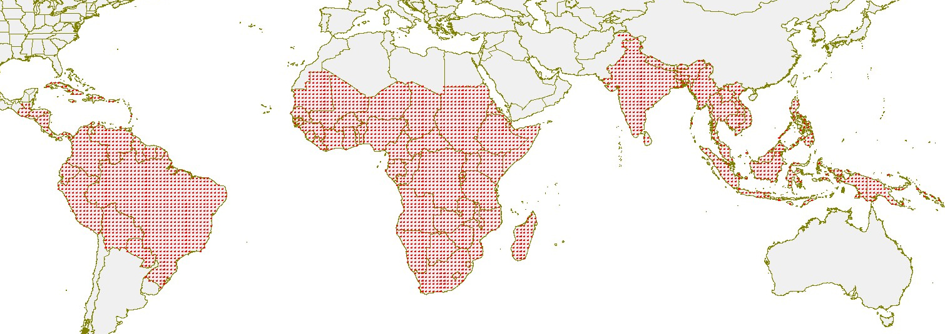
Sampling scheme for the Tropics 1990-2000-2010
Systematic sample based on 1° x 1° lat-long confluence points

Slide 5
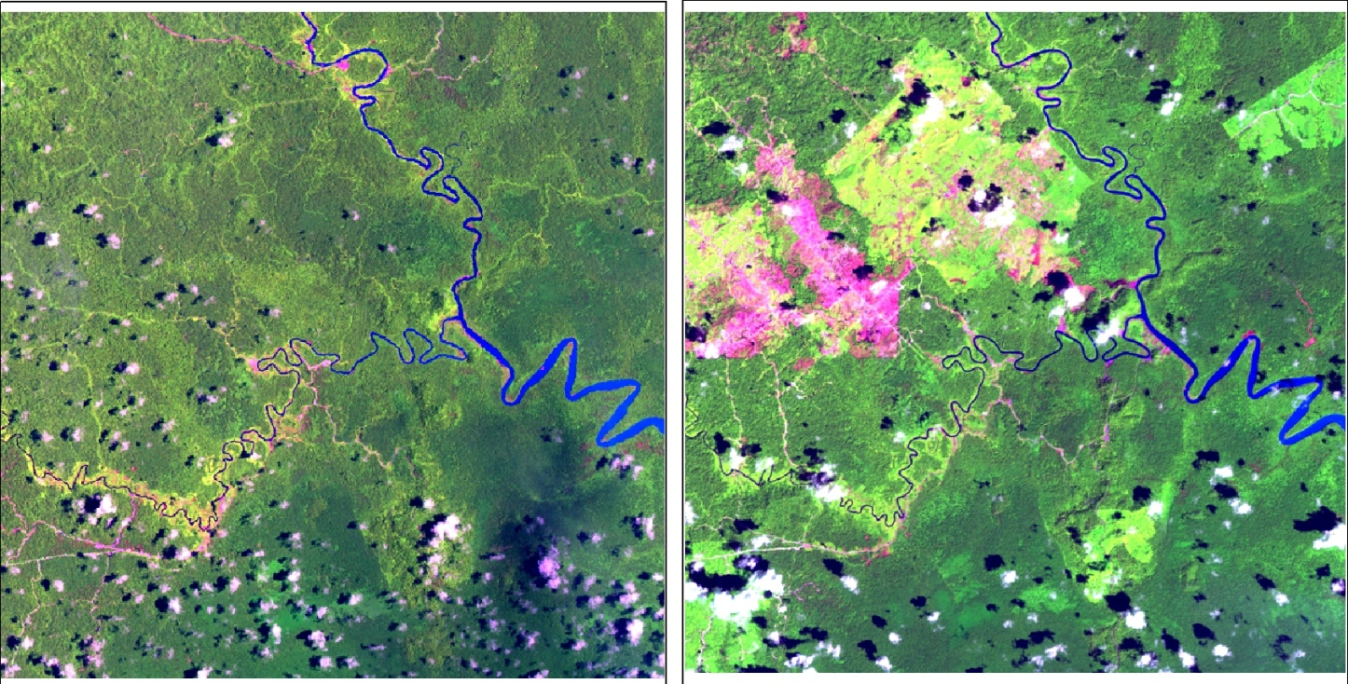
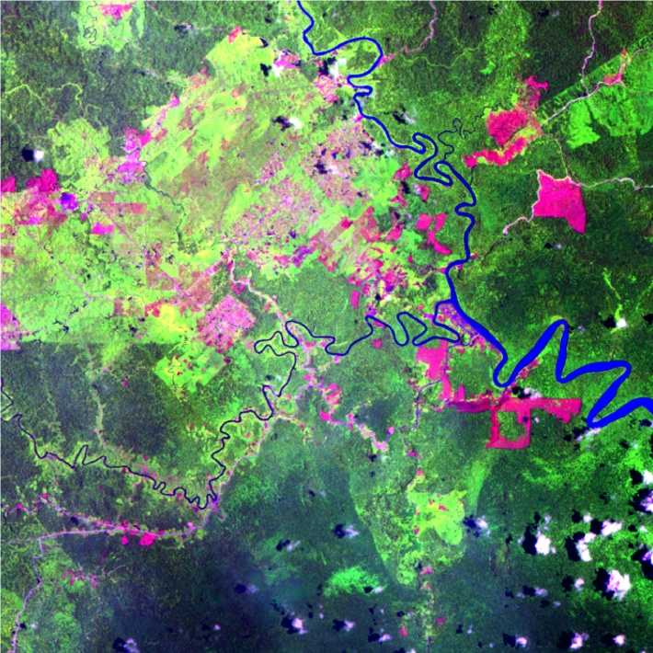
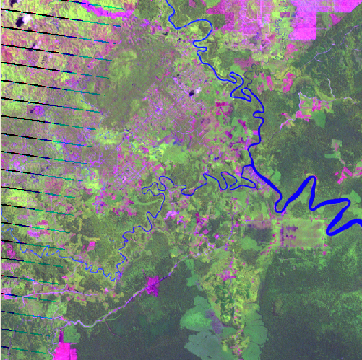
Sample Unit - Size 10 km x 10 km
1990
2000
2010
Forest Conversion to Oil Palm in N-Kalimantan (N04 E117)

Slide 6
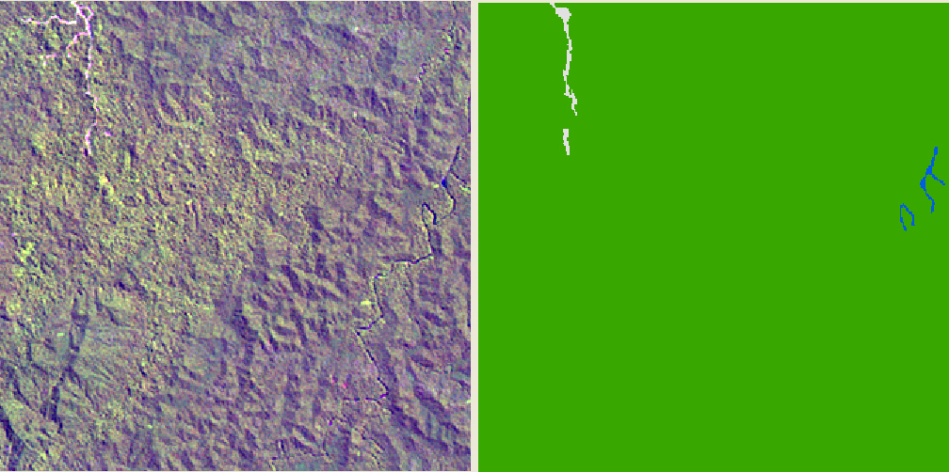
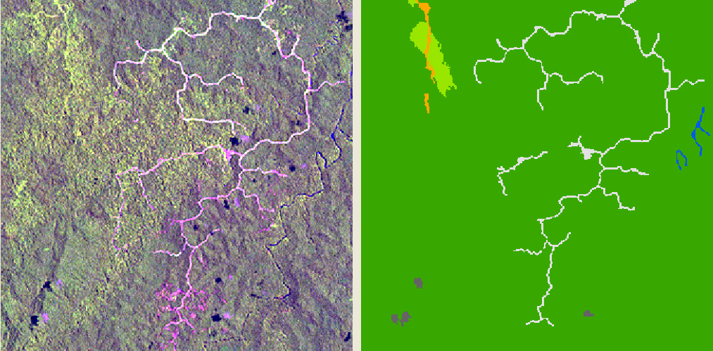
Logging: Eastern Kalimantan (N00 E115) 1990-2000
10km

Slide 7
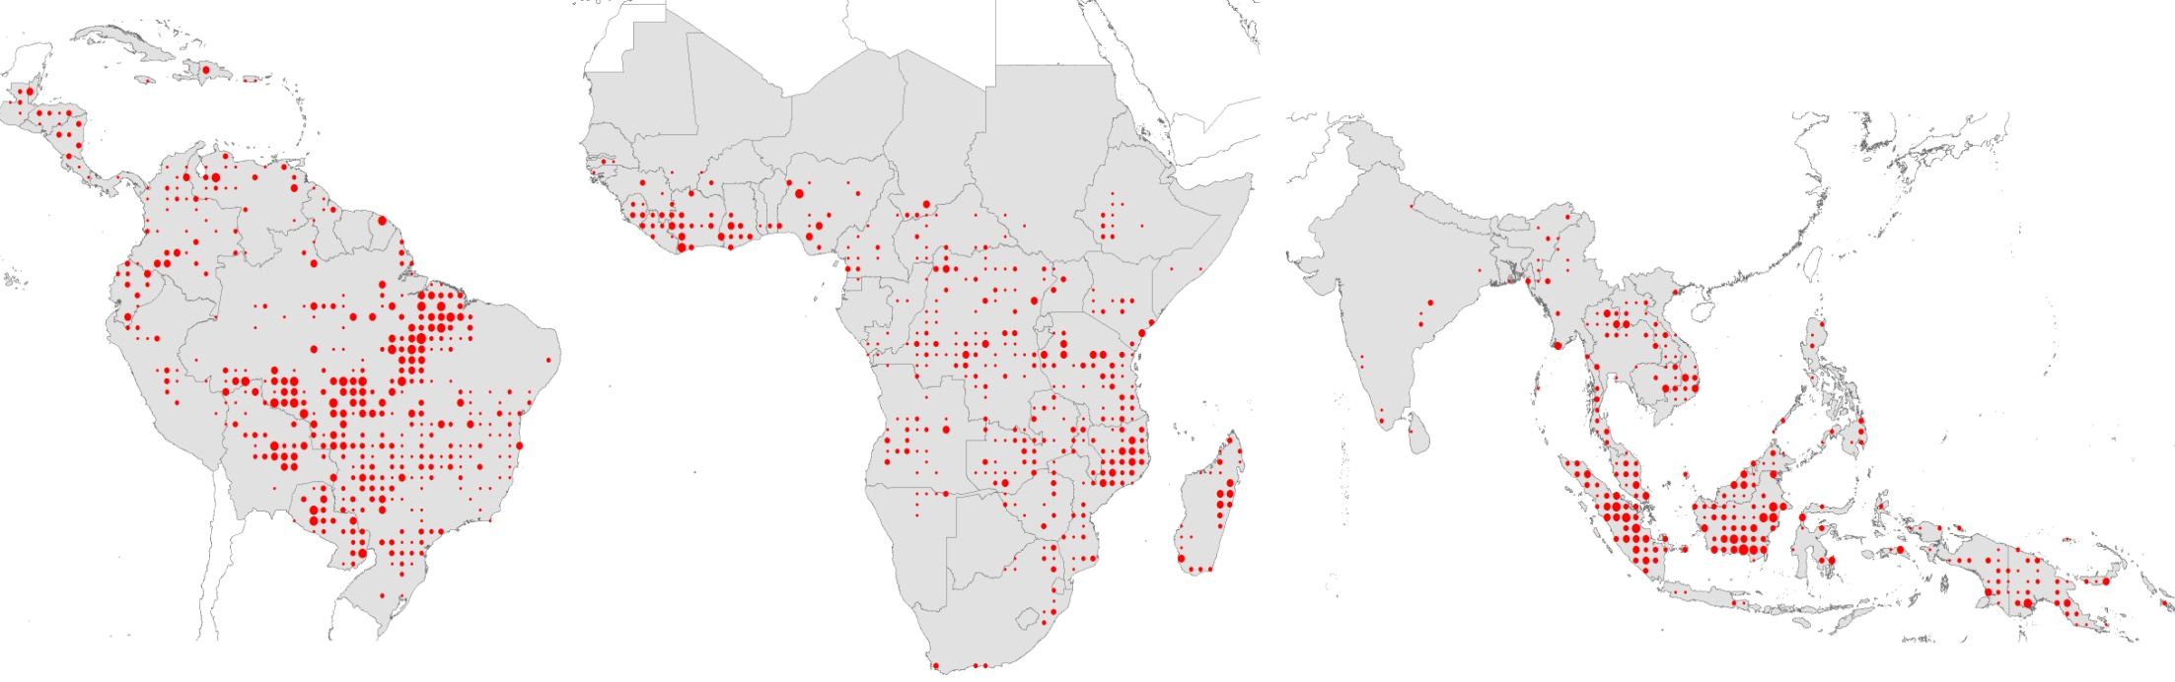
TREES-3 results for the Tropics:
Annual gross forest cover loss 1990-2000 within sample units

