Slide 1
Feedback to Plenary
Asia Group Discussions on FLEGT
26th April 2012

Slide 2

Chut Wutty - RIP

Slide 3
Asia Regional Projects
Lessons/issues from Day 2
Independent Monitoring by civil society – need sustainable financing mechanisms that maintain their independence and credibility
How to build capacity in the thousands of small forest-based enterprises in the region to meet TLAS audit standards and EU TR; must scale up our support approach from small resource intensive “projects” to large scale programmes
When and how to promote FLEGT timber in Europe and other markets….???
  Need a strategy so we can talk to producer countries and their private sector, and EU importers.
  How to ensure the credibility of FLEGT schemes – “manage the brand”

Slide 4
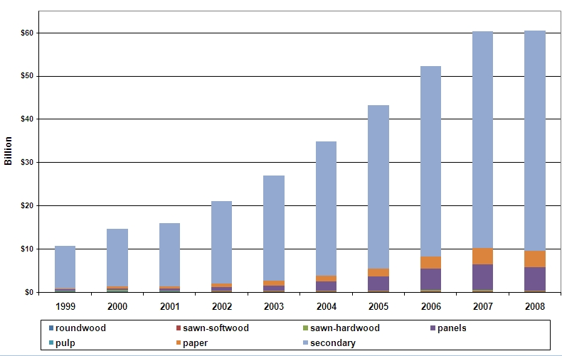

China is the motor!
Based on domestic and imported roundwood
World’s largest exporter of wooden furniture
and other secondary-processed products
5x in 10 years,
no downturn in 2008

Slide 5
Working in Asia
Asia is booming, increasing wealth, growth in demand, high populations, emerging middle classes…
Flegt engagement in the region should reflect the proportion of the problem that the region represents (c.90% of global illegal timber production and c.90% of direct imports)
Trade and business drivers are often the entry point, not just development cooperation and the language of good governance
Yet development outcomes are enormous;
  E.g. In Indonesia small-scale community forests are now supplying more than 50% of raw material (=100,000’s of rural poor)
More FLEGT work in Asia will bring big returns in terms of impact on global levels of illegal timber, and especially on Africa, which is increasing exports to Asia
Importance of Russian Far East supplies to China – 20 to 30 million m3 of logs/sawn timber – still “out of control”

Slide 6
Recommendations/issues
Increase the understanding and awareness of the EU Timber Regulation in Asia through better communication and involving the Trade/Political sections of the EU Delegations
The EU TR has to work in practice too – not a toothless tiger
Collect better measures of the impact of FLEGT on the region, for instance on development indicators, as well as economic data
To address more the issue of weak enforcement and prosecution in the region, work more with partners such as Interpol, WTO, UNODC, WB with existing programmes of support with law enforcement agencies to focus on the real villains.
Use FLEGT legality definitions and experience from other countries such as Brazil as the basis for training in catching and prosecuting illegal loggers
VPA’s should include measures to catch and prosecute those cases that come to light through monitoring and auditing.

Slide 7
More recommendations….
Regional communication and information;
  dates for meetings using Capacity4Dev.com
  more translations into local languages to share skilled translators
  develop both targeted messages and chose the right messengers
  Communication is a long term investment,
  This means hiring and nurturing local FLEGT Facilitators in every country
Need partnerships/alliances with other countries in order to work in Asia, notably the US, Japan and Australia, but also China and South Korea.
Regional coordination; existing institutions; FAO facility, ASEAN, WCU regional office, civil society networks, trade shows such a Global Wood Mart Oct 2012 in KL

Slide 8
Final slide….
Capacity building for rural forest businesses;
  use existing mechanisms e.g. farm extension services, and religious networks, trading networks
  more peer-to-peer coaching in the forest or factory,
  material adapted to low literacy levels, and
  less “chalk and talk” in the classroom
For Asia big questions remain about how to “do” FLEGT when VPA’s won’t work…we need a Plan B!!
Russia Far East is part of the region and needs much more attention
Ask importing countries in Asia to require FLEGT licenses as a step towards general prohibitions

Slide 9

All Things to All People?

