Slide 1
Vulnerabilities and Social Protection in Asia and the Pacific: the regional context
Donovan Storey and Patrik Andersson
Social Development Division
ESCAP
Notes:
2012/6/12
1
OPTION 2 for title slide.
GUIDELINES: Try to keep titles short. Justify left and don’t center the text. Font used is Calibri, size 32pt in title, 20pt in subtitle.

Slide 2
Overview
Introduction to ESCAP
The Asia-Pacific context
Tracking MDG progress at regional and sub-regional levels
Existing & Emerging Vulnerabilities
Social Protection in the region
Exercise

Slide 3
ESCAP – regional arm of the UN for Asia-Pacific
Part of UN Secretariat
62 member states – 58 are regional members
ESCAP covers the world’s most populous region - two thirds of humanity
ESCAP fosters:
  regional cooperation to promote social & economic development
  normative, analytical & technical cooperation at the regional level
  a platform for South-South dialogue & exchange of practices

Slide 4
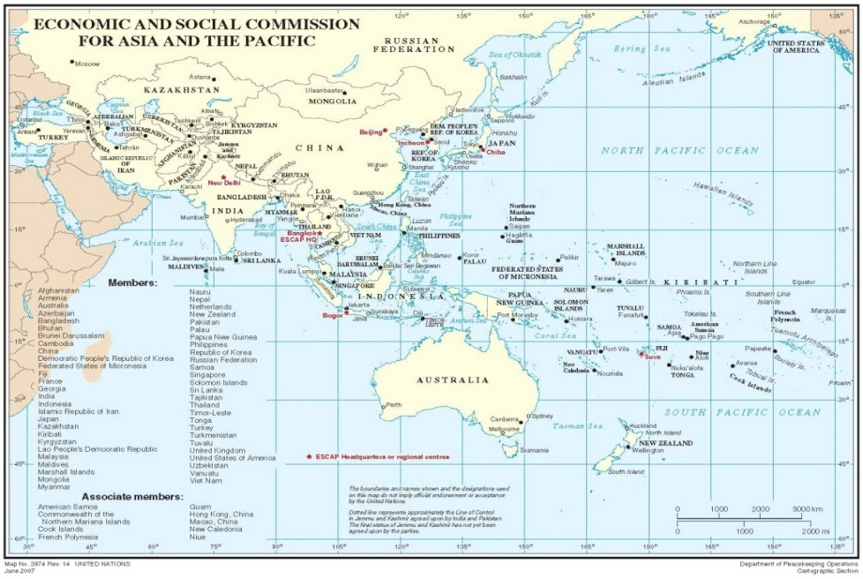
ESCAP cont’d

Slide 5
The Asia-Pacific: Context
More than 4.2 billion live in the Asia-Pacific region, over 60% of the world’s population
Regional growth has been impressive. The number of people living in extreme poverty fell from 1.6 to 871 million (1990-2012)
But there remain development divides between and within countries
Several countries will not meet MDG targets in gender, health, sanitation and under-five mortality
Yet, Asia-Pacific invests comparatively less than other regions on social protection – despite its emerging wealth

Slide 6
MDG Progress in Asia and the Pacific
Reduction of poverty by half, shaped greatly by China’s performance
Asia-Pacific has achieved targets of reducing gender disparities at all levels of schooling; reducing the prevalence of HIV and tuberculosis; access to safe drinking water – though 466 million people do not enjoy access
But is still lagging behind in reducing under five and infant mortality & increasing access to basic sanitation. This is shaped largely by South Asia
Over forty percent of the region (1.8 billion people) still lacks access to basic sanitation. There are also 83 million children underweight.

Slide 7
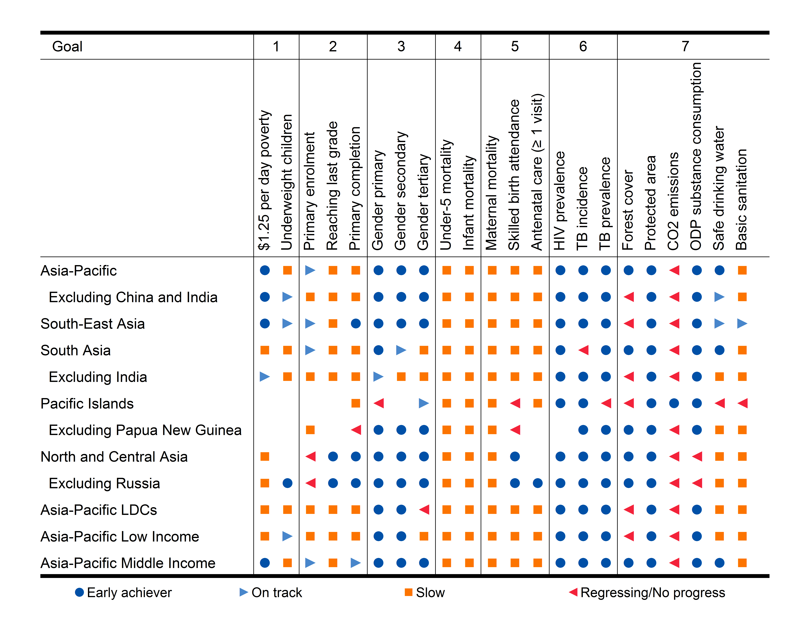
Unequal progress in sub-regions
Source: Asia-Pacific Regional MDG report 2011/12 (ESCAP/ADB/UNDP)

Slide 8
Unequeal progress in subregions
Asia-Pacific has achieved the target of halving poverty, South Asia (excl. India) and North and Central Asia still lag. Progress in reducing the number of underweight children of particular concern in South Asia
Several targets achieved in South-East Asia; halving poverty and attaining gender equality. Gaps in health-related goals such as reducing child, infant mortality and maternal mortality
Pacific Islands progress in combating HIV/AIDs and some environment targets, but regression on access to safe drinking water and basic sanitation. Progress on health-related goals 4 and 5 have stagnated
North and Central Asia are early achievers in several goals, but more slowly reducing child and infant mortality, and access to drinking water and sanitation.

Slide 9
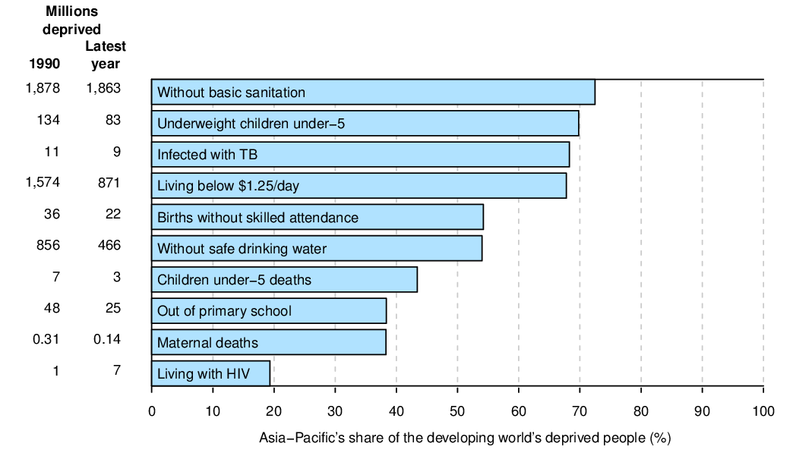
The Asia-Pacific share of the world’s deprived
Source: Asia-Pacific Regional MDG report 2011/12 (ESCAP/ADB/UNDP)

Slide 10
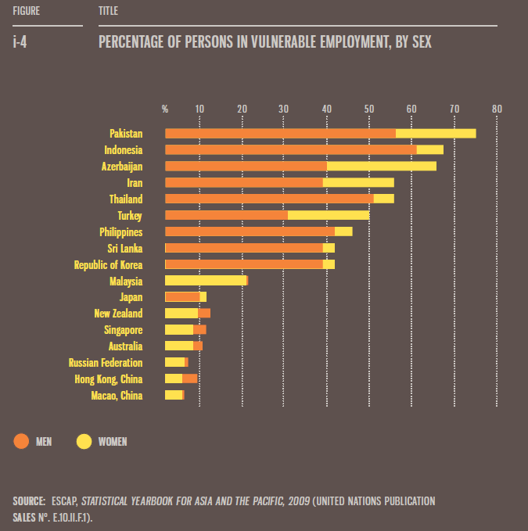
Vulnerabilities and Future Challenges
Youth bulge and challenges of youth employment
1.1 billion workers remain in ‘vulnerable’ forms of employment
The majority of women still depend upon precarious and vulnerable forms of employment: In India and Bangladesh over 90% of the female workforce are in the informal sector

Slide 11
Vulnerabilities and Future Challenges
Vulnerability of the region to economic shocks (shallow roots). Volatility and exposure to global shocks exacerbated by high inequality levels
Ageing populations: From 438 million in 2010 to 1.26 billion by 2050. increased costs of support services, health costs, pension and social protection
  Urbanization and the growth of cities: gaps in urban services, infrastructure, inter-generational poverty
High vulnerability to natural disasters: more than 200 million people were affected each year over the past decade - 90% of the world’s total

Slide 12
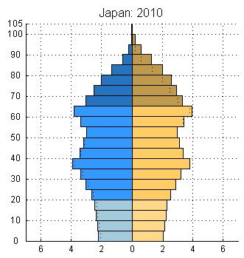
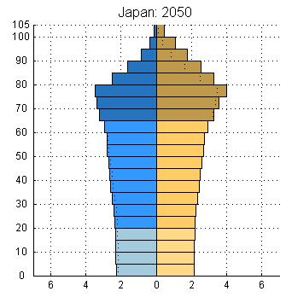
Japan: 2010-2050
Source: United Nations, Department of Economic and Social Affairs, Population Division (2011): World Population Prospects: The 2010 Revision. New York

Slide 13
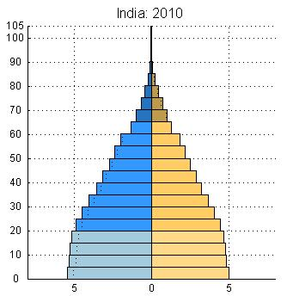
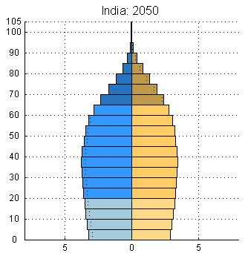
India: 2010-2050
Source: United Nations, Department of Economic and Social Affairs, Population Division (2011): World Population Prospects: The 2010 Revision. New York

Slide 14
Key elements of Social Protection - Reasons
Redistribute resources to those in need
Solidarity between persons and across generations
Support people to move out of poverty (into decent jobs)
Automatic stabilizers in (economic) downturns
Counter/respond to social unrest and facilitate cohesion
Boast economic growth

Slide 15
Key Elements of Social Protection - Modalities
Financial means to redistribute
Taxpayers/employers / the State
Formal employment helps
Coordination across schemes and actors – avoid fragmentation
Public support and political consensus important - stability

Slide 16
Key Elements of Social Protection – Sustainability
The extent to which social protection schemes are perceived as being legitimate will depend to an important degree on whether people believe that there is a just and fair connection between what they (and others) are paying and what they are receiving in the form of various benefits and support.

Slide 17
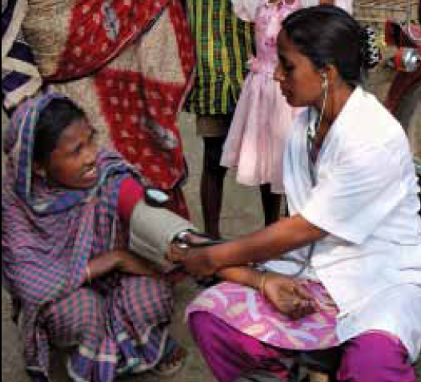
Key Elements of Social Protection – Questions
Who should administer / govern the system?
How should it be funded?
Who should be covered?
Quality and delivery of services?

Slide 18
Social Expenditure by Program Category - 2008
% GDP
Source: ADB, Social Protection Index for Committed Poverty Reduction Volume 2: Asia. 2008, Manila.

Slide 19
Social Protection in the Asia-Pacific region
Ranges from sophisticated multi-sectoral and universal systems, to carefully targeted/conditional and time-bound programs
Sub-regional variation?: employment guarantee schemes in South Asia; CCTs in Southeast Asia; pensions in East Asia
They also serve diverse purposes and development goals: employment creation, poverty alleviation, community development, asset accumulation etc
From fragmented programs to comprehensive systems?
But legal and institutional barriers also need to be dismantled/socio-cultural barriers addressed

Slide 20
Keys examples in the region
Employment-based targeted schemes: The MGNREGA, Bangladesh, Pakistan, Solomon Islands
Conditional Cash Transfers: 4Ps (Philippines), PKH (Indonesia)
‘Universal’ health systems (Thailand, China, Philippines)
Universal pension schemes (Nepal)
etc

Slide 21
Overview of Training Task
Identify one or two existing and anticipated gaps in social protection
What is in place? What works well?
What needs to developed? How will such arrangements have the greatest impact?

Slide 22
THANK YOU
For more information
escap-sdd@un.org
www.unescap.org

