Slide 1
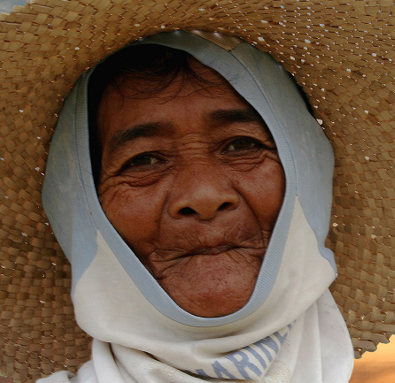
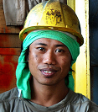

Global and regional approaches to social protection
Valerie Schmitt
ILO DWT Bangkok, 12 June 2012

Slide 2

Structure of the presentation
What is social security
The challenge of the extension
The social protection floors: basic entitlement and diversity of approaches
Why it is important?
Recommendation on National Floors of Social protection
ILO’s work at regional and country levels

Slide 3
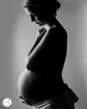





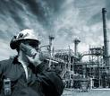

What is social security?
People face contingencies during their lives
Maternity
Sickness / ill health
Unemployment
Work injury
Life cycle
Families with children
Invalidity
Death of the
breadwinner
Old age
These have financial consequences

Slide 4
What is social security?
THE PROTECTION PROVIDED BY SOCIETY
To compensate for the loss of income & covers health care expenditures
To facilitate access to social services and fulfill basic needs
FINANCIAL SUPPORT
ACCESS TO SERVICES

Slide 5
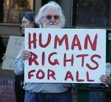
What is social security?
Social security is a human right (Article 22 Universal declaration of human rights)
Flagship Convention 102, 1952

Slide 6
Structure of the presentation
What is social security
The challenge of the extension
The social protection floors: basic entitlement and diversity of approaches
Why it is important?
Recommendation on National Floors of Social protection
ILO’s work at regional and country levels

Slide 7

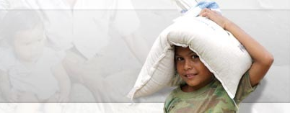
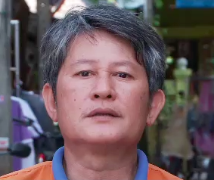
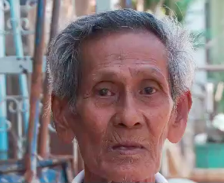
The challenge of the extension
50% of the children are living in poverty, many lack access to health and education
60% of the elderly do not receive a pensions
Only 15% of the working age population have access to unemployment benefits
30% of the population do not have access to essential health care
>> Overall 80% of the World’s population do not have access to comprehensive social security coverage

Slide 8
But how to extend social security?
For a long time, SS was contributory and mainly adapted to the formal sector
Level of coverage
Assumption that these schemes would progressively extend their coverage with the shrinking of the informal sector
This did not happen….
Model= C102
???
Poor - Informal economy - Form. Sect.

Slide 9
But how to extend social security?
Level of coverage
Discussion on SS in 2001 -> new consensus: priority to the extension of coverage, exploring several strategies: adapted SS, micro-insurance, social assistance…
Model= C102
Poor - Informal economy - Form. Sect.

Slide 10
Towards the two dimensional social security extension strategy
Level of coverage
The Social Protection Floor initiative launched in April 2009
All countries should at least provide a Social Protection Floor to all their populations
Two dimensions of social security extension: horizontal and vertical
Model= C102
Poor - Informal economy - Form. Sect.

Slide 11
Towards the two dimensional social security extension strategy
Level of coverage
With the Social Protection Floor the horizontal dimension would be achieved
Based on which additional blocks (partially or fully contributory) can be built
In order to achieve higher levels of protection
Model= C102
Poor - Informal economy - Form. Sect.

Slide 12

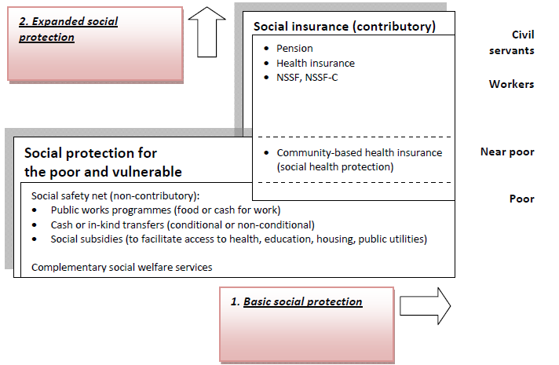
The two dimensions in the National Social Protection Strategy
Cambodia’s NSPS

Slide 13
Structure of the presentation
What is social security
The challenge of the extension
The social protection floors: basic entitlement and diversity of approaches
Why it is important?
Recommendation on National Floors of Social protection
ILO’s work at regional and country levels

Slide 14


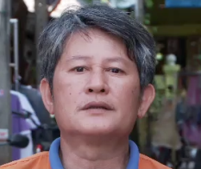

In a country with a Social protection floor
❶
All residents have access to essential health care
❷
All children enjoy income security through transfers in cash or kind → access to nutrition, education and care
❸
All those in active age groups who cannot earn sufficient income enjoy a minimum income security (transfer in cash or in kind & employment guarantee schemes)
❹
All residents in old age and with disabilities have income security through pensions or transfers in kind

Slide 15
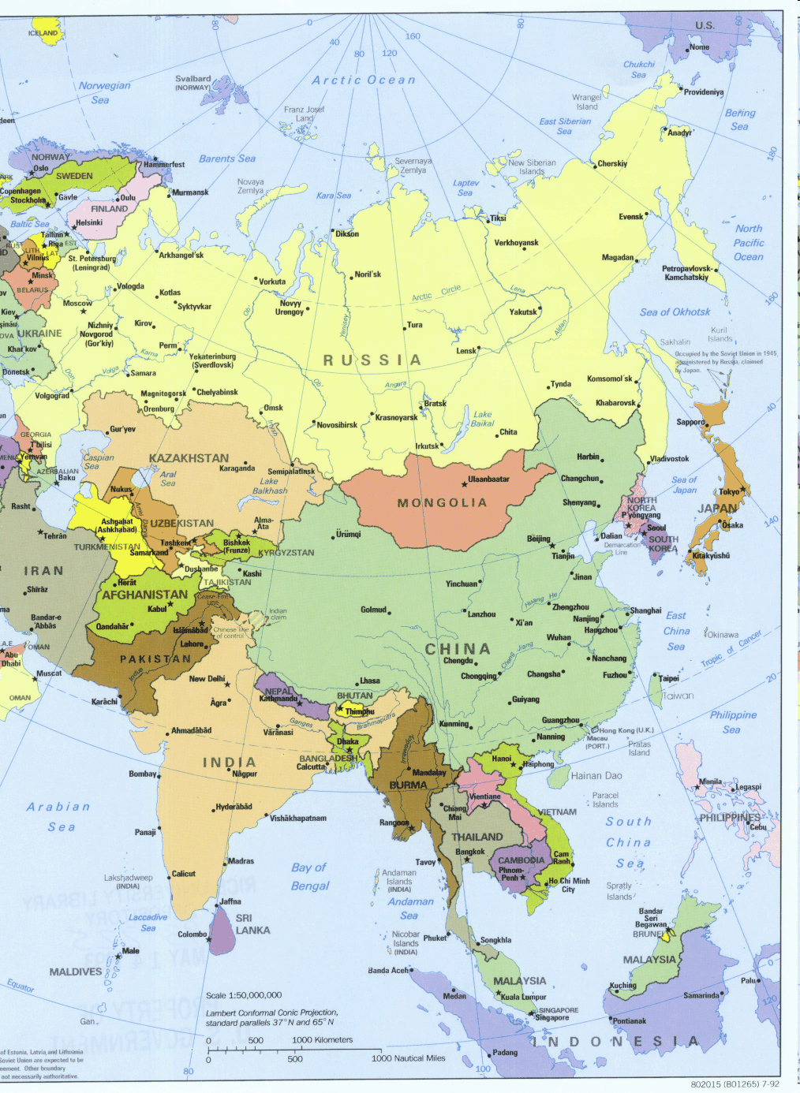
Four guarantees can be achieved with many different schemes
China: minimum living standard guarantee program; new rural corporative medical care (NRCMC); health insurance for urban uninsured residents (HIUR); rural old-age pension
India: RSBY, NREGA
Cambodia: CARD’s NSPS with clear reference to the SPF … including HEFs, CBHIs, Food distribution, PWPs,…
Lao: extension of SHP for all
Thailand: UC scheme, minimum pension scheme (500 THB)
Philippines: 4Ps
Indonesia: Jamkesmas, Jampersal, PKH, Rice for the poor, PNPM
Vietnam: 10 years Social security strategy

Slide 16
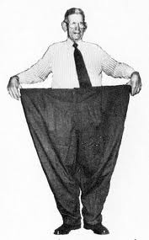
National Social Protection Floors
Not a one size fits all approach : each country defines the levels of benefits that it can/is willing to provide
Each country also decides how to do it – through universal schemes, targeted social assistance, social insurance, a combination…

Slide 17
However some guiding principles
UNIVERSAL COVERAGE
REACHING ALL THOSE IN NEED OF PROTECTION (UNIVERSALITY CAN MEAN TARGETED MECHANISMS)
NON DISCRIMINATION
SUSTAINABILITY
SUPPORTING AFFORDABILITY AND FEASIBILITY ASSESSMENTS
IMPROVING GOVERNANCE AND INSTITUTIONAL CAPACITY, INCLUDING AT THE LOCAL LEVEL
STRENGTHENING INFORMATION SYSTEMS, MONITORING AND EVALUATION
RIGHTS BASED APPROACH
PROMOTING A LEGAL FRAMEWORK BASED ON EVIDENCE, PREDICTABILITY

Slide 18
However some guiding principles
ADEQUACY AND FOCUS ON OUTCOMES
PROVIDING ADEQUATE LEVELS OF BENEFITS
ENSURING IMPROVEMENTS OF THE SUPPLY SIDE (health care, schools)
DIALOGUE
FAIR BALANCE OF INTERESTS - INVOLVEMENT OF SOCIAL PARTNERS & OTHER STAKEHOLDERS
COHERENCE
ENSURING POLICY COHERENCE AND HARMONIZATION
STRENGTHENING LINKAGES WITH EMPLOYMENT, WITH DECENTRALIZATION PROCESSES
PROGRESSI-VENESS
ENCOURAGING GRADUATION TOWARDS HIGHER LEVEL OF SOCIAL PROTECTION BENEFITS

Slide 19
Structure of the presentation
What is social security
The challenge of the extension
The social protection floors: basic entitlement and diversity of approaches
Why it is important?
Recommendation on National Floors of Social protection
ILO’s work at regional and country levels

Slide 20
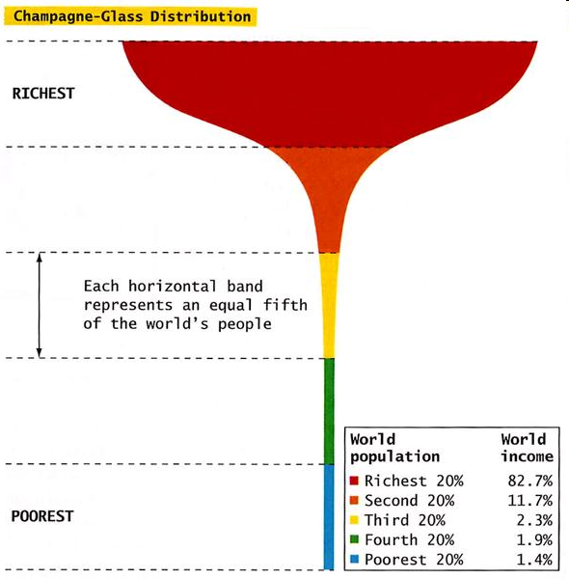
Why it is important?
Human right
Persistent poverty
Social exclusion and increasing inequalities (polarization)
Financial-economic crisis
Natural disasters
Growth based more and more on the domestic market
Need for more productive and skilled workforce particularly in the aging societies

Slide 21
And it contributes to accelerate the extension of coverage
Long term process
Thailand
Acceleration

Slide 22
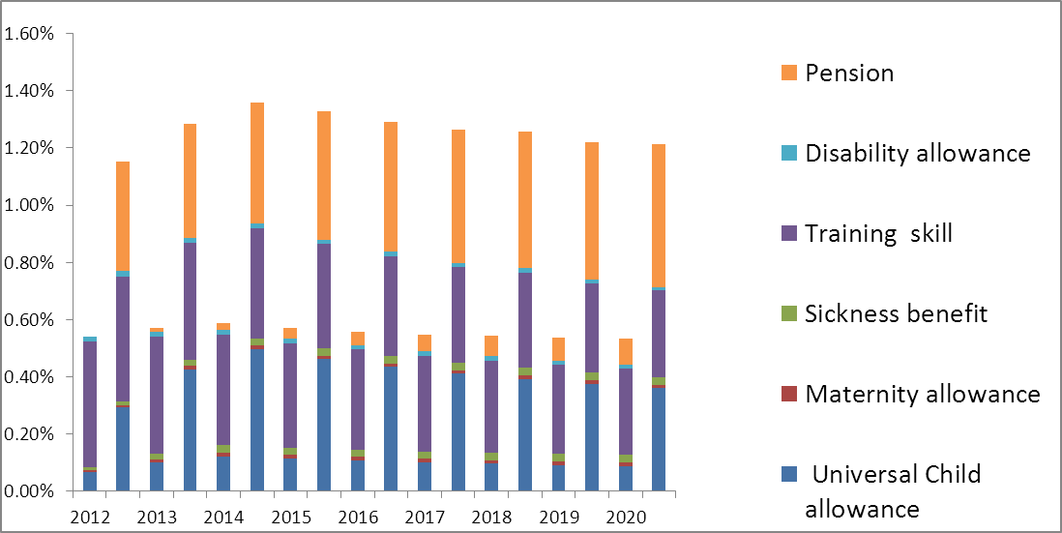
It is affordable - Example of Thailand
(cost in % GDP of completing the SPF)

Slide 23
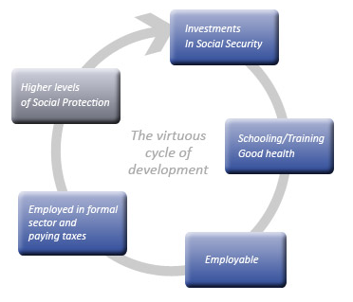
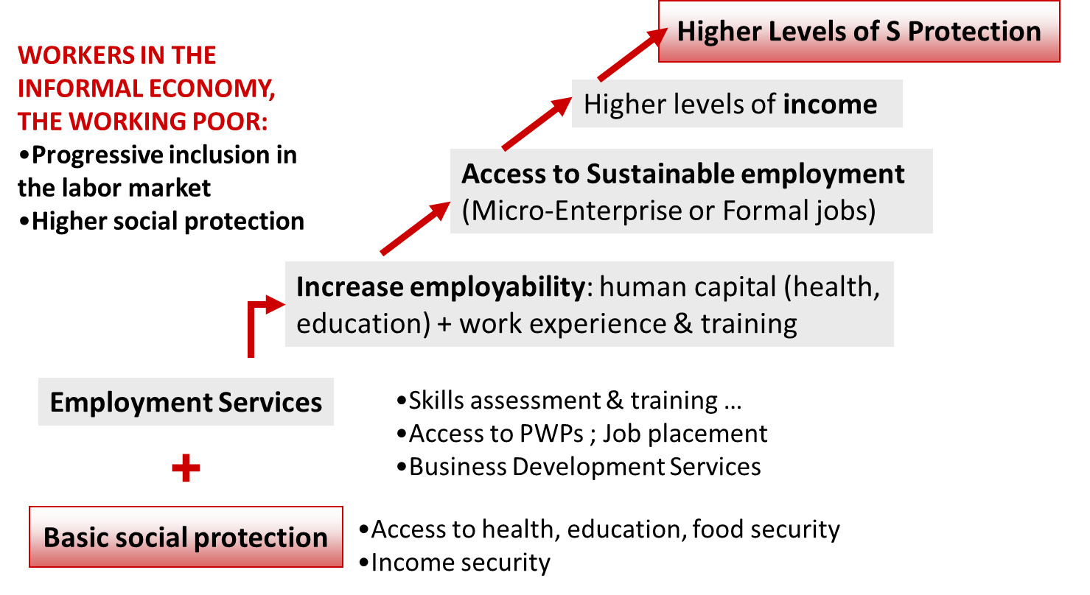
The SPF is an investment (not a cost)

Slide 24
Structure of the presentation
What is social security
The challenge of the extension
The social protection floors: basic entitlement and diversity of approaches
Why it is important?
Recommendation on National Floors of Social protection
ILO’s work at regional and country levels

Slide 25
The Recommendation 202 will be
A useful guidance for ILO members:
  In establishing elements of the SPF and filling the SPF gap
  In developing higher levels of social protection, progressively
  for as many people as possible, guided by ILO social security standards

Slide 26



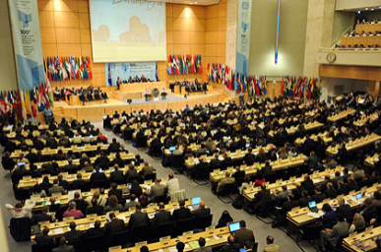
The elaboration process of the recommendation
June 2011
ILC Recurrent Discussion on social protection (social security)
August 2011
Law and practice report (white report)
Summary of Member responses to questionnaire (2A)
March 2012
Final report
(blue report)
Resolution and conclusions concerning the recurrent discussion on social protection
Decision on standard-setting item (single discussion) at ILC 2012 (GB)
Questionnaire on possible Recommendation on social protection floors (deadline:
1 November 2011)
Office draft of proposed Recommendation (2B)
June 2012
ILC standard-setting discussion
(single discussion)
Discussion of amendments
Possible adoption of Social Protection Floor Recommendation
Summary of law and practice in member States
Office commentary (2A)
Replies from
118 member States
Resolution and conclusions
ILC 2011
Questionnaire
please
submit
before
1 Nov 2011

Slide 27
The recommendation at a glance
Preamble
Objectives, scope and principles
National social protection floors
Definition of basic social security guarantees
National strategies for the extension of social security
Prioritize implementation of national SPFs
Progression to higher levels of protection
Monitoring
Social security as human right and social and economic necessity
Reference to various international instruments
Objective
and scope
Principles
Definition of national social protection floors
Establishment and review
National monitoring
International exchange of information, experiences and expertise
Provision
Financing
Legal foundations
Building and maintaining social security systems
ILO social security standards
Policy coherence

Slide 28
Discussion at the ILC
(1-14 June 2012)
Vote of the instrument
1st meeting of the committee
Adoption of the report
1
2
4
5
6
7
8
11/13
14
General Statements
07/06 - Adopted the Draft of the SPF Recommendation and an accompanying resolution to support the implementation of SPFs on the national level
Amendments
General presentation of the Recommen-dation
05/06 - Core definition of the SPF untouched; Issue of coverage (i.e. the definition of residence) - after a substantial debate, the office draft was retained

Slide 29
Structure of the presentation
What is social security
The challenge of the extension
The social protection floors: basic entitlement and diversity of approaches
Why it is important?
Recommendation on National Floors of Social protection
ILO’s work at regional and country levels

Slide 30

Regional level: promotion of the SPF and two-dimensional extension strategy
UNDG-AP Issues Brief on Social Protection- entry points for UNCTs to support the development & progressive implementation of social protection plans

Slide 31

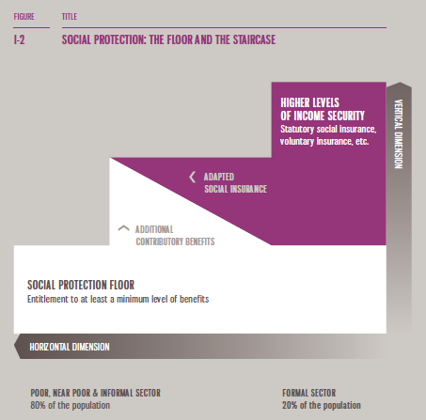
Regional level: promotion of the SPF and two-dimensional extension strategy
  The SPF framework was included in UNESCAP major document The promise of protection that was launched at the Sixty-seventh session of the Commission on 19-25 May 2011 (http://www.unescap.org/commission/67/)

Slide 32

Regional level: promotion of the SPF and two-dimensional extension strategy
“Agreed on the need to strengthen cooperation amongst ASEAN Member States towards universal coverage of social protection to the peoples of ASEAN”
TOWARDS A COMMON DENOMINATOR???

Slide 33
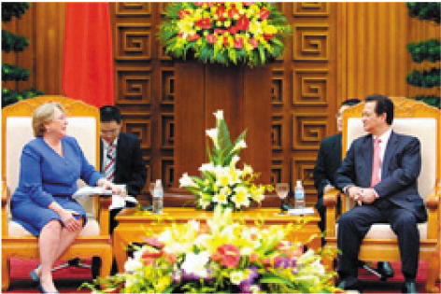
Country level: a phased approach
Step 1 - Promotion of the SPF and two-dimensional extension strategy
Cambodia’s NSPS
Viet Nam: visit of Mrs Bachelet

Slide 34
Country level: a phased approach
Step 2 –Assessment of social protection
 | SPF objectives | Existing SP provision | Planned SP provisions (strategy) | Gaps |  | Recommendations
 |  |  |  | Design gaps | Implemen-tation issues
Health
Children
Working age
Elderly
The Social Protection Situation
Design gaps and implementation issues (to complete the SPF)
Social Protection Floor template: guarantees and objectives
Priority policy options to be decided through national dialogue

Slide 35
Country level: a phased approach
Step 2 – The costing of “SPF” recommendations
Costing results of completing the SPF gap, Thailand, May 2012

Slide 36
Assessments / country
NOV.2010
OCT. 2012
Training
Training
2011 ….. 2012
2013 ….. 2014
VIETNAM
LAO PDR
INDONESIA
PHILIPPINES
THAILAND
MALAYSIA
…???
PRELIMINARY COSTING IN CAMBODIA

Slide 37



Country level: a phased approach
Step 3 – Technical assistance to the design, implementation, monitoring of SP schemes
Health care schemes (Cambodia, Lao PDR)
Child Allowance (Thailand)
Unemployment insurance schemes (Viet Nam, Malaysia)
Long term care schemes (Thailand)
Pension schemes (Viet Nam)

Slide 38
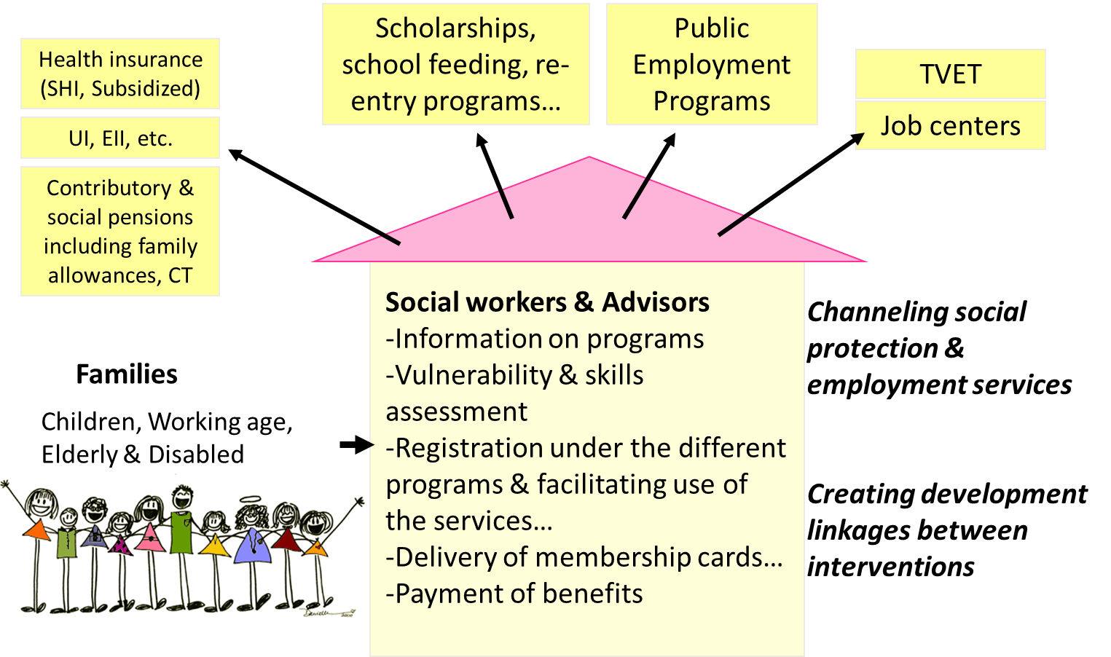
Country level: a phased approach
Step 3 – Technical assistance for the implementation of coordinated SP plans

Slide 39

MoLVT
MoE
MoH
MoSA
MoRuralDevlt
National level
Coordination board, chaired by CARD-SPCU
Coordinates policies
Supervises SP/Empl. Schemes
Monitors NSPS (based on DB)
Manages grievances
CARD-SPCU
MoPI
NSPS DB
Defines indicators & guidelines
Analyses the data from DB
Manages DB
Reporting
TVET
NSSF
Scholarships
HEFs
CBHIs
NSSF-C
NFV
PWP
JobCenters
School feeding
PEOPLE service
Local governance & appeals committee
Commune/district
Grievance resolution

Slide 40
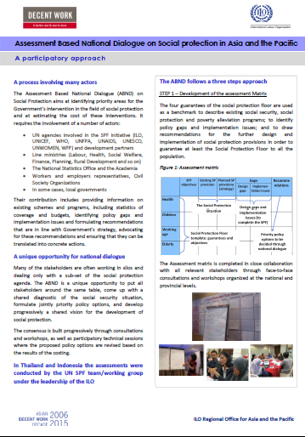
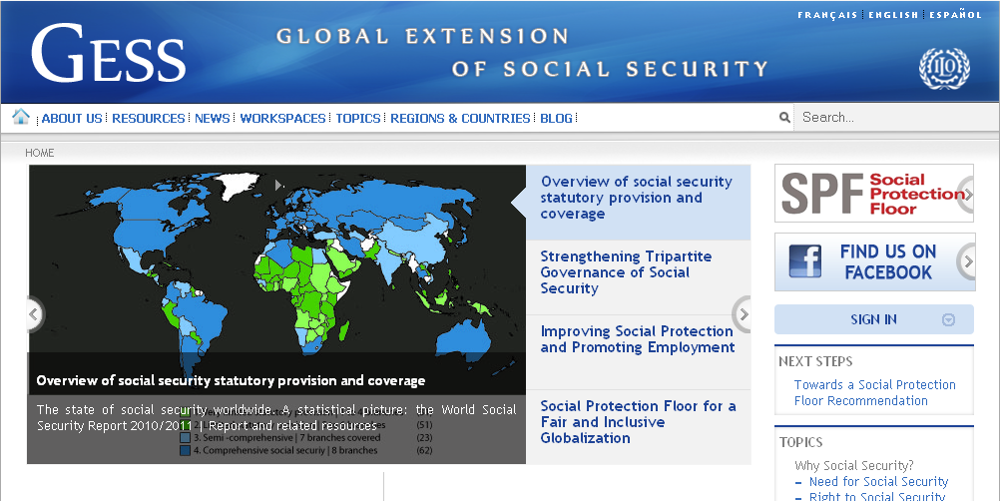
Readings…
PROPOSED RECOMMENDATION
www.ilo.org/ilc/ILCSessions/101stSession/reports/reports-submitted/WCMS_174637/lang--en/index.htm
FACTSHEETS ON SPF, ABND, SWS, UNEMPLOYMENT…
www.social-protection.org

