Slide 1
Financing Social Protection
Franziska Gassmann
Bangkok, June 2012

Slide 2
Ongoing debate
The introduction or extension of social protection in low- and middle income countries requires substantial funding.
Governments are faced with financial constraints and fear the commitment to long-term liabilities.
Current debate: is a basic SP package affordable in LICS and MICS?
  Costs determined by size of target population, benefit levels (and administrative capacity)
Can sufficient fiscal space be found or created for SP?
  How to finance in such a way that promotes redistribution and does not hinder economic growth?
  Is financing through taxation a feasible option?
  What about competing national objectives?

Slide 3
A lot has been done
ILO: Groundbreaking work
  Affordability studies of social protection in LICS (Cichon, Hagemejer, Behrendt, etc.)
  Social security expenditure database (accessible from GESS website)
UNDP (Poverty Center), UNICEF (Bachelet report, a.o.)
Academia and research centers (ManU, ODI, IDS, EPRI, MGSoG, etc)
HelpAge: pension watch, tool to calculate costs of universal pension
ADB: social protection index, expenditure data
IMF: recognition that SP can play a role as automatic stabilizers during crisis
Most recently: FAO wants ‘to jumb on board’

Slide 4
Outline
What are the costs of SP?
  → Economic calculation
What are countries currently spending?
Is it affordable?
  → Political calculation
How to create fiscal space?

Slide 5
How much money do we need?
Mainly based on simulations, due to limited evidence base for LICS
  ILO, HelpAge, UNICEF
Different packages, main focus on:
  Universal pensions
  Child allowances
  Extremely poor households

Slide 6
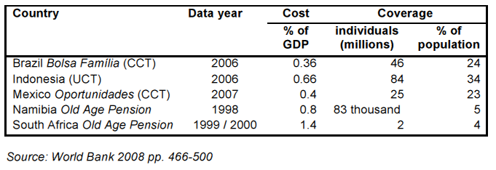
Annual costs existing programs - MIC
Notes:
DFID, 2011, p. 67

Slide 7
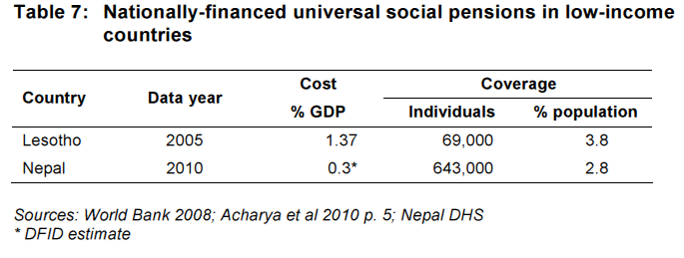
Annual costs - LIC
Notes:
DFID 2011, p. 73

Slide 8
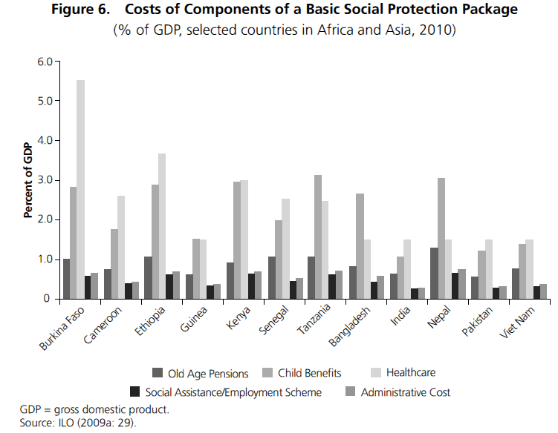
Costs of the full package
Notes:
ADB 2010, p. 71

Slide 9
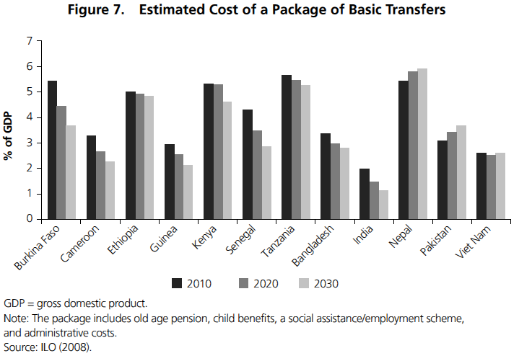
…and over time
Notes:
ADB 2010, p. 50

Slide 10
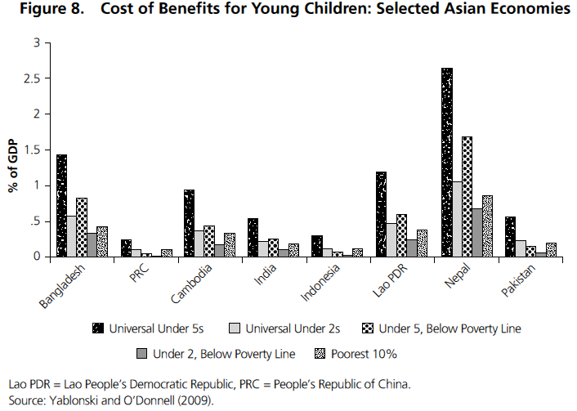
Design matters
Notes:
ADB 2010, p. 51

Slide 11
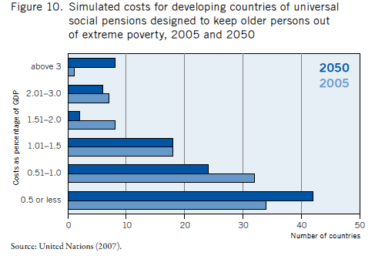
Universal pension
Notes:
Source: Bachelet Report, p. 43
Universal pension of 1 USD per day for all people over 60.
Out of 100 developing countries, costs would be less than 1 percent of GDP for 66 countries.

Slide 12
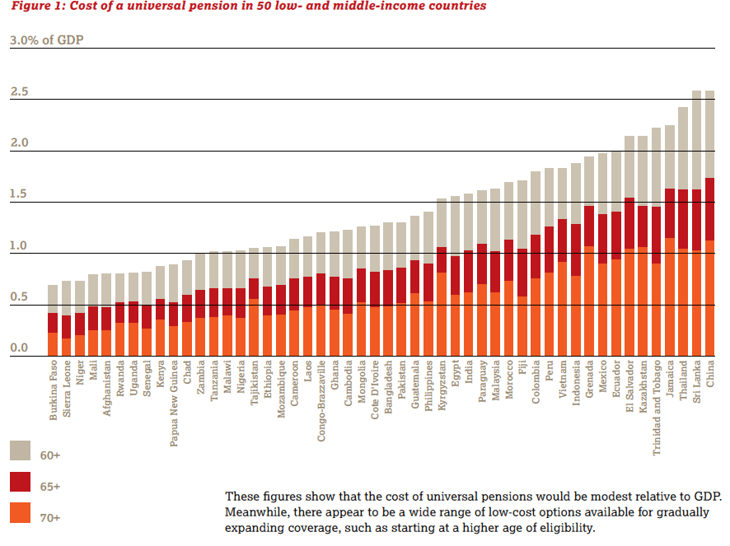
Notes:
HelpAge, 2011a, p. 3
Note: for some countries (especially in Central Asia) this might be an overestimate, as some have already existing pension schemes.

Slide 13
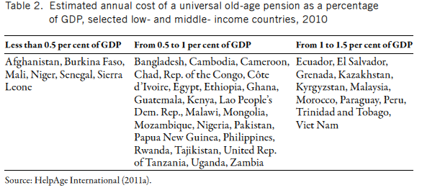
Universal pension
Notes:
Bachelet p. 44 (summary of HelpAge Figure on previous slide)

Slide 14
It’s affordable, isn’t it?
What does 1% of GDP mean?
  In terms of total government expenditures?
  In terms of current social policy expenditures?
LICS: total public spending usually in the range of 15-20% of GDP (DFID, 2011:71)
On the other hand, a basic SPF would never be implemented all at once, but incrementally.
Notes:
Most countries already spend 1-2% of GDP on social transfers. But this conceals large variation in the actual level and effectiveness of public spending.
In MICS, 1% of GDP may be sufficient, but in LICS this would translate into very low levels of absolute spending (DFID, 2011:67)

Slide 15
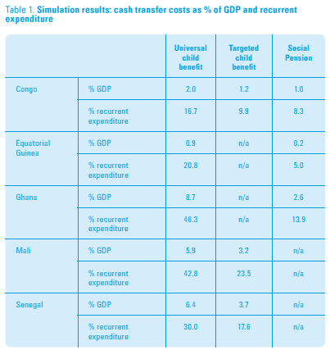
Affordable in terms of GDP, but prohibitive in terms of government expenditures?
Notes:
Unicef/ODI 2009, p.4

Slide 16
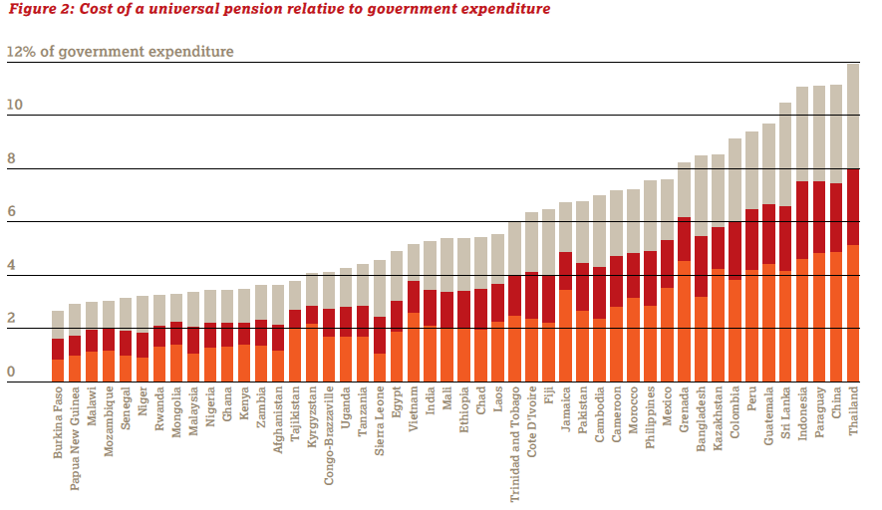
…and it would come on top of existing spending
Notes:
HelpAge 2011a, p. 4
Is there a fear of crowding out other social spending? Not necessarily.
27 out of the 50 countries spend more on military expenditures than it would to cost to provide universal pensions to all 60 and older (Help Age 2011a, p4).

Slide 17
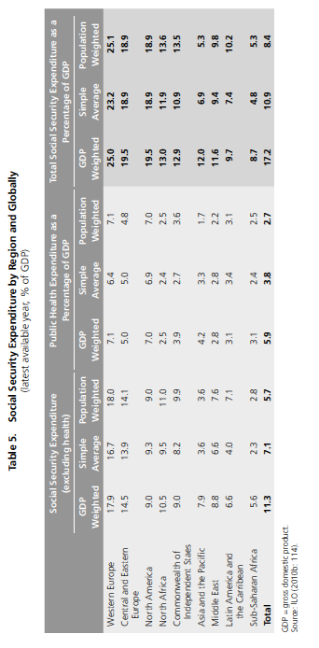
Current spending on SP
Notes:
ADB 2010, p. 73

Slide 18
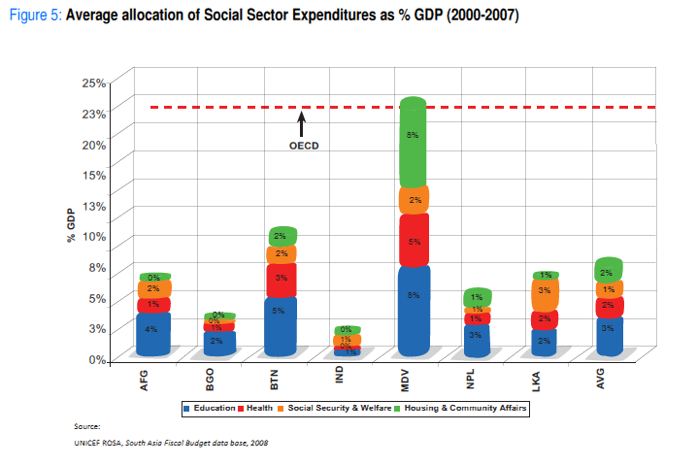
South Asia in detail
Notes:
Köhler et.al., 2009, p.17

Slide 19
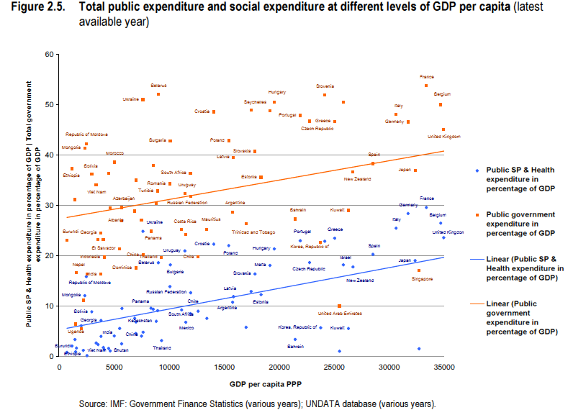
Notes:
Source: ILO 2009
Countries make different choices. At similar levels of GDP, countries set their priorities different. However, it may also be the result in tax revenues as a % of GDP!
This illustrates role of political choices in the process.

Slide 20
Affordability
“Affordability is a question of political choice about the best way to allocate resources” (Andrews et.al. 2012:26)
Social protection investments are long-term and recurrent investments
Affordability depends on
  Fiscal space
  Political will and commitment
  Policy priorities (competing, within and between sectors)
Affordability is at the core of the social contract between government and citizen: willingness to redistribute (how and how much)
Notes:
Even if SP is affordable theoretically, allocation of more government resources depends on political will, commitment and policy priorities.
Commitment can be stimulated and policy priorities guided by international community. If a government commits to poverty reduction strategies, MDGs or national development plans.
Without political and civil consensus on how to implement rights to social protection, long-term commitments are difficult to obtain.
Affordability can change due to economic circumstances:
Mongolia: had to revoke the universal child allowance in 2010 when revenues became constrained;
Nepal: although social pension eligibility was expanded, benefits had to be rationed as a result of limited resources and capacity (both examples from Andrews, et.al. 2012:27).
Even with the same size of government budgets, countries spend very different proportions on social expenditures.

Slide 21
Strategies to ensure sustainability of SP systems
Stimulate economic growth, formalize economy, enhance productive employment
Create necessary fiscal space
Political will
Cost-control mechanisms
Effective institutions (administrative capacity)
Sound implementation and good governance, including M&E
Account for long transition period wherein SP spending is increased
  Sequential introduction of different transfers
  Start with limited coverage, small benefit levels and expand over time
Notes:
Source: Bockstal, 2012, DFID, 2011
Admin capacity: needs to be maximized in order to deliver benefits efficiently and to minimize waste and misuse of resources.
Implementation and good governance: processes for efficient service delivery, monitoring and evaluation and proper financial management.

Slide 22
Fiscal space
“Fiscal space is the availability of budgetary room that allows a government to provide resources for a desired purpose without any prejudice to the sustainability of its financial position” (Heller, 2005).
Dynamic concept, subject to
  Political priority setting
  Short-, medium- and long-term planning
Usually determined for 3-5 years (medium term)
Can be created by cutting costs or increasing resources
Notes:
Rationale: fiscal space needs to exist or be created in order to increase spending on social protection (or any other national priority program) in a sustainable manner.
Nowadays even more difficult due to economic and financial crisis.
Time horizon especially relevant in the case of universal pensions, as they need to be planned well in advance, taking into account expected demographic developments and growth.

Slide 23
What determines fiscal space?
Fiscal balance
  Government revenues and grants minus government expenditures and net lending
  IMF Article IV as first indication
Tax revenues
ODA (Aid, concessional loans, debt relief)
Prioritization/reallocation of resources
Government borrowing
A country’s ability to diversify tax income and economic activity determines the reliability of revenue streams and as such, fiscal space (HelpAge 2011b:4)
Economic growth provides the easiest way to create fiscal space (Bachelet, 2011:67).
Notes:
Key issues in LMICS: aid dependency; dependency on limited number of exports subject to volatile global market prices.

Slide 24
Taxation
Guiding principle for financing social protection spending
  Government-driven
  Sustainable
Potential impacts of direct and indirect taxes need to be considered
  Progressive or regressive
  Fair tax burden
  Distributional consequences (tax incidence)
Challenges:
  Lack of administrative capacity, inadequate records
  General lack of trust in quality of public spending
  Reliance on narrow range of taxes
  Political economy
Notes:
In context of high inequality, taxes need to be progressive in order to reduce poverty and inequality (HelpAge, 2011b).
If tax increase for financing social protection raises tax burden of the poor, then poverty reduction impact is counteracted.
Progressive tax: poorer households are taxed less than richer households.
Regressive tax: tax constitutes a larger percentage of poor household’s income.
Political economy: in countries with high inequality, governments need to tax the rich and middle class in order to generate sufficient revenues. These groups are politically powerful. Their support for social spending is more likely when it is accessible for all citizens, e.q. with universal entitlements. Citizens are more likely to pay taxes if they will benefit. Note, that the benefit does not need to be a direct transfer. Reduced crime or cleaner neighborhoods may be considered a benefit as well.

Slide 25
Taxes have potential
The lower tax revenues as % of GDP, the greater the potential for raising additional funds
Advantage of ensuring sustainability and legitimacy of SP programs
However, potential diminished if informal sector is large
  Widen coverage of informal sector
Need to improve revenue collection procedures
  Strengthen capacity of tax administration to enforce compliance
  Simplify taxes and encourage voluntary compliance
  Fight against corruption
Notes:
Example Burkina Faso: raising tax revenues by 1 pct. Point from 13 to 14% of GDP would be enough to finance a universal pension for all those aged 65 and over (Holmqvist, quoted in HelpAge 2011b:5).
Informal sector in LICS and MICS between 40-90% of economy. Taxing employment will not generate substantial revenues.
Tax simplification helped to expand formal jobs recorded in Brazil substantially since the early 2000s (in OECD, 2011;76).
Extension of social assistance in Brazil, China, India and South Africa financed mainly through general tax revenues. In China and India this was facilitated by strong economic growth (Bachelet, 2011:68).
Corruption: it is estimated that in SSA in 2002 50% of total tax revenues were lost due to corruption (Bachelet, 2011:70).

Slide 26
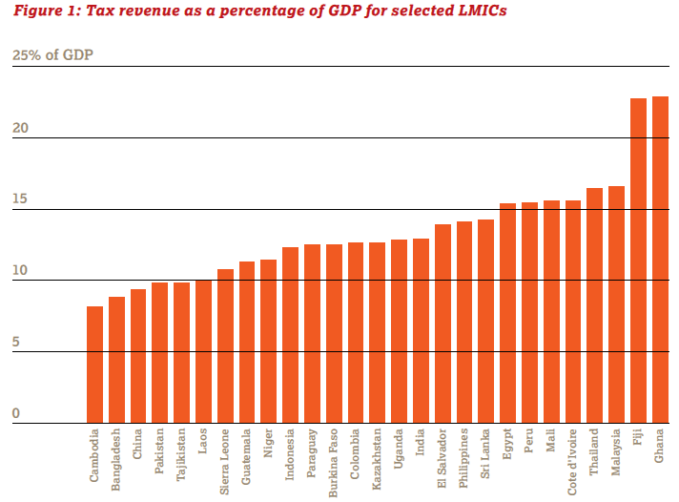
OECD average = 36%
Notes:
HelpAge 2011b, p. 6

Slide 27
Consumption Tax
Provides broad tax base
  Peru: 18% VAT, 40% of tax revenue
  Sri Lanka: VAT = 2/3 of tax revenue
Low and relatively flat rates across broad base of goods and services are relatively easy to collect and administer
Needs to be low for basic necessities (esp. food)
Special case: excise tax
  Taxing goods with negative externalities
  May be politically better acceptable
Notes:
Consumption tax:
indirect tax levied on spending on goods and services (e.g. VAT)
Usually follows GDP development
Provides broad tax base
Sri Lanka: small increase in VAT would pay a universal pension for all 70+ (quoted in HelpAge 2011b:6)
VAT is less regressive than thought, as basic commodities are often exempt.
Study of 8 SSA countries: broad-based taxes such as VAT are progressive, not putting inequitable burden on the poor.

Slide 28
Payroll and income tax
Main financing source for SP in developed countries (esp. payroll taxes – social contributions for social insurance type benefits)
Some MICS went the same way by taxing wages of those working in formal sector
  Brazil: payroll tax for formal workers finances means-tested pension in urban areas
Not an option for LICS (and many MICS
  Formal sector too small
Payroll tax may also reduce incentive for workers to move into formal sector
Notes:
Brazil: Beneficio de prestacao continuada (BPC); also includes extremely poor with disability.
ILO estimates informal economy: 78% of employees in Asia

Slide 29
Natural resource tax
Only relevant for mineral-rich countries
Fiscal space can be increased/created with relatively limited public administration
  Bolivia: universal pension financed by SOE privatization, later by a Direct Hydrocarbon Tax
Drawback:
  usually heavy reliance on exports and dependence on world prices
  Governments lack incentives to invest in other sectors, or to develop effective tax systems and institutions
Notes:
Bolivia: universal pension introduced in 1997 (‘Bonosol’). Currently called ‘Renta Dignidad) and for all 60 years and older. Government aims at shifting financing to general tax revenues.

Slide 30
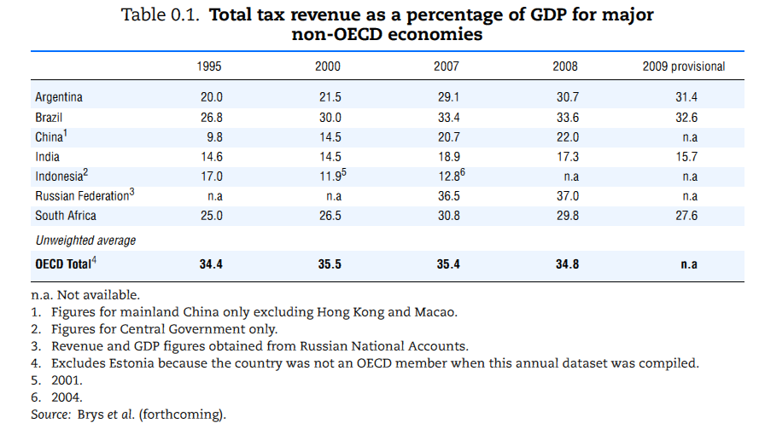
Share of tax revenues is increasing in emerging economies
Notes:
OECD 2011, p. 62

Slide 31
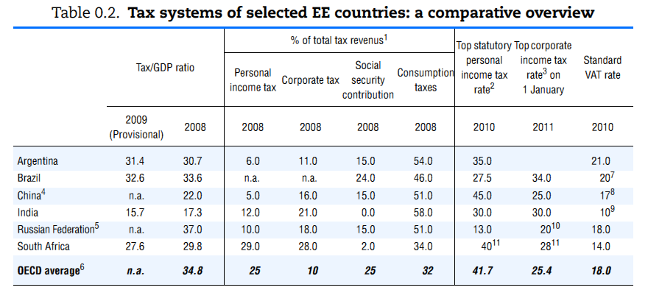
Composition differs from OECD
Notes:
OECD 2011, p. 63
Personal income tax less important in BRICS+, while consumption taxes account for 34 to 58% of total tax revenues.

Slide 32
ODA
Important for initial direct funding of SP programs, especially in LICS
  Support of development of institutions and administrative capacity
  Support of pilots
Challenge: sustainability
  if insufficient government ownership and capacity
  If (pilot) transfers not translated into entitlements
  ODA often inflexible and unreliable; transaction costs can be high
Special case: debt relief
  Can free up fiscal space
  Need to earmark debt relief funds for SP, possibly separating from other public expenditures
  Explicitly link to social protection
Notes:
Examples: Zambia, Kenya, where it is still not clear whether there is sufficient political will and funding for the government to take over and reach national coverage.
Key lessons/suggestions on the use of ODA funding for introduction and implementation of social protection schemes (HelpAge 2011b;9):
Donor financing needs to be predictable, while governments’ own tax resources need to be developed;
Donors should invest in capacity building of civil society to increase political debate, demand and accountability;
Donors should fund capacity building and technical assistance to create national evidence base;
Donors should support the development of a legislative social protection framework and national social protection policies.
Examples:
Ethiopia PSNP: financed through donor cooperation providing funding (Bachelet, 2011:69). However, other LICS in SSA did not succeed in coordinating donors, leaving them with small-scale pilots.
Ghana: debt relief enabled initial financing of LEAP. Success depends whether savings are earmarked for SP.

Slide 33
Reallocation of resources
Shift expenditures from inefficient or inequitable allocations
  Mexico C.: social pension financed by reducing senior officials’ travel and salaries
Reduce unproductive spending, especially if it is recurrent
Considerations:
  Balance spending in and between sectors
However, annual margins generally small
Notes:
Kenya spends 1.4% of GDP on civil service pensions, but only 0.3% on all other forms of social protection.
Kyrgyz Republic spends more than 4% of GDP on implicit energy subsidies, which are largely regressive (Gassmann, 2012).
Examples:
El Salvador: savings from removal of untargeted energy subsidies used to increase social spending (Bachelet, 2011:46).
Mozambique: elimination of subsidies on fuel, bread and other regressive measures could help finance two basic programs (Bachelet, 2011:46).
Indonesia: CCT mainly financed by gradual reprioritization of social expenditure (Bachelet, 2011:69).
South Africa: 48% decrease in defense spending made funding of social programs from public resources possible (Bachelet, 2011:69).

Slide 34
Government borrowing
Not sustainable in medium to long term!
Only if return on expenditures justifies investment
Fiscal deficit and rise in public debt
  Interest rates may increase
  Shifting burden to next generation
  Potentially adverse implications for future growth
Should be limited to infrastructure projects
But: most CCTs in LA are financed (partially) by WB and IADB loans (Barrientos in HelpAge 2011b)
  Sustainability?
  (and: all social pensions in region are financed from domestic resources…)
Notes:
Finally, generating revenue by money creation (‘printing money’) offers another, though potentially risky, alternative.
But, active debt management can generate resources for SP. In Thailand, almost 1/3 of freed resources used for SP.

Slide 35
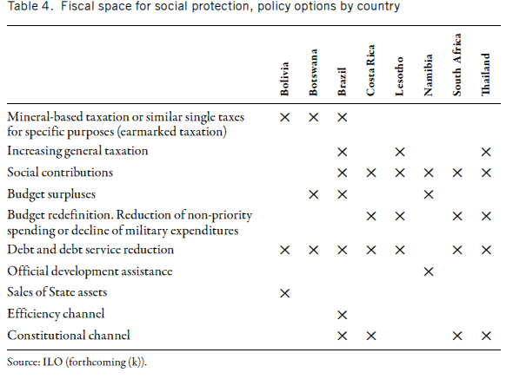
Policy options to enhance FS
Notes:
Source: Bachelet, 2011:71.
Costa Rica, Lesotho, South Africa, Thailand: Government cut spending in areas considered as low priority.
Costa Rica, Thailand: reduce or eliminate military spending.

Slide 36
Innovative financing
Financial transaction tax
  Tax on share trades
  Raises less than 0.5% of GDP on average, but potential to yield 48 billion USD/year in G20
  Brazil: helped consolidating health system
Global currency transaction tax
  0.005% tax on FEX transactions could raise up to 36 billion USD/year for 4 major currencies
Solidarity levy on airline tickets
  Brazil, France, Norway and UK agreed to tax airline tickets and support basic health protection in LICS
  1 – 40 USD/ticket
  Since 2006, 2 billion USD collected; funded programs in 94 countries
Notes:
Source: Bockstal, 2012
Other instruments:
Remittances:
about 350 billion USD in 2011, accounting for about 2% of GDP in developing countries and 6% of GDP in LICS.
Increase consumption and reduce poverty in origin countries
Further reduction of transaction costs can further increase money flows.
Stimulates solidarity in some communities
Debt-base instrument:
Debt2Health swap (Australia and Germany since 2007): conversion of bilateral debt into investments in basic health in Côte d’Ivoire, Egypt, Ethiopia, Indonesia, Pakistan

Slide 37
Measuring fiscal space?
Countries with low fiscal deficit and low tax revenues have more fiscal space (Bauer, et.al. 2010)
ODA is especially relevant for LICS, but to a lesser extent for Asia
Reallocation of resources difficult to measure
Notes:
More room to raise expenditures and revenues.

Slide 38
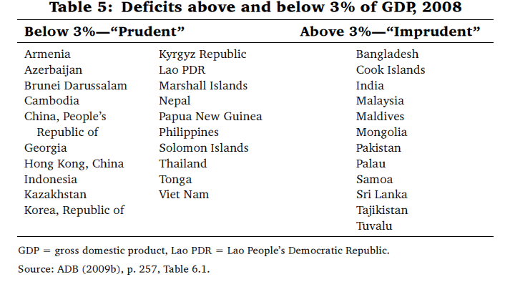
Fiscal deficits
Notes:
Bauer et.al. , 2010, p. 265

Slide 39
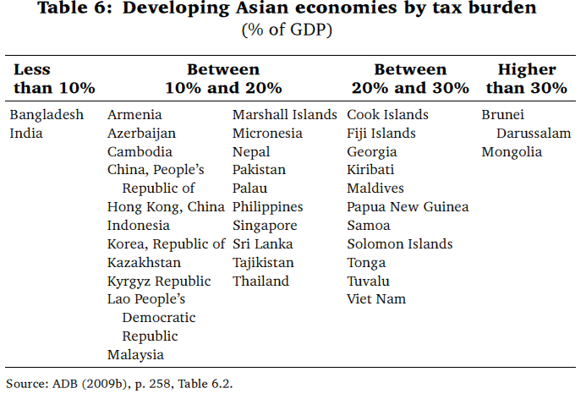
Tax burden
Notes:
Bauer et.al. , 2010, p. 266

Slide 40
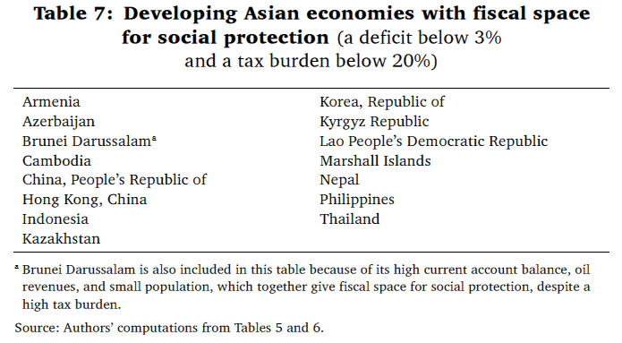
Fiscal space (…at least in theory)
Notes:
Bauer et.al. , 2010, p.266

Slide 41
From fiscal space to actual spending
Through national budget process
Budgeting is mainly incremental, with little space for new policy initiatives
Politics matter:
  new SP initiatives require political support AND fiscal space
  Formal versus informal budget decision making process
Notes:
Usually no more than 5% of government budget can be reallocated.
Even if fiscal space can be identified, without political commitment within executive for reallocation, the available funds may be used for political or clientelist purposes (UNICEF/ODI 2009).
In the absence of both fiscal space and political support: SP may benefit from ODA. Aid-financed projects circumvent needs for domestic fiscal space and politics of domestic resource allocation process. Risky strategy, as SP programs may be unsustainable. Lack of domestic support endangers scaling-up (see, e.g. Kenya, Zambia).

Slide 42
Key messages
Political (affordability) as well as fiscal (cost) considerations determine the scope of options for SP programs.
Fiscal space is country-context specific as it depends on political priorities and macro-economic conditions.
Domestic social and political priorities remain critical issues.
Financing option is the outcome of political debate, decisions and technical considerations.
Fiscal space is relatively easy to find for the short term. The challenge is maintaining it.
In LICS, issues of fiscal sustainability are important given the small budgets, great needs and intense competition from other sectors.
Increasing revenues and reallocating spending are the preferred options for the creation of fiscal space for SP.

Slide 43
References
Andrews, C. et.al. (2012), Social Protection in Low Income Countries and Fragile Situations, Social Protection & Labor Discussion Paper, no. 1209, World Bank, Washington DC.
Bachelet, M. (2011), Social Protection Floor for a Fair and Inclusive Globalization, ILO, Geneva.
Bauer, A. et.al. (2010), Global crisis and fiscal space for social protection, in: Bauer, A. and T. Myo (eds), Poverty and Sustainable Development in Asia. Impact and Responses to the Global Crisis, ADB, Manila.
Bockstal, C. (2012), Financing Social Protection Floors (presentation), ILO, Geneva.
DFID (2011), Cash Transfers, Evidence Paper, DFID, London.
Handayani, S. W. (ed.) (2010), Enhancing Social Protection in Asia and the Pacific, ADB, Manila.
HelpAge (2011a), The price of income security in older age, Pension Watch, Briefing no.2, HelpAge International, London. www.pension-watch.net
HelpAge (2011b), Financing social pensions in low- and middle-income countries, Pension Watch, Briefing no. 4, HelpAge International London.
ILO (2009), Extending Social Security to All: A Review of Challenges, Present Practice and Strategic Options, for the Tripartite Meeting of Experts on Strategies for the Extension of Social Security Coverage, ILO, Geneva.
Köhler, G. et.al. (2009), Social Protection in South Asia: A Review, UNICEF ROSA, Kathmandu.
OECD (2011), Divided We Stand: Special Focus: Inequality in Emerging Economies, OECD Paris.
UNICEF/ODI (2009), Fiscal space for strengthened social protection in West and Central Africa, Briefing Paper, UNICEF WCARO, Dakar.

