Slide 1
The impacts of EU consumption of food and non-food imports on deforestation
Informal meeting between the Commission and Member States on FLEGT related matter, 19 June 2012
Caroline Lemeire, Arnoud Lust

Slide 2
DISCLAIMER
"This is a presentation about an unfinished draft report under preparation by the Contractor; its contents are the sole responsibility of the Authors and do not reflect the opinions of the European Commission.
It is intended to inform and feed the discussions during an informal meeting between the Commission and Member States on FLEGT related matter on 19 June 2012.
It does not imply any commitment to a partial or full approval of the report from the European Commission services.
Receivers are requested not to further disseminate these documents and not to use them outside the meeting discussions"

Slide 3
Objectives
(a) produce a comprehensive analysis of the impacts of EU consumption of imported food and non-food commodities and manufactured goods on deforestation;
(b) identify areas where Community policies and where applicable legislation would need to be reviewed in order to support efforts to reduce deforestation;
(c) make specific suggestions for how the policies identified under (b) could be oriented to reduce EU impacts on deforestation;
(d) list other possible policy measures at other levels (e.g. EU Member State, multilateral, private sector) that could support the overall objective of reducing the loss of forest cover in third countries.

Slide 4
TASK 2: Comprehensive analysis of the impact of EU consumption of imported food and non-food commodities and manufactured goods on deforestation
1. Identify and quantify the imports and trade flows of food and non-food commodities and manufactured products into the Community market that are closely associated with deforestation in the country of origin.
2. Estimate, for each identified commodity, intermediate product or category of manufactured goods imported into the Community, the direct and/or indirect impacts on deforestation in the countries/region(s) of origin.
3. Analyse the current consumption of the selected commodities, intermediate products and/or manufactured goods + foresight scenario
4. Quantifying the overall EU impacts vs. the theoretical sustainable level of use/consumption.

Slide 5
Causes for worldwide deforestation
Worldwide gross deforestation : 239 Mha over 1990-2008 or 13 Mha/year
  Worldwide net deforestation : 124 Mha
24% unexplained (not supported by FAO reported area extensions)
55% (= 132 Mha) due to consumption (29% crops, 24% ruminant livestock, 2% logging) = Embodied deforestation

Slide 6
Deforestation embodied in international trade
33% (= 22,4 Mha) of deforestation crops were exported over 1990-2008
Figure 2‑3 Deforestation embodied in traded crop commodities, by crop groups, for the period 1990-2008, totaling 22.4 Mha
8% (= 4,7 Mha) of deforestation lifestock products are exported
1 Mha of lifestock products, fed on crops with embodied deforestation were exported

Slide 7
Relative weight of impacts associated with EU27 trading compared to impacts associated with other trading countries/blocks? (1)
EU27 imported 8,7 Mha of deforestation crop and lifestock products over 1990-2008, equalling 35% of embodied deforestation
  Eastern Asia (including China and Japan) came second with 4,5 Mha
EU27 imported 7,4 Mha of deforestation crops over 1990-2008, equalling 33% of embodied deforestation crops
Figure 2‑4 Cumulative deforestation embodied in EU27 crop consumption by crop group, 1990-2008 (note that 0.2 Mha is re-exported in livestock products)

Slide 8
“Apparent” versus “final consumption” approach
“Apparant consumption” approach is based on physical tracking of agricultural commodities and products and wood products up to the point where they become highly processed; (IIASA)
“Final consumption” approach is based on tracking of deforestation in highly processed or manufactured products through links between sectors, based on monetary trade streams; (CICERO)
Purpose, sectors and level of detail are different

Slide 9
Relative weight of impacts associated with EU27 trading compared to impacts associated with other trading countries/blocks? (2)
    EU27 more associated with embodied deforestation in agricultural and forestry products than other trading regions
    Trade balances for deforestation embodied in final consumption for different world regions. Figure shows deforestation embodied in the different sectors. The EU27 is the largest net importer, by a factor two, followed by East Asia and North America (2004)

Slide 10
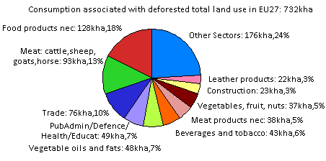
Consumption of commodities, products, goods and services in the EU27 that can be associated with deforestation (1)
Figure 2‑6 Consumption of goods and services associated with deforestation allocated by sector for the EU27 (2004). The pie chart only explicitly shows sectors covering 75% of the total are shown explicitly. The sectors shown represent the goods and services that were consumed in the EU27.
    Food dominates (60%, with 18% meat and 42% other food)
    Service sector second most important (22%): mainly due to consumption of food products, paper, furniture etc.
    Other significant sectors: textiles (6% - including leather), wood and associated products (5%) and manufacturing (3%)

Slide 11
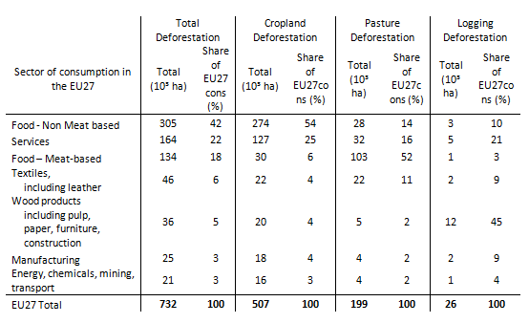
Consumption of commodities, products, goods and services in the EU27 that can be associated with deforestation (2)
    Consumption of goods and services associated with deforestation allocated by aggregated sector for the EU27 (2004). The sectors shown represent the goods and services that were consumed (cons) in the EU27, but were produced by deforestation.

Slide 12
Origins of the goods and services consumed in the EU27 that are associated with deforestation
In 2004, EU consumption of goods and services was responsible for 10% of global deforestation.
Most important commodities:
  Soybean and derived products (soy cake, soybean oil) from Brazil, Argentina and Paraguay: largest driver of deforestation
    Imports 240 kha per year (61% of Brazilian export and 48% of Argentinian export)
    Consumed as milk and tofu (direct) and meat, biscuits, bread, cosmetics, biofuels… (indirect)
  Palm oil from Indonesia and Malaysia
    Oil palm imports have grown rapidly - from 1 million tonne in 1990 to more than 5 million tonnes in 2008
    Incorporated into a wide variety of food products (e.g. cooking oils and margarines). Industrial uses include liquid detergents, soaps, waxes, cosmetics and fuel oil.

Slide 13
  Meat from South America, especially Brazil, and Subsaharan Africa
    Imports 280 kha per year (from poultry and pork to ruminant livestock products)
    Importing large amounts of crop commodities for feeding livestock and is a net exporter of livestock products (small net exporter of deforestation (annually around 10 kha)
  Stimulants from Sub-Saharan Africa (cocoa from Ghana, Nigeria, Cameroon and Togo and coffee from Kenya, Uganda and Tanzania)
    For coffee and cocoa, globally about 27% is imported by the EU27
  Wood from Brazil and Indonesia
    Deforestation embodied in wood products from logging preceding deforestation: 250 kha per year (very low compared to the impact of the agricultural sector)
    Imports only 11 kha per year. One-sixth (17%) of this import is re-exported, mainly in processed form as paper products and sawn wood
    Cumulative deforestation embodied in EU27 imports of wood-based products, by main sub-sectors, 1990-2008

Slide 15
Quantifying the overall EU impacts vs. the theoretical sustainable level of use/consumption.
    Rate of deforestation shows signs of decreasing – but is still alarmingly high.
    Between 1990 and 2008, annually around 7150 kha of deforestation linked to worldwide consumption
    In the period 1990-2008, average EU27 changes in consumption patterns (per capita as well as for total population) have led to a decreasing import of products with embodied deforestation into the EU27.
    However, the EU27 population will grow slightly by 2020 and 2030 and thus require an additional deforestation (3-4 Mha) if average food consumption levels, meat and dairy diets remain unchanged.
Evolution of deforestation for EU27 consumption

Slide 16
Identification of the Community policy areas with the greatest potential for reducing pressure on forests in third countries
Terms of Reference :
  Screen and assess Community policies, including relevant legislation, in relation to their impact on deforestation
  Identify policy areas with the greatest potential for reducing pressure on forests in third countries

Slide 17
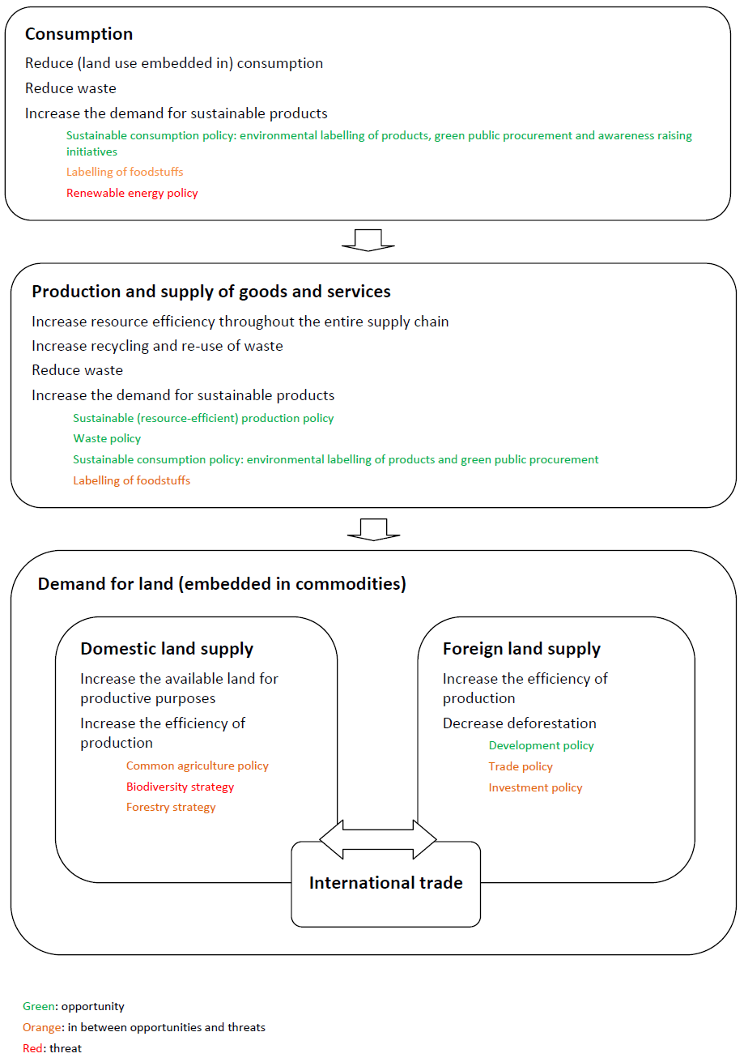
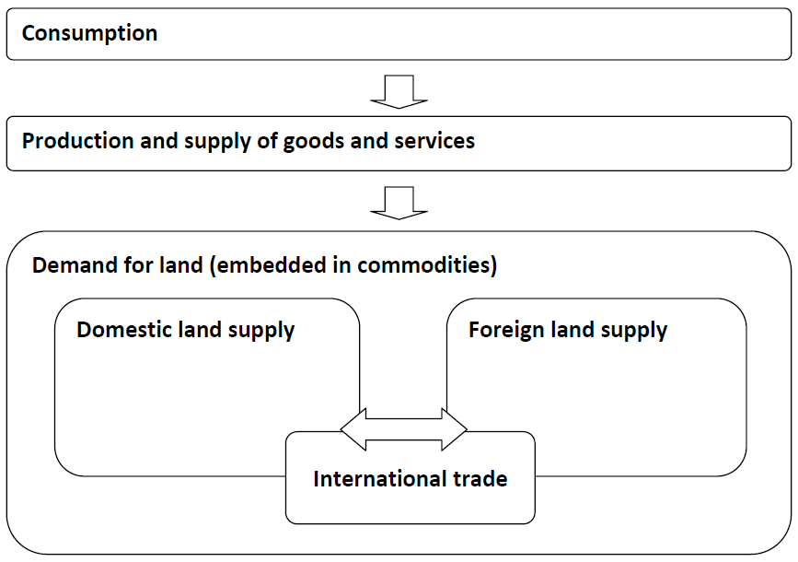
Causal model

Slide 18
Basic strategies
Decrease consumption
Increase (the demand for) sustainably produced products (that meet (deforestation related) sustainability standards
Increase resource efficiency (decrease land use embedded in consumption)
Reduce waste (both by consumption and production)
Increase the re-use of waste
Increase the domestic land that is available for productive purposes
Decrease deforestation

Slide 19
Critical areas
EU climate related policies : renewable energy policy, REDD+, ...
Common Agriculture Policy
EU Forestry Strategy
EU Biodiversity Strategy 2020
Sustainable consumption and production polices
International trade
Foreign investment
Development cooperation
Research and Innovation policies

Slide 20
Request
Please provide information on EU Member State national policy measures that could support the overall objective of reducing the loss of forest cover in third countries.
To :
  Caroline.Lemeire@vito.be; Tel. +32 14 33 59 13
  Arnoud.Lust@vito.be; Tel. +32 14 33 58 58
  By 29 June 2012
Thanks for your support!

