Slide 1

Strengthening Capacity to Innovate at National Level
TAP-AIS Project: Insights from Malawi and Burkina Faso
Selvaraju Ramasamy, Head, Research and Extension Unit, FAO

Slide 2

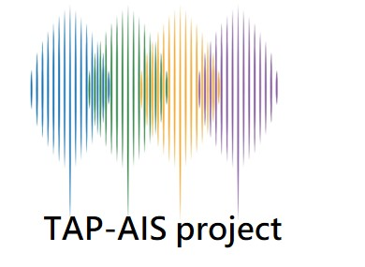
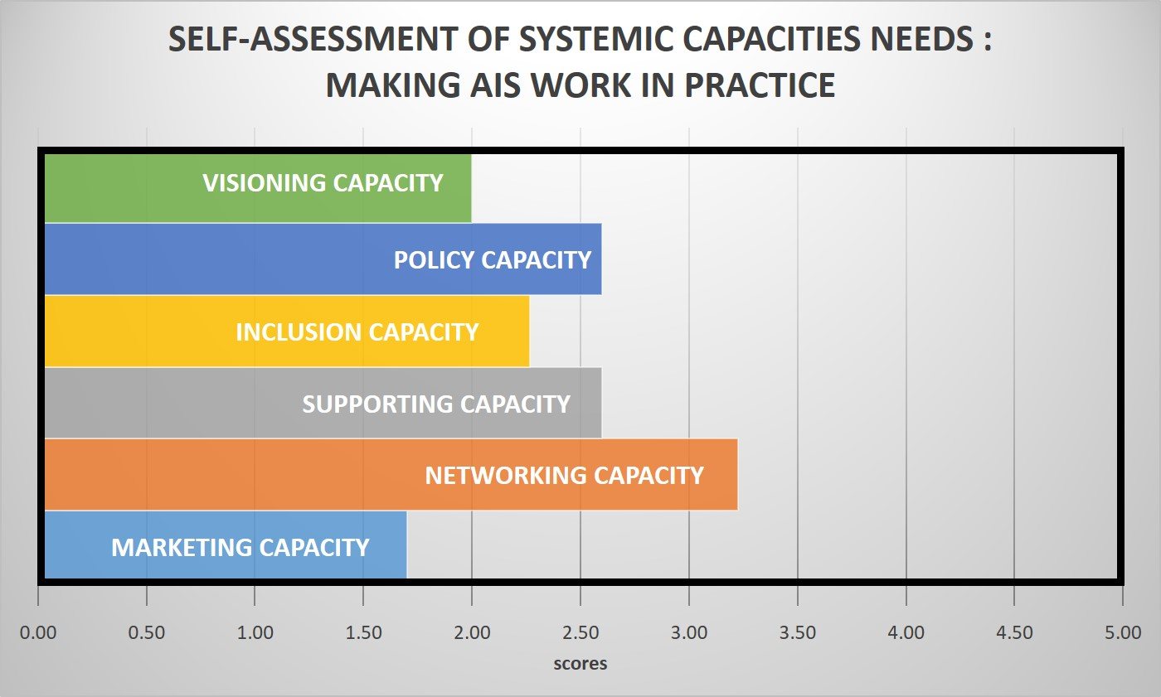
Capacity Development at the policy level: Malawi
1) Support to joint learning from successful innovation cases: the management of Fall Army Worm (Farmer Field School Platforms)
Pivotal Organizations of the AIS:
District Agriculture Extension Services System (DAESS)
Land Resources Conservation and Agricultural Research Services (DARS)
International Potato Center
Lilongwe University of Agriculture and Natural Resources
National Smallholder Farmers' Association
2) Support to joint prioritization of AIS: Research-Extension-Education-Farmer linkages, marketing and business support, technical and policy support
3) Support to the Identification of key organizations and Conducting self-assessment of their capacity needs
Unlock the full capacity potential
4) Facilitation of evidence-based Policy making:
Upgrading researcher’s skills, equipping multi-stakeholder platforms to facilitate farmer-led innovations

Slide 3
Capacity Development for organizations: Burkina Faso
Increased systemic capacities and evidence-based policy dialogue led to decisions:
New financing mechanisms and service supports (agri-food processing sector)
Develop semi-industrial agricultural machinery manufactures in agri-food processing
Increased access to micro-credit
Improved linkages between education and innovation
Uptake of new professions (Innovation facilitators, business coach, incubator manager etc.,)
New multiservice center to support innovative firms
FIAB: Federation of agri-food industries
ANVAR: National Agency for the Promotion of Research and Innovation
CPF: Farmer Confederation
Provision of a Coaching team
Exchange visits with Senegal
Mobilization of R&D for the design of the center
Fundraising among TAP partners
FAO’s support:
Organizational coaching
Facilitation of inter-organizational collaboration
New support services
FAO
DGPV /MAAH

Slide 4
Key insights on the role of Research Institutions
Research institutions need to support the on-going innovation processes led by other actors (e.g. Farmers’ Organizations, public services etc.,)
Investments in Research Institutions are still very much needed
TAP-AIS project focuses on some demand-led training and joint learning between researchers and the other AIS actors
TAP-AIS project supports Research Institutions to play new roles
  Support to evidence-based policy making and informed decisions
    Data generation, monitoring progresses and advocate for new investments.
  Support to the design of incubators and service centers for increasing the efficiency of support services to meet needs of innovators.

Slide 5
Thank You

