Slide 1
How CGIAR support innovation : which theories of change and impact pathway
Dr Elisabetta Gotor
Leader of the Performance, Innovation and Strategic Analysis for Impact program
e.gotor@cgiar.org
June 4th, 2021

Slide 2
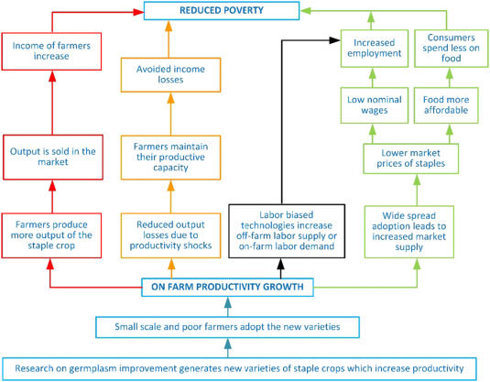
Demand Driven Pathways linking Research to Poverty reductions
Direct, short-term impacts vs indirect, long –term pathways leading to impact.
  The latter more difficult to measure.
This has implications for:
The design of M&E and the crafting of appropriate targets for outcomes of research on staple crops.
The design of credible Theories of Change that are taking into account
    Who are the actors involved along the impact pathway?
    What are the relationship among them?
    What are the bottle necks?
Alwang, J.; Gotor, E.; Thiele, G.; Hareau, G.; Chamberlain, J. (2017) Pathways from research on improved staple crop germplasm to poverty reduction for smallholder farmers. Agricultural Systems. ISSN: 0308-521X; http://hdl.handle.net/10568/91673.
Notes:
Innovations to improve staple crop germplasm can reduce poverty and otherwise improve farmer livelihoods through complex and multiple pathways
The importance of developing demand driven theory of changes that will enable scientists to understand who are the needed partners along the impact pathway that will enable the needed changes in behavior or in status/environment required by the project among beneficiaries

Slide 3
So…
We need to develop an evidence-based system that allow the channeling of food system technologies and innovations - developed during the research life cycle - along intricated, non linear and often indirect impact scaling pathways articulated around a sound strategic results framework and indicators.
What are the stage gating technologies mature enough for being scaled out and assessed for their contribution to high level impact indicators?

Slide 4
Thank you!
Elisabetta Gotor
Program Lead
Agricultural Economist
e.gotor@cgiar.org

