Slide 1


The contribution of research to innovation, participation of farmers and private sector and taking innovations to scale
Aggrey Agumya
Director, Research and Innovation

Slide 2
Outline
Background: About FARA; why Africa’s AR&D has embraced working within an innovation framework
Example Cases:
  Integrated Agriculture Research for Development (IAR4D) Approach—Sub Saharan Africa Challenge Programme (SSA CP)
  Users led Process to R&D –PAEPARD
Lessons / Conclusions

Slide 3
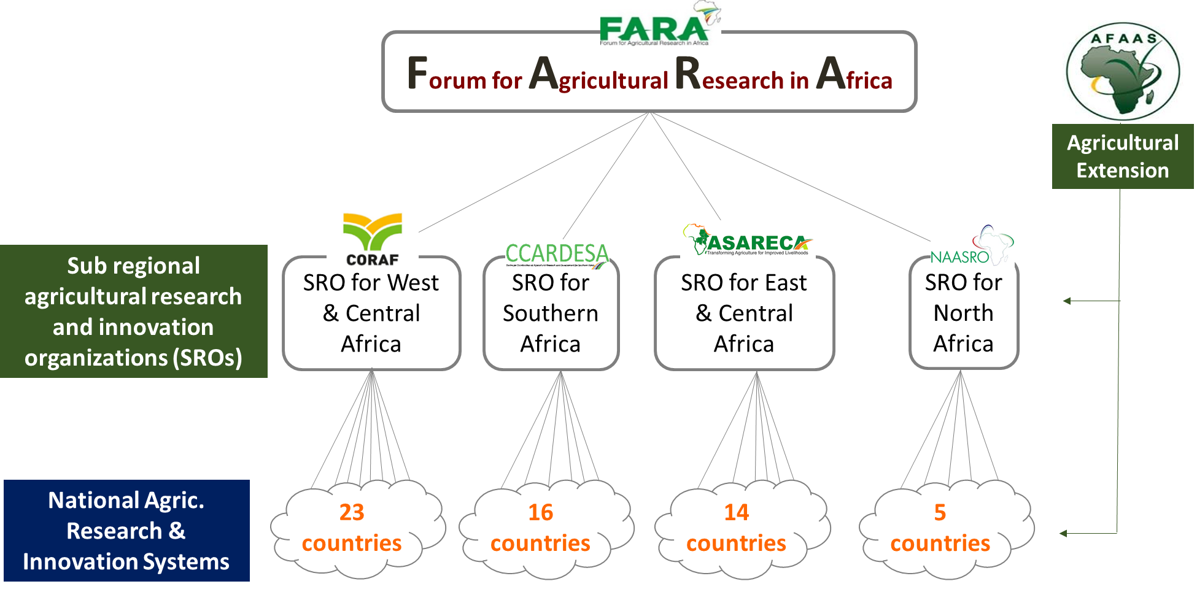
FARA
About FARA

Slide 4
Why growing interest in the innovation approach
Under the linear approach there is a long lag for:
  Research outputs to reach end users
  End user demand to reach research
Research embedded in innovation is demand driven; high uptake of outputs, ↑returns/impact
Innovation is a systems approach, and therefore better suited to addressing complexity

Slide 5
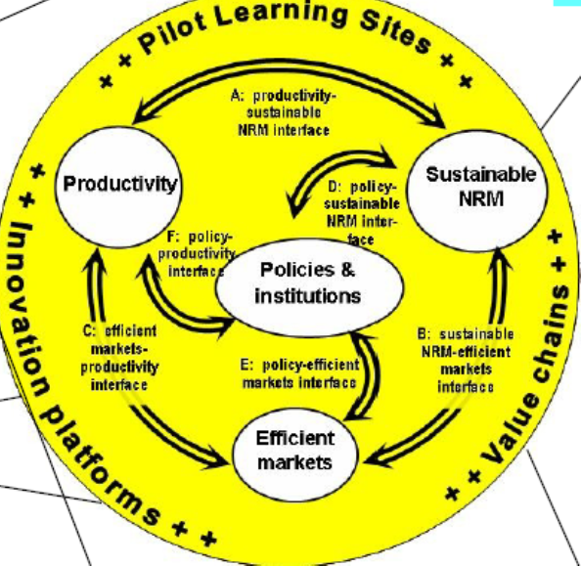
Integrated Agricultural Research for Development (IAR4D)
Main Instrument
Integration around
Productivity
Markets
NRM
Policies and Institutions
  Innovation Platform (IP)
  Institutional tool that facilitates:
  Generation of relevant technologies + knowledge
  Application to create development outcomes.

Slide 6
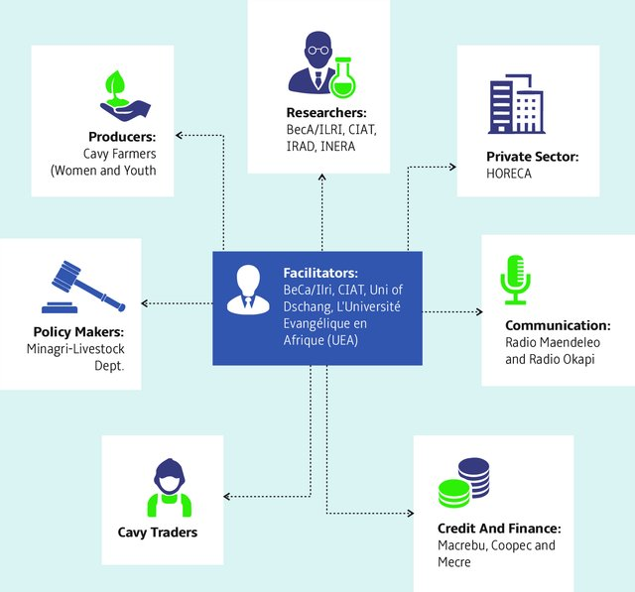
Innovation Platform
Multi-stakeholder platform
Operational (local level) & Strategic (higher level)
Functions
Problem / opportunity Identification
Joint resolution of probs / opportunities
Lessons; refinement of processes

Slide 7
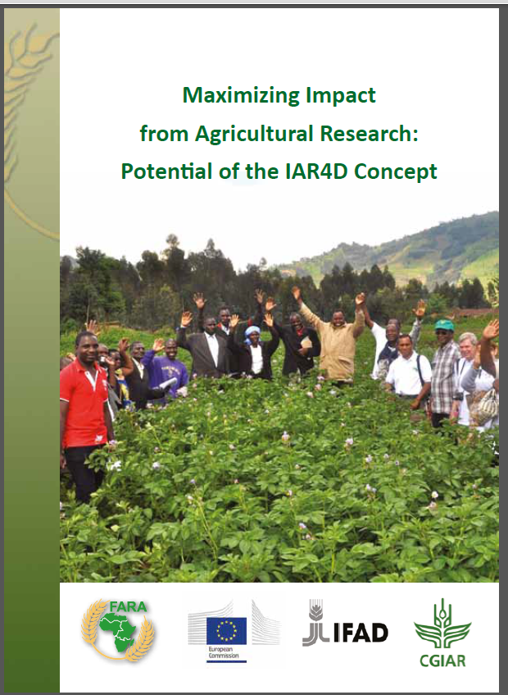
Innovation platforms
Market pathways deliver highest outcomes.
Other pathways: social capital, institutional change; innovation capacity.
10-year FARA-led study (in collaboration with SROs) established that IAR4D delivers more benefits than linear approach.
Incomes of farmers engaged in IAR4D were 232% higher than non-IAR4D farmers
https://library.faraafrica.org/2021/01/18/maximizing-impact-from-agricultural-research-potential-of-the-iar4d-concept/

Slide 8
Research within the market-led pathway to impact
Source:
Maru, Y., et al., 2018, IAR4D: from a theory of change perspective, Agricultural Systems, Vol 165, pp 310-20.

Slide 9
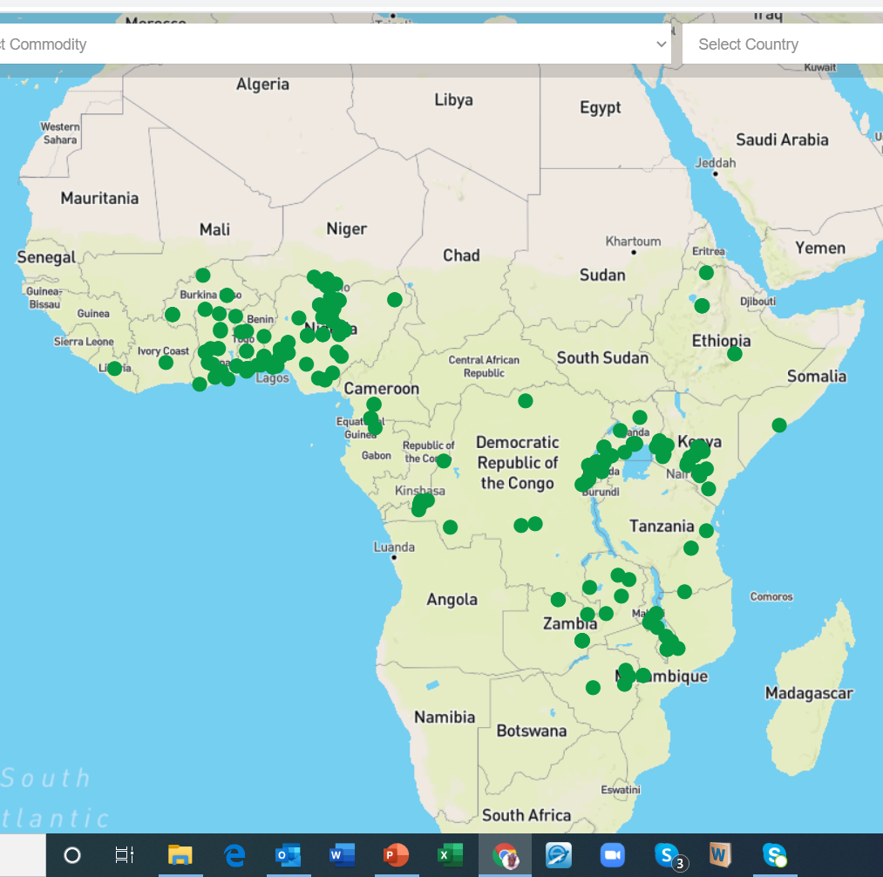
IP as a tool for scaling
Large body of evidence to show that IPs facilitate scaling exists
Process not well understood
Best applicable to innovations that are context specific, through:
  Scaling out across platform members
  Scaling up by addressing institutional bottlenecks
IP Agribusiness Portal [IPAbP] https://ipabp.org/

Slide 10

Platform for African-European Partnership on Agricultural Research for Development
Objective:
Facilitate African-European partnerships that are equitable and balanced between:
Africa and Europe
Research and research-users
Public and private organizations

Slide 11
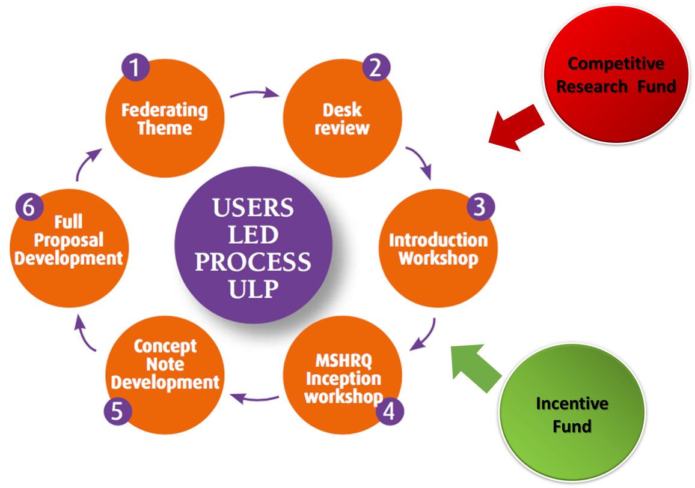
Demand-led research
Strengthened capacities to develop projects and mobilize resources
  Every €1 invested in PAEPARD MSPs to respond to calls leveraged €3.3
  If funding mobilized by non-consortium partners is included, this ratio increases 8x
Impactful implementation that is sustained beyond the lifetime of the project

Slide 12
Lessons / Conclusions
For most innovation in African agriculture, research plays a fundamental role in generating knowledge and technology. The innovation framework facilitates the application of research outputs.
Multi-stakeholder partnership (MSP) approaches have proven to offer greater development impact, but they require a long-term engagement. Their results are not immediate, but they are long-lasting (sustainability).
Research actors contribute to MSPs; they do not always lead. User-led MSPs have demonstrated sustainability.
IPs have proven to accelerate scaling but process not well understood—more work needed to unravel this

