Slide 1

How to support innovation through research for the transformation of the agri-food systems in Africa?

Slide 2
The innovation model of transfer of knowledge and technology
  The innovation is "technical" with a linear (research, advisory services, farmers)
    Decisive role of research and scientific knowledge (technology, method, model, etc.)
    Limited stakeholder interactions
  The linear approach:
    Effective in addressing simple problems (e.g. new variety, new vaccine)
    Apply in different contexts

Slide 3
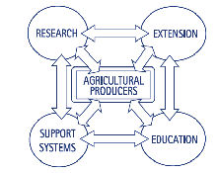
The multi-stakeholder model of innovation
  Innovation is multifaceted, knowledge is distributed, management is uncertain
    Decisive role of formal and informal networks of public and private actors to build knowledge, mobilize resources, strengthen skills
    Research contributes to innovation by interacting with other players
  The multi-actor approach:
    Relevant for dealing with complex problems involving a variety of actors
    Implementation depends on the context (see PEI in the EU, innovation platforms in Africa)
AIS : Agricultural
Innovation System

Slide 4
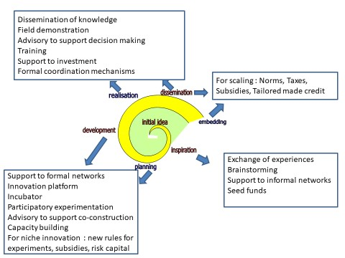
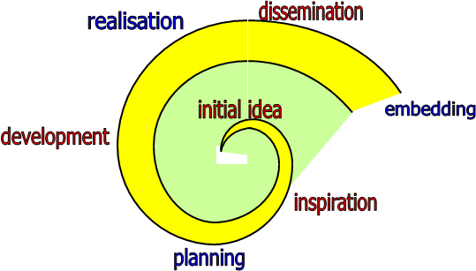
How to support innovation : type of ISS depending on innovation phases

Slide 5
Four key generic innovation services
networking, facilitation, and brokerage’ (formal and informal networks)
strengthening the actors’ capacities to innovate (technical and functional) at different level (individual, organization, institution)
diversity of funding mechanisms with a repartition between public and private finance
new knowledge production for action valorizing both local knowledge and scientific knowledge.

Slide 6
Research plays a variety of roles to contribute to innovation
Production et dissemination of knowledge
- Analysis of processes
- Diagnostic and expertise
- Modelling
- Production of scientific documents
- Dissemination and extension activities
Co-conception of innovation
- Experiments
- Conception and adaptation of technology and process
- Design of methods and tools
- Negociation of property rights
Support to actors to innovate
- Design / facilitation of partnerships (research and multistakeholders)
- Advocacy and advice
- Intermediation between actors
Awarness actions and
communication
Capacity strengthening
- Capacity building of researchers and non-researchers
Management of resources
- Design and implementation of projects
Monitoring and evaluation of projects
Fund raising
Notes:
La diversité des rôles est grande
Relation avec grille Erefin (soulignée par le comité d’éthique)
Attention : cela ne veut pas dire que tous les chercheurs du Cirad joue tous ces roles (complémentarité dans les équipes, rôle différent au cours du temps)
Quand un chercheur du Cirad a produit de la bonne science, il n’a pas fini son boulot !

Slide 7
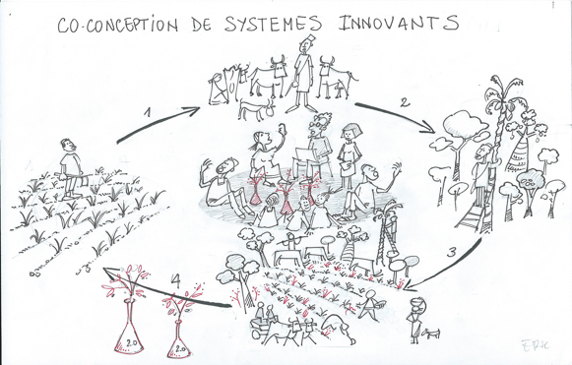
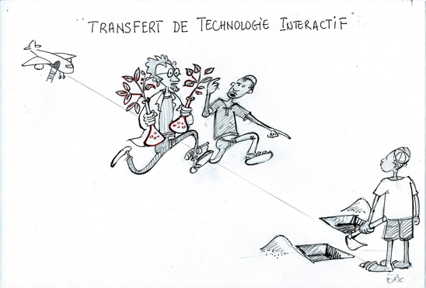
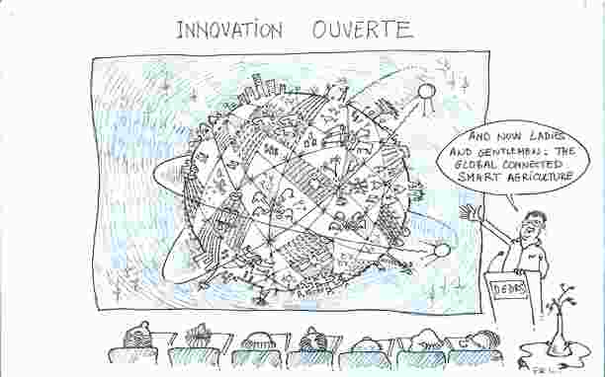
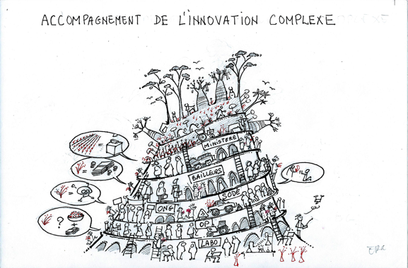
Research intervention models depend on the type of innovation, resources and strategic choices of research
Participatory transfer of knowledge and technology
Co-construction of innovation
Support for innovation process
Open innovation

Slide 8
Conclusions
Need to have a broad perspective on innovation (AKIS)
Diverse role of researchers and diverse models of research intervention
Need to strengthen innovation policies and AKIS

