Slide 1
The informal economy and decent work
European Commission Workshop
ADDRESSING THE INFORMAL ECONOMY FROM A BOTTOM UP PERSPECTIVE
Assessment of projects selected by call for proposals targeting the informal economy
Brussels 25-27 June 2012
    Sriani Ameratunga Kring
    Employment Policy Department
    International Labour Office
    Geneva

Slide 2
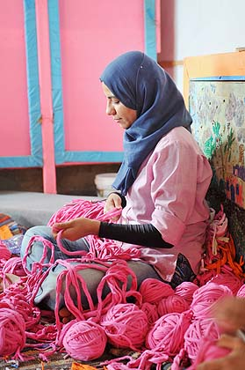
Why focus on the informal economy?
Informality is a key issue because it concerns the quality of work and the adequate functioning of labour markets. It is linked to issues of poverty, inequality and vulnerability.
Marginalisation from the mainstream economy generates heavy costs for individuals, enterprises and national economies

Slide 3
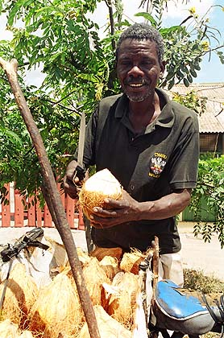
Why focus on the informal economy?
A significant part of the global labour force earns a living in the informal economy
Informality affects all labour markets, including high income countries, though the way it manifests itself is country-specific
ILO regional data: 72 per cent of non-agricultural employment in sub Saharan Africa, 65 per cent in Asia, 51 per cent in Latin America, 48 per cent in North Africa

Slide 4
Country, Year | Persons in informal employment, % of non-agricultural employment
Argentina (2009 IV Qtr) | 49.7
Armenia (2009) | 19.8
Bolivia (2006) | 75.1
Brazil (2009) | 42.2
Colombia (2010 II Qtr) | 59.6
Costa Rica (2009 July) | 43.8
Dominican Republic | 48.5
Ecuador (2009 IV Qtr) | 60.9
Egypt (2009) | 51.2
El Salvador (2009) | 66.4
Honduras (2009) | 73.9
India (2004/2005) | 83.5
Liberia (2010) | 60.0
Madagascar (2005) | 73.6
Mali ((2004) | 81.8
Mexico (2009 II Qtr) | 53.7
Nicaragua (2009) | 65.7
Panama (2009 August) | 43.8
Paraguay (2009) | 70.7
Sri Lanka (2009) | 62.1
South Africa (2010) | 32.7
Thailand (2010) | 42.3
Turkey (2009) | 30.6
Vietnam (2009) | 68.2
Zambia (2008) | 69.5
Country data:
Employment in the informal economy in non-agricultural employment
Source: Statistical update on employment in the Informal Economy.
ILO Department of Statistics
June 2011

Slide 5
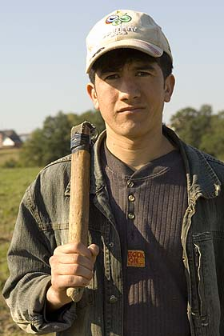
What is the informal economy?
Working people who are excluded from exchanges that take place in the recognised system.
They are not captured by national accounts or official statistics, are often invisible in policy formulation
They often lack social protection, rights, representation and voice, and are often in lowly productive work with poor working conditions
They are excluded from the benefits provided by states, markets and political processes
They are therefore unprotected, vulnerable, insecure
Weak governance a key issue underlying informality

Slide 6
The 2002 International Labour Conference Resolution on Decent Work and the Informal Economy
A ‘break-through’ in analysis, and generated a tripartite consensus on the objective of moving out of informality
Analytical framework grounded in the four pillars of decent work: rights, employment, social dialogue and social protection
Broadened the parameters of understanding informality – as an economy–wide phenomenon, covering diverse sectors and actors
It ‘..encompasses all economic activities by workers or economic units that are – in law or practice – not covered or sufficiently covered by formal arrangements’
Includes informality in the formal economy
Provided an integrated and comprehensive framework for action

Slide 7
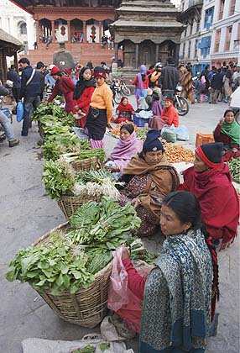
Who is in the informal economy?
17th International Conference of Labour Statisticians (ICLS) (2003) spelled out specific categories:
  Own-account workers (self-employed with no employees) in their own informal sector enterprises;
  Employers (self-employed with employees) in their own informal sector enterprises;
  Contributing family workers, irrespective of type of enterprise;
  Members of informal producers’ cooperatives (not established as legal entities);
  Employees holding informal jobs as defined according to the employment relationship (in law or in practice, jobs not subject to national labour legislation, income taxation, social protection or entitlement to certain employment benefits (paid annual or sick leave, etc.);
  Own-account workers engaged in production of goods exclusively for own final use by their household.

Slide 8
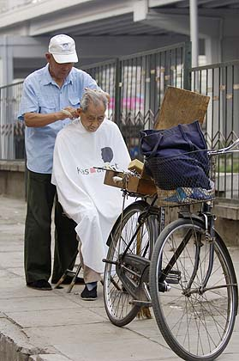
What drives informality?
Multiple factors drive informality, among them:
Poverty and social exclusion
Poor labour market absorption in the industrial sector
Flexibilization and global competitive pressures
Changing production structures
Economic restructuring
Economic crises including the current global financial crisis
The regulatory debate
Need for a comprehensive integrated approach

Slide 9
Decent Work Strategies for the Informal Economy
Growth strategies and quality employment generation
INTEGRATED STRATEGY
Regulatory environment, including enforcement of ILS & core rights
Organization, representation and social dialogue
TRANSITION TO FORMALITY
Equality: gender, ethnicity, race, cast, disability, age
Entrepreneurship, skills, finance, management, access to markets
Extension of social protection, social security, social transfers
Local (rural and urban) development strategies

Slide 10
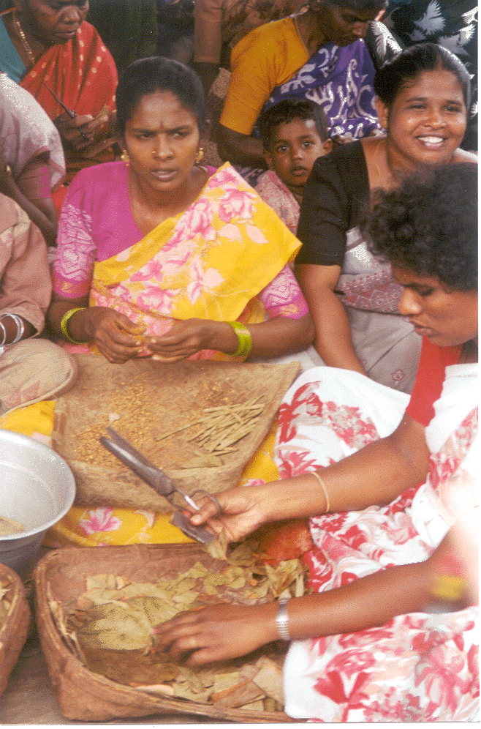
The Informal Economy and Decent Work: A Policy Resource Guide
Package provides the key elements of an integrated strategy to support the transition to formalisation
‘The promotion of decent work for all workers, women and men…. requires a broad strategy: realizing fundamental principles and rights at work: creating greater and better employment and income opportunities; extending social protection; and promoting social dialogue.’
Conclusions adopted by the International Labour Conference at its 90th session, Geneva, 2002

Slide 11
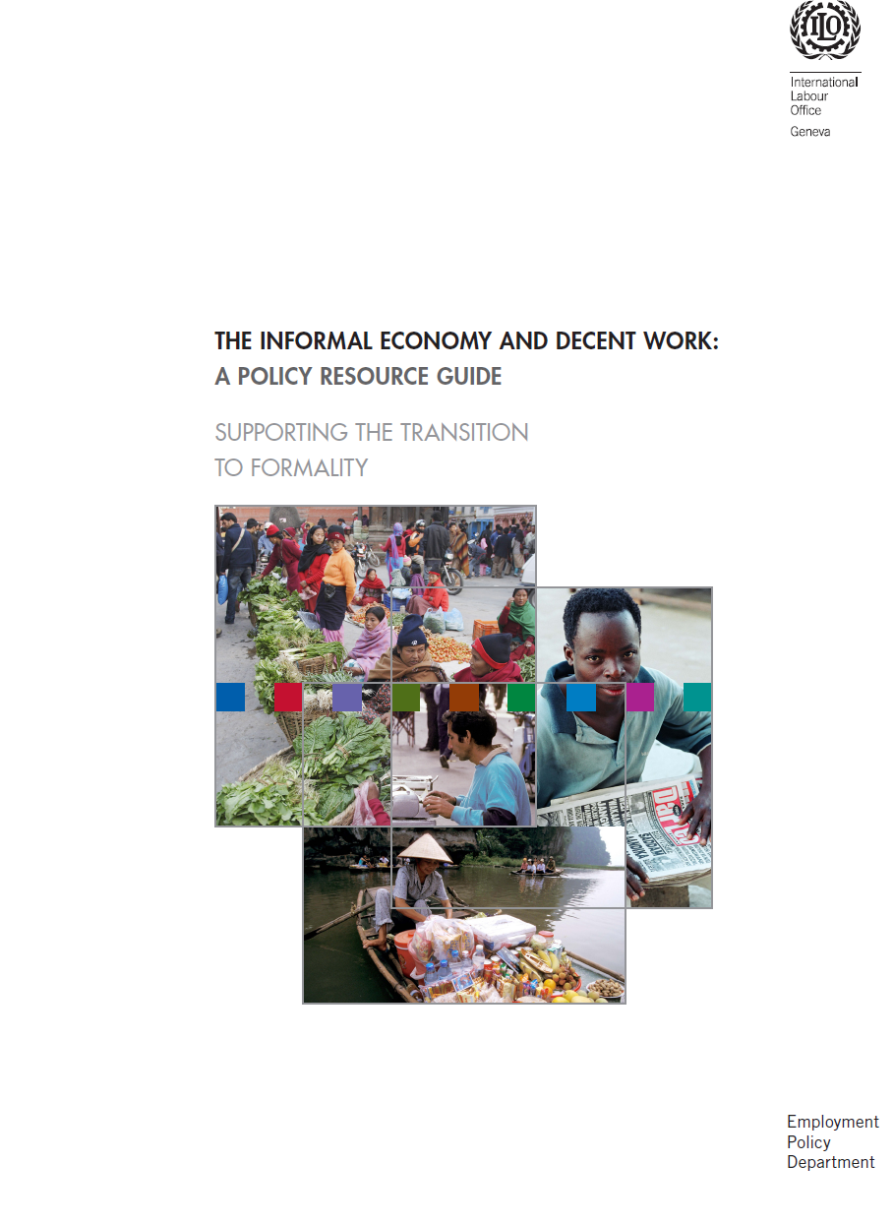
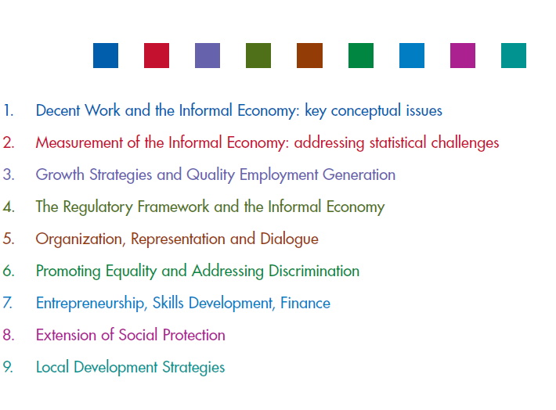

Slide 12
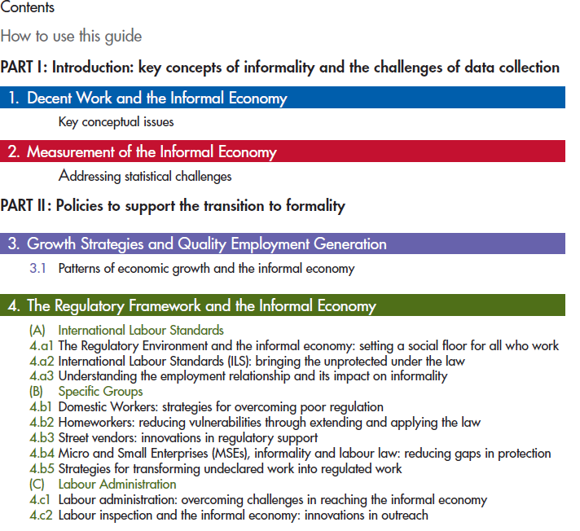

Slide 13
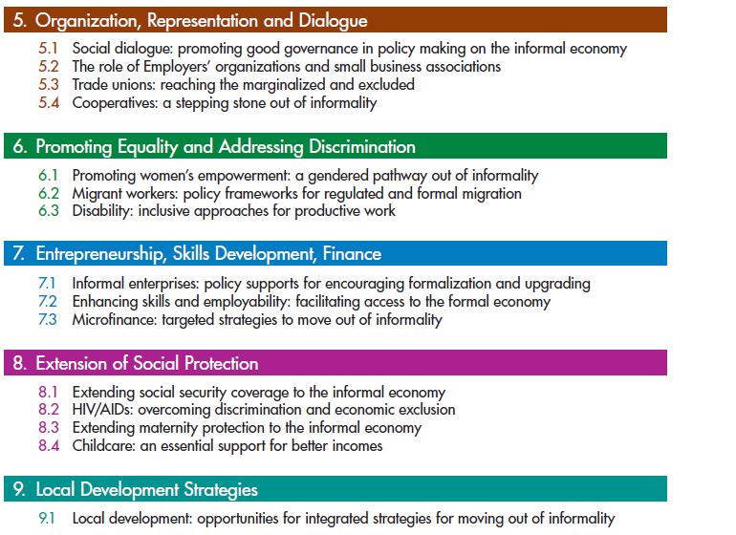

Slide 14
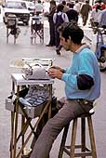
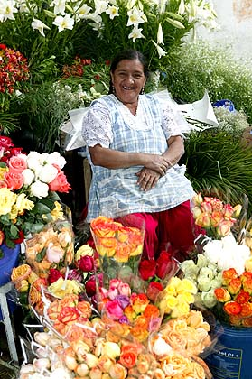
Structure of each brief
The key challenges.
symptoms and causes of exclusion from the formal economy
internal constraints and characteristics of the informal unit;
and the limitations within existing institutions and mechanisms to extend their reach to the informal economy.
Emerging approaches and innovative policies and practices.
Policy innovations from around the world
Shows the diversity of approaches
Roles of key stakeholders.
Resources.
List of resources which can assist in developing effective strategies to move out of informality

Slide 15
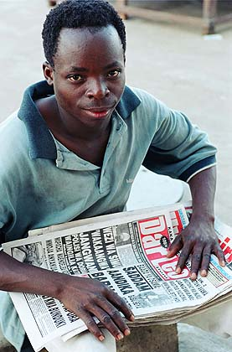
Contents of the Policy Resource
Introduction
The informal economy and Decent Work: Key conceptual issues
  What is the informal economy?
  Who is in the informal economy?
  What drives informality?
Measuring the informal economy - statistical challenges
  Innovations from the international statistical community to better capture informality

Slide 16
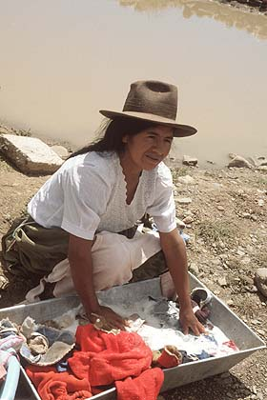
Thematic Area One: Growth, employment generation and the informal economy
Economic growth not enough to reduce poverty
Recognition of employment creation as the key link between growth and poverty reduction
The quality of employment created is also critical, as the incidence of working poverty indicates
The relationship between growth and informality
Heintz and Polin (2005) analysis of 20 developing countries:
  Increasing economic growth can reduce the rate at which informalisation is growing, though it cannot on its own create an environment where informalisation actually declines

Slide 17
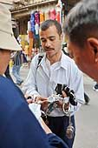
Thematic Area One: Growth, employment generation and the informal economy
Policy Responses
Ensuring the centrality of employment policies
Re-orienting macro economy frameworks
Case studies from Argentina and Brazil
– explicit strategies, integrated approaches, and better regulation.
Argentina:
Prioritizing employment in the growth strategy;
Defining a consistent policy and regulatory framework;
Strengthening labour inspection and labour administration;
Promoting education and awareness on formalization issues;
Extending social protection to the informal economy; and
Promoting social actors and private-public partnerships
Brazil:
Macroeconomic environment;
Simplified and progressive taxation for MSE’s;
Reduced labour supply pressure;
Improved labour inspection and new approaches to formalization;
Greater respect for the law, including extending labour protection to unprotected sectors;
Minimum wage;
Social protection

Slide 18
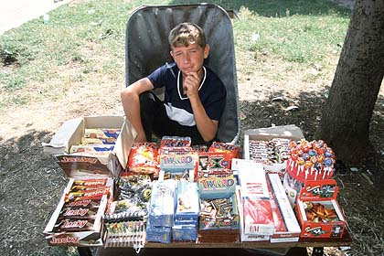
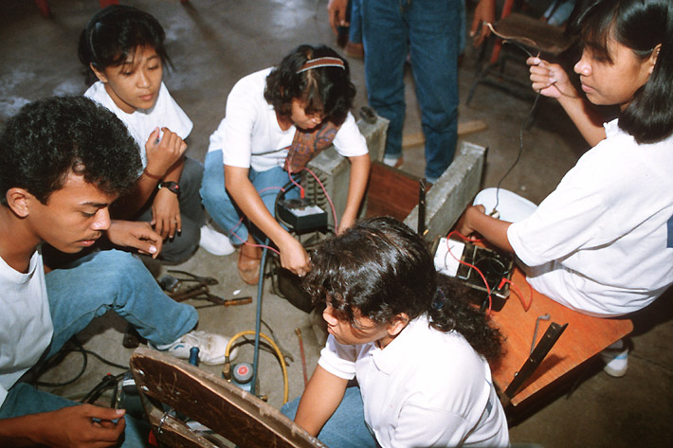
Thematic Area two: The Regulatory Framework
Informality is often cast in terms of the weak relationship to the law.
Workers and entrepreneurs who in law or practice not covered by formal arrangements
The Employment Relationship and its link to informality
International Labour Standards (ILS) – provide guidance on the application of rights at the national level, and are designed to be adapted to local contexts
ILS are applicable to all who work, irrespective of where they work.
They have both social and economic benefits and ensure a minimum social floor for all who work.
The Regulatory debate
Bringing the multitudes of informal workers and enterprises under the protection of the law would be a major step forward in the direction of moving out of informality and towards Decent Work

Slide 19
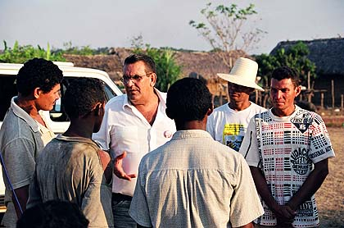
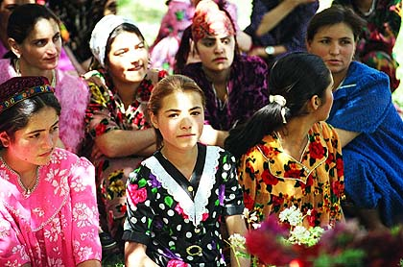
Thematic area three: Organisation, representation and dialogue
Currently, many informal economy actors are unorganized and/ or poorly represented in social dialogue mechanisms
Strong, independent, membership based organisations need to be built by informal economy actors
Social dialogue must underpin all policy making on the informal economy
Governments have a key role in creating an enabling framework for social dialogue – establishing freedom of association and creating social dialogue platforms at different levels
Different forms of organization are appropriate for different groups - trade unions, cooperatives, the development of associations and alliances, employers organizations, organizations of self employed

Slide 20
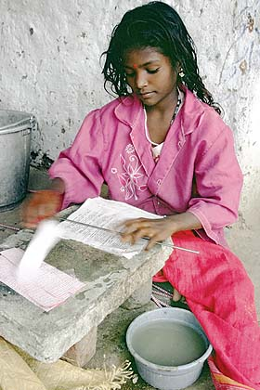
Thematic area four: Promoting Equality
Labour market discrimination pushes many groups into the informal economy
Women are often clustered in the most marginalised segments of the informal economy
Gender wage gaps, occupational segregation, lack of access to resources, the burdens of unpaid work, are as problematic in the informal economy as the formal
Policy making requires a gender lens to understand the different needs, constraints of women and men
An inclusive approach to other marginalised groups is also needed to enable them to enjoy their rights, and have opportunities for productive, formal work

Slide 21
Thematic area five: Entrepreneurship, finance, skills
Employment in enterprises is one of the most important sources of job creation in developing countries, but many remain informal
Policy supports for entrepreneurship
Streamlining licensing and business registration administration and reducing costs;
Appropriate taxation policy – simplifying tax administration and experimenting for MSE taxes.
Appropriate social protection mechanisms;
Reforming land ownership and titling which in turn can help raise capital for enterprises;
Labour and labour related issues – finding the balance between reducing burdens and cost for the enterprise while ensuring worker protection. ILS are an important benchmark for labour and labour related reforms;
Judicial reform;
Financial services – reforms to open up access to finance
Integrating enterprise development into local development strategies;
Creating a business friendly environment, including service provision;
Creating incentives for compliance with regulations such as fiscal incentives, public procurement, market opportunities and support, credit
Establishing public- private partnerships;
Supporting the organization of informal economy enterprises and establishing social dialogue mechanisms at various levels;
Targeted approaches towards vulnerable groups of entrepreneurs such as poorer women, youth, disabled among others

Slide 22
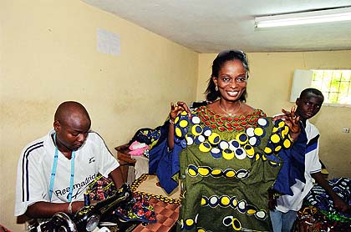
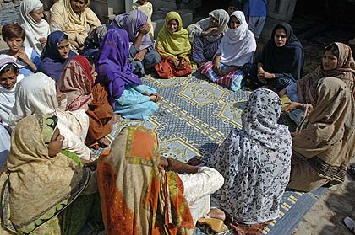
Thematic area five: Entrepreneurship, finance, skills
Microfinance
Can support formalization through:
Providing incentives to clients, such as opening access to markets
Offering non-financial services such as training
Offering diverse financial products
Targeting of Decent Work outcomes for clients
MFIs are particularly relevant for moving out of informality because they have both equity and efficiency objectives including job creation, reducing vulnerability and facilitating empowerment through group mobilisation

Slide 23
Thematic area five: entrepreneurship, finance, skills
Skills training
Strategies to support transition out of informality include:
ensuring a supportive employment-centred macro-economic framework, and policy coherence between human resources policies and other macro policies;
re-orientation of skills policies towards the informal economy and not just the formal;
strengthening the capacity of existing providers to reach the informal economy;
upgrading the quality of learning and the access to productive work from informal apprenticeship systems;
improving the quality and relevance of skills training through better alignment of the supply and demand for skills;
developing integrated incentives structures for formalisation such as training opportunities, access to productive resources, market information, technology, credit, BDS services and fiscal incentives and streamlined registration procedures;
developing more effective, flexible and participatory training delivery mechanisms;
promoting equitable outcomes amongst marginalised groups; and
developing mechanisms to recognise skills gained in the informal economy, which can open up better job opportunities in the formal economy or enable access to further training.

Slide 24
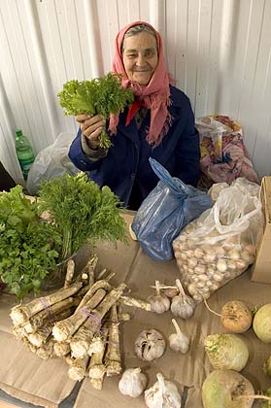
Thematic Area six: Expanding social protection
Lack of access to social protection is a defining feature of informality. Although most at risk, informal economy actors are likely to be the least protected
Social Security
A growing number of countries are showing that extending social security coverage is viable even for low income countries.
These instruments need to be adapted to the specifities of informal economy groups and should be used in combination
Measures include:
the gradual extension of social insurance schemes;
the introduction of special arrangements for informal economy workers;
the provision of non-contributory social pensions;
the development of conditional and unconditional cash transfer programmes which support health and educational access; and
employment guarantee schemes.

Slide 25
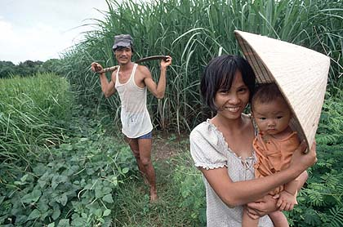
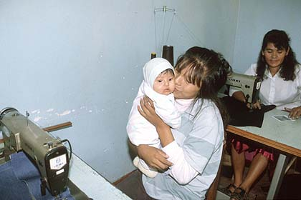
Thematic Area six: Expanding social protection
Maternity
A range of instruments are available to mitigate the economic and health risks of maternity:
Micro-insurance
Expansion of universal health schemes
Community based health initiatives
Cash transfers
Childcare
Women’s care responsibilities largely determine their ability to earn an income in the informal economy
Measures to support women’s household burdens include:
Investing in infrastructure, particularly in rural areas
Extending service provision to rural areas
Multiple partnerships for childcare supports

Slide 26
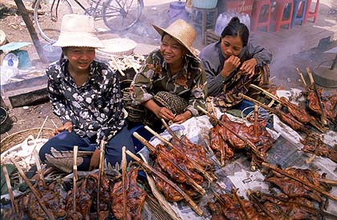
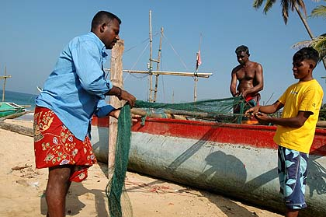
Thematic Area seven: Local Development Strategies
Offers great potential for integrated approaches. A range of strategies, used in combination, include:
Developing basic infrastructure,
Setting up social dialogue mechanisms
Supporting access to training and microfinance
establishing streamlined regulatory environments and zoning regulations,
supporting MSME development, facilitating public contracts and tendering processes,
fostering public-private partnerships,
targeting support to the especially disadvantaged such as women and youth,
encouraging labour-intensive methodologies
facilitating employment creation
supporting market access

Slide 27
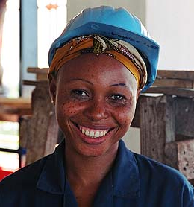
Key messages
Informality affects all labour markets, but in different degrees and manifestations
National policy development on the informal economy needs to be anchored in tripartite social dialogue
Policy responses need to take into account the diverse actors, activities and sectors involved, i.e. uniform responses are inappropriate
Policy responses need to be based on the specific drivers of informality in a particular context and should be targeted, comprehensive and coherently linked

