Slide 1
Consultation on Inclusive Multilateralism, Monday, 13 September
Joint Communication on strengthening the EU’s contribution to rules-based multilateralism
DG International Partnerships

Slide 2
Why a new strategy on Multilateralism?
Global actors/competition
Growing global challenges
USA
other
Natural disasters
Climate change
China
Extreme poverty
EU?
Terrorism
Russia
Migration
COVID-19
Regional conflicts
New actors like “Big Tech”
Feeling of disconnect from Governance & Importance of partnerships
Google
Facebook
CSOs
LAs
Apple
Amazon
Academia
Science
Priv Sector
Notes:
Today’s world marked by major geopolitical and economic power shifts. Emerging players are creating new dynamics. Relations between major powers are increasingly confrontational and unilateralist. Competing visions and agendas on the global order are at play, which challenge established multilateral rules and organisations.
Current geopolitical rivalries have a negative impact on efforts to promote peace and prevent conflict: they hamper humanitarian responses, undermine trust and complicate the provision of global public goods. Basic principles of international law, human rights, democracy and the rule of law are being challenged. Existing institutions upholding such values are all too often bypassed or misused for narrow national or ideological interests.
Strong non-state actors, including digital platforms and multinationals, have become shapers of international norms outside established channels. Citizens feel increasingly disconnected from all levels of governance. The result is a more unpredictable and unequal world.
The COVID-19 crisis nevertheless exemplifies the need for multilateral solutions: a major
global threat, it has created much-needed momentum for a coordinated, global crisis
response. Throughout 2020, international fora and organisations led the global response and
delivered tangible results, such as the its COVAX facility or the G20 Action Plan to respond to the pandemic.
Growing global challenges call for more multilateral governance and rules-based international cooperation.
Multilateralism is most effective means to govern global relations in a way that benefits all. Growing global challenges, such as the COVID-19 pandemic, climate change, conflicts and extreme poverty in many parts of the world, make all too evident the need for multilateral cooperation grounded on basic principles of international law and universal values.
‘Non-traditional’ coalitions and formats should be explored. Multi-stakeholder
partnerships between governments, the private sector, civil society, academia and the
scientific community are key for shaping inclusive multilateralism and act as a catalyst for
Reform.

Slide 3
EU Joint Communication: An EU vision and ambition for Multilateralism
A multilateral system that is “fit for purpose”
1. Focusing the EU’s multilateral agenda
(i) Making the world safer
(ii) Building back better
2. Strengthening the multilateral system
Uphold international norms and agreements
Reform multilateral organisations
Extending multilateralism to new global issues.
A Stronger Europe partnering with the multilateral system
(i) Strengthen EU coherence and coordination
(ii) Speaking with one voice
(iii) Funding the multilateral system
(iv) The EU’s presence in the multilateral institutions
(v) Alliances, Partnerships and regional co-operation
(vi) Working with Multilateral Institutions
Principles of the EU’s multilateral engagement
Notes:
The current context calls for a clearer and better articulated strategic approach to engagement with our international partners.
With the Joint Communication on Multilateralism we have set up a more strategic vision for our multilateral engagement.
New EU strategic approach has generated a lot of interest among MS and feedback has been overall very positive.
Our priorities are clear. Joint Communication outlines concrete strategic priorities on issues, including peace and security, human rights and the rule of law, sustainable development, public health, or climate.
To address challenges, we have already jointly defined long-term priorities, e.g. with the Green Deal, the Digital Agenda or on sustainable finance.

Slide 4
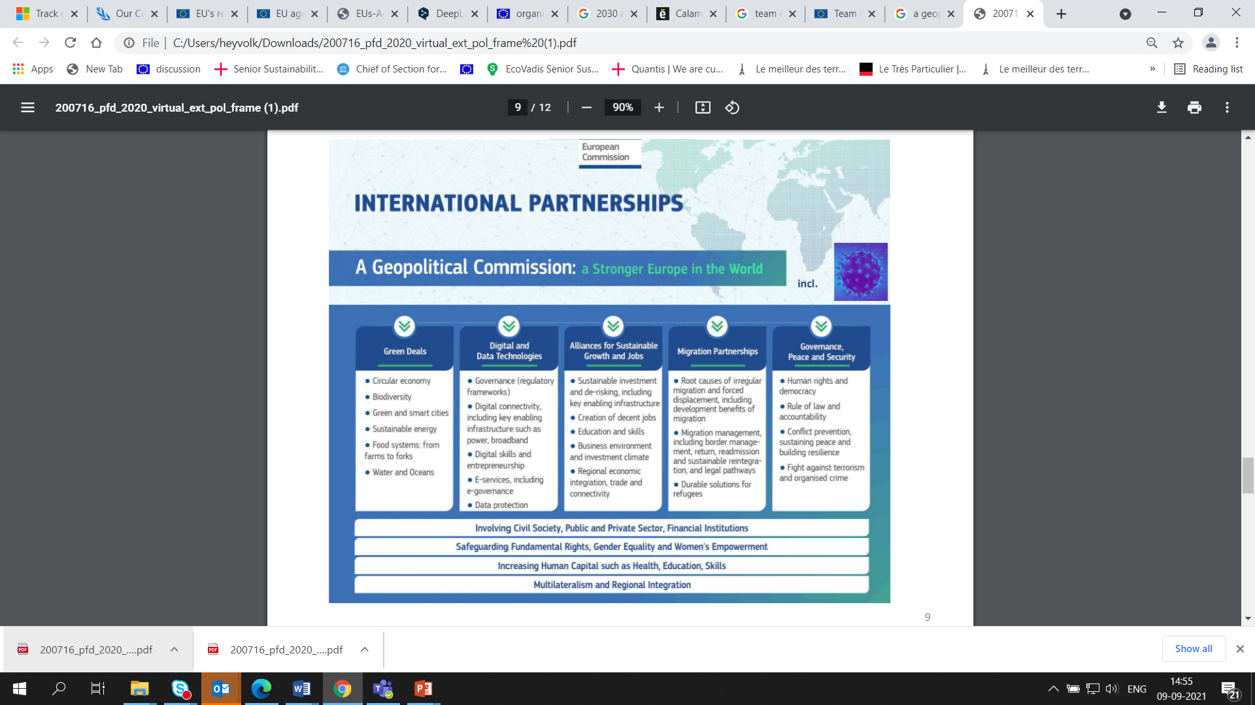
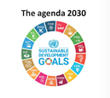

EU Multilateralism Strategy
A more strategic vision for our multilateral engagement
Clear criteria guiding our approach to multilateral organisations:
Strategic partnership through alignment with universal agendas and EU interests
Role as important normative and standard setters
Role as implementers for the delivery of EU’s development and humanitarian assistance
Notes:
Our new approach includes notably outlining the criteria which will guide our approach to multilateral organisations, so that we can work in a true ‘partnership’ spirit (as per INTPAs new name incidentally).
We want to work with important policy and strategic interlocutors based on
their alignment with universal agendas and EU’s interests (e.g. Green Deal, Digital, Human Development) and their ability to pursue them.
role as important normative and standard setters
role as implementers for the delivery of EU’s development and humanitarian assistance.
EU will work for a renewed rules-based multilateralism fit for the 21st century that serves global governance with the UN at its core, as well as EU and global interests and values.

Slide 5
EU Multilateralism Strategy
A more strategic vision for our multilateral engagement
Principles of EU’s multilateral engagement:
Focus:
Work towards global governance and standards
Defend universal values, agendas and international law
Project EU’s own strategic priorities to enhance global governance
Support reform, effectiveness, efficiency, and inclusive multilateralism
Coherence
Act with a coherent and united voice in global fora
Ensure greater consistency between multilateral/bilateral diplomacy
Make the most out of its political, diplomatic, and economic leverage
Partnerships
Step up EU leadership (convenor, honest broker and bridge-builder)
Deepen partnerships and alliances
Notes:
Focus
The EU will work towards global governance and standards, in particular with respect to its safer world and build back better ambition, and will support multilateralism as the best way of achieving that.
The EU will defend universal values, agendas and international law, including the UN 2030 Agenda and the Paris Agreement, human rights law, that form the bedrock of cooperative relations between countries and peoples.
In a more competitive and transactional global context, the EU will project its own strategic priorities, that seek to enhance global governance and that are inspired by the universal common goods as spelled out above.
The EU will support reform, effectiveness, efficiency, and a truly inclusive multilateralism where governments, the private sector, civil society, academia and other stakeholders work together to serve both EU and global interests and values
Coherence
The EU will act with a coherent and united voice in global fora. The EU must ‘deliver as one’ to ‘succeed as one’.
The EU will ensure greater consistency between its multilateral and bilateral diplomacy.
It will make the most out of its political, diplomatic, and economic leverage. In particular it will use its strong collective financial weight in multilateral institutions more strategically, and as Team Europe.
Partnerships
The EU will step up its leadership and make better use of its ability to act as a convenor, honest broker and bridge-builder
The EU will deepen partnerships and alliances with third countries, multilateral and regional organisations, and reinforce coalitions on key priorities.
The EU will be the best ally of multilateral partners but will demand focus conducive to transformation and truly strategic relationships.

Slide 6
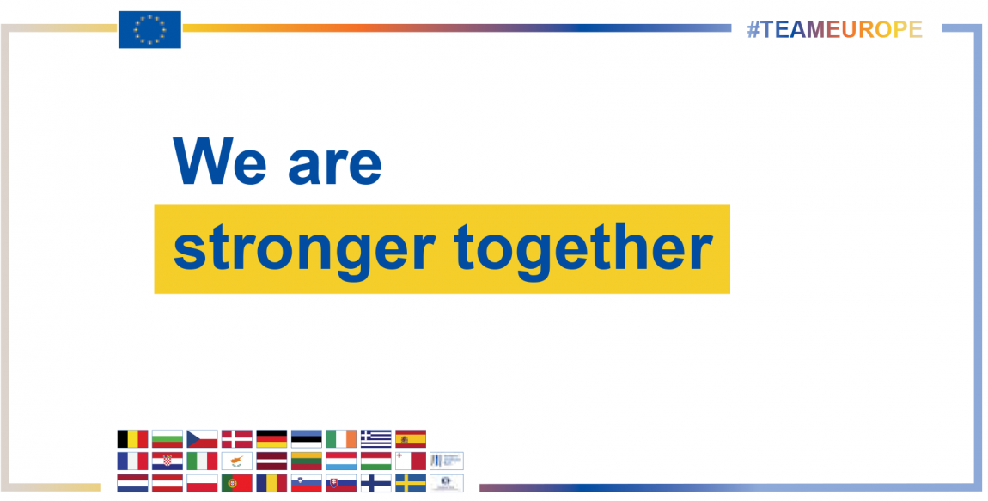
EU approach for new ML strategy
Implementation of the new Multilateralism Strategy
The new EU financial cycle and its innovative instruments as drivers for reforms and efficiency
The Team Europe approach allows us to define a common agenda and to leverage EU and MS funding, normative power and strong country presence
Team Europe approach should also translate into more coordination at and with the UN, as well as International Organisations and IFIs
Our new way of working thus supports the UN Development system
Notes:
EU will move forward with concrete operationalisation of ML JC. EU is already in the process of assessing how to deepen partnerships and alliances with third countries, multilateral and regional organisations, and reinforce coalitions on key priorities. We count also on EU MS to bring the new strategic vision for a reinvigorated Multilateralism to life.
The beginning of the new EU financial cycle and its innovative instruments has also the potential to drive reforms and efficiency. In the programming process under the new NDICI the EU will better focus on what can be done together at country, regional and multilateral level, under a policy-driven approach.
The Team Europe approach allows us define a common agenda and to leverage EU and MS funding, normative power and strong country presence to engage with partner countries, multilateral organisations and other partners around joint priorities at country, regional and multilateral level. This should also translate in more coordination at and with the UN, as well as International Organisations and International Financial Institutions.
Our new way of working thus supports the UN Development system reform as we want the RCs to play a central role in liaising with our Delegations and coordinating the UN system on the ground.

Slide 7
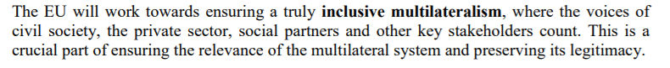



Inclusive Multilateralism
Inclusive Multilateralism as one key element of the JC and crucial part of ensuring the relevance of the multilateral system and preserving its legitimacy:
We need to:
find ways to better address demands of citizen in terms of
transparency, quality, inclusiveness and delivery
work towards a truly inclusive multilateralism where the
voices of civil society, the private sector, academia, youth and other stakeholders count
mobilise a new, broader set of actors if we want to address
twenty-first-century threats and challenges
Notes:
Inclusive Multilateralism as one key element of the JC. EU and MS face rise in populism and disconnect of citizens from governance, including global governance. We need to find ways to better address demands of citizen in terms of transparency, quality, inclusiveness and delivery.
Need to work towards a truly inclusive multilateralism where the voices of civil society, the private sector, academia, youth and other stakeholders count.
This is a crucial part of ensuring the relevance of the multilateral system and preserving its legitimacy.
The response to the COVID-19 pandemic is also example on how global actors, not states alone, drive solutions to complex problems.
If we want to address twenty-first-century threats and challenges, such as climate change, pandemic disease and inequality, we need to mobilise a new set of actors.
Today, power is much more diffuse, with nonstate actors strong enough to both create international problems and help solve them. Accordingly, the current order needs to expand not by differentiating between various kinds of states but by making room for new categories of non-state actors.

Slide 8
Inclusive Multilateralism
Examples from our delegations at international organisations and IFIs
UN
Executive Office of the SG has organised an inclusive consultation process on the UN’s Common Agenda leading to the SG’s report. Four different tracks on: intergovernmental reflection, thought leaders’ reflection, young thinkers and “We the Peoples” as input from broader civil society.
WB/IMF
The Civil Society Policy Forum (CSPF), is an integral part of the IMF and WBG Spring and Annual Meetings, providing an open space for CSOs to dialogue and exchange views with WBG and IMF staff, their peers, government delegations, and other stakeholders on a wide range of topics.
UNEP
The Geneva Environment Network (GEN) is a cooperative partnership of more than 100 environmental and sustainable development organisations. GEN organises events and promotes awareness on environmental issues..
Notes:
In the field of environment, there are also some concrete examples of inclusivity and especially linked to the UN Environment Programme (UNEP) and its Europe Regional Office:
The Geneva Environment Network (GEN) is a cooperative partnership of more than 100 environmental and sustainable development organisations. GEN organises events and promotes awareness on environmental issues. GEN has great visibility and hosted EU speakers on numerous occasions including on the Green Deal developments.

Slide 9
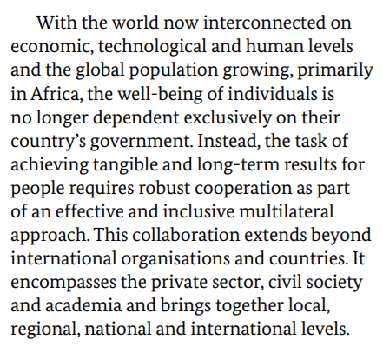
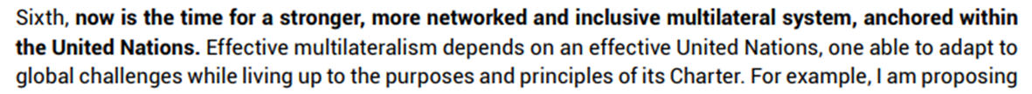
Inclusive Multilateralism in recent strategies by EU, Germany, UN

Slide 10
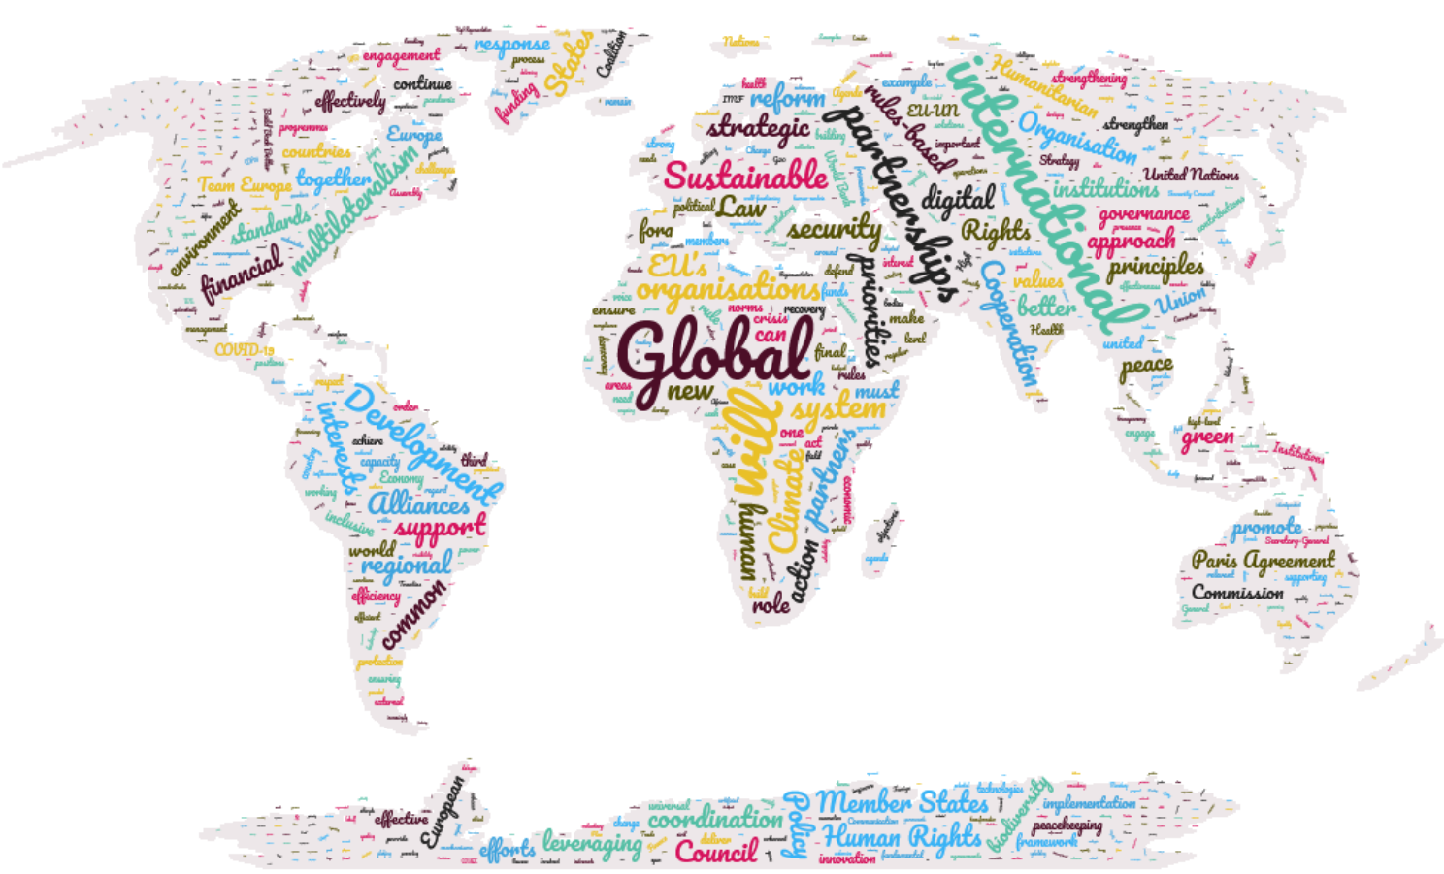
Thank You!

