Slide 1
Institution & Capacity Development
The institutional perspective – module 4
(should perhaps include uncertainty slides)

Slide 2
Environmental mainstreaming is…
Mainstreaming in an institutional
perspective
… ”the informed inclusion of relevant environmental concerns into the decisions of institutions that drive development policy, rules, plans, investments and actions” (Dalal-Clayton and Bass, 2009)

Slide 3


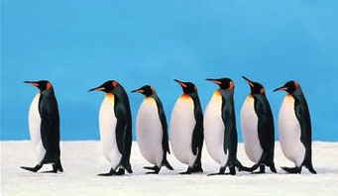

Environmental Mainstreaming
Mainstreaming (don't forget to refer to CC and also introduce GE)
Collaboration
Leadership
Process
Not procedural
assessment but use of
Large toolkit
Notes:
requires collaboration. It will often be as much a political and institutional change process as a technical one.
EM depends upon leadership and catalytic organisations to forge the necessary links and processes
EM needs to be a continuing and long-term process, not a one-off project.
EM goes much wider than procedural assessment and embraces a broad array of tactics and approaches – and a large toolkit of analytical and assessment methods.

Slide 4
Effective Environmental Mainstreaming
Integrated institutional development approach – I like the slide, but leave for Day 1 only perhaps?
But what about the EU delegations themselves?
Clear environmental vision and leadership?
Strategy and systems for environmental mainstreaming?
Notes:
The often used application of a safeguard mechanism – a ‘tool’ – needs to be complemented by an integrated and systematic institutional development approach that realises the potential of environmental assets and recognizes the limits.

Slide 5

Entry points for mainstreaming in the policy cycle
Finding the entry points & making the case
Mainstreaming Env. & CC into institutions, policy & planning processes
Agenda setting
National development planning
Policy making
Implementation & monitoring
Meeting the implementation challenge
Adapted from: UNDP-UNEP (2009) Figure 3.2, p. 15

Slide 6
Finding the entry points and making the case
Mainstreaming CC into policy and planning processes
Meeting the implementation challenge
Preliminary assessments
Understanding CC–development linkages
Understanding the science
Understanding climate-related uncertainties
Collecting country-specific evidence and influencing policy processes
Mainstreaming CC in (sub)national and sector policies, strategies, programmes
Budgeting and financing
Mainstreaming CC in the budgetary process
Mainstreaming CC in monitoring systems
Performance assessment frameworks
Raising awareness and building partnerships
National consensus and commitment to climate-resilient, low-emission development
Costing, assessing and selecting adaptation and mitigation options and measures
Supporting policy measures
National, sector and sub-national levels
Strengthening institutions and capacities
Needs assessment
Working mechanisms
Strengthening institutions and capacities
Learning by doing
Strengthening institutions and capacities
Mainstreaming
as standard practice
Engaging stakeholders and coordinating within the development community
Notes:
This slide to be available as a poster to be used as a reference on flow through the workshop
Adapted from: UNDP-UNEP (2009) Figure 3.1, p. 15

Slide 7
Effective Mainstreaming
Institutional factors of importance
Resources
Political will &
Leadership
Culture
Strategy
Vision
Systems
Staff
Structure
Effective mainstreaming
Political, Environmental,
Economical and Social Factors

Slide 8
Effective Mainstreaming
Institutional factors of importance
Incentives; sharing of exp. and good practices;
stakeholder participation
Political commitment; National champions
Resources
Analysis of constraints; Objectives;
Road Map
Political will &
Leadership
Goals; Policies; national plans
Culture
Strategy
Capacity strengthening; level of awareness, skills and capacity
Vision
Systems
Staff
Cross sectoral + cross level coordination; monitoring
Clear mainstreaming responsibilities;
Structure
Effective mainstreaming
Political, Environmental,
Economical and Social Factors

Slide 9
Roles & responsibilities of main stakeholders
Stakeholder group – ideally we need examples… | Main roles & responsibilities
Central government (incl. office of prime minister, ministries of finance/budget/planning, ...) | Leadership, performance management frameworks Policies, standards & regulations Allocation of budget resources Guidance & capacity building
Local governments | Implementation of national policies Integration with community strategies
Private sector | Preparation for losses & opportunities, risk mngt Contribution to sustainable investments & vulnerability reduction through development
Scientific & academic organisations | Policy-oriented research Support for decision making
Investment promotion agencies | Env. and climate-proofing of investments, bridging of development gaps
Poverty reduction organisations | Env and climate change adequately addressed
Adapted from: Schipper et al (2008)

Slide 10
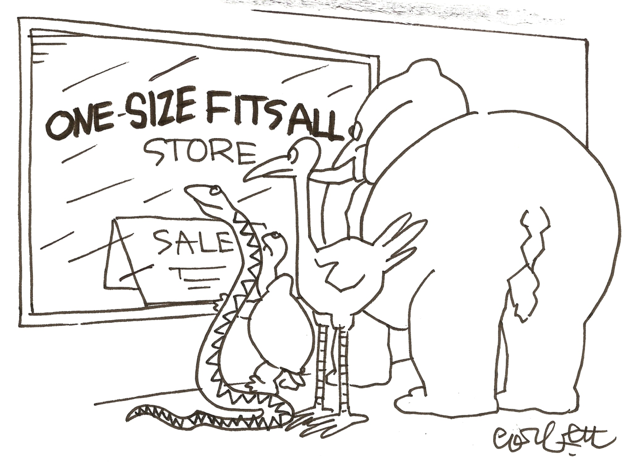
Principles for institutionalising
Environmental and Climate Mainstreaming (and Green Economy)
X
No single, ‘blueprint’ institutional model
Model should be based on
  Overall structures
  Strengths and weaknesses
  Plans for gov. development
  Some good practices – we are at early stages in the GE world,
  But good to "flag" the issue and highlight similarities expected to be encountered,
  Between "mainstreaming" and transformation to a green economy
Notes:
There is no single, ‘blueprint’ institutional model for effective EM and CCM
Each country has to determine the most suitable institutional arrangements based on:
current institutional structures
a clear diagnosis of their strengths and weaknesses
a clear plan for overall governance improvement
However, there are some agreed principles and examples of good practice

Slide 11
Principles for institutional strengthening – message on this slide I guess is "look for the champions" – which also means, lobby, explain, make the case etc at the "right levels"
Body 1
Coordinating body 2
Central body
Body 5
Body 3
Body 4
Source: UNDP-UNEP (2010)
Notes:
At national level, a high-level formal or informal climate change coordinating structure can support the overall response – but should catalyse it rather than act as a substitute for action by other government agencies.
Central body with a coordination mandate and decision-making power over line ministries, in particular with regard to budget allocation:
Move coordination of sustainable development/climate adaptation/mitigation to a central body with a coordination mandate and decision-making power over line ministries, in particular with regard to budget allocation, e.g. Office of the President or Prime Minister, Ministry of Finance, Ministry of Planning or equivalent
e.g. China: National Development & Reform Commission
e.g. Kenya: Office of the President
Establish or strengthen coordination mechanisms, with a clear allocation of responsibilities and permanent arrangements
e.g. Mexico: Inter-Ministerial Commission on Climate Change (CICC) with dedicated working groups

Slide 12
Principles for institutional strengthening and coordination/communication
Body 1
Body 2
Central and
Coordinating body
Body 5
Body 3
Body 4
Remember: Flexibility and sub-national entities
Notes:
At national level, a high-level formal or informal climate change coordinating structure can support the overall response – but should catalyse it rather than act as a substitute for action by other government agencies.
Central body with a coordination mandate and decision-making power over line ministries, in particular with regard to budget allocation:
Move coordination of sustainable development/climate adaptation/mitigation to a central body with a coordination mandate and decision-making power over line ministries, in particular with regard to budget allocation, e.g. Office of the President or Prime Minister, Ministry of Finance, Ministry of Planning or equivalent
e.g. China: National Development & Reform Commission
e.g. Kenya: Office of the President
Establish or strengthen coordination mechanisms, with a clear allocation of responsibilities and permanent arrangements
e.g. Mexico: Inter-Ministerial Commission on Climate Change (CICC) with dedicated working groups
Institutionalise flexibility
Strengthen institutions at the sub-national level

Slide 13
Raising awareness and building partnerships

Slide 14
Process and tools for awareness raising and partnership building
Assessing evidence
Engaging key actors
Vulnerability and adaptation assessments
Awareness raising & partnership building
Communication & advocacy strategy
Macro and meso economic analysis
National consensus and commitment to environmentally sound, climate-resilient and low-emission development
Demonstration or pilot projects
Notes:
Adapted from: UNDP-UNEP (2010)

Slide 15
Mapping vulnerability
Assessing evidence /1
GIS-data used to identify assets vulnerable to elevated sea levels – we need to stress that GIS is "nice" but has to be based on sound data
Notes:
Geographical Information System (GIS) tools can be used to map vulnerability
They can be used to visualise and assess the possible synergies between vulnerability factors in specific locations
e.g. combining on a map poverty areas with areas exposed to specific natural disasters (floods, landslides, storm surges) will support the identification of ‘high-risk’ areas, and the development and prioritisation of disaster risk reduction measures
Source: Economics of Climate Adaptation (2009) Test case on Samoa – Focus on risks caused by sea level rise, Fig. 03, p. 122

Slide 16
Assessing evidence /2
Macro- and meso-economic analysis (clean up slides – and other similar "cluttered" ones a little)
Economic analysis - a powerful tool for motivating policy makers to action
  Macro level: analysis of the impact climate change may have on the national economy
  Meso level: analysis at the level of key sectors or sub-sectors of the national economy
The costs (climate-related losses) of inaction are compared with the net benefits of taking action (costs of action minus avoided losses)
Also consider the distribution of losses and benefits (among social groups, regions...)
Notes:
Macro level: e.g. GDP growth, public deficit and debt
Meso level: e.g. value added and employment in the tourism sector, impacts on some key infrastructure, impacts on health

Slide 17
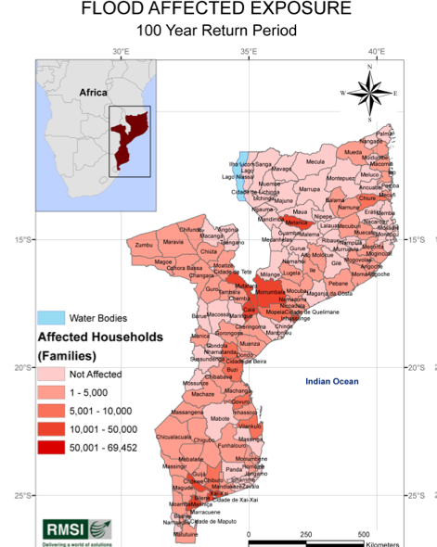
Vulnerability assessment with an economic focus: Mozambique
Assessing evidence /3
Mozambique
Hazard assessment: Evaluate location, severity, probable frequency of hazardous events – this is probably not an appropriate comment here – but not to forget the Barbados Green Economy Scoping Study: http://www.unep.org/greeneconomy/Portals/88/documents/SYNTHESIS%20REPORT_Barbados.pdf should probably be referred to during the course
Assessment of direct loss potential: Analyze/quantify impact of historical and probable future drought/flood events
Evaluation of adaptation scenarios:
Formulate options to reduce risk and economic vulnerability caused by drought and floodings
Notes:
Mozambique Economic Vulnerability and Disaster Risk Assessment, 2007.
1.1 Background ; The Economic Vulnerability and Disaster Risk Assessment in Mozambique project1 is funded by the World Bank through the Global Facility for Disaster Reduction and Recovery (GFDRR) Track II program. The AFTWR, African Region of the World Bank has appointed Risk Management Solutions India (RMSI) as a part of the team of technical consultants. The objectives of this study are:•Hazard assessment: To evaluate the location, severity, and probable frequency of a hazardous event in a given time period based on the analysis of historical weather data. The proposed methods and models should be able to simulate different climate change scenarios.•Assessment of direct loss potentials: To analyze and quantify the impact of historical and probable future drought and flood events, and produce a direct loss analysis, including probable maximum and average direct losses arising from damages due to drought and flood events of probable severity and frequency as estimated by the models.• Evaluation of mitigation scenarios: To identify and formulate possible options and scenarios to reduce drought and flood related risk and economic vulnerability. To evaluate economic impacts of the identified mitigation scenarios (for example, structural changes in the economies, risk financing options, irrigation expansion, crop diversification, water conservation measures, flood protection infrastructure, resettlement, etc.) over the long-term (20-25 years), by simulating the mitigation scenarios‟ impacts on the potential economic losses at the macro level and in the main sectors.•Assessment of indirect economic loss potentials: To build a macro-economic structural model identifying economic sectors affected by droughts and floods, and their interdependencies. To determine the indirect potential economic losses at the macro level and in the main affected sectors due to droughts and floods based on the direct economic impacts assessed. To examine the risk allocation of total (direct and indirect) loss potentials across sectors and geographical areas / administrative zones.In the present study, the vulnerability analysis has been conducted at the administrative area level of district spatial resolution.

Slide 18
Demonstration projects
Assessing evidence /4 Demonstration or pilot projects
Support lesson drawing for adaptive management
Test what works and does not work (relevance, effectiveness)
Mobilise communities, local/regional authorities & other stakeholders
Demonstration/pilot projects
Help foster interest and commitment of national authorities & other stakeholders
Create motivation and knowledge for replication/ scaling-up
Notes:
See UNDP-UNEP (2010) pp. 46-49
Lesson drawing: e.g. enabling conditions needed to scale up measures

Slide 19
Engaging key actors
Stakeholder analysis
Who might be good champions?
Even more important:
Will anyone be seriously negatively affected by the project?
Who can seriously block the process and the project?
Influence on project success/ Affected by project results | Little | Large
Positive
Negative
Notes:
Assessing available evidence:
using the findings of relevant studies and demonstration/pilot projects
Engaging key actors:
identifying and mobilising key organisations involved in development at the national and sector levels
identifying and mobilising ‘champions
Developing and implementing a communication
and advocacy strategy in support of mainstreaming
Define the target audience to be informed or influenced
Develop policy-relevant messages and materials based on evidence collected (e.g. policy briefs, radio programmes)
Select and use appropriate communication channels for the various target groups (e.g. media, sector working groups)

Slide 20
Communication and advocacy strategy
1. Goal
8. Evaluate, follow up
2. Sender
7. Carry through
3. Recipient
6. Channels
4. Message
5. Concept

Slide 21
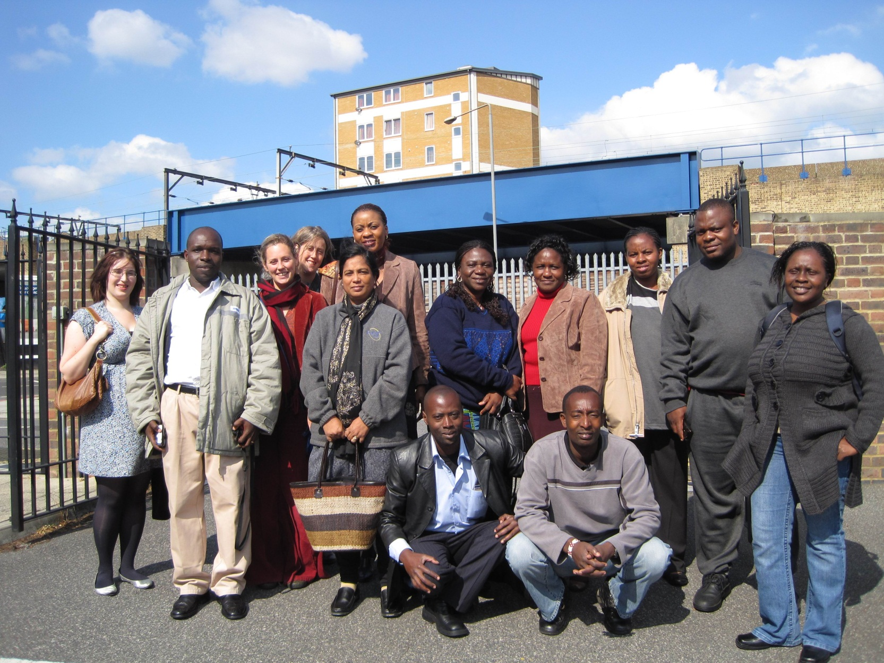
Making sense of capacity building

Slide 22
Promotion of capacity building
Capacity is the ability of people, organisations and society as a whole to manage their affairs successfully.
Capacity development is the process whereby people, organisations and society as a whole unleash, strengthen, create, adapt and maintain capacity over time.
Promotion of capacity development refers to what outside partners – domestic or foreign – can do to support, facilitate or catalyse capacity development and related change processes. (i.e. the Delegation/donor role)
OECD/DAC 2006

Slide 23

Accra Agenda for Action on Capacity Building

Slide 24
Accra Agenda for Action on Capacity Building
Without robust capacity — strong institutions, systems, and local expertise — developing countries cannot fully own and manage their development processes.
Capacity development is the responsibility of developing countries, with donors playing a supportive role.
Developing countries will identify areas where there is a need to strengthen the capacity to perform and deliver services and design strategies to address them.
Donors will strengthen their own capacity and skills to be more responsive to developing countries’ needs.
Donors’ support for capacity development will be demand-driven and designed to support country ownership.
Developing countries and donors will work together at all levels to promote operational changes that make capacity development support more effective” (i.e. need to remind our partners and ourselves (management) what we have signe du to and how we can assist)
(Accra Agenda for Action, September 2008)

Slide 25
Making sense of env. capacity building
Donors cannot “do” capacity development. Donors can suggest and promote – nothing more.
Donors need to understand the political playing field of capacity building to be able to provide good support. Their role is more as brokers than as players.
 | Functional dimension | Political dimension
Internal dimension | Strategy, systems, structures, work processes etc. | Leadership, values, power distribution, staff incentives etc.
External dimension | Legal framework, performance targets, oversight bodies etc. | Political governance, pressures from stakeholders etc.
Notes:
Donors need to understand the political playing field of CD to be able to provide good support. Their
role is more as brokers than as players, but that role requires deep contextual knowledge and
networks.

Slide 26
Institutional and capacity building
Needs assessment – examples?
National capacity self-assessment
Stakeholder analysis
Working mechanisms
Inst’l arrangements
Management framework
Work plan
Learning by doing
Training, exchange visits, on-the-job learning, lesson learning/dissemination
Mainstreaming as standard practice
Notes:
Source: UNDP-UNEP (2009)

Slide 27
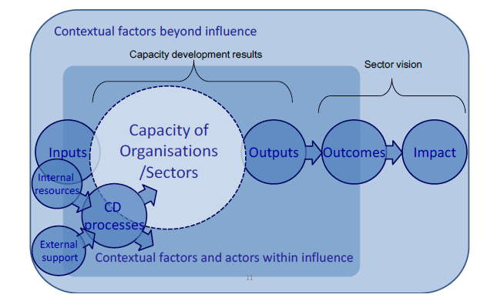
Adressing CD in organisations
Notes:
The illustration underlines the importance of context – institutional, social and political factors
Internal resources are key to successful CD Processes
Importantly, there are factors and not least actors (or stakeholders) in the context that can be influenced.
The model is developed in EC (2009b) and expands on Danida’s ROACH model (Danida, 2005).

Slide 28
Change readiness
Enabling situation
Ref. notes below – I guess message is then that EU needs to support each of these…
Change management capacity
Appealing vision
Notes:
During preparation, the emphasis is on change readiness. This includes a focus on the enabling
(or less enabling) situation, the change management capacity, and the broad vision for CD. It
relates to the strategic directions and ambition for the sector (or programme).

Slide 29
Principles for capacity development
Apply a strategic perspective
Apply a strategic development perspective, not only an aid effectiveness perspective.
Start where the partners are
The point of departure is where the partners are and what they can and will do to promote CD
Focus on tangible results
CD dialogue is driven by a focus on results in terms of effectiveness
Joint donor efforts – as default
Joint donor approaches to CD dialogue and support is the default
Recognize dilemmas openly
Recognise dilemmas openly when balancing policy and CD ambitions
Notes:
1. CD has to be addressed from a strategic development perspective, and not only from an aid effectiveness perspective.
CD is part of sector, thematic or area policies. Development of the education or agricultural sector includes development of the capacity of the sector to deliver certain outputs that lead to
outcomes/impact. Therefore CD is an integrated key element of any policy or plan.
Having a strategic approach that discusses CD based on the wider perspective on sector development is also required to avoid becoming “locked” in a particular institution – notably the sector ministry. If CD support is concentrated here it may end up serving the narrower institutional interests of the ministry rather than the broader sector.
Experience indicates that a “donor-centric” focus of CD support risks leading to fragmentation, splitting up CD efforts supported by different donors in bits that lacks coherence and consistency. This may affect the entire partnership, potentially undermining the coherence that e.g. budget support modalities should in principle promote.
2. When addressing CD the point of departure is where the partners are and what they can and will do to promote CD as integral part of their policies and programmes.
CD dialogue starts from an understanding and recognition of why current capacity is what it is; and how institutions, incentives and interests shape current dynamics. This is neither a given, nor a harmonious, nor a static picture. Therefore CD dialogue must be permanent, and support flexible.
Starting from what is there also implies building on strengths, adopting a realistic, but appreciative approach to CD support rather than an overly critical and often superficial focus on gaps, shortcomings and “lack of...” observations.
Starting from where the partners are also implies that donor support to CD will only be effective as a supplement to the partners’ investment – of political capital, managerial attention, staff dedication etc.
Dialogue about CD is driven by a focus on tangible results in terms of effectiveness and efficiency of service delivery and/or regulatory performance.
CD must focus on creating better outputs. These are, in the public sector, the services (health, education etc.) and regulatory performance (e.g. ensuring that environmental standards are observed) that are aimed for in the wider programme, and the capacity this will require, as well as the processes that will enhance the capacity to deliver this improved performance. CD works when it is an integrated part of mainstream, daily management functions. This is why dialogue about CD must focus strongly on leadership and management – because leaders and managers ultimately are in charge of and responsible for performance, and for CD of their organisations.
4. Joint donor approaches to CD dialogue and support is the default.
The more a country is dependent on aid the more will fragmented donor behaviour risk introducing perverse incentives in the public sector as well as additional patronage opportunities. This risks doing harm to existing capacity. It therefore requires special justification if Danish dialogue about and assistance for CD is conducted and delivered parallel to what others deliver in the same sector or subsector. This said, it is recognized that it is often difficult for donors – including Danida – to harmonize effectively when it comes to the “soft” components of aid (advisers, analytical work, twinning arrangements, fellowships etc).
5. Recognise dilemmas openly when balancing policy and CD ambitions
Development aid aims at enabling the partners to achieve results that they could otherwise not achieve. Or it enables them to attend concerns that donors find important but that the partners would not otherwise prioritize. In many aid dependent countries, the resource transfer from aid constitute a significant part of the public budget, in particular the investment budget. Despite formal agreement, donors and country partners may in several cases effectively pursue less than fully overlapping priorities. Policy documents may for this same reason (and not because of poor technical formulation) be less than clear. In addition, many aid dependent and developing countries have difficulties spending donor funds well – in the same way as they have difficulties spending their own resources well.

Slide 30
Purpose - Needs assessment
  It is crucial to decide the specific objective of the CD effort
  What is the need for CD?
  For what, targets to be achieved?
  At which level?
  For whom?
Notes:
Source: UNDP (2011)
At which level?
the ‘enabling environment’ or ‘system level’ (overall institutional level)
the organisation level
the individual level

Slide 31
National capacity self-assessments
Based on existing or ad hoc institutional assessments, consider for all relevant organisations:
  Level of education & awareness of environment, climate change, green economy
  Organisations’ mandates & functions with regard to climate-related issues
  Influence of climate risks on capacity to function
  Technical, financial, legal/regulatory capacities & information systems in relation to climate-related issues
  Planning, decision-making, budget allocation & programming mechanisms
  Collaboration & coordination structures & mechanisms
Notes:
UNDP (2011: 72) A NCSA is ‘a country-driven, locally adapted, consultative process that aims to:
-review global environment issues that require priority attention
-determine how capacity development could strengthen management of these issues
-prepare a national action plan for capacity development’.
On national capacity self-assessments and ‘vulnerability and capacity assessments’, see UNDP-UNEP (2010) pp. 32-35.

Slide 32
Module 4 – recap main messages
Mainstreaming of environment and climate concerns is a complex institutional issue – not just application of a procedural tool. [Same for transformation to GE]
Understanding the roles of the different stakeholders is the basis for effective institutional mainstreaming
Awareness raising and partnership building comprise assessment of data, demonstration projects, and engagement of key actors + a communication strategy based on a stakeholder analysis
Donors cannot ”do” capacity building
Capacity building should be applied with a strategic approach in support of partners in their present position
Notes:
EC steps and other donors : slides 2-4 + optional slides to go into detail
EC cycle of operations: slides 5,6
Relevance of political economy: slides 7 +optional slides to go into detail
CSP: slides 8
Example of Indonesia CEP: slides 9,10
Rio markers and trends in aid: Slides 11,12

Slide 33

Action plan – from words to actions
Reflections
Identify good examples of environmental mainstreaming from your own experience.
Identify and analyse how it occurred – how it was maintained – what was the benefits.
Identify the institutional factors of importance for the good results.
Actions
Identify measures for environmental mainstreaming in an institutional perspective to be used in your present programs and projects.
Relevant factors for good environmental mainstreaming may include:
Visionary environmental and climate policies and national plans
Dynamic and bold env. leadership institutions, national champions
Feasible and realistic env. and climate strategies to fulfil visions
Clear national env. structures with relevant institutions involved
Well coordinated national environmental efforts and climate efforts
Good participatory environmental processes
Strategic capacity building programmes in close cooperation
Adequate involvement of researchers in programming and implementation

Slide 34
Resources (a bit thin... Will look)
Overall
EU Guidelines on the Integration of Environment and Climate Change in Development Cooperation
Institutional
Dalal-Clayton and Bass: Environmental mainstreaming diagnostics
Capacity Development
Ministry of Foreign Affairs of Denmark: Addressing Capacity Development in Danish Development Cooperation

