Slide 1
Greening Development Cooperation
Planning under uncertainty &
Mainstreaming into
Sector Approach – module 5 – before I forget will send you the Rwanda Agric SEA from this year – we should refer to it as we funded it and it seems to be quite good. Did I send you the report from the Agric and CC Hot Topic Day?

Slide 2
Module 5 a:
The premise:
Understanding and planning under uncertainty

Slide 3
Socio-economic uncertainties:
  future population growth,
  economic growth,
  technological choices,
  societal choices,
  international relations
  Influence the level of future emissions and thus the magnitude of climate change and environmental worsening
  Create uncertainties about future vulnerability to climate change (possibly need to reword these last two bullet points – not sure I understand them)
Notes:
Socio-economic uncertainties (e.g. related to future population growth, economic growth, technological choices, societal choices, international relations):
influence the level of future emissions and thus the magnitude of climate change
also, create uncertainties about future vulnerability to climate change

Slide 4
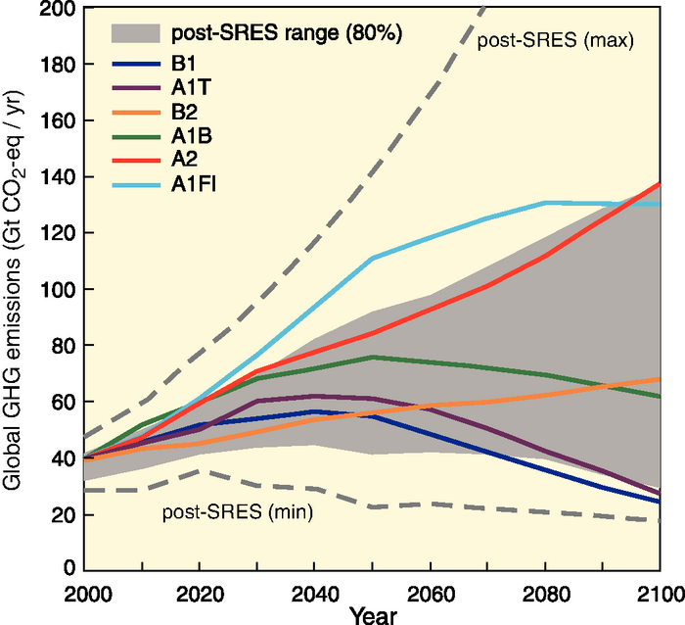
IPCC GHG emission scenarios – tone down use of all the "fancy" climate model codes – just point out that there is a lot of uncertainty…
  Variables include:
  population growth
  economic growth
  technological choices
  societal choices
  international relations
  Just recall previous slide, otherwise slide gets cluttered
Notes:
IPCC Special Report on Emission Scenarios (SRES, 2000): 4 scenario families using different assumptions on the evolution of emission drivers:
* A1: rapid economic growth, population stabilising in 2050, rapid introduction of more efficient technologies (with 3 sub-scenarios: A1FI = fossil-intensive, A1T = non-fossil energy, A1B = balanced use of energy sources).
* A2: rapid population growth, slower & more fragmented economic development, slow adoption of new technologies.
* B1: similar to A1 but more rapid transition to a service and information economy, and reduction in material intensity.
* B2: intermediate population and economic growth, local solutions to economic/social/environmental sustainability.
Higher end of the range: A1FI and A2. GHG concentrations does not stabilise.
Middle-range scenarios: A1B and B2. GHG concentrations stabilise at, respectively, 750 and 650 ppm.
Lower end of the range: B1 and A1T. GHG concentrations stabilise at, respectively, 550 and 650 ppm.

Slide 5
Climate uncertainties
For any given emission scenario, different Atmosphere-Ocean General Circulation Models (AOGCMs) provide different projections of future change
– sometimes very different ones (!)
Due to the complexity of the climate system, many uncertainties prevail and will persist over the evolution of climate (what does this mean?)
Notes:
AOGCMs = mathematical representations of the earth’s climatic system, which link the atmosphere, ocean, land, and biosphere both vertically and horizontally in a series of 3-dimensional grid boxes that partition the earth into layers and grids (Jones & Mearns 2004). They simulate future climate change by gradually increasing the level of radiative forcing.
WDR 2010: «Uncertainty: An expression of the degree to which a value (such as the future state of the climate system) is unknown. Uncertainty can result from lack of information or from disagreement about what is known or even knowable. It may have many types of sources, from quantifiable errors in the data to uncertain projections of human behavior. Uncertainty can therefore be represented by quantitative measures, for example, a range of values calculated by various models, or by qualitative statements, for example, reflecting expert judgment. However, in economics, uncertainty refers to Knightian uncertainty, which is immeasurable. This is in contrast to risk, wherein the occurrence of certain events is associated with a knowable probability distribution. »

Slide 6
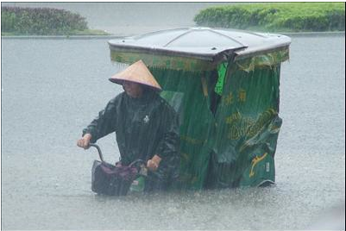
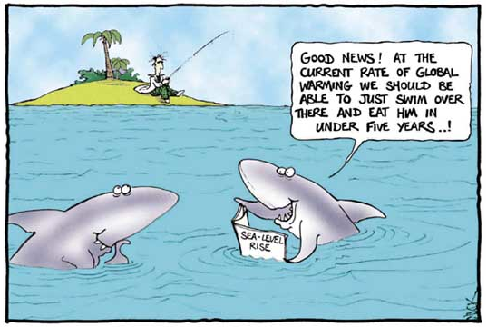
Uncertainties in climate change projections – ok to have pictures but try to make them as faint as possible or they will "confuse" the slide
Temperatures
and sea levels
Rainfall
Floods and/or
Drroughts
These uncertainties arise from:
Uncertainties in the amount of future emissions;
Uncertainties about the relationship between the rate of GHG emissions and their concentration in the atmosphere;
Uncertainties about the extent of the warming that results from any given change in atmospheric GHG concentration;
The complexities of the climate system. This is just too much text….
Notes:
Temperatures and sea levels:
consensus that they will increase
magnitude of the increase quite uncertain
Rainfall:
expected to increase overall
but some regions are likely to get more and some less
for many regions in the world, uncertainty about the direction of change
These uncertainties arise from:
Uncertainties in the amount of future emissions;
Uncertainties about the relationship between the rate of GHG emissions and their concentration in the atmosphere;
Uncertainties about the extent of the warming that results from any given change in atmospheric GHG concentration;
The complexities of the climate system.
OECD (2009a), Section 2:
‘In general, high-latitude areas will see increased precipitation; mid-latitude areas will see a mix of changes, many subtropical areas will see a decrease in precipitation, and many equatorial areas could have increased precipitation. There are likely to be substantial variations in changes in precipitation patterns in particular regions within these latitudinal ranges. The seasonality of precipitation patterns is also likely to change in many locations.’

Slide 7
The cost of inaction
Failure to adapt
Failure to reduce emissions
More harmful impacts
Higher adaptation costs
Wasted investment
Increased vulnerability
Uncertainties surrounding climate change often invoked to justify inaction (!)
BUT, even with uncertainty, some measures are justified (as we shall see)
Notes:
The uncertainties surrounding climate change are often invoked to justify inaction
In a medium- to long-term perspective, however, inaction now is likely to be more costly:
Even in the face of uncertainty, some types of measures are justified
Adaptation – OECD (2009): “The effect of discounting would normally favour a delay in adaptation (...). However, there is also a class of adaptations where early action is cheaper. They include adjustments to long-term development plans and long-lived infrastructure investments (...). In each of these cases, it will be cheaper to make adjustments early, in the design phase of the project, rather than incur the cost and inconvenience of expensive retrofits.” The same applies to land use policies and long-term development plans.
Mitigation – Stern Review: «The benefits of strong, early action on climate change considerably outweigh the costs». What we do in the next 10 or 20 years can have a profound effect on the climate in the second half of this century and in the next. Mitigation must be viewed as an investment to avoid the risks of very severe consequences in the future.
The social cost of carbon under the business-as-usual scenario is about $85/tonne of CO2 – well above marginal abatement costs in many sectors.
If a path towards stabilisation of atmospheric concentration of GHGs at 550ppm CO2e is adopted, then the net present value of benefits over costs is around $2.5 trillion. With a target of 450-550 ppm CO2e, then the social cost of carbon is in the region of $25-30 per tonne of CO5 – about one-third of the cost under the BAU scenario.
The social cost of carbon is likely to increase steadily over time because marginal damages increase with the stock of GHGs in the atmosphere. Policies should thus aim for a gradual intensification of marginal abatement efforts, while supporting the development of technologies that reduce abatement costs.
The annual costs of stabilisation at 500-550ppm CO2e are estimated to be around 1% of GDP by 2050 - a level that is significant but manageable.

Slide 8
Justified measures in the face of uncertainty
‘No-regret’ measures: those expected to produce net benefits for society even in the absence of climate change
‘Low-regret’ measures: those expected to have an acceptable cost for society in view of the benefits they would bring
‘Robust’ measures: those that produce net benefits or deliver good outcomes across various possible scenarios
"New measures" – green economy – would that be too much of a stretch?
Notes:
World Bank (2010c):
(No- and) low-regret measures include most of the ‘soft’ adaptation measures, which enhance development and welfare across all or most climate change scenarios including the no-change scenario
‘No-regret’ measures:
those expected to produce net benefits for society
even in the absence of climate change (adaptation) or independently of any ‘reward’ for mitigation (zero or negative net cost at a zero carbon price)
‘Low-regret’ measures:
those expected to have a cost for society, but an acceptable one in view of the benefits they would bring if climate change turns out to produce significant effects (adaptation), or to have a low net cost at zero or low carbon prices (mitigation)
.
Robust’ measures: those that produce net benefits or deliver good outcomes across various possible climate change or carbon price scenarios and economic development scenarios (rather than just under the ‘most likely’ scenario)

Slide 9
Scenario-based planning
To support the choice of adaptation measures, scenarios reflecting prevailing uncertainties can be developed, e.g.
1) No change in temperatures
2) Moderate change in temperatures
3) High change in temperatures
1) No change in temperatures and rainfall
2) Temperatures up, rainfall up
3) Temperatures up, rainfall down
Notes:
* ‘No change’ (= baseline): based on continuation of historical weather patterns.
* ‘Moderate change’: based on average forecasts of climate change, using available studies and expert knowledge.
* ‘High change’: based on the outer range of climate change forecasts, using available studies and expert knowledge.
* Higher temperatures combined with an increase as well as a decrease in rainfall.
UNDP (2004) – Adaptation Policy Frameworks “Assessing future risks”:
A scenario is ‘a coherent, internally consistent and plausible description of a possible future state of the world’. ‘Scenarios can range from the simple to the complex, and from the qualitative to quantitative, encompassing narrative descriptions of possible futures to complex mathematical descriptions combining mean climate changes with climate extremes.’

Slide 10

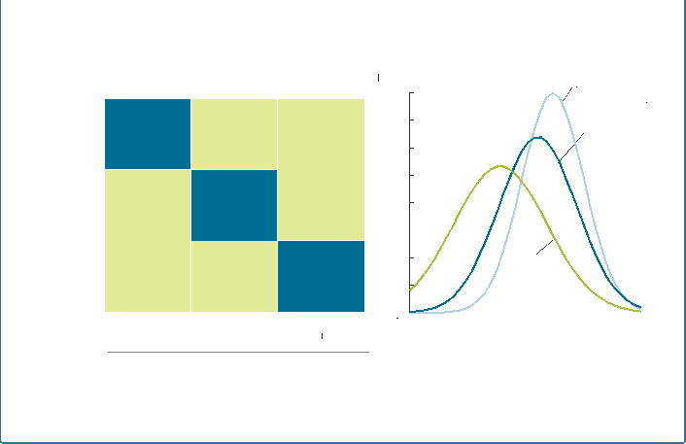
Three climate change scenarios for the central regions of Tanzania
02
Scenarios are built to reflect potential outcome of climate change - EXCELLENT example it seems - but would split on two slides
Each scenario has its own distribution of probability for rainfall
No change
 | Scenario 1 No climate
0% | change
 |  | Scenario 2
Average -10% |  | Consensus climate
 |  | change
 |  |  | Scenario 3
Max* |  |  | Severe
-20% |  |  | climate change
 |  |  |  | 0
Probability
0.08
0.07
0.06
0.05
0.04
0.03
0.02
0.01
Scenario 1
No climate change
Change In average rainfall
Scenario 2 Consensus climate change
Scenario 3 Severe
climate change
0%
No change
+25% Average
+50%
0 200 400 600 800 1000
Rainfall
mm
Max¹
Change in variability (Standard deviation)
10
Notes:
For Tanzania as a whole, general circulation models predict an increase in rainfall by 2030. However, regional climate models (RCMs), which offer a higher degree of granularity, expect the central regions (Dodoma, Singida, Tabora) to experience a decrease in annual precipitation. This is important since the central regions already face droughts and are the location of most hydropower reservoirs (major dams on the Rufiji river: the Kidatu and Mtera dams provide 50% of Tanzania’s hydropower production capacity).
Source: Economics of Climate Adaptation (2009) – Case study on central Tanzania – Figure 02, p. 126

Slide 11
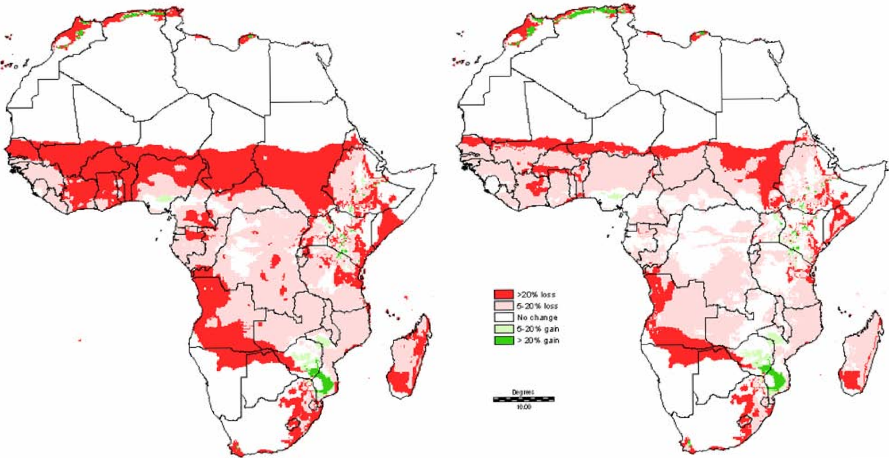
Projected changes in the length of the growing period
Consensus climate change – maybe have this slide before the Tanzania example? Severe climate change
Length of growing period change 2000-2050
Notes:
Source: Thornton et al (2006), Figure 7(A)

Slide 12
Module 5b:
Environment and climate in sector support – I would very much prefer if we start with this

Slide 13
Overview of aid delivery methods – can we make the slide a little more appealing visually?
APPROACH
FINANCING MODALITY
Project approach
EC (donor) contractual and financial procedures
Sector approach
Pooled fund
Macro approach
Budget support

Slide 14
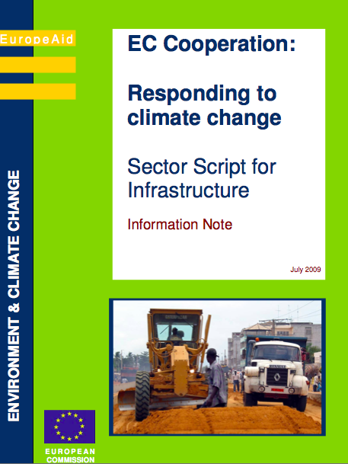
Climate change sector scripts (2009)
Agriculture and rural development
Ecosystems and biodiversity management
Education
Energy supply
Health
Infrastructure
Solid waste management
Trade and investment
Water supply and sanitation
http://capacity4dev.ec.europa.eu/env_cc_ge_4_ec_and_eeas/minisite/key-documents-environment-and-climate-change-0
(this is a closed EC/EEAS group –I have yet to put them there. I will do before the course)

Slide 15
Terminology
Sector approach = a way of working shared by a government, development partners and other stakeholders; aimed at developing a sector in a holistic manner, based on a continuous process
Sector programme = the result of a sector approach; includes:
  A sector policy and strategy
  A sector budget
  A sector coordination framework
Sector Policy Support Programme (SPSP) = the EC instrument to support the (national) sector programme

Slide 16
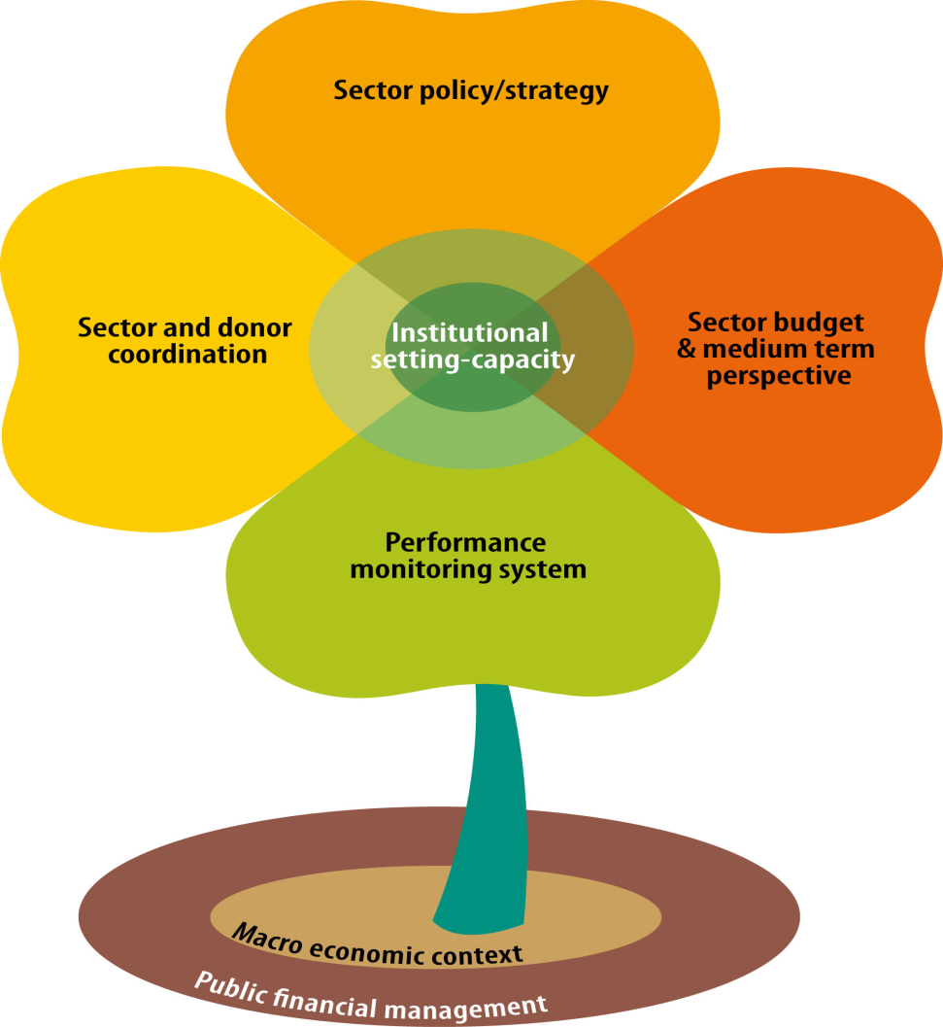
Key elements of a sector programme
The 5 components of the sector programme
2 additional elements that influence the performance of the sector programme
Notes:
Identification: environmental integration
Take account of environmental, Climate Change and possibly GE issues in the seven assessment areas
Apply an SEA to the policy (timing?!)
Integrate the main outcomes of environmental, CC and GG integration in the SPSP’s Identification Fiche + AF

Slide 17
The seven key assessment areas: Possible entry points for environmental integration
SEA of sector policy / strategy?
Identification and formulation are based on the assessment of seven areas corresponding to the seven key elements:
  Sector policy and strategy
  Sector budget and its medium-term perspective
  Sector and donor coordination
  Institutional and capacity issues
  Performance monitoring systems
  Macroeconomic framework
  Public financial management
  (perhaps take out as we do not really address them here….)
  Effects of expenditure on env.? Resources allocated to the env.?
  “Environment” working group?
  Capacities for the prevention/monitoring of env’l impacts?
  Indicators relevant from an env’l perspective?

Slide 18
Strategic Environmental Assessment (SEA)
Analysing the positive and negative environmental consequences of proposed policies, plans and programmes
Ensures that environmental, biodiversity and CC considerations are taken into account, alongside social and economic considerations, as early as possible in the policy and planning process (possibly also an opener for GE – but I guess experience is limited on that)
Notes:
A study analysing the positive and negative environmental consequences of proposed policies, programmes and strategic interventions
Compared with the EIA (Environmental Impact Assessment – for individual projects), applied at a higher decision-making level
Ensures that environmental considerations are taken into account, alongside social and economic considerations, as early as possible in the policy and planning process

Slide 19
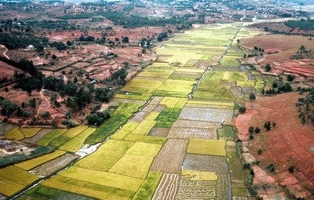
SEA vs. EIA: a different focus – "hanging title - should be on white part of slide – phot is a bit confusing)
Strategic Environmental Assessment - SEA
Policy, plan, programme
Project
Environmental impact assessment
EIA
Notes:
Should be carried out for all PPPs that are likely to produce significant negative impacts on the environment during implementation
SEA “has the potential to make the world a greener and more liveable place”.
“It also has the potential to be a dreary and resource- intensive formality, applied in a grudging minimalist fashion by people who just hate having to do it, adding further to some great useless administrative burden – so again we have to make the case and ensure that SEAs are done and used ….
Compared with the EIA (Environmental Impact Assessment – for individual projects), applied at a higher decision-making level
© Bruno Locatelli

Slide 20
SEA: a more recent tool than EIA
EU Directive of 2001 (1985 for EIA)
2000+ SEAs undertaken in EU each year
Some experience in EC development aid, incl.:
  Indian Ocean - SEA scoping for coastal tourism
  Chile – National SEA system
  Maldives – regional development strategy (2006)
  Mauritius, Tanzania, Belize, Jamaica, Trinidad & Tobago, Zambia – sugar sector reform
  Mali – transport sector programme (2008)
  Ghana – National Development Plan
  Guyana – sea defences
  Congo – Social and Env. Study, Forest + Nature
Notes:
Not all partner countries have adopted SEA legislation

Slide 21
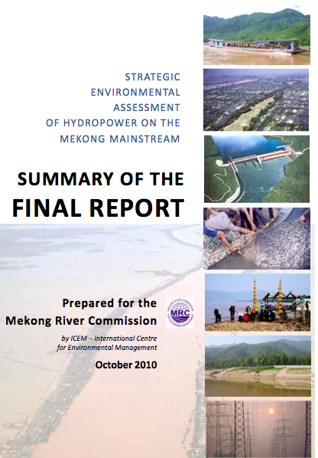
SEA
Should be carried
out for all PPPs
that are likely to produce significant negative impacts on the environment during implementation – maybe 2 slides…. I would be overjoyed if we could refer to Paris Declaration and EU Consensus on Development statements on SEAS – strengthens the case (!)

Slide 22

Key stages in an SEA -split slide in 2 or simplify – it is too cluttered right now…)
Screening
Decision on need for an SEA
Definition of SEA approach and aspects to be assessed (incl. scenarios/alternatives) and incl. concerns and values of stakeholders.
Scoping
Baseline “business-as-usual” situation
Identification of env’l, CC, GE opportunities and constraints of the PPP and alternatives
SEA study should embrace ‘5 of the 7’:
Sector policy and strategy assesm.
Budget and expenditure framework
Sector and donor coordination
Institutional setting
Performance monitoring system
Stakeholder participation
Identification of elements that may conflict with or hinder env. policy objectives
Conclusions and recommendations for formulation of preferred and improved alternative
Monitoring, performance indicators
SEA report
Notes:
Applications of SEA: some examples
‘Macro’ policies : e.g. poverty reduction strategies; agricultural subsidy reforms; public sector reforms; privatisation policies; trade policies
Sector strategies and programmes : e.g. water sector; waste management; transport infrastructure; rural development
Sub-national strategies : e.g. coastal zone management; urban development plans; regional development plans

Slide 23
Screening for SEA
Process of deciding if an SEA would add value
An SEA is recommended if the sector is environmentally “sensitive”
  Infrastructure (incl. transport)
  Water & sanitation
  Energy
  Waste
  Agriculture, food security and rural development
  Regional and land use planning
  Environment and sustainable management of natural resources
See screening questionnaire in Annex 3 of the Guidelines

Slide 24
Identification Fiche: possible entry points for environmental, CC and GE integration
  Description of sector strategy/programme
  Issues and state of play in the 7 assessment areas
  Strategic response incl. cross-cutting issues
  Implementation issues
  Assumptions and risks
  Next steps, work plan and time schedule
Env.t- & climate-related stakes/issues?
See specific entry points
Env’l sustainability, contribution to sustainable dvpt?
Development of env’l managem. capacities?
Climate-related risks, availability of nat. resources?
SEA screening

Slide 25

SEA and sector support – lessons learned /1
The Chicken or the egg
Sector Strategy
SEA
Joint Ownership – changed around to make more please to eye -I thought….
Notes:
To qualify for sector support, one of the conditions is that the government has a sound sector strategy in place. In a strict sense, this means that the EC can only trigger an SEA once the relevant strategy has already been completed. So much for an early SEA!
The general understanding of SEA by EC staff is increasingly one where the SEA is ‘owned’ both by the partner government and the EC. And so it should be.
The scoping phase has proved extremely useful to identify the key environmental aspects related to the sector and sector strategy. This has allowed focusing the SEA Study on those aspects that are really important.
Prior to the launch of an SEA process for the Zambia National Sugar Strategy, the EC delegation organised a workshop with participation of key stakeholders. The workshop aimed at drafting the ToR for the SEA. This allowed raising awareness of SEA and what to expect from it; and building ownership from both the EC staff, the partner government and key stakeholders

Slide 26

SEA – Ownership – messy slide!
Workshop – Key stakeholders
Purpose: Draft ToR for the SEA
Awareness of SEA
Ownership from EC, GOZ and stakeholders
Zambia Sugar Strategy
Promotion of bio-ethanol
But no distilling industry
And no regulatory framework
SEA Recommendations:
Funds for capacity building of env. authorities
Environmental guidance and standards for the sector
Notes:
The scoping phase has proved extremely useful to identify the key environmental aspects related to the sector and sector strategy. This has allowed focusing the SEA Study on those aspects that are really important.
It is tempting to advance long-lists of ‘key issues’ that should be assessed in the SEA Study. However, this undermines the role of scoping.
Still not well applied for General Budget Support – BUT IT SHOULD BE!!!! (KEY TO MAINSTREAMING)
SEA awareness amongst EC staff dealing with GBS is limited
Not always joint ownership of SEAs
Value of SEA depends on the partners’ commitment and knowledge - so need to lobby, make the case, raise awareness, etc

Slide 27
Formulation phase: Is SEA needed - Screening questionnaire (Annex 3)
  Significant negative (cumulative?) environmental impact (Annex 1)?
  Valued areas or landscapes with protection status?
  Vulnerable areas? – TOO MUCH DETAIL ON THIS SLIDE… MAYBE SPLIT IN 2
  Human health or safety?
  Other environmentally sensitive sectors?
  Dependent on scarse natural resources?
  GHG emissions (increase or reduction)?
  Vulnerability of population to climate change?
  Existing analytical work (CEP, orther SEAs)?
  Does the PPP promote sound environmental sector management?
  Consideration of sector-related environmental concerns?
  Sufficient institutional capacity for environmental efforts?
  Local processes promoting harmonisation and alignment?
Notes:
Screening for SEA
Process of deciding if an SEA would add value
CEP = country environmental plan
An SEA is recommended if the sector is environmentally “sensitive” – need to emphasise that it is an excellent "dialogue tool" – strong role for EU
List of sensitive sectors, plus questionnaire

Slide 28
SEA or Formulation study – not sure I "get" this slide…
SEA / Formulation study
Environment
SEA / Formulation study
Programme
Impacts generated
Opportunities, risks & constraints
  The potential (positive and negative) impacts of the PPP on the environment
  The (positive and negative) environmental conditions that may affect the effectiveness, efficiency, sustainability or impact of the PPP
Notes:
Identification of environmental opportunities, risks and constraints
Evaluation of the sector programme’s main environmental impacts, incl. alternatives and socio-economic dimension
Analysis of performance indicators
Evaluation of institutional capacities
Recommendations for sector programme improvement and SPSP formulation

Slide 29
Formulation phase and environmental integration
Lay out… - incorporate in a previous slide perhaps?
Some sector programmes require an SEA, others do not
In both cases: Action Fiche (+ Technical and administrative provisions to be attached to the Financing Agreement)
Annex 4 of the Guidelines identifies the environmental issues to be considered in SPSP formulation studies

Slide 30
SEA of a sector programme - main results
Identification of environmental, CC and [GE] opportunities, risks and constraints (incl. those originating from other sectors / policies)
Identification and evaluation of the sector programme’s main environmental impacts:
  incl. alternatives
  incl. the socio-economic dimension of environmental impacts
Analysis of the sector programme’s performance indicators with regard to env, cc, ge isues
Evaluation of institutional capacities to manage environmental issues
Recommendations: (next slide – so delete here..)
  for sector programme improvement
  for SPSP formulation

Slide 31
Using SEA results
SEA results and recommendations should allow:
  Analysing in more depth the environmental aspects of the five (seven) key assessment areas
  Choosing the SPSP financing option that is most likely to contribute to the sustainable development of the sector
  Identifying possible institutional and capacity building measures to be supported
  Choosing the SPSP monitoring and evaluation indicators on a better informed basis
  If relevant, choosing on a better informed basis the indicators, targets and performance criteria that will condition the disbursement of variable tranches of budget support

Slide 32
Implementation: possible entry points for environmental, CC and (GE) integration
Env’l indicators (or indicators associated w/ env’l trends)
Sector performance monitoring
  Evolution of sector performance indicators
  Qualitative reports (working groups, studies, annual review…)
  Implementation of institutional support measures
Participation in sector dialogue
If SBS: tranche disbursement
  Evolution of environmental indicators and/or indicators associated with environmental trends
  If relevant, implementation of conditions related to environmental / natural resource management
Environment-related aspects
Building up of env’l mngt capacities
Dialogue on env’l aspects
Notes:
New slide

Slide 33
Evaluation: possible entry points for environmental integration
Env’l indicators (or ind. associated w/ env’l trends)
Sector performance evaluation
  Evolution of sector performance indicators
  Qualitative reports (working groups, studies, annual review…)
  Institutional reforms
Evaluation of the contribution of the SPSP to the sustainable development of:
  the sector
  the country
Environment-related aspects
Building up of env’l management capacities
Relevance, effectiveness, efficiency, impacts and sustainability of env’l integration measures
Notes:
New slide

Slide 34
Climate Risk Assessment
Climate Risk Assessment, CRA
  Relevant for Sectors and for projects.
  In this course dealt with in module 6, Projects.
Notes:
New slide

Slide 35
Module 5a – recap main messages
  Understanding the sector approach – 5 (7) assessment areas give us entry points
  SEA – a key tool for integrating environment and climate change (and GE?) at the sector level
  SEA - provides information for entry points at the identification, formulation, implementation and evaluation stages
  Socio-economic uncertainties increase environmental and climate uncertainties – the scenarios of climate development vary a lot
  Inaction is costly. Some measures are justified even in the face of uncertainty.
Module 5b – recap main messages
Notes:
EC steps and other donors : slides 2-4 + optional slides to go into detail
EC cycle of operations: slides 5,6
Relevance of political economy: slides 7 +optional slides to go into detail
CSP: slides 8
Example of Indonesia CEP: slides 9,10
Rio markers and trends in aid: Slides 11,12

Slide 36

Action plan – from words to actions
Reflections
Climate uncertainties are often disputed – are environmental uncertainties similarly significant and controversial?
Identify SPSPs or Budget Support Programs in which environmental and climate concerns have been thoroughly built in.
Identify processes where SEA has played an important role in the pursue of sustainable development.
Actions
Identify SPSPs – already accomplished or new – in which SEA or an environmental study could (have) contribute(d) to improve the overall environmental performance of the effort.
Discuss environmental initiatives that could potentially be relevant in planned EC support.

Slide 37
Resources – perhaps needs more…
Overall
EU Guidelines on the Integration of Environment and Climate Change in Development Cooperation
Uncertainty
WUCA: Decision Support Planning Methods: Incorporating Climate Change
Uncertainties into Water Planning
SEA
OECD: Strategic Environmental Assessment in Development Practice
A Review of Recent Experience

Slide 38
Exercise – Mainstreaming into SPSP and GBS

Slide 39
General budget support

Slide 40
Identification: 7 assessment areas
Priority granted to env’l and nat. res. mngt?
Identification is focused on eligibility conditions and the 7 assessment areas (see SPSPs):
  National development/reform policy/strategy
  Macroeconomic context
  Budget and medium-term expenditure framework (MTEF)
  Public financial management
  Donor coordination
  Performance monitoring
  Institutional framework and capacities
  Env’l impacts of ME policies?
  Resources allocated to env.t? Env’l fiscal reform?
  Public env’l expenditure review?
  Indicators relevant from an env’l perspective?
  Capacities for env’l mngt?
  “Environment” working group?

Slide 41
Identification Fiche: possible entry points for environmental integration
Env’l & climate-related stakes/issues?
Conclusions of the identification phase
  Consistency with EC policies & the programming framework
  National development policy/strategy
  Budget & MTEF
  Performance evaluation
  Institutional setting and capacities
  Assumptions & risks
  Implementation issues
  Next steps, action plan & work programme
See entry points for the 7 assess.t areas
Climate-related risks, availability of natural resources?
Needs for further env’l or climate-related assess.t?
Dvpt of capacities for env’l management?

Slide 42
Formulation: possible entry points for environmental integration
See points already mentioned
More in-depth investigation of the 7 key assessment areas
Choice of indicators, targets and other performance criteria linked to tranche disbursement
SEA of the national policy/strategy supported by GBS
  If one exists: use results for formulation
  If not: discuss the possibility of undertaking one, in the context of policy dialogue and in coordination with other donors
Action Fiche (+ Technical and administrative provisions to be attached to the Financing Agreement)
Prefer sustainable dvpt indicators
Results of env’l integration efforts

Slide 43
Use of indicators in budget support operations
Both sector and general budget support use indicators for performance monitoring:
  of the sector
  of the PRSP or reform programme
In the framework of a results-based approach, performance indicators and associated targets are also included in the financing agreement as conditions for the disbursement of tranches
In principle, these indicators and targets must come from the performance assessment framework (PAF) of the programme being supported (alignment and ownership principles)
Notes:
New slide

Slide 44
Indicators and environment
Environmental indicators should reflect environmental issues and concerns
Non-environmental indicators associated with other objectives should be selected keeping in mind the possibility of adverse environmental impacts: ideally, indicators typically associated with environmental damage should not be used for the monitoring and evaluation of an SPSP or GBS programme (sustainable development approach)

Slide 45
Implementation: possible entry points for environmental integration
Env’l indicators (or ind. associated w/ env’l trends)
Performance monitoring of supported policy/strategy
  Evolution of performance indicators
  Qualitative reports (working groups, studies, annual review…)
  Implementation of institutional support measures
Participation in policy dialogue
Tranche disbursement
  Evolution of environmental indicators and/or indicators associated with environmental trends
  If relevant, implementation of conditions related to environmental / natural resource management
Environment-related aspects
Building up of env’l mngt capacities
Dialogue on env’l aspects
Notes:
New slide

Slide 46
Evaluation: possible entry points for environmental integration
Env’l indicators (or ind. associated w/ env’l trends)
Performance evaluation of supported policy/strategy
  Evolution of performance indicators
  Qualitative reports (working groups, studies, annual review…)
  Institutional reforms
Evaluation of the contribution of GBS to sustainable development
Environment-related aspects
Building up of env’l management capacities
Relevance, effectiveness, efficiency, impacts and sustainability of env’l integration measures
Notes:
New slide

