Slide 1
Institution & Capacity Development
Greening a project – module 6

Slide 2
Greening a project through the log frame
The identification phase involves:
  Identifying relevant project ideas
  Assessing relevance and feasibility
  Pre-selecting best options for detailed formulation
Result: Draft Identification Fiche
Notes:
Identifying project ideas consistent with partner country’s and EC’s objectives and strategies
Assessing relevance and feasibility
Pre-selecting options that look worth financing and will be subject to more detailed formulation

Slide 3
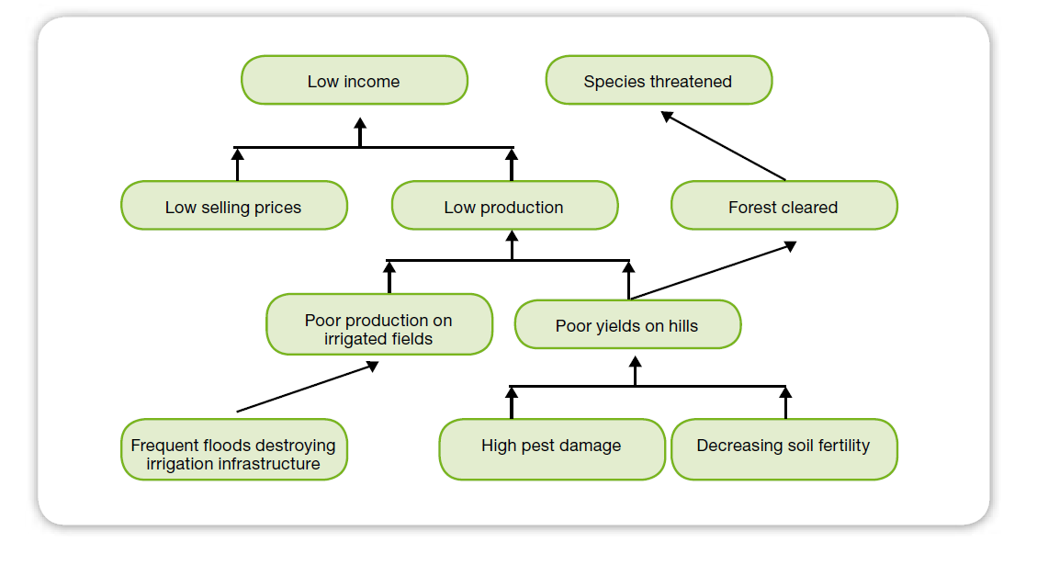
Problem analysis – need to stress that this is the excellent theory – which is used far too little in real life

Slide 4
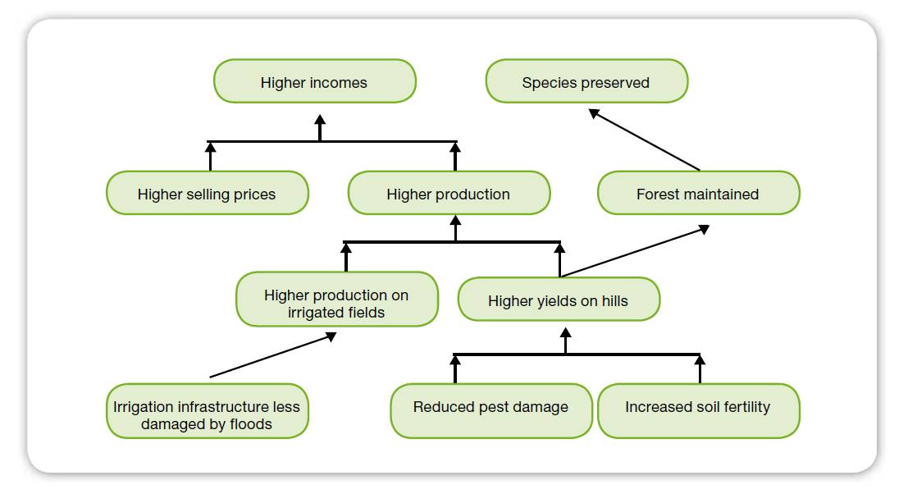
Strategy analysis

Slide 5
Building the logical framework – 2 slides?
Intervention logic
Logical framework
Overall objective
Overall obj.
Indicators
Sources
of verif.
Specific objective
Specific obj.
Assumpt.
Output 1
Output 2
O1
O2
Activity 1.1
Means
Costs
Activity 1.2
Activities
Activity 1.3
Moyens
Activity 2.1
Activity 2.2
Activity 2.3
Means
Budget
Notes:
Includes consideration of environmental, CC {and GE} issues in analyses
Integrates the environmental dimension:
In objectives and results
In the choice of indicators
In risks and assumptions
See Annex 6 of the Guidelines
Indicators allow measurement of the achievement of objectives and results; they are associated with targets (= quantified objectives defined in time)
Environmental indicators are selected to measure:
the achievement of environmental objectives
the implementation of some environmental requirements linked with other objectives (“mainstreaming-related” indicators)
Non-environmental indicators should not be associated with negative environmental pressures or impacts

Slide 6
Environmental Impact Assessment and Climate Risk Assessment
EIA is an ex ante assessment, specified in legislation.
  To reduce environmental damage by preventive measures
  To optimise positive impacts
  Through technical/scientific studies and stakeholder consultations
CRA is an optional ex ante assessment – but should be adopted/combined:
  To reduce the project’s vulnerability to climate change;
  To reduce the project’s climate impact;
  Through technical/scientific studies and stakeholder consultations
Notes:
Ex ante = before the event
Traditionally, EIA assesses the potential (positive and negative) environmental impacts of the project on the environment (“impacts generated”)
As a complement, either the EIA or the feasibility/formulation study should include provisions for the analysis of the (positive and negative) environmental and natural resource-related conditions that may affect the effectiveness, efficiency, sustainability or impact of the project (“opportunities, risks & constraints”)
Legal requirement for an EIA?
Policy commitments?
Annex 7 – project lists and questions
Project EIA and CRA classes:
A – significant impacts expected – EIA , significant likelihood of being affected by climate change: CRA
B – some uncertainty, further analysis necessary
C – no significant impacts expected – EIA not required
Annex 8 (ToR for EIA) cover these aspects as an option
Annex 9 of the Guidelines provides guidance on integrating environmental issues in formulation studies

Slide 7
Indicators and environment, CC [and GE]
Environmental, CC and GE indicators are selected to measure:
  the achievement of environmental, xx objectives
  the implementation of some environmental, xx requirements linked with other objectives (“mainstreaming-related” indicators)
Non-environmental indicators should not be associated with negative environmental pressures or impacts
Notes:
Indicators allow measurement of the achievement of objectives and results; they are associated with targets (= quantified objectives defined in time)
Indicators are usually classified according to their level: input indicators (which measure the resources provided),
output indicators (direct results), outcome indicators (benefits for the target group) and impact indicators (longterm
consequences).
Independently from the environmental nature of the indicators, the hierarchy between these levels should always
be maintained, especially when the inputs or the outputs are a source of environmental impact. For instance, when
roads are built (outputs) to allow farmers to sell more and at a higher price (outcome), we should never measure
the outcome in terms of ‘number of km of road’ because this is reflecting a cost, including an environmental cost.
Similarly, if we want to protect biodiversity (impact), we should be aware that the area covered by the network of
protected areas (MD G 7, target 7.B, indicator 7.6) measures only an institutional input and implies costs that are
not necessarily compensated by a positive impact on biodiversity. This is a general rule but it is particularly important
for environmental integration because environmental costs are frequently associated with low-level objectives.
Environmental indicators can also be classified according to another system: the DPSIR 170 (Driving forces - Pressure
– State – Impact – Response):
ÎÎ ‘Driving forces’ relates to drivers, such as population growth, markets, education.
ÎÎ ‘Pressure’ refers to the human activities generating impacts, e.g. fishing, logging, emission of pollutants.
ÎÎ ‘State’ refers to the situation and trends of environmental resources or parameters, e.g. forest cover or
deforestation rate, water quality.
ÎÎ ‘Impacts’ refers to the consequences for human beings171, ecosystems and man-made capital.
ÎÎ Response refers to the measures taken in order to address environmental issues, e.g. establishing
protected areas, preparing new laws.
It is important not to mix these classification systems (notably in assessments like the Country Environmental
Profile). In logical framework approaches (for NI Ps, GBS, SPSPs or projects) the input–output–outcome–impact
system is the most adequate.

Slide 8
Screening for environmental impact
Is there a legal requirement for an EIA?
Would an EIA fit a policy commitment?
Annex 7 – project lists and questions
Project EIA classes:
  A – significant impacts expected – EIA required
  B – some uncertainty, further analysis necessary
  C – no significant impacts – EIA not required
Notes:
Is there a legal requirement under national legislation for an EIA to be conducted ?
Would an EIA be recommended in conformation with a policy commitment?
Annex 7 – project lists and questions
Project EIA classes:
A – significant impacts expected – EIA required
B – some uncertainty, further analysis necessary
C – no significant impacts expected – EIA not required

Slide 9
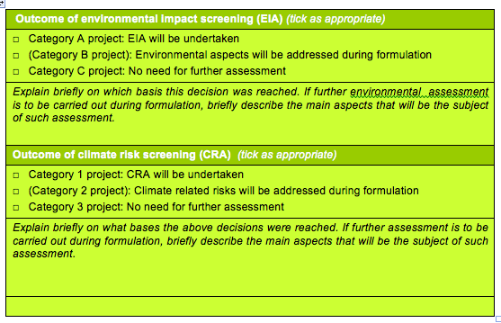
Screening results in the
Identification Fiche

Slide 10
Screening for climate change influence
No legal requirement to screen for climate change influence (yet).
Lists of project types to classify into one of 3 categories:
  Category 1 - projects which a very likely to be affected by climate change and require a climate risk assessment CRA
  Category 2 - projects which may require a CRA determined by additional questions
  Category 3 – projects unlikely to be affected by climate change do not require a CRA.

Slide 11
Identification Fiche: possible entry points for environmental integration
Environmental policy
Conclusions resulting from the identification phase
  Policies/Strategies of partner government
  Problem analysis/Strategic analysis
  Lessons learned
  Stakeholder analysis
  Assumptions and risks
  Objectives and expected results
  Cross-cutting issues/Sustainability
  Budget
  Next steps, work plan and time schedule
Problem tree
Sustainability
Groups affected by env’l/climatic impacts
Climate-related risks
Screening results
Resources for env’l measures (+awareness raising, cap dev, inst. Strengthening..?)

Slide 12
Studies potentially undertaken during the formulation phase
Technical feasibility study
Environmental impact assessment
Possibly, climate risk assessment
Financial and economic analysis
OR, preferably a single “formulation study” covering these various aspects of the project (would we have an example?)

Slide 13
Projects with / without EIA (not sure I "get" this…)
EIA / Formulation study
Environment
EIA / Formulation study
Project
Impacts generated
Opp., risks & constraints
Notes:
Annex 8 (ToR for EIA) cover these aspects as an option
Annex 9 of the Guidelines provides guidance on integrating environmental issues in formulation studies

Slide 14
Reminder: what is an EIA?
An ex ante assessment of the environmental impacts of a specific project, in order to:
  Reduce environmental damage by means of preventive measures
  And/or optimise positive impacts
An EIA includes:
  Technical and scientific studies
  A process of stakeholder consultation

Slide 15

EIA example : Kyrgyzstan road EIA

Slide 16
Key stages in an EIA
1. Screening (during the identification phase)
2. Scoping study
  Project and its alternatives, constraints, legal and institutional framework, stakeholders, project-environment interactions, scope of the study, methodology, time frame, costs, means
3. EIA study
  Identification then evaluation of significant environmental impacts (project and possible alternatives)
  Mitigation/optimisation measures and recommendations, incl. Environmental Management Plan, residual impacts
Stakeholder participation is required.
The competent authority makes the final decision.

Slide 17
Evaluation of project impacts
Impacts can be characterised using various criteria, e.g.:
  Direct or indirect
  Positive or negative
  Temporary or permanent
  Short-, medium- or long-term
  Continuous or sporadic
  Reversible or irreversible
  Various degrees of magnitude
  Impacts that can or cannot be mitigated …
Taking into consideration the local context, the sensitivity of the environment, the opinions and values of those concerned, etc.

Slide 18
Methods used for the EIA
There are various methods for identifying and evaluating impacts; they can be more or less complex et complementary:
  Checklists
  Various types of matrices
  Network (flow diagram) analysis
  GIS-based analysis
  Modelling techniques
  …
The chosen method(s) and the level of complexity must be adapted to the issues addressed and the information available

Slide 19
Translating EIA recommendations
EIA recommendations must be translated into a concrete action plan for the implementation stage
This action plan is called the Environmental Management Plan (EMP)
It includes:
  Details of the proposed mitigation measures
  Identification of parties responsible for implementation
  Identification of parties responsible monitoring and control
  Ideally, cost estimates of the proposed measures

Slide 20
EIA in practice
Use consultants independent from those in charge of carrying out technical feasibility studies (esp. for large projects)
The EIA must be based on sufficient technical information (draft technical design)
EIA results should be used to adapt and finalise the project’s technical design
Ideally, the EIA should precede financial and economic analysis, to allow:
  Consideration of final project design
  Inclusion of environmental mitigation costs (in financial analysis)
  Possibly the valuation of some environmental externalities (in economic analysis)

Slide 21
Social aspects of EIA
The social effects are important and must be analysed as well as biophysical aspects
Social and environmental aspects should be considered together because of their interdependence
Various groups (women, minorities, ...) are frequently not equally effected by environmental changes

Slide 22
Project Action Fiche (AF) and TAPs
Possible entry points – examples? | Environmental aspects
Justification, problem analysis | Environmental issues addressed
Objectives and expected results | Environmental constraints linked to objectives/results
Stakeholder analysis | Stakeholders who may see their environment modified by the project
Assumptions and risks | Environment- and climate-related risks
Cross-cutting issues | Measures to ensure environmental sustainability
Monitoring and evaluation | Environment-related indicators
Annexes to the TAPs | EIA report, EMP, budget for environmental management, …

Slide 23
Implementation: reminder
The implementation phase involves:
  Executing an action plan for the purpose of producing the expected results
  Managing available resources as efficiently as possible
  Monitoring progress
This phase of the cycle of operations involves the production of periodic monitoring reports

Slide 24
Implementation: possible entry points for environmental integration
Incl. EMP or equivalent measures
Minimise pollution-generating consumption
Execution of action plan
Monitoring activities:
  Monitoring of activities, consumption, costs,…
  Monitoring of results (based on indicators)
  Monitoring of assumptions and risks
  to be able to respond quickly to new information and changes in the project’s environment
Undertaking environmental performance review is a good management practice
Incl. env’l indicators
Incl. environment-related ones

Slide 25
Environmental indicators
Environmental, CC [and GE] indicators should be included in
  The logframe
  The monitoring framework
  The Environmental Management Plan
The regular monitoring of environmental indicators is useful as a preparation for project evaluation:
  Basis for the definition of impact indicators
  Basis for evaluating the effect of external factors on the achievement of project objectives

Slide 26
Environmental performance review
During implementation, aimed at correcting weaknesses in identification/formulation
  The location of project activities / infrastructure
  The use of energy and means of transport
  The use of paper
  Water consumption
  The use of chemicals
  The production and disposal of waste
  …

Slide 27
Evaluation: Environmental integration
Implementation of the recommendations formulated in the EIA and/or the formulation study?
  Level of implementation (zero, partial, full)
  Effectiveness and efficiency (cost-effectiveness) of environmental integration measures
  Impact and sustainability of these measures
Impact of environmental integration (or lack thereof) on the project’s general performance?

Slide 28
Evaluation: Environmental integration
The classical evaluation criteria (for both projects and sector support) can be interpreted from an environmental perspective
  Relevance
  Effectiveness
  Efficiency
  Impact
  Sustainability

Slide 29
Relevance
Has the project taken into account the environmental issues identified during problem analysis and/or in the Country Environmental Profile?
Has the project been given environmental objectives, or have environmental constraints been attached to its objectives, so as to properly manage its potential environmental impacts?

Slide 30
Effectiveness
If the project was effective (i.e. achieved its objectives), was this at the expense of the environment?
If the project was not effective, was this because some environmental constraints were under-estimated?
Have the adopted environmental measures (e.g. Environmental Management Plan) produced the expected effects?

Slide 31
Efficiency
Has the project made an appropriate (limited) use of scarce resources or inputs that damage the environment?
Were the measures adopted in the context of the Environmental Management Plan (or assimilated measures) cost-effective?

Slide 32
Impact
What were the project’s environmental effects on the outside world? Are they acceptable? How do they compare with the effects predicted in the EIA?
Overall, has the project contributed to the objective of promoting sustainable development?

Slide 33
Sustainability
Are the natural resources on which the project’s sustainability depends threatened?
Does the project itself encourage stakeholders to overexploit their resources?
If the Environmental Management Plan recommends the adoption of recurrent and long-term mitigation measures, are they financially sustainable?

Slide 34
The ex post EIA
Usually, an (ex ante) EIA predicts potential impacts
The ex post EIA determines actual impacts. It aims to:
  Improve capacities to predict environmental impacts, for use in future EIAs
  Study in more detail the environmental aspects of project evaluation (impact criterion) so as to draw lessons for future projects

Slide 35
Module 6 – recap main messages
Greening a project starts with the logframe
EIA and CRA tools can be highly effective at the project level
Identification – screening tools are useful, different entry points are available
Formulation – dealing with projects that have and do not have EIAs, entry points (?)
EIAs – Example of an EIA (Kyrgyzystan road project)
Implementation – entry points and the role of indicators
Evaluation – relevance, effectiveness, efficiency, impact, sustainability

Slide 36

Action plan – from words to actions
Reflections
Do any of the logframes you are familiar with have significant environmental targets, actions or indicators? Should they?
Have any of the projects you are involved in had an EIA? Are you aware of the decision process that led to deciding if they should have one or not? If an EIA was done, was it helpful – in what aspects?
Have you ever had to read an EIA or express an opinion on it? What was your opinion?
Actions
Bring a recent or new project proposal from your EU delegation
Discuss with your group the potential environmental, climate and social aspects of the project (annex 7 in the Guidelines)
Is the project relevant for an EIA?
Formulate environmental targets and indicators for the project

Slide 37
Resources
Overall
EU Guidelines on the Integration of Environment and Climate Change in Development Cooperation
In depth EIA
UNEP: http://www.unep.ch/etb/publications/enviImpAsse.php
http://eia.unu.edu/course/?page_id=137
Experience
UNEP: Studies of EIA Practice in Developing Countries
Wood: EIA in developing countries, an overview

