Slide 1
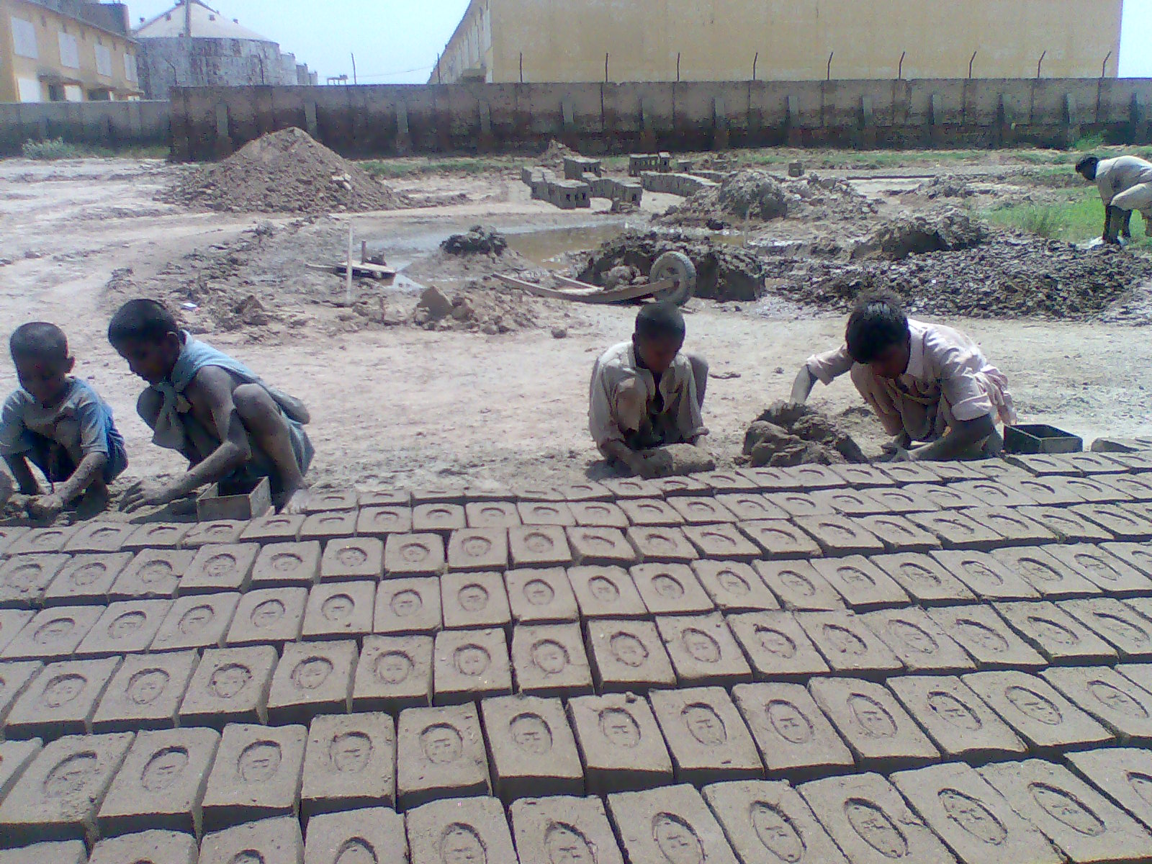

Support social protection and decent work of brick kiln workers and bonded labourers in
Pakistan
Funded by: European Union

Slide 2
Project Details
Project Duration:
The project is for 42 months starting from 1st April 2011 till 30th September 2014
Funding:
Total cost of the action: EUR 1,709,805
Total funding from European Union: EUR 1,367,844
Target Group:
5000 Brick Kiln Workers in 6 districts of Pakistan (Sindh and Punjab Provinces)

Slide 3
Relevance of the Action
The women and child workers below the age of 14 years are engaged in the most labour intensive and least paying process of brick making;
The household decisions are taken in consultation with both partners of the house but males have final say in matters concerning money and material;
There is no separate agreement of payment with each family members; the payment is made to the whole family unit jointly in this case;
The average earnings of females and males differs, the adult male earn on average 276 rupees per day, the female adult workers earn 227 rupees per day while a child earn an average of 87 rupees a day;

Slide 4
Relevance of the Action
Workers especially females have no access to other sources of income generations to improve their living conditions
Various kinds of deductions are made from earnings of workers. The penalty for damaged bricks is to borne by the workers. The advances are also deducted from wages which are taken due to poverty, ill health, expenditures on marriages and social customs; and the recruiting agent also deduct 10 rupees per 1000 bricks as his commission;
Majority of the workers (male and female) have no computerized national identity cards (CNICs);
None of the workers were found to be covered under the labour laws;

Slide 5
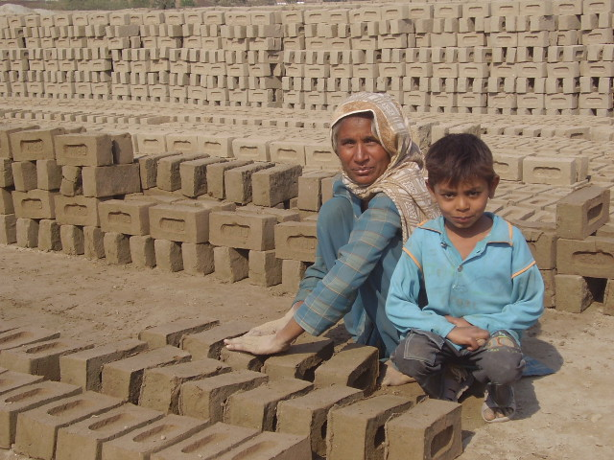
EU Brick kiln Project contribution to these issues/ Overall Objective of the Action
Overall Objective:
To contribute towards poverty reduction and social inclusion of informal workers and bonded labourers in Pakistan
Specific Objective:
To ensure that brick kiln workers have better access to social protection services and more productive employment

Slide 6
Expected Results
1: Increase awareness and access of brick kiln workers (right holders) to social security services/benefits and minimum wages to ensure respect of existing legislation;
2: Local community organisations representing brick kiln workers are strengthened and have capacity to lead advocacy on rights to minimum wage, social protection and decent employment

Slide 7
Expected Results
3: Basic community based services are functional, coordination with government institutions is ensured to provide and protect basic rights of brick kiln workers;
4: Enhanced productive potential and technical skills through vocational training

Slide 8
Major activities included;
Awareness raising on the rights to social protection and decent employment;
Registration of brick kilns
Establishment of a model brick kiln with representation of decent work environment for brick kiln workers;
Provision of social security cards and minimum wages through lobbying and consultations with key government departments
Vocational and technical skills training to women workers;

Slide 9
Major activities included;
Advocacy/ Policy review on legal and policy framework;
Seminars and dialogues with policy makers and employers;
Establishment of workers trade unions and federations
Capacity building on the leadership, advocacy, lobbying and campaigning;
Providing healthcare, legal support to brick kiln workers and educational support to children working in brick kilns.

Slide 10
Overall progress of the Project during one year implementation process
The project achieved its intended outputs through establishing a multipronged approach of mobilization; and a series of activities were carried out in line with the project document, which included mobilization and advocacy of brick kiln workers, owners and key stakeholders on the issue;
leading from the awareness raising of brick kiln workers through corner meetings, broad based community meetings (BBCM), discussions, presentation of documentaries, dissemination of brochures on the issue in local languages, TV and Radio programs;
strong coordination with key government departments including Labour, police, education, health, employees social security institutions in Sindh and Punjab; brick kiln owners association and federations; like-minded actors through meetings, consultations and seminars;

Slide 11
Overall progress of the Project during one year implementation process
60 Brick kilns identified and selected for project interventions after conducting surveys in these districts;
Minimum wages PKR. 517/1000 bricks implemented in Punjab province of Pakistan;
Labour inspection restored in Punjab province of Pakistan after 10 years;
Police Anti-bonded labour cells established in collaboration with Police department for provision of immediate legal aid services to brick kiln workers in Hyderabad and Tando Allahyar district of Sindh province of Pakistan;

Slide 12
Overall progress of the Project during one year implementation process
District Vigilance Committees (DVCs) reactivated and notified in the 6 target districts of Sindh and Punjab;
10 trade unions established in line with project targets;
16 cases of brick kiln workers resolved through the first court decision;
120 Community groups (60 male, 60 female) formed within these brick kilns;

Slide 13
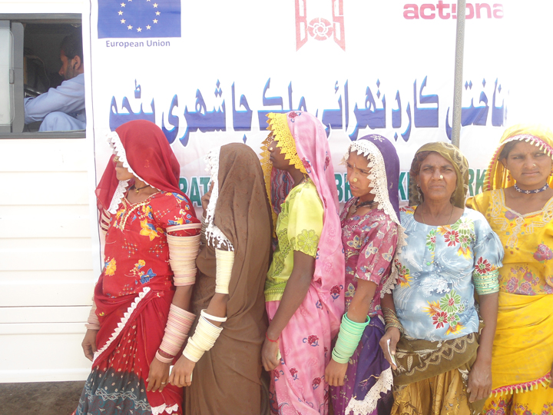
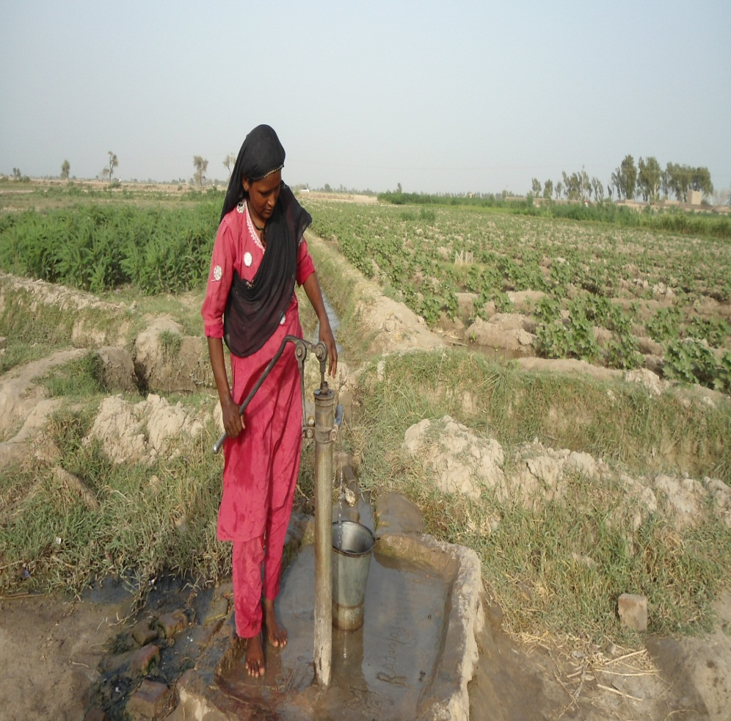
Photo Gallery
NADRA mobile vans register women brick kiln workers for Computerised National Identity Cards (CNICs)
Women brick kiln worker pump water from hand pumps installed under EU Brick Kiln Project

Slide 14
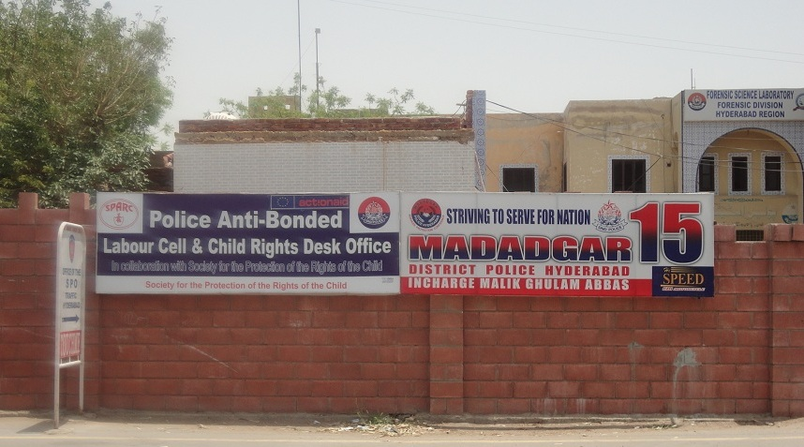
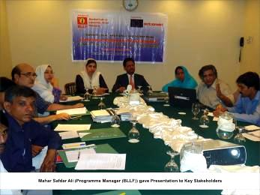
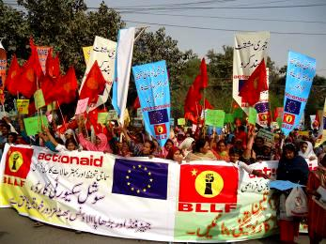
Photo Gallery
Police Anti-bonded labour cell established under EU Brick Kiln Project in Hyderabad of Sindh Province
Meeting with Secretary labour Punjab and DG Punjab Social Security institution for provision of Social Security Cards to brick kiln workers
A view of Brick kiln workers rally for minimum wages and social secuirty cards

Slide 15
T h a n k Y o u
Project websites:
www.spdw.org
www.sspdc.org.pk
www.modelbrickkiln.com
Case studies:
Minimum wages:
http://spdw.org/index_files/Page1438.htm
Legal Aid support:
http://modelbrickkiln.com/wp-content/uploads/2012/06/Story-of-change-Legal-aid-support12.pdf

