Slide 1
Vocational Training in the Informal Economy
DEVCO, Brussels, 25th of June 2012
Richard Walther
ADEA /AFD

Slide 2
Vocational Training in the Informal Economy
Summary
A brief historical reminder of the concept
The context: the « normality » of the informal economy
The impact of the informal economy
The potential roles of education and training
The efficiency factors of education
The efficiency factors of vocational training
Conclusion: the issue of an inclusive and sustenable development

Slide 3
A historical brief reminder: the appearance of the concept of informal sector as category of the labor market
The term " informal sector “ (IS) was used for the first time in the ILO report on employment in Kenya ( 1972 ) as a major category for the analysis of the labor markets in developing countries
The report explained that the IS (development of self employment or independent employment outside the frame of the public and private enterprises) had prevented that the lack of job creation in the modern sector causes an unbearable increase of unemployment
From the beginning one of the seven criteria defining the informal sector concerned the acquisition of skills outside the formal school system

Slide 4
A brief historical reminder: the appearance of the concept of informal sector as being part of the national economy
The conference of the statisticians of 1993 operated a major conceptual change:
  it removed the image of IS as being an illegal or underground sector
  it divided the IS into agricultural and urban sector
  it defined the units of production and service as individual enterprises not separated from the activities of the household and not keeping full sets of accounts allowing them to be distinguished from the households that own them
The informal sector became as such a subset within the household sector in national accounts and national surveys on employment

Slide 5
A historical brief reminder: informal sector or informal economy?
Resolutions adopted by the International Labour Conference at its 90th Session (2002)
“The term “informal economy” (IE) is preferable to “informal sector” because the workers and enterprises in question do not fall within any one sector of economic activity, but cut across many sectors”.
Vocational training in the informal sector (AFD 2007)
“The term of informal sector may continue to be used as far as the statistical definition of the concept indicates clearly that the informal units of production and service not keeping full sets of accounts find are distributed in the various business sectors ".

Slide 6
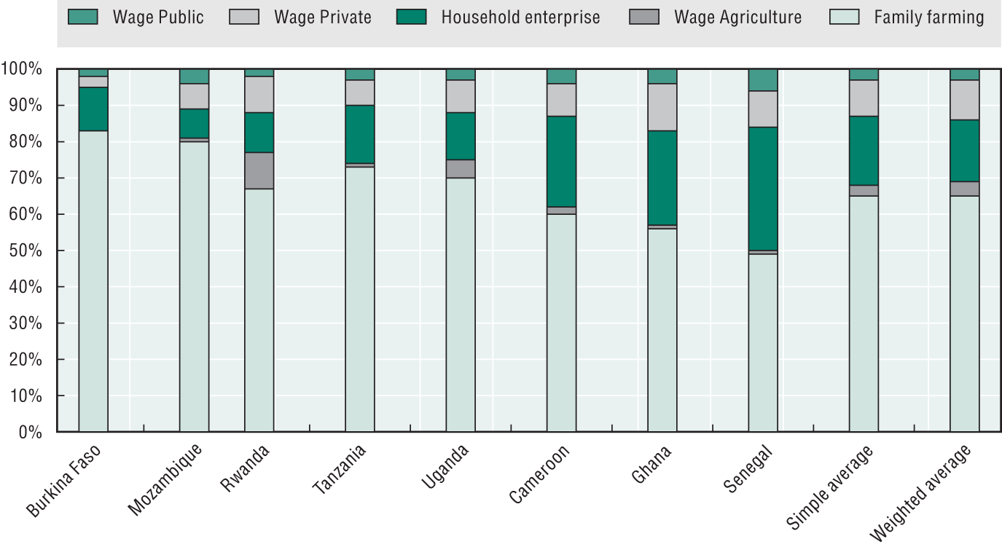
The current context: the main characteristics of the informal rural economy (WB,2011)

Slide 7
The current context: the main characteristics of the informal urban economy (West Africa, AFRISTAT 2005)
Size of the enterprises:
  80% of the employees work in enterprises having less than 6 employees
  an average of 1,53 employee per enterprise
Status of the employees:
  13,6% are wage employed (30% if the business owners and their associates are taken out) and 5% have a written contract
  28% are family members
  43% are apprentices
Types of payment
  23% have a fixed salary (if not payment per day, per task or according to profits)
  45% are unpaid (but 45% have family relationships with the employer)

Slide 8
The current context: the main characteristics of the informal urban economy ( West Africa, AFRISTAT 2005)
Sector of activity
48% of the enterprises are in the trade sector against 28% in the industry and 26% in the services
Business environment
22% of the enterprises have business premises
98% do not have any access to water , 93% have no phone and 78% have no electricity.
Working conditions
9 to 10 jobs are permanent
9,1% of the employees benefit from the social protection and 3,3% have their social protection paid by the enterprise
Education and training
The average number of years of formal education is 3,5 years
All the employees have acquired theirs skills at work, but the more the level of formal education is high, the more it favors access to better jobs

Slide 9
The current context: the relationship between informality and vulnerability
In most of the African countries, vulnerable employment and informal work are strictly connected (OECD, 2012)
The informal work takes on two forms:
  an informal job in micro-enterprises and in other not-registered enterprises
  an informal job in a company of the formal sector which has neither work contract, nor social protection when having more than five employees (examples of South Africa where the wage employment represented, according to Charmes, 79 % of the informal employment in 2000)
There are close links between these two forms of informality
  many employees work at the same time in the formal and the non formal sectors
  formal companies subcontract their work to the informal sector (the case of the building and civil engineering works in Morocco)

Slide 10
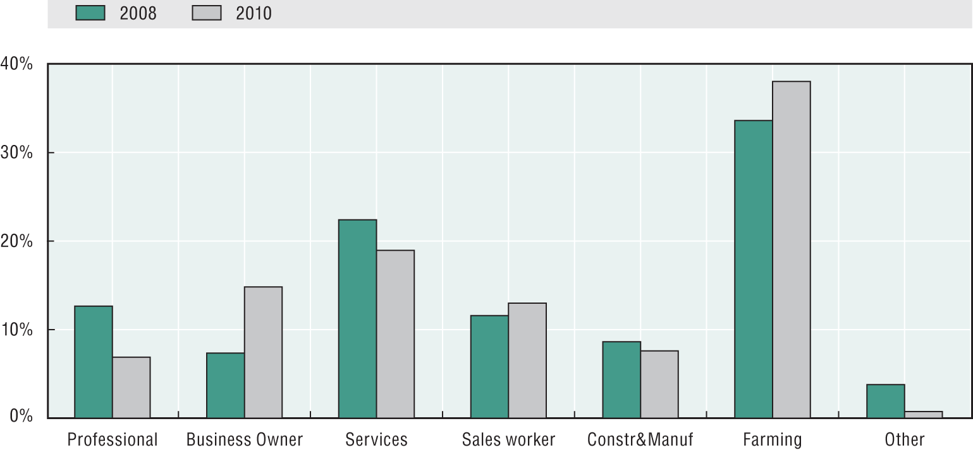
The current context: Informal sector activities and farming have absorbed the impact of the crisis (Gallup World Poll 2010)

Slide 11
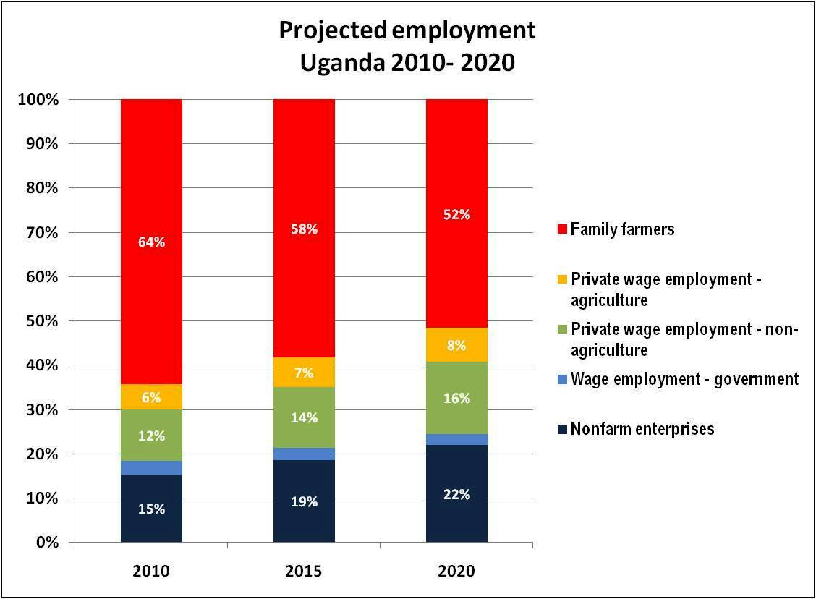
The current context: the informal economy will continue to dominate the African labor market (BM 2011)

Slide 12
The current context: The low growth of the formal economy
The economic growth in low-income countries (LIC) does not create enough jobs: in Africa, between 2000-2007, the working population increased by 96 millions while jobs increased only by 63 millions (ILO)
As a result the young people represent 60 % of the unemployed people in Africa and the category of the NEET (not in employment, not in education, not in training) threatens the social stability
This situation keeps pace:
  with a public sector in regression: only 21% of those aged under 30 with at least secondary education work for the government, compared to 37% among adults aged 30 and over (Gallup)
  with a too small private sector and a too low economic growth: 1 formal employment on 5 created between 2003 and 2006 in Uganda (WB 2011)

Slide 13
The current context : the normality of the informal economy
Between 70 % and 80 % of the young people in developing or low-income countries, in particular African countries, will continue to occupy massively during the next years:
vulnerable jobs in farms or more globally in the individual enterprises of the rural area
vulnerable jobs in the individual enterprises of the urban area
independent activities or jobs which they will have the capacity to create
In this context it’s does not make sense to keep saying and repeating that there is need to create formal jobs. INSTEAD There is a strong need to increase the productivity and the income of the employees of the informal economy

Slide 14
The informal economy is more than a subsistence economy
Recent data show that the informal economy is not condemned to be only a subsistence economy:
The small family companies show the strongest growth in the LIC (WB 2011)
The returns to capital investment in the urban informal sector are high (Banerjee and Duflo 2004 and 2012, MacKenzie and Woodruf 2008)
In sub-Saharan countries, high country income levels are associated with a growing number of household enterprises and less subsistence farming, rather than a significant increase in wage jobs (OECD / BAD 2012)

Slide 15
The informal economy is potentially an engine of inclusive growth
The informal sector and the rural area constitute pools of talents and entrepreneurial success likely to serve as engines of inclusive growth regarding their capacity to hire more and more unemployed youth (OECD / BAD)
However this inclusive growth is not obvious. It calls for a change of paradigm in the public policies and action plans:
  On the demand side: investments in infrastructures (water, electricity…), in business environment (corruption, access to property, legislation adapted to the specific needs and situations …)
  On the supply side: a better access to financial resources and to public markets, specific measures to reinforce the capacities of the informal stakeholders (entrepreneurship, education, training, technological skills…)

Slide 16
Education and training as investments in the informal economy
Recent surveys show that education and training are efficient in stimulating the informal economy
  They reduce the vulnerable employment
  They increase the return to investment
  They increase the capacity to access employment
But more qualitative analyses show that these efficiency factors intervene only after an often long period of unemployment due to the disconnect between education, training and world of work

Slide 17
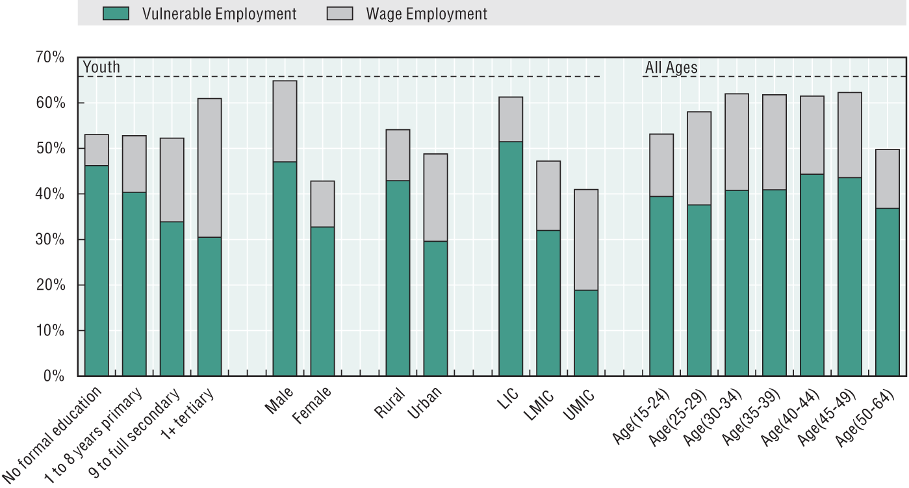
Education and training as means for reducing vulnerable employment (Gallup World Poll 2010)

Slide 18
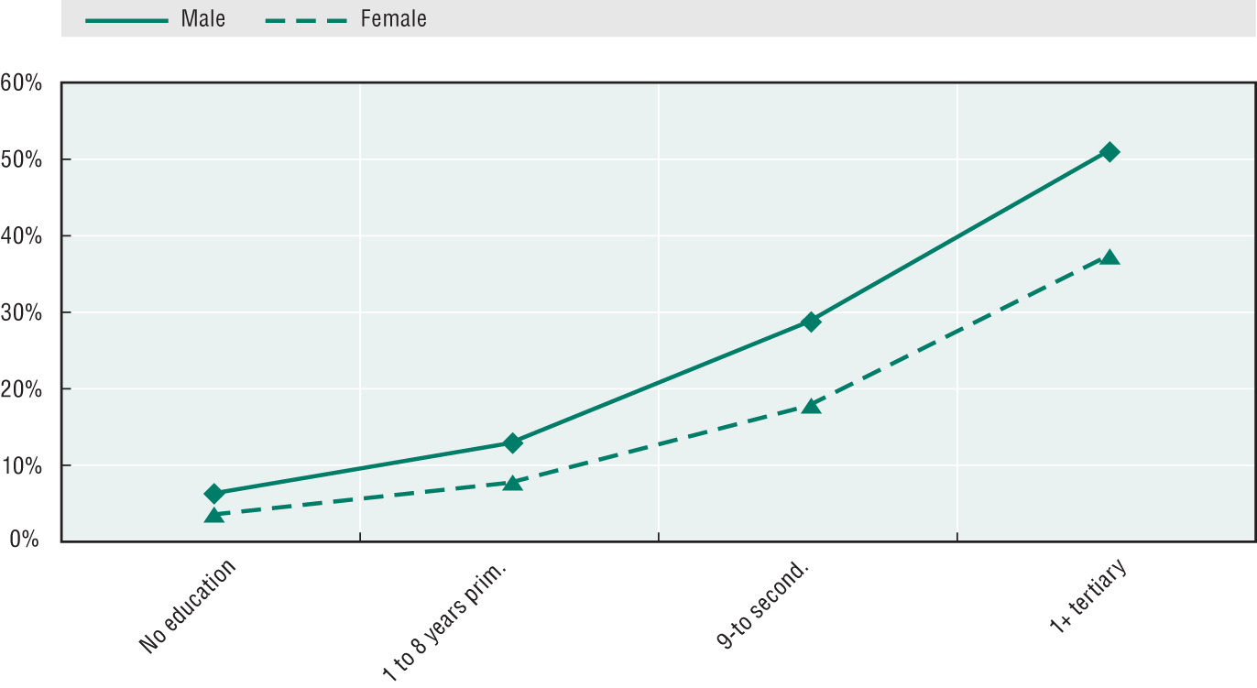
Education and training as means to reduce vulnerable employment (Gallup World Poll 2010)

Slide 19
The economic efficiency of Education and training
( AFRISTAT)
The educational level secures employability and productivity when the young people have entered the labor market. Therefore, within the framework of the informal sector:
  The employees having no formal education gain slightly less that those who have a primary education level
  The income increases twofold for an employee having obtained the secondary education level
  The income increases fivefold for an employee having studied in tertiary education
AFRISTAT, Survey in the Capitals of Western Africa, 2005

Slide 20
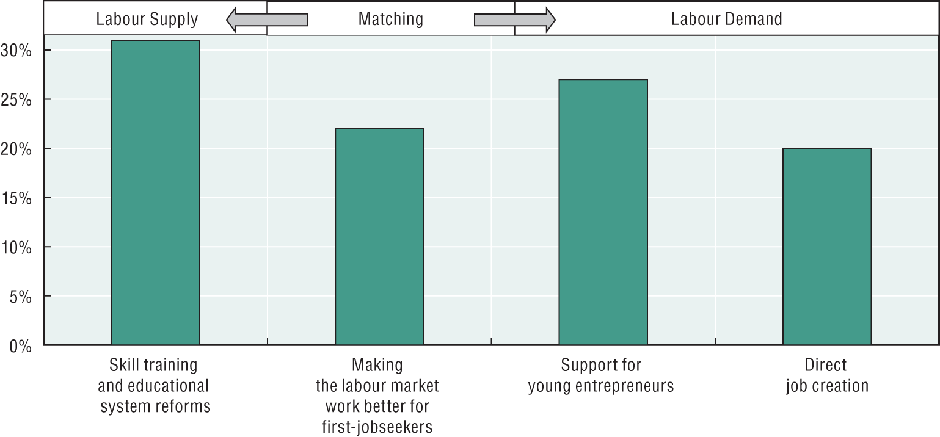
Education and training as means to improve the entry in the labour market (Survey AEO experts, 2012)

Slide 21
How to optimize the efficiency of the education and training systems?
All the identified return to investment criteria are really efficient according to conditions which are under discussion today particularly in Africa

Slide 22
The efficiency factors of the education system
Analyses and surveys concerning the performance of the education system, in particular in the LIC , identify clearly those factors:
First factor: ensure a fairer access to basic education and a better quality of it
  the girls and the young people of the rural area are discriminated whereas this area contributes the major part of the economic growth (EFA 2010)
  40 % of the sub-Saharan Africa adults having been in school for 5 years run the risk of relapsing in illiteracy (EFA 2010) and therefore will have many difficulties going out of the vulnerable employment
Second factor: teach the adults to read and write (759 millions at the World level) whose great majority works in the informal economy and needs to reach a minimum level of literacy (EFA 2010)

Slide 23
The efficiency factors of the education system
The third factor: include basic learning as part of efforts to control the human, social and economic environment or to switch from teaching to acquisition of knowledge and skills needed to be able to live, act, communicate, analyze, decide … (ADEA 2012)
The fourth factor: create opportunities for access to the “common core skills” by all categories of ages (lifelong learning) and allow in particular the adults to acquire recognized generic skills which they need to succeed in their social and professional life (ADEA 2012)
All these factors advocate for a restructuring of the relationship between the school and its environment

Slide 24
The efficiency factors of the training system
First factor: recognizing that the informal economy is the biggest producer of skills in the LIC ( AFD)
Morocco: 80,3 % of the employees of the IS have acquired their skills through on-the-job training, only 4,5 % of them trough formal training (AFD, Survey 2000)
Ethiopia: 0,9 % of the employees of the IS had formal training whereas 68 % acquired their skills by doing, 27 % in family and 4 % trough traditional apprenticeship (AFD, Survey 2005)
A large number of graduates (without the possibility to calculate this number) indicate the inadequacy existing between the training they received and the job they occupy and acquire their professional skills at work inside the IS, (50 % of higher education graduates according to a qualitative AFD survey in Central Africa in 2008)

Slide 25
The efficiency factors of the training system
                The IS trains the major part of the youth in West Africa (AFD)
It trains an average of 5% of the youth at school
All the public financing goes to the formal TVET which plays a very minor role
The training inside the IS is paid by the companies, and the families
but not taken into account by the public authorities
Center based training in the TVET schemes and institutions
The training is performed in the frame of the tradritional and renewed apprenticeship
Professional skills are acquired at work place
The non formal and informal training concerns the major part of the youth entering the labour market but they are not evidence bases data

Slide 26
The efficiency factors of the training system
Second factor: investing in raising the level of skills of young people and adults inside the informal sector ( ADEA / AFD)
Developing non formal and informal pathways giving access to literacy and to the common core of skills
Supporting all the experiences of renovation and modernization of the traditional apprenticeship
Training all the individual business owners in the domains of management, innovation, new technologies and entrepreneurship in order to increase the quality of their productions and services
Raising the skills level, inside the informal sector, of the master craftsmen having the responsibility to train the great majority of the young people entering the world of the work

Slide 27
The efficiency factors of the training system
Third factor: from supply-led to a demand-led TVSD (CBT)
Diploma route
  Skills development route
Level of access
Real profile for a job
Diploma prepared
Curriculum definition
Job expected
Skills profile definition
No real profile for a job
Forseen job
World of work / Labour market /Economic and social demand

Slide 28
The efficiency factors of the training system
Forth factor : from TVET concept to TVSD concept (ADEA/OCDE)
Ensuring that vocational training becomes a way of success and not of selection by failure and guarantee flexible bridges and ladders between general education and vocational training
recognizing, accrediting and certifying all the formal, non formal and informal ways of acquisition of skills
supporting the implication of the economic, professional and the civil society stakeholders in the conception, the piloting, the implementation and the evaluation of the vocational training pathways
more globally passing from the concept of TVET (Technical and Vocational Education and Training) to the concept of TVSD (Technical and Vocational Skills Development)

Slide 29
The efficiency factors of the training system
Forth factor : from TVET concept to TVSD concept
Dual training
Short training courses
SD through job training
Different forms of apprenticeship
Work-based training
National qualification
Framework
Center-based TVET
Validation/accreditation
SD through learning in the workplace
Apprenticeship/dual training
Center-based training

Slide 30
The efficiency factors of the training system
Fifth factor: investing in an efficient and sustainable TVSD
All the public financial means go currently to the center based TVET
They are attributed most of the time without any reference to the unit cost of the financed scheme and to the external efficiency of it
The informal sector trains young people and adults and get them to the labor market with unit costs unaffordable by formal training
A public co-financing would allow at lowest cost:
  to raise the level of qualification of masters and trainers of the informal sector
  to raise the level of training of the apprentices and of the family employees
  to develop more efficient schemes of apprenticeship and dual training in partnership with the training centers
  to train the business owners in the domains of management, innovation and entrepreneurship

Slide 31
The efficiency factors of the training system
Fifth factor: investing in an efficient and sustainable TVSD
Types of schemes | Running costs | Tangible investment costs | Intangible investment costs | Employment follow up costs | Relevance = efficiency + sustainability
Center-based training | ++++ | ++++ | +++ | +++ | Weak or very weak
Apprenticeship /dual training | +++ | + | +++ | + | Strong
Learning at the workplace | +++ | + | +++ | + | Strong

Slide 32
Conclusion
The informal economy is strongly integrated in the macroeconomic reality of the developing countries or LIC
It is a major category of the labor market of the young people as the adults working inside
The education and training systems have the capacity to stimulate the economy of self employment, individual and micro enterprises and to increase their productivity and growth at the condition:
to invest in rising the education and training level of the young people and the adults of the informal sector and therefore to strengthen its capacity of integrating the technological and professional evolutions
to make a paradigm shift and to take into account, to validate and to certify all the formal, non formal and informal pathways of education and skills development

Slide 33
Conclusion
The informal sector offers opportunities and is part of the solution to the problem of employment of the young people in Africa (OECD)
Investing in the education and the training of the young people and the adults working in the informal sector is an essential but not a sufficient factor for stimulating the sector
The family enterprises of the rural and urban economy have a high potential of growth which has to be supported at the economic, institutional and social levels in order to increase their efficiency and help them to create good quality jobs
What is at stake is to win the battle against poverty and to promote an inclusive and sustainable development

Slide 34
Merci
Thank you

