Slide 1
Aid delivery modalities and approaches:
GCCA experience
Ms. Tamara Levine
GCCA Global Support Facility
Session 19, Day 2, 12th September 2012

Slide 2
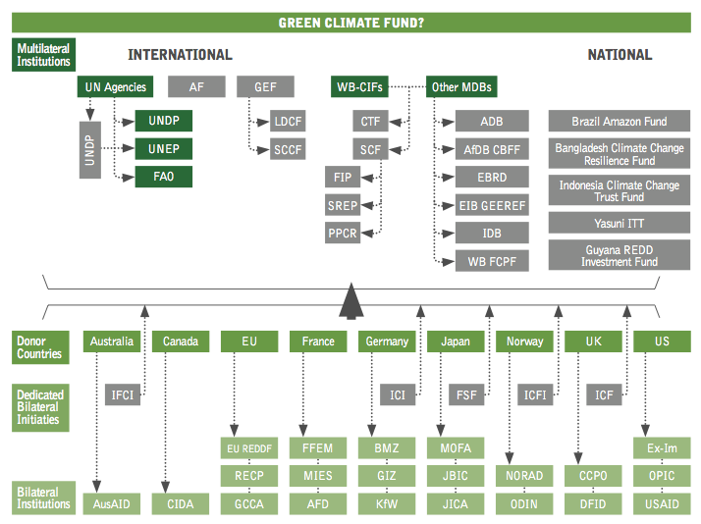
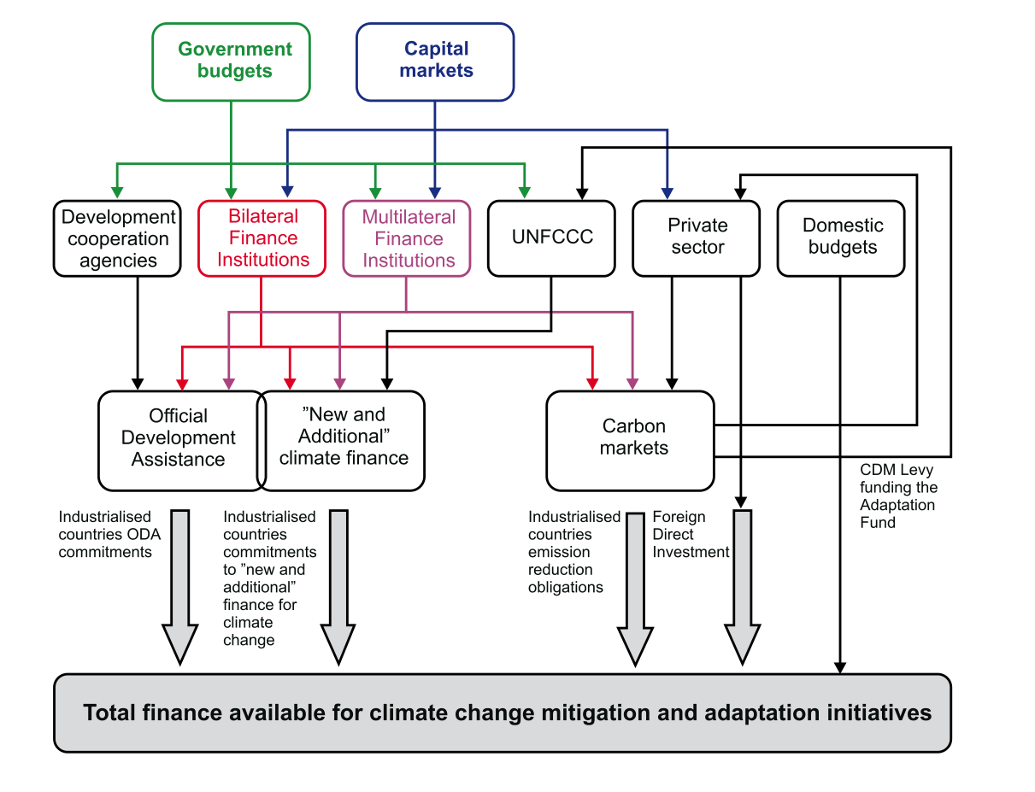
A Complex Climate Finance Architecture
Notes:
Jos Yesterday talked a fair bit about the
Fast Start Finance 2010-2012 – 30 billion
Long term goal of 100 billion a year
The challenges of generating the 100 billion a year by 2020

Slide 3
Recipient Country Institutions and Policies
CC in National Development Strategy
Donor Coordination
National climate change committee
UNFCCC/REDD Focal Point/DNA
Enabling Legislation
Institutions needed at country level to absorb climate change finance
Finance tracking system including budget markers
Operational Strategies
Finance/Budget Specialist
CC Desk in each Minstry
Parliamentary Committee
President Prime Ministerial Coordination

Slide 4








Busan HLF 4:
The aid effectiveness journey…
HLF-4
Busan
29 Nov – 1Dec 2011
Istanbul principles on CSO effectiveness
HLF-3
HLF-2
Dili Declaration on Fragile States
HLF-1
Accra Action Agenda
Bogota Declaration on SSC
Paris Declaration on Aid Effectiveness
Rome Declaration on Harmonisation
Monterrey Consensus
2002
2003
2005
2008
2010
2011
Notes:
At the beginning of the 21st century, with annual volumes of aid increasing again after a decade of aid “fatigue”, it became clear that a new approach had to be agreed to manage these resources better. Interest in effectiveness was not new; what was new was the broad consensus and political support on what needed to be done to produce better results, later embedded in the 2005 Paris Declaration and the 2008 Accra Agenda for Action.
Dialogue on aid is often difficult, developing countries’ position being “give us the money, we know what we will do with it”, whereas donors mainly see their aid as a support to partner countries’ institution reforms. The Paris Declaration in march 2005 was a major trade off with commitments for donor and partner countries , underpinned by mutual accountability – including the monitoring survey.
The final review of the Paris Declaration is next year in Korea. [Meanwhile, the process is expanding: The Accra Agenda for Action spurred agreements to improve the quality of assistance provided by other developing and middle income countries, including BRICs (Bogotá statement on South-South cooperation) and by donors to fragile states (the Dili Declaration last April)]
4

Slide 5


Lessons from Development Experience
1. Ownership: Developing countries set their own strategies for poverty reduction, improve their institutions and tackle corruption.
2. Alignment: Donor countries align behind these objectives and use local systems.
3. Harmonisation: Donor countries coordinate, simplify procedures and share information to avoid duplication.
4. Results: Developing countries and donors shift focus to development results and results get measured.
5. Mutual accountability: Donors and partners are accountable for development results.
Paris Declaration on Aid Effectiveness (2005)

Slide 6
A Range of Aid Modalities
Sector Policy Support Programmes
Direct Support to projects
Macro-economic budgetary aid
EC specific procedures
Sector budget support
Common pool funds
Partner government control of external resources
Targeting my partner government through National Budget
Lower Transaction costs
Donor control of external resources
Donor targeting of external resources
Limited donor influences on partner policy
High transaction costs
Notes:
The transfer of financial resources of an
external financing agency to the National Treasury
Provides extra resources for the national budget
either grants (e.g. EC) or loans (e.g. World Bank)
National procedures apply to the commitment and disbursement of funds
implementation via the national Public Financial Management system => reduced transaction costs, increased ownership
Budget support is provided in the form of:
sector budget support -> support for a sector policy/ programme
general budget support -> support for an overall development, poverty reduction or reform strategy
Joint budget support operations are conducted with other donors where such initiatives exist
Usually 3-4 year programmes with annual disbursements
Annual disbursements include two types of ‘tranches’
fixed tranche: paid in full as long as eligibility conditions are maintained
provides an element of predictability
variable tranche: paid in full or in part based on actual performance against an agreed set of criteria and targets (as long as eligibility conditions are maintained)
criteria/targets in principle taken from the PAF associated with the supported policy or strategy
provides a results-oriented performance incentive
General eligibility conditions:
Existence of a well-articulated national or sectoral policy/strategy to which the budget transfer will contribute
) Reasonably stable macroeconomic framework
Reliable or improving public financial management

Slide 7
Aid Modalities Used by GCCA
Sector Budget Support
Project Approach -
General Budget Support
Sector Project Support
3.9%
5.5%
8.1%
82.4%

Slide 8
An overview of GCCA experience
See Table 1 in the background paper

Slide 9
Insights and emerging lessons
Aligning with national priorities and supporting national initiatives
Understand and supporting institutions in support of alignment and ownership
Achieving greater harmonization through joint financing, programming and/or management
Managing for results
Improving management practices
Promoting access climate finance
Choosing the right aid modality

Slide 10
Lesson 1: Aligning with National
Priorities (Table 2)

Slide 11
Lesson 1 Aligning with National
Priorities Continued….

Slide 12
Lesson 2- Understanding Institutions
CPEIRs
Develop a comprehensive climate fiscal framework
Enable GoB to improve prioritization, efficiency and effectiveness of finances in support of climate adaptation and mitigation
Enhanced accountability of Climate Change Finance
Mainstreaming Climate Change in development process and use of country systems

Slide 13
Funding of Climate Actions

Slide 14
Bangladesh Climate Expenditure
Government of Bangladesh spends 6% to 7% of its annual combined budget on climate sensitive activity
Annual sum of US$1bn or just over 1% of GDP
Climate spend increased in absolute terms over last two years, but slight decline in relative terms
97% spent on adaptation

Slide 15
Climate institutions : types & their activities.
Institutions | Key areas of activities | Examples
Government | Program planning/ implementation | MoFDM, CDMP, MoEF, DoE, MoWR MoA, LGED, BWDB, WARPO
 | Disaster response | DoRR, DMB, Army, Coastal Guard, BRCS, CPP
 | Climate data generation | IWM, CEGIS, BMD, BWDB
 | Research & modeling | BARC, BARI, BRRI, BIDS, IWFM
Local government | Emergency measures, Food security | UP, UZ Parishad, M Corp, VGD, VGF, FFW
Donors(Multi-Bi) | DRR, CC, CCA activities | WB, DFID, UNDP, USAID, ADB, DANIDA, SIDA, CIDA + +
NGOs, CBOs, | Promotion, Awareness raising, Training | CARE, BRAC, Oxfam, Water Aid,
Civil society/Think tanks | Socio-Political motivation/ lobbing | BELA, BAPA, Nirapad, Deshpremik Mancha, BIDS
Media | Popular investigation,, Awareness raising, | Electronic & print media organizations
Commercial enterprises | CSR activities, Capacity building | Banks , Companies
Financial institutions | Micro credits/bank loans | BRAC/Grameen Bank/other NGOs
Households | DRR, CCA activities | Roads/Homestead raising, Cropping pattern, climate-tolerant species, Crop diversification

Slide 16
Lesson 3: Joint Management and Co-Financing (Table 3)

Slide 17
Lesson 3 continued GCCA contributions to multi-donor Funds (Table 4)

Slide 18
Managing for Results
Performance Assessment Frameworks
The logical framework provides the foundation for the PAF in many GCCA interventions
In terms of indicators Geneal Budget Support Programs use process indicators (eg.) setting up a new policy, law or regulation
Sector budget support tend to use output indicators related to concrete implementation – eg an agricultural programme has been implemented and measurably reduces GHGs

Slide 19
Improving Management
Appropriate timelines
  - for identification
  - Formulation
Timely Delivery of finance
Regular consultation with all stakeholders

Slide 20
Selection of Aid Modalities
Aid modalities are not mutually exclusive
Project support may effectively target local actors
Budget support can be most effective for policy dialogue
Project support may be a mechanism to build capacity for sector or general budget support
Aid modalities must be selected based on the principles of aid effectiveness.

