Slide 1

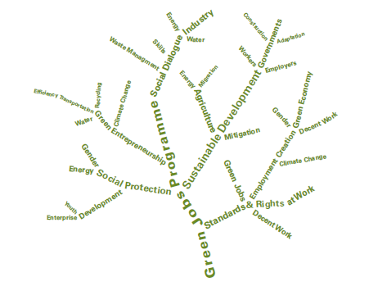


Green Jobs
As a tool for Sustainable Development
Steven Stone
Chief, Economics and Trade Branch
1

Slide 2

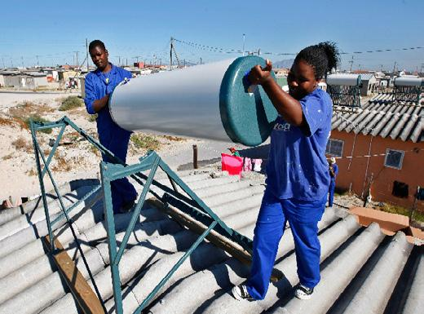
Rationale: Why is an Inclusive
Green Economy needed?
A business-as-usual approach is no longer feasible: planetary boundaries constrain economic growth as traditionally conceived.
Science tells us we are approaching and crossing bio-physical tipping points: environmental degradation threatens to undermine our collective well being.
Threat exacerbated by a mounting social crisis, with growing unemployment and a daunting challenge to provide for new jobs and income opportunities, especially for youth.
This calls for bold action to find new pathways for creating prosperity, decent work and income within a resource-constrained world.

Slide 3
Key numbers
National savings in LDCs, adjusted for depletion of natural resources, declined since late 1990s and were almost zero in 2008.
Source: UNCTAD, LDC Report 2010
UNEP research shows that a green economy would reduce global ecological footprint by over 20% in 2020 and by nearly 50% in 2050, as compared to business as usual.

Slide 4
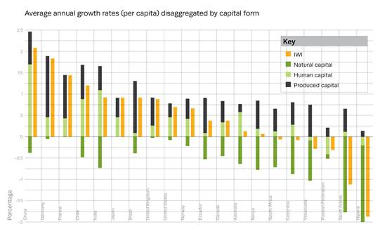
Key numbers
The Inclusive Wealth Report 2012 takes account of natural capital.
Source: UNCTAD, LDC Report 2010
Notes:
The Inclusive Wealth Report 2012 presents an index that measures the wealth of nations by carrying out a comprehensive analysis of a country's capital assets, including manufactured, human and natural capital, and its corresponding values: the Inclusive Wealth Index (IWI). Results show changes in inclusive wealth from 1990 to 2008 and feature a long-term comparison to GDP for an initial group of 20 countries.
The Summit's outcome document requests the UN Statistical Commission to work with other UN bodies including UNEP and other organizations to identify new approaches for measuring progress.
The Commission's work will draw on a range of assessments and pilot projects ongoing across the globe.
UNEP and the UN University's International Human Development Programme at Rio+20 presented findings from an Inclusive Wealth Index (IWI) looking at several countries including Brazil.
UNEP research shows that a green economy would reduce global ecological footprint by over 20% in 2020 and by nearly 50% in 2050, as compared to business as usual. This is particularly important for the national savings in LDCs, when adjusted for depletion of natural resources, have declined since late 1990s and were almost zero in 2008.

Slide 5
Green economy: What leaders are saying…
“Sustainability and the green economy offer compelling opportunities to promote jobs, growth, innovation and long-term stability. The future we want can be ours – if we act now.”
UN Secretary General Ban Ki-moon, 25 September 2012
“To promote sustainable development, we should explore effective models for a green economy…In the course of growing a green economy, we should create more jobs, alleviate poverty and improve living standards, develop green technologies and create new models of technology transfer.”
H.E. Wen Jiabao, Premier of China, 20 June 2012
A growth model that improves resource efficiency and mitigates climate change also generates a number of reinforcing benefits including accelerated job creation, healthier populations, expanded access to secure energy supplies and sustained global economic growth.
As the President of Mexico, I have strongly endorsed green growth as the model for my country’s long-term development.
H.E. Felipe Calderon, Former President of Mexico, 18 June 2012
5

Slide 6
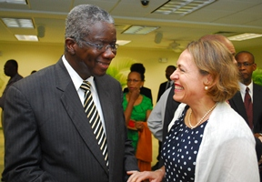
Green economy: What leaders are saying…
“Indeed, there are a variety of effective tools that we can use to promote sustainable growth with equity. We can use policy measures. Governments can pass laws and regulations that would place sustainability at the heart of social activities; and also incentivise and reward activities that reinforce sustainability.”
H.E. Susilo Bambang Yuhoyono President of Indonesia, 13 June 2012
“We have spoken a great deal about using cleaner sources of energy. Today we reaffirm that commitment and determination to move towards a low-carbon economy.”
H.E. Jacob Zuma, President of South Africa, 5 December 2011
What is critical for Barbados and other small island developing states is that the green economy debate recognizes our structural vulnerabilities, offers a model to assist us in further realizing our sustainable development aspirations and creates the institutional platform that enables us to participate in innovative partnerships to help save the planet.”
H.E. Freundel Stuart , Prime Minister of Barbados, 28 March 2012

Slide 7
Rio+20 Outcomes on Green Economy
“We consider green economy in the context of sustainable development and poverty eradication as one of the important tools available for achieving sustainable development.”
Need for broader measures of progress beyond GDP in order to better inform policy decisions, and a request to launch a new programme of work building on existing initiatives.
A call to enhance Corporate Sustainability Reporting, drawing on best practices and options for capacity building in developing countries.
Adoption of a 10-Year Framework Programme on Sustainable Consumption and Production.
Endorsement to create a set of Sustainable Development Goals, which compliment the MDGs and support the transition to a green economy.

Slide 8
Programme of Action on Green Economy (PAGE)
Vision
Objectives
Accelerating and improving the transition to socially inclusive, resource efficient, low-carbon economies
To strengthen the capacity of Governments and other stakeholders to manage the transition to socially inclusive, resource efficient, low carbon economies
To provide a springboard for action on commitments made at Rio+20
To foster cooperation, pool resources, and ensure coherence between the activities of various stakeholders while drawing upon the best of their respective expertise and political leverage

Slide 9
PAGE components:
Develop new research addressing key policy questions on the drivers of green growth
Offer policy dialogues for high-level government officials to share experiences and formulate strategies
Provide capacity development and applied practical training on economic and fiscal policy, green jobs and sustainable management of natural resources
Provide country-driven advisory services consisting of policy advice, technical assistance and applied capacity development of “learning by doing” for governments.

Slide 10
PAGE Partnerships
UNEP, WB, OECD, GGGI
UNEP, UNDP, ILO, Governments, National Institutions
Green Economy
Green Growth Knowledge Platform
Report
Advisory Services
Demonstrating that Greening
is a new engine for growth,
addressing hurdles &
enabling conditions
UNEP working with 40 Agencies in the UN system
TEEB
ILO, ITUC, IOE, UNEP
ecosystems & biodiversity,
capturing these values, and
Green Jobs Initiative
Inter-agency Partnerships
Networking with Civil Society and Private Sector
GEC, GGGF, UN Global Compact
GEC Green Economy Coalition ITUC International Trade Union Confederation
GGGF Global Green Growth Forum OECD Organization of Economic Cooperation & Development
GGGI Global Green Growth Institute UNDP United Nations Development Programme
ILO International Labour Organization WB World Bank
IOE International Organization of Employers

Slide 11

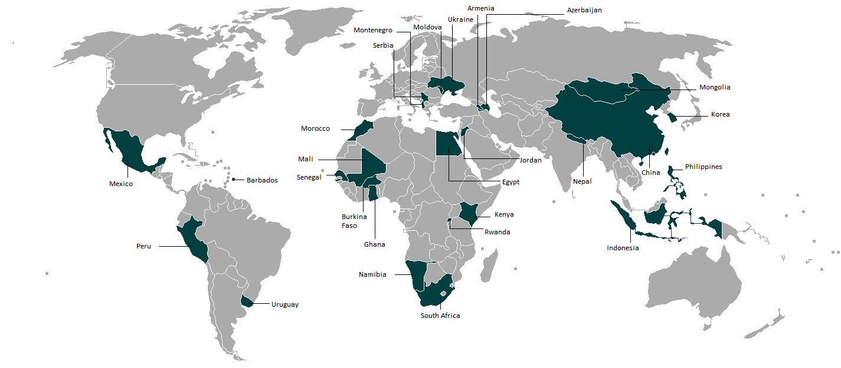
Advisory Services Countries

Slide 12
UNEP Green Economy Advisory Services
Technical assistance to countries seeking to make a transition to a Green Economy
Rapid response to countries with strong commitment to Green Economy
Supporting the development of strategies to green national economies building on national development priorities, forging extensive partnerships, and enhancing analytical capacities in countries.
12

Slide 13
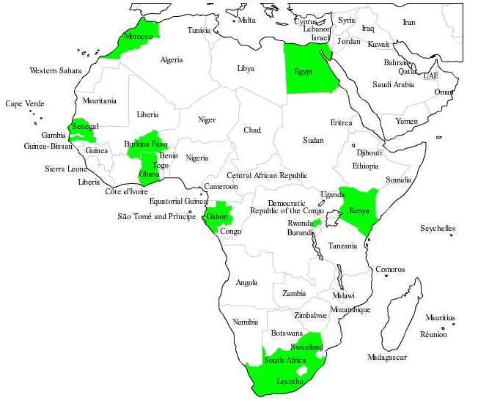
Green Economy Pilot Project in Africa
Regional project on green economy supporting 7 countries: Burkina Faso, Egypt, Ghana, Kenya, Rwanda, Senegal, South Africa
Project being extended to Côte d’Ivoire, Ethiopia, Gabon, Mali, Mozambique, Morocco, Uganda and other countries
Project supported by the European Union and the Netherlands
Organised national green economy workshops in Burkina Faso, Egypt, Kenya, Gabon, Ghana, Morocco, Rwanda, Senegal, South Africa
Providing green economy assessments and policy support

Slide 14
Partnership for Action on
Green Jobs
Steven Stone
Chief, Economics and Trade Branch
steven.stone@unep.org
Peter Poschen
Director, Job Creation and Enterprise Department, ILO
peter.poschen@ilo.org
14

