Slide 1
Green Jobs for Poverty Reduction and Social Inclusion
Peter Poschen (ILO)
Working towards a green economy after Rio+20
European Parliament
Brussels, 2 October 2012

Slide 2
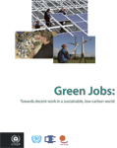
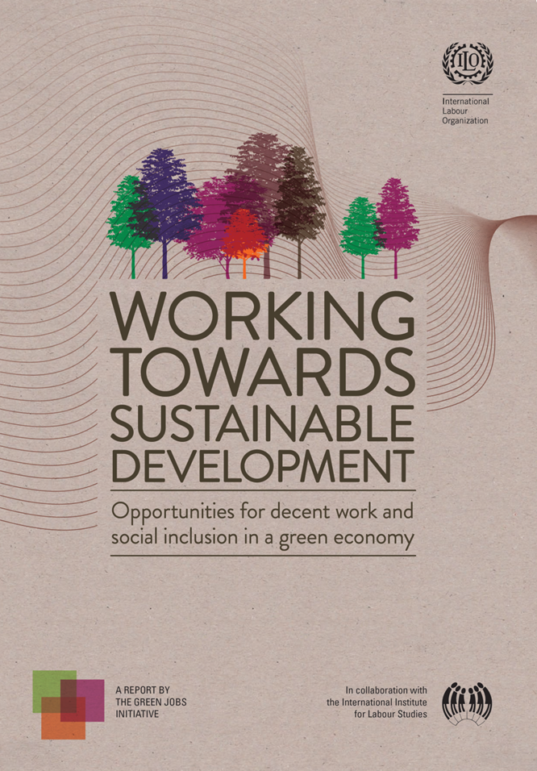



The Green Jobs Initiative
Since 2007
First report 2008
New report 2012

Slide 3
Green jobs = decent work which
Reduces consumption of energy and raw materials (dematerializes economies)
Avoids greenhouse gas emissions (decarbonizes economies)
Minimizes waste and pollution
Protects and restores ecosystems and environmental services
Adapts to climate change

Slide 4
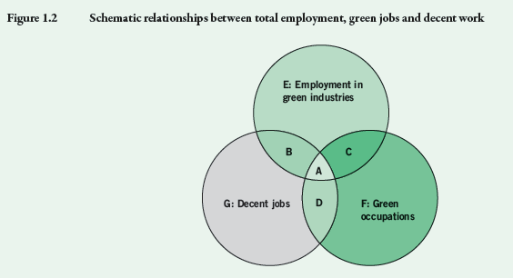
Defining green jobs
= Decent + green
= Sectors + occupations

Slide 5
What the 2012 report contains
Analysis:
  Employment and income implications of green economy
  8 most-affected sectors: agriculture, forestry, fisheries, energy, manufacturing, recycling, buildings, transport
  Policies for decent work and social inclusion
Exemples of good practice
Policy lessons

Slide 6
4 Key Findings:
The current development model is inefficient and unsustanaible
Greening has created tens of millions of jobs
Net employment gains in a green economy possible
Green economy can be pathway for reduced inequality and more social inclusion

Slide 7
EXISTING GREEN JOBS
Tens of millions exist already:
USA: 3 million in environm. goods and services
EU: 14.2 million in biodiversity, nat. resources
Brasil: 2.9 million (2010) 6.6% all formal jobs
Renewable energy:
  in 2009-10: 5 million (direct and indirect) + 20%/year
  double 2006: 2.3 million

Slide 8
Net employment effects
Significant net employment gains possible:
0.5 – 2 % of global workforce
= 15 – 60 million jobs
More ambitious greening larger gains?
  e.g. Germany and Australia
More in developing countries? Leapfrogging
Forest protection (REDD+): US$30 billion/year
= 8 million jobs in developing countries

Slide 9
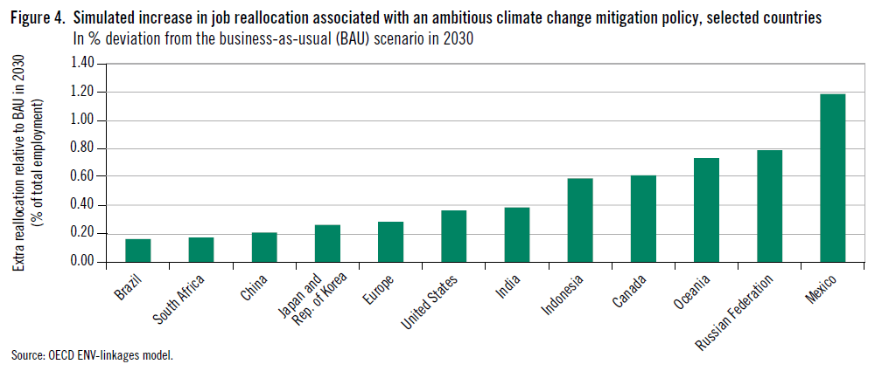
Transition:
OECD: ‘much smaller than from globalization’ (?)
Shifts between sectors: ~ 1% (globalization 20%)

Slide 10
Policies for sustainable development with decent work and social inclusion
Coherent economic policies:
  Eco-tax
  Green investment
  SMEs
Decent work in sustainable development
  Social protection (floor)
  Skills for green jobs and transitions
  Active labour market policies
Social dialogue

Slide 11
Green Jobs
Programme countries

Slide 12
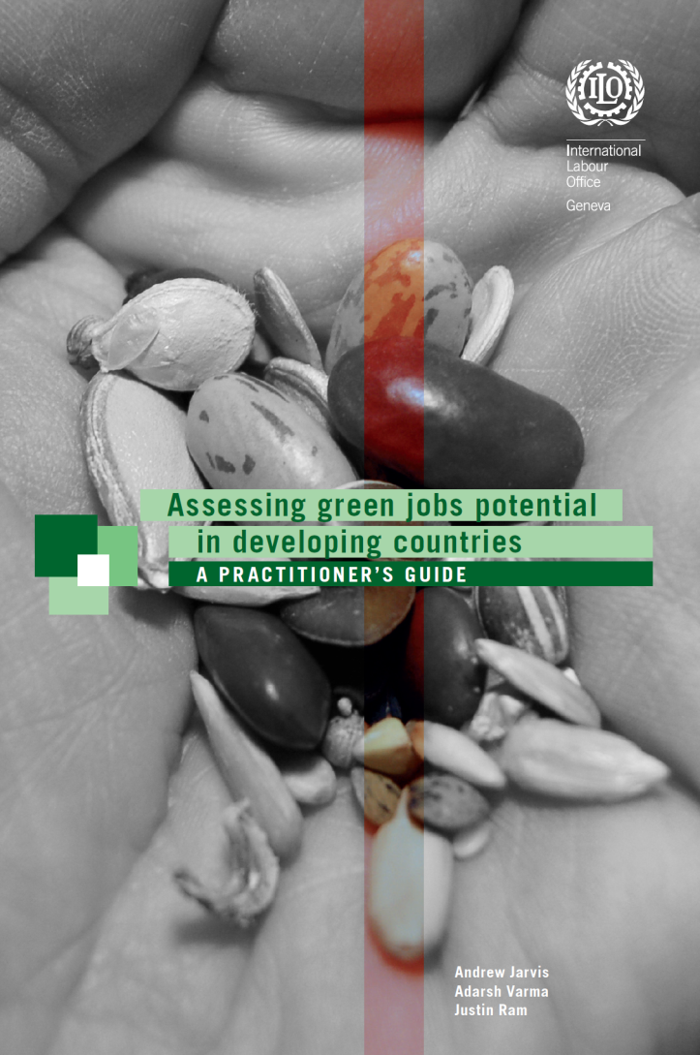
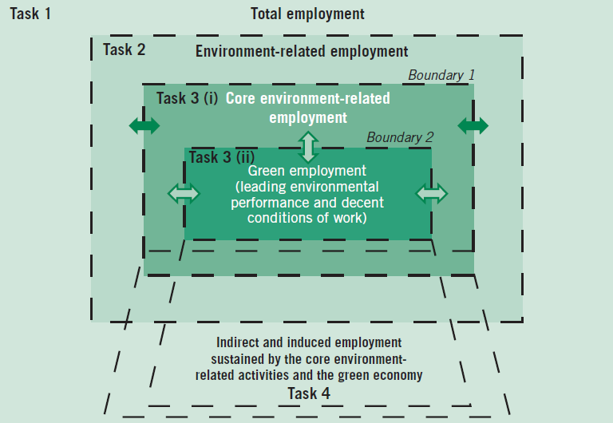
Assessment methodology
Based on Social Accounting Matrix
Estimates Direct, Indirect & Induced effect
Allows for ‘What if’ Scenarios
(E.g. if policy shifts 5% investment into Green sector how many jobs will be created?)

Slide 13

Green Jobs Potential:
South Africa’s New Growth Path
Development Strategy
Component green jobs
Assessment green jobs potential:
Net direct jobs | Short term (2012) | Medium term ( 2017) | Long term (2025)
Total | 98,000 | 255,000 | 462,000
Energy generation | 13,565 | 57,142 | 130,023
Energy efficiency | 31,569 | 70,193 | 67,979
Pollution control | 8,434 | 13,189 | 31,641
Nat. resources | 44,512 | 114,842 | 232,926

Slide 14
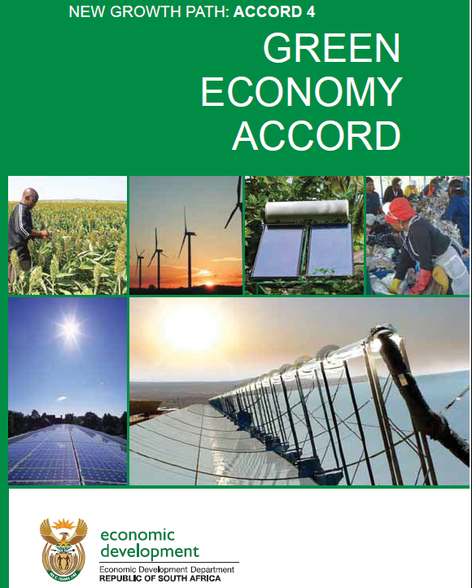
South Africa - New Growth Strategy:
Green Economy Accord
South African government, business and labour signed an accord in 2011
One of the most comprehensive social partnerships on "green economy” in the world
Notes:
Although the ILO has not played a pivotal role, since 2010 ILO is involved and supported conferences, meetings and the Green Jobs assessment 2011.

Slide 15

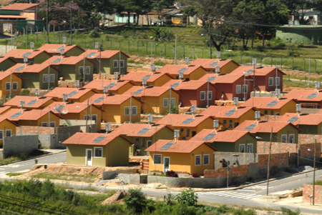
Social inclusion: housing, sustainable construction
‘My house-my life’
social housing program (5/2009)
300,000 units energy savings measures
- 40% electricity bill
- 18% peak demand
+ 18,000 jobs

Slide 16
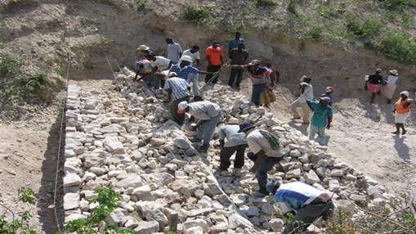
Social protection
India: Rural employment guarantee
NREGA (Rural employment guarantee act)
Right to 100 days/year
US$ 8 bill (~ 0.4% GDP)
Beneficiaries 59 mill households
Adaptation, irrigation, reforestation

Slide 17

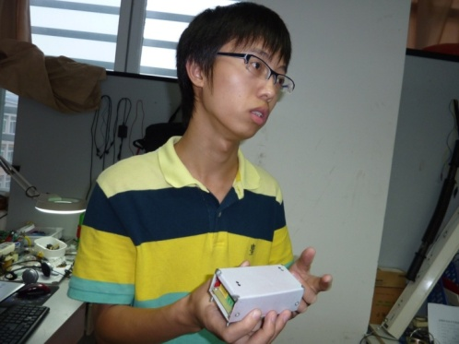
ILO Green Youth Entrepreneurship Program 2010-2014
Background
East Africa: 70% youth unemployment; economy highly dependent on environment
e.g. Deforestation 83% biomass cooking
Green Jobs for youth in business opportunities: e.g. improved stoves
Success 2010-2012:
4,680 students participated in green entrepreneurship program of Junior Achievement (world’s largest youth business network)
2011 competition, 31 Student Companies (43%) out of 73 created green businesses
Notes:
While YEF takes the same systemic approach as in Zambia it is not focused here because of the rational giving some concrete examples and success.

Slide 18
Conclusions
Rio+20 outcome: green economy should create decent work and promote social inclusion
Green growth/economy not equitable and socially inclusive by definition
Green economy necessary condition for sustainable development, but not sufficient
Policy coherence essential, complementary social policies needed: UNEP – ILO partnership

Slide 19
More info?
  For more information:
  Para mayor información:
  Pour plus d’informations:
  ILO.org/green-jobs-programme
  ILO.org/greenjobs

Slide 20
Current development model
Environmentally unsustainable:
climate change, biodiversity loss, overuse natural resources a.o.
Socially inefficient:
Too few jobs: 200 million unemployed
Too few decent jobs: 900 million working poor
Persistent social exclusion: 1.3 billion without access to modern energy

Slide 21
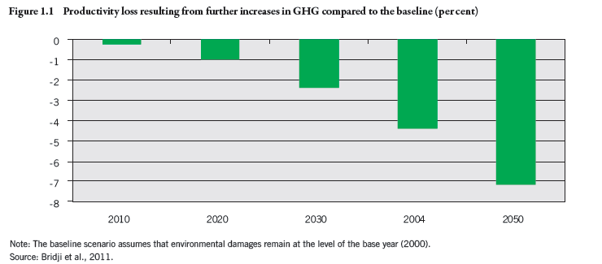
Growing cost of inaction

Slide 22
Thank you
Merci beaucoup
Muchas gracias
Muito obrigado
Vielen Dank

Slide 23
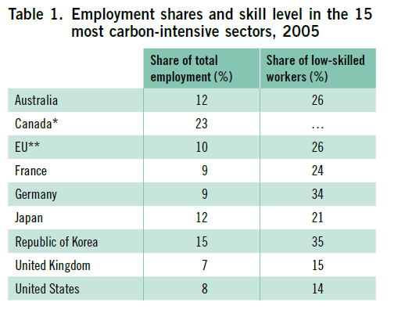
Carbon-intensive sectors not big employers
8-12 % employment most OECD countries
High share of low-skilled workers

Slide 24
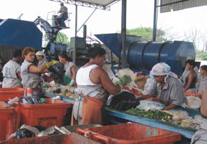
Brazil : Formalization
Waste management & recycling
~ 60,000 formalized workers in
recycling industry
Cooperatives, service
contracts, installations,
fair wages and OSH
Approx 400,000 informal
New law: Tax reductions if recycling via cooperatives, formalized waste pickers
Goal 2011 poverty strategy: formalize 250,000

Slide 25
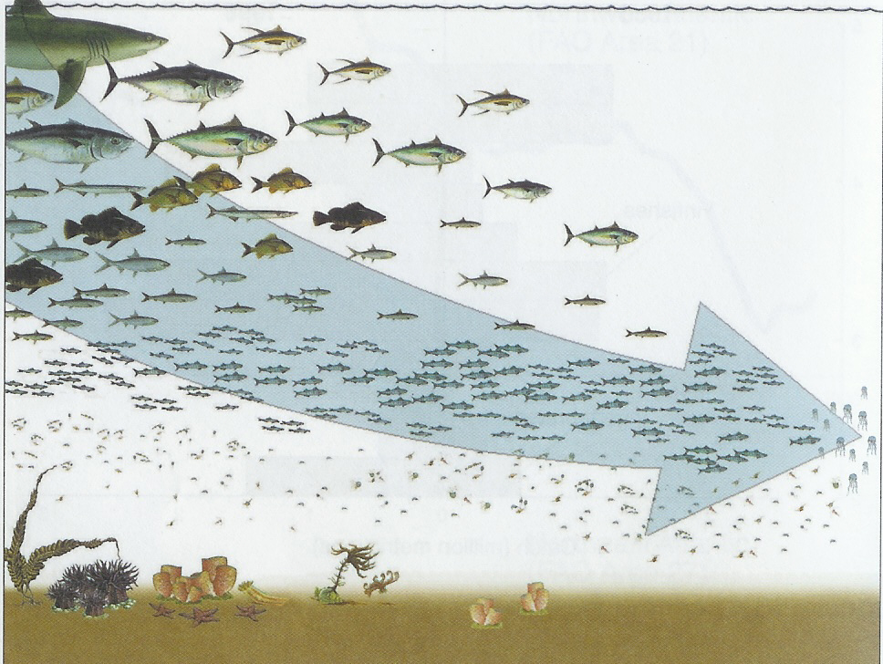
An imminent transition challenge:
Preventing the Loss of Global Fisheries
Open Access & Perverse Subsidies are key drivers of the loss of fisheries
Half of wild marine fisheries are fully exploited, with a further quarter already over-exploited
at risk : $ 80-100 billion income from the sector
at risk :
est. 27 million jobs
but most important of all…..
We are fishing down the food web
to ever smaller species…
at risk : Health … over a billion rely on fish as their source of animal protein
02.10.2012
Source: Ben ten Brink (MNP) presentation at the Workshop: The Economics of the Global Loss of Biological Diversity 5-6 March 2008, Brussels, Belgium. Original source: Pauly
25
UNEP ETB
Notes:
25

Slide 26
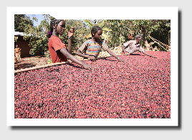
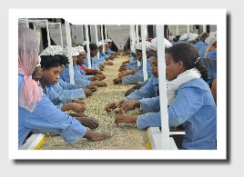
Social inclusion: better jobs
Agriculture:
1 billion workers
50% women
70 % of world poverty
Ethiopia:
Oromia Coffee Growers :
217 cooperatives
200,000 farmers

Slide 27
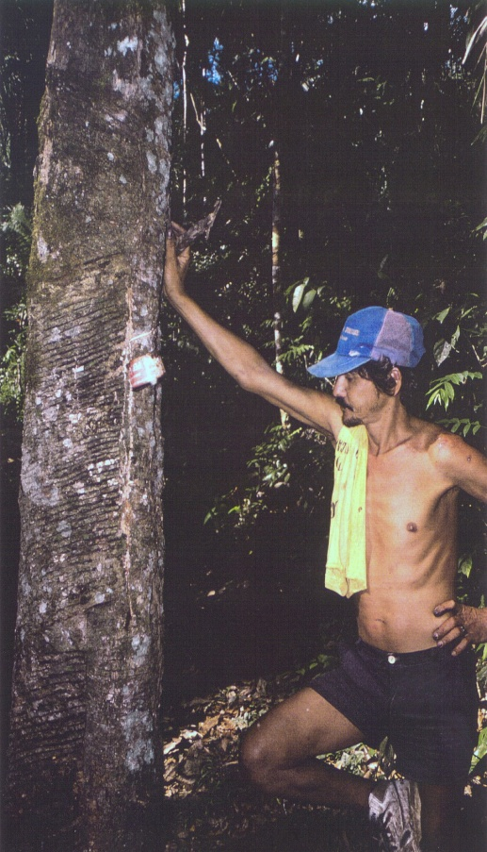
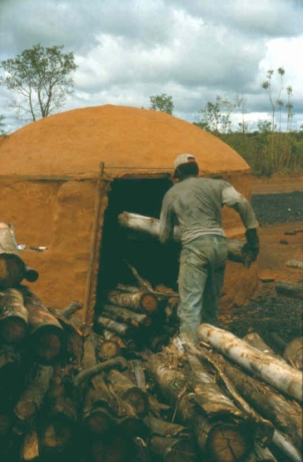

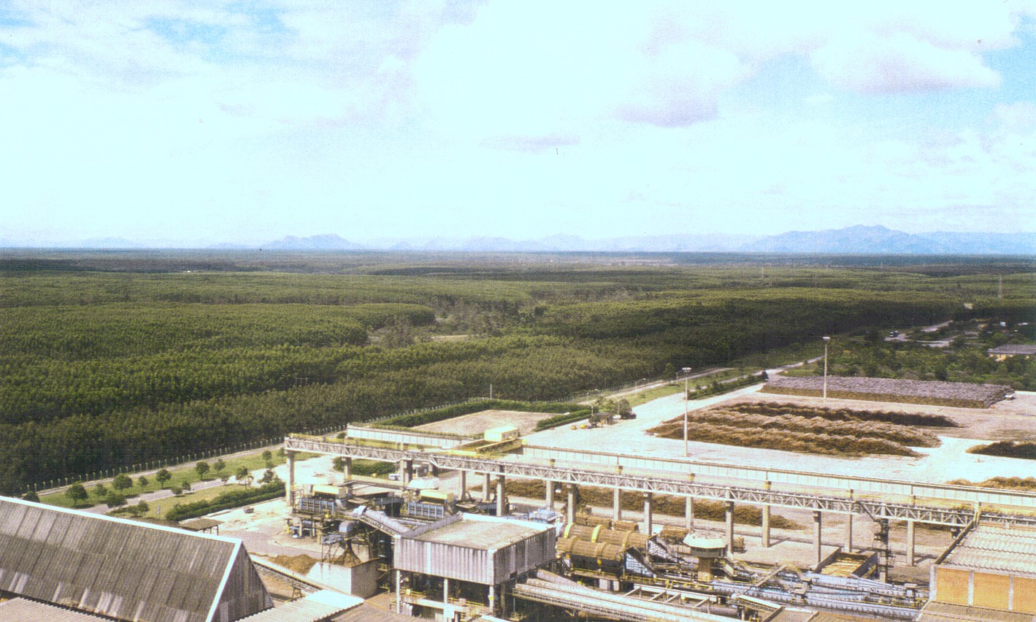
Better jobs
Brazil: Sustainable Forests
Certificied Products
New regulation:
  Decent work in concession agreements (Amazon)
In progress:
Practice DW
Sustainable non-wood forest products
Sustainable biofuels

