Slide 1








Marine and Coastal Areas Baseline Study
The Consultation process: Cross Cutting Issues and Remaining Gaps
Lucy Scott & Winfried Wiedemeyer

Slide 2
Identification and Planning of short, medium and long term Activities towards
GMES and Africa Coastal and Marine Areas Services
Contributing to the Final Technical Draft of the
Marine and Coastal Areas Chapter of the GMES & Africa Baseline Study
Notes:
While the WS is on Bullet 1, this presentation is on Bullet 2

Slide 3
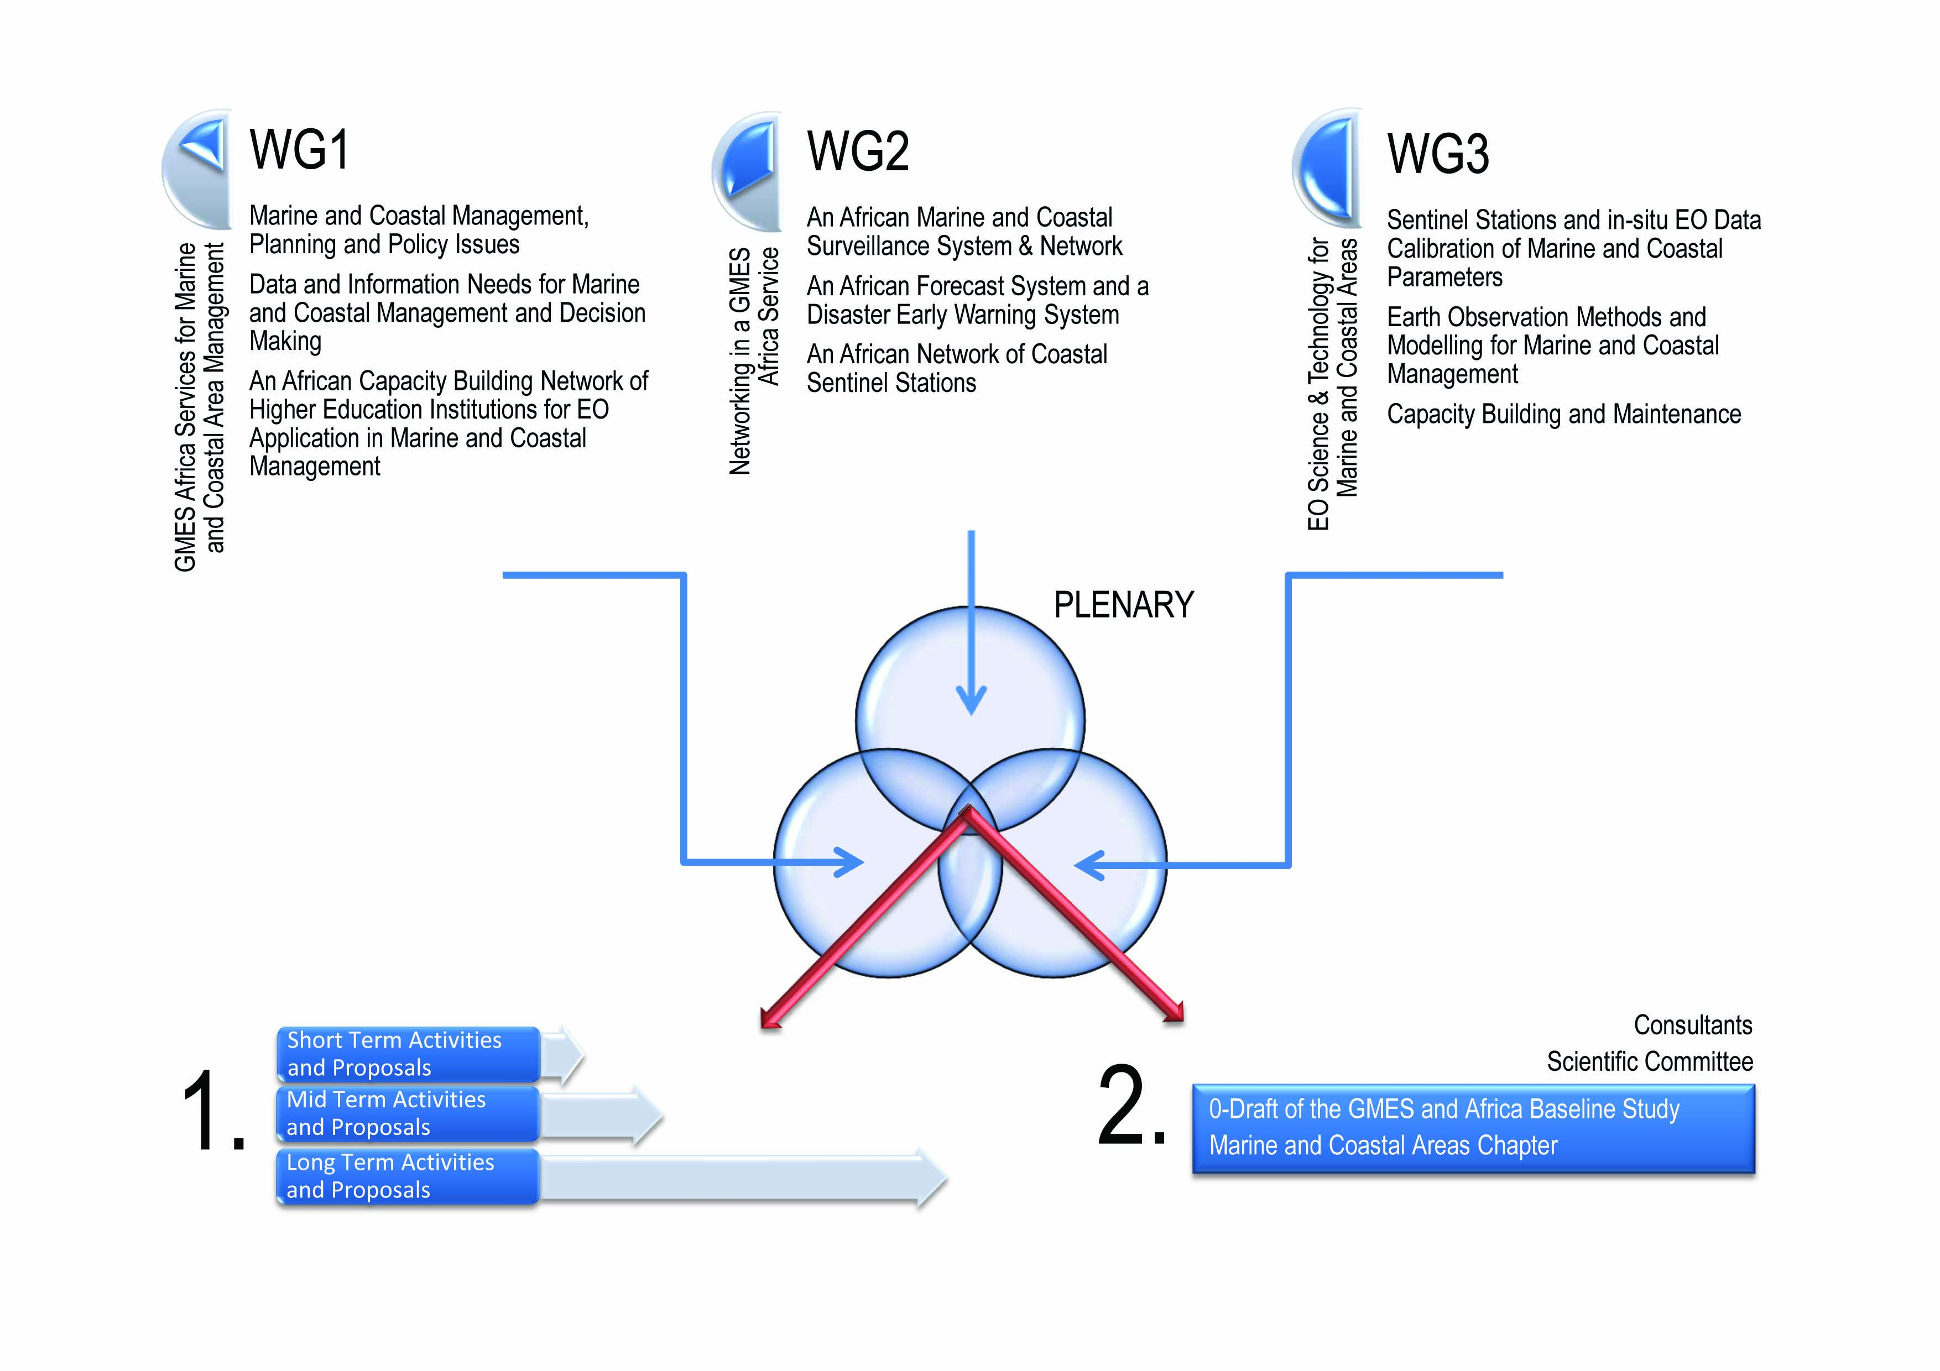

Slide 4
A Chronology of Consultation
  Comments, Suggestions and Text Changes over Time
Content, Focus & Intentions
  The Content is in Focus? The Focus matches the Intentions? The Intentions are clear? (Effectiveness-Relevance-Objectives)
The Way Ahead
  Define Outputs / Products, and
  Who does What until When?

Slide 5
– 2011
From existing initiatives, it is possible to identify gaps and priorities where new investment is sorely needed. In a broad sense, the crucial priority is for operational programmes in the marine and coastal areas of Africa, which routinely bring information and products of value to policy makers in the user community. To rectify this, Africa needs a GMES Africa Service for Marine and Coastal Areas that is pan African, operational and provides a comprehensive end-to-end service from observations, through analysis and forecasting to the dissemination of carefully designed value added products.
NH, GB
The GMES & Africa Baseline Study Marine and Coastal Chapter - A Chronology of Consultation

Slide 6
– 2011
The recommended components of the GMES Africa Service for Marine and Coastal Areas are:
A Network of Regional Early Warning Centres, providing products of value to the public and private user communities around the coast of Africa, such as state of the marine environment reports, operational coastal sea level, … and coastal vulnerability atlases.
A Network of Marine Remote Sensing Centres, as fully operational successors to existing pilot facilities, …linked to the new generation of GMES Sentinel satellites.
A Network of Coastal Stations, gathering in situ observations from priority areas such as mega cities, ports, offshore industrial sites and localities at risk from natural disaster and CC.
An African Capacity Building Network of Higher Education Institutions linked to the Network of Coastal Stations and to the Network of Marine Remote Sensing and Dissemination Centers.
NH. GB
The GMES & Africa Baseline Study Marine and Coastal Chapter - A Chronology of Consultation

Slide 7
– 2011
… Supporting platforms will be needed in data management and high speed computing, and there will need to be a rapid uptake of new communication technology and communication links…
The keys to its [ed.: GMES&A Service] long term viability will be:
The provision of adequate capacity in personnel and infrastructure within its institutions;
Addressing the real priorities for marine and coastal areas of Africa within a coordinated framework; and
Providing a stable level of financial support into the future.
The GMES & Africa Baseline Study Marine and Coastal Chapter - A Chronology of Consultation

Slide 8
Identified Room for Document Improvements
The current Marine and Coastal Areas chapter of the GMES Africa Baseline Study does have the requested standardised form as specified in 2010.
The current Marine and Coastal Areas chapter of the GMES Africa Baseline Study does not have a list of acronyms used which will need to be added.
2011WS, WW, LS

Slide 9
Identified Room for Document Improvements
The current Marine and Coastal Areas chapter of the GMES Africa Baseline Study needs to be considerably shortened from currently 14 to 10 pages.
  Some paragraphs at the end of the document are repetitive.
  ‘Thematic Content’ and ‘Pressures and Constraints’ need to be shortened and made more precise on Marine and Coastal Areas theme.
  The summary needs to be shortened to ½ page maximum.
  2011WS, WW, LS

Slide 10
Identified Room for Document Improvements
The language of the current document is precise, yet simple enough to be understood by decision makers and donors rather than only by EO scientists and technicians. There are however still a few technical terms that would need to be clarified better.
The document is still in several parts not sufficiently specific regarding the Coastal and Marine Areas theme and regarding the specific development issues a that are of interest and pertinent to African coastal and marine planners, managers and decision makers at local, national, regional and continental levels. 2011WS, WW, LS
The GMES & Africa Baseline Study Marine and Coastal Chapter - Content, Focus & Intentions

Slide 11
Identified Room for Document Improvements
The current Marine and Coastal Areas chapter of the GMES Africa Baseline Study does sufficiently set up a context ensuring that the whole chain from data acquisition to EO information integration into decision making is covered.
The current Marine and Coastal Areas chapter of the GMES Africa Baseline Study does provide for sufficient awareness building actions on the availability of specific multi-scale EO data and information for decision making.
2011WS, WW, LS
The GMES & Africa Baseline Study Marine and Coastal Chapter - Content, Focus & Intentions

Slide 12
Identified Room for Document Improvements
The document lacks the description of actions reaching the point of clear demonstrability of the benefits of integrating EO information into decision making. It would be advisable to make use of a few (practical) examples to demonstrate real EO benefits to coastal and marine planners, managers and decision makers through …
2011WS, WW, LS
The GMES & Africa Baseline Study Marine and Coastal Chapter - Content, Focus & Intentions

Slide 13
Identified Room for Document Improvements
(ctd.) … demonstrate real EO benefits to coastal and marine planners, managers and decision makers through …
  The demonstration of practical use, possibly in comparison to other methods of EO data acquisition and/ or monitoring will be ... Those practical uses need to be in the text.
  Connected to this aspect, the current document does not yet specifically identify and does not adapt to actual decision-making user groups at different geographical scales …
  2011WS, WW, LS
The GMES & Africa Baseline Study Marine and Coastal Chapter - Content, Focus & Intentions

Slide 14
Identified Room for Document Improvements
The current Marine and Coastal Areas chapter of the GMES Africa Baseline Study does not yet provide for articulation, correlation and communication of the user community of coastal and marine planners, managers and decision makers between different geographic scales.
  In the intended GMES Africa Service Networks, communication of user groups will be equally important as communication between data providers and analysts.
  2011WS, WW, LS
The GMES & Africa Baseline Study Marine and Coastal Chapter - Content, Focus & Intentions

Slide 15
Identified Room for Document Improvements
The current Marine and Coastal Areas chapter of the GMES Africa Baseline Study does not yet clearly point out the benefits of EO support functions to development issues to stimulate investment/ fund mobilisation.
  In view of the current and future competitive environment of donor support, but also the current global economic crisis and the reduction of bilateral development funding, the comparative advantages and benefits in terms of cost efficiency need to be clearly pointed out, possibly using some examples of cost-benefit analyses.
  2011WS, WW, LS
The GMES & Africa Baseline Study Marine and Coastal Chapter - Content, Focus & Intentions

Slide 16
Conclusions and Way Ahead…
Identified Gaps & Room for Improvement | Approach / Solution / Action
List of acronyms; Document length; Some few technical terms need clarification; | Add acronyms list; Edit repetitive paragraphs; shorten and make more precise on M&C Areas theme; shorten summary
Document not always sufficiently enough focussed on Marine and Coastal issues and aspects | Check for focus and possibly edit for better focus
Insufficient choice of practical examples to demonstrate clear benefits of EO to Marine and Coastal Planning and Management | Editing for practical examples, possibly in comparison to other methods

Slide 17
Conclusions and Way Ahead…
Identified Gaps & Room for Improvement | Approach / Solution / Action
Insufficient choice of practical examples to demonstrate benefits of EO to different levels and geographic scales of Marine and Coastal Planning and Management | Choice of practical examples and enhanced demonstration of benefits at specific management levels and geographic scales
Insufficient coverage of communication and cooperation aspects between user groups of EO information in M&C Areas | Enhanced coverage of communication, cooperation and networking aspects
Insufficient clarity on effectiveness and cost-efficiency of EO integration into M&C Management to stimulate budgetary and financial commitments (domestic, IO, RO, etc.) | Editing and choice of appropriate examples to demonstrate effectiveness and cost efficiency in the context of development

Slide 18
Conclusions and Way Ahead …
The 1st GMES & Africa Marine and Coastal Areas Workshop will be asked to endorse the current 0-Technical-Draft of the Marine and Coastal Areas Chapter of the GMES & Africa Baseline Study
  Session 6, 10th October 2012
The GMES & Africa Baseline Study Marine and Coastal Chapter - The Way Ahead

Slide 19
Conclusions and Way Ahead…
The Marine and Coastal Areas Scientific Committee, with the assistance of two consultants (editors), will prepare the Final Technical Draft of the Marine and Coastal Areas Chapter of the GMES & Africa Baseline Study until 31st October 2012
  Integrating outputs from the current workshop
  Integrating information gathered during the current workshop
  Integrating inputs and information gathered from continued discussions on the two GMES & Africa Web Portals (capacity4dev & BRAGMA [mixxt])
The GMES & Africa Baseline Study Marine and Coastal Chapter - The Way Ahead

Slide 20
Thank you
Merci
Obrigado

