Slide 1





Reality Check

Slide 2
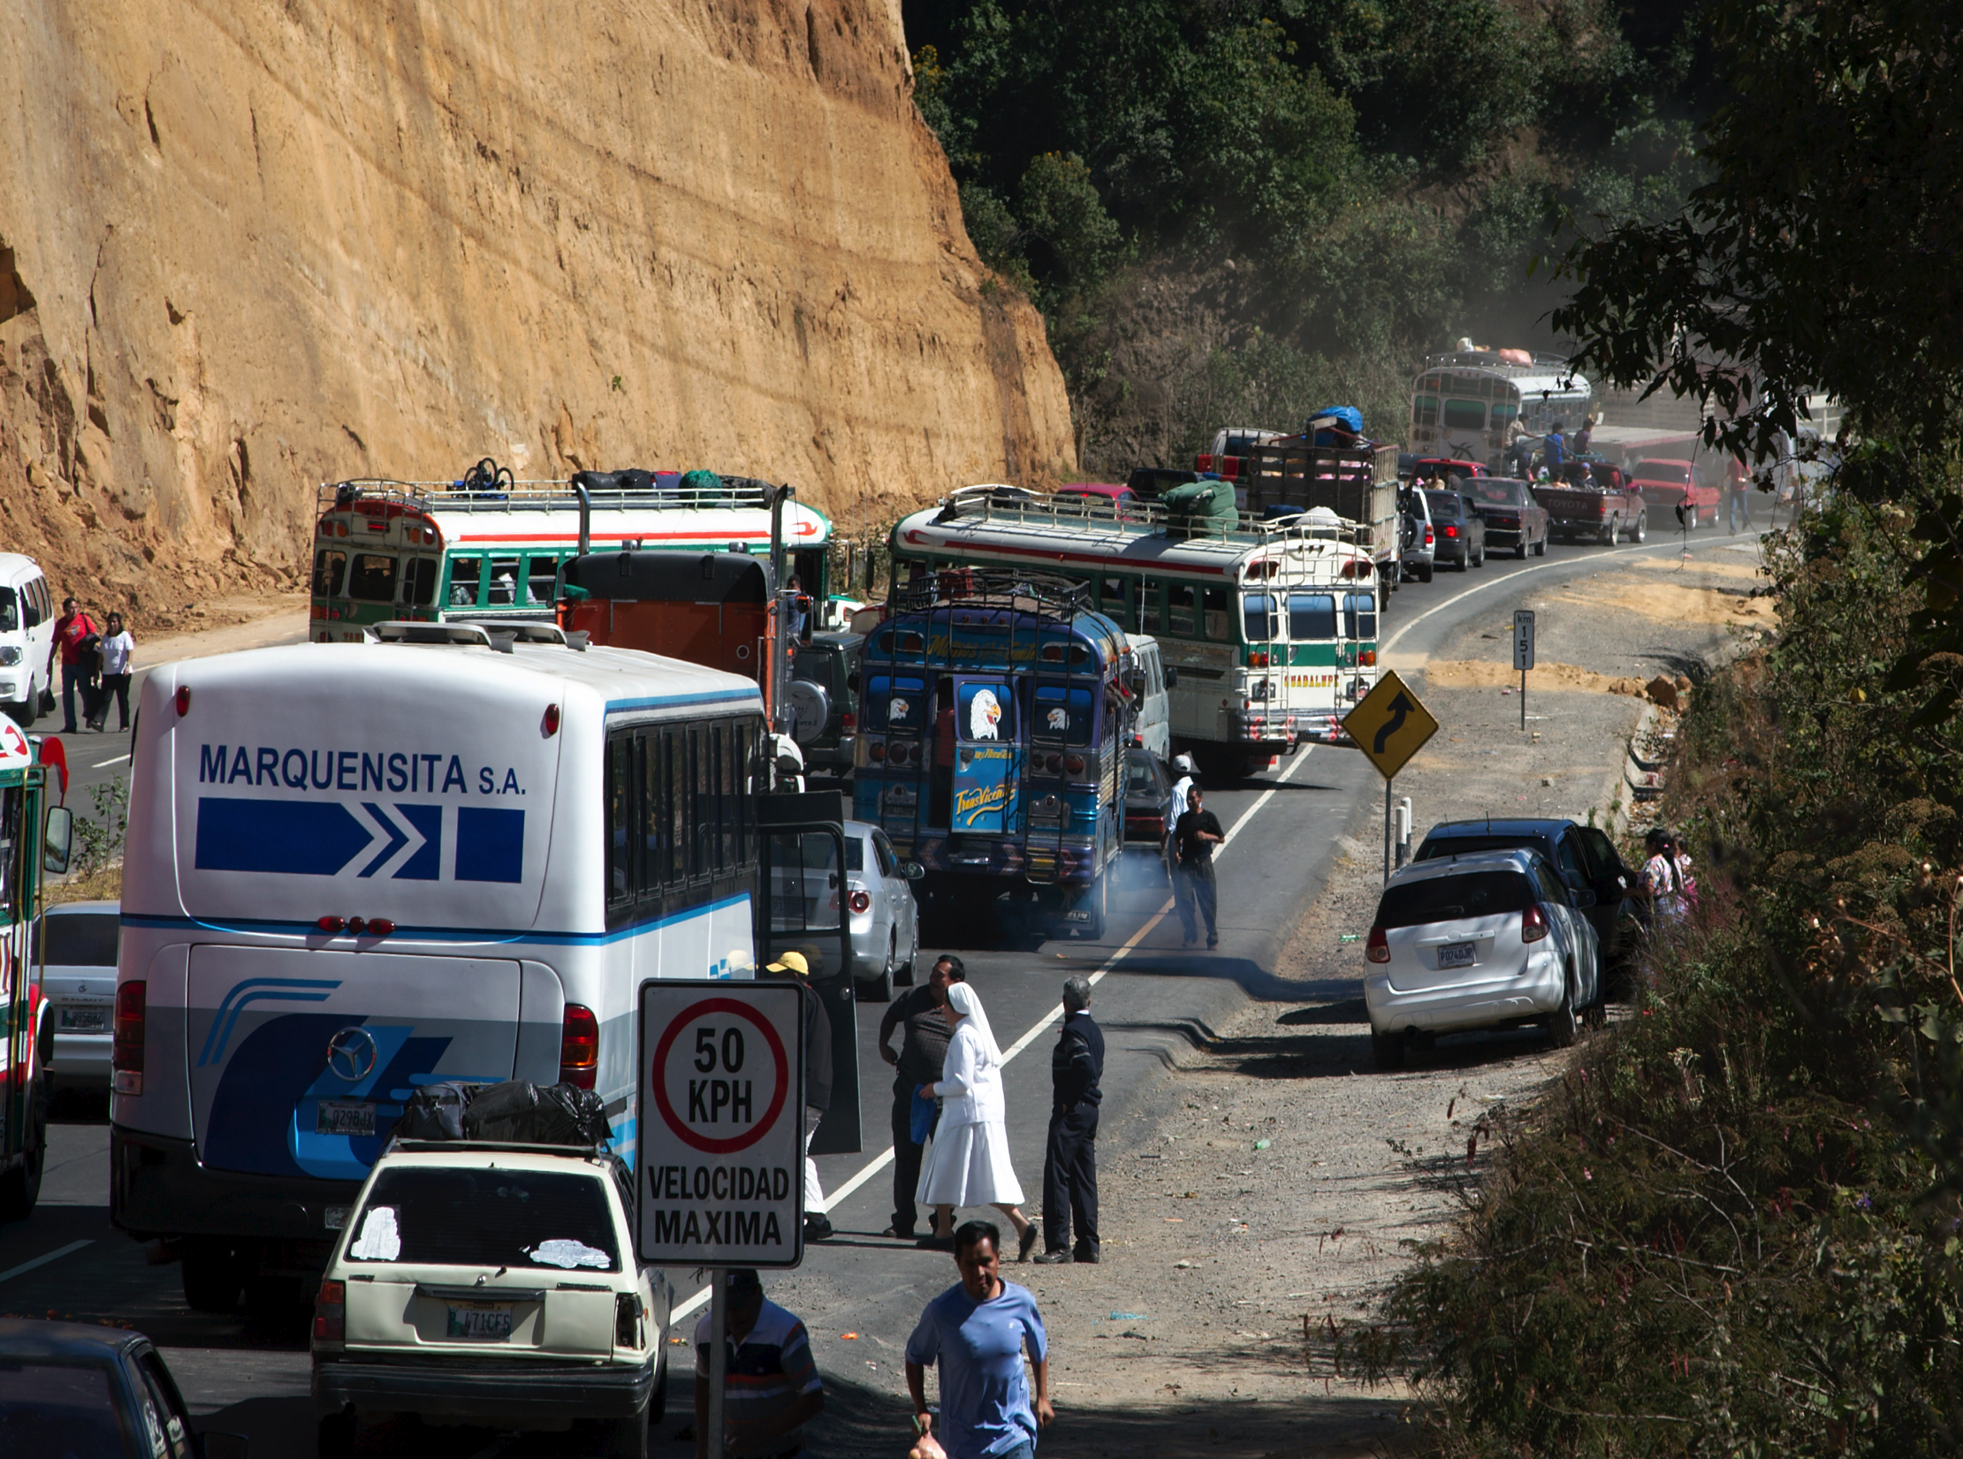
“The international aid system, with a profusion of bilateral donor agencies, lacks direction & coherence. A serious effort is needed to coordinate.”
Partners in Development Report
1 9 6 8

Slide 3
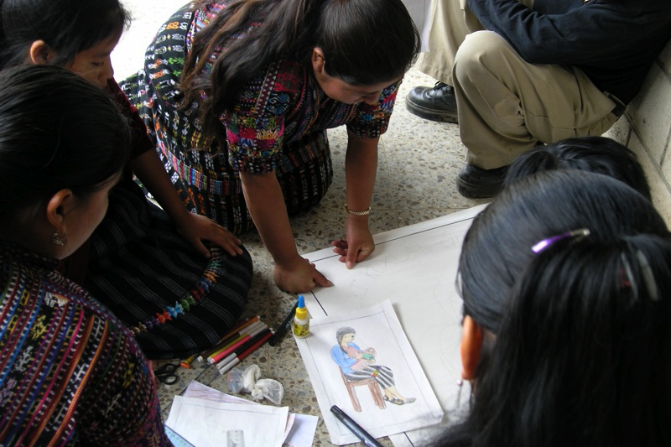
Step 1: Explain

Slide 4

Top Five Fears
✗
Number 1: EU MS who don’t work here get to tell me what to do
Number 2: all my projects have to be implemented jointly & simultaneously
Number 3: Brussels will get a veto on what I do
Number 4: we’ll all have to use EC procedures
Number 5: I’ll have to scrap my bilateral implementation plan

Slide 5

Step 2: Sell

Slide 6
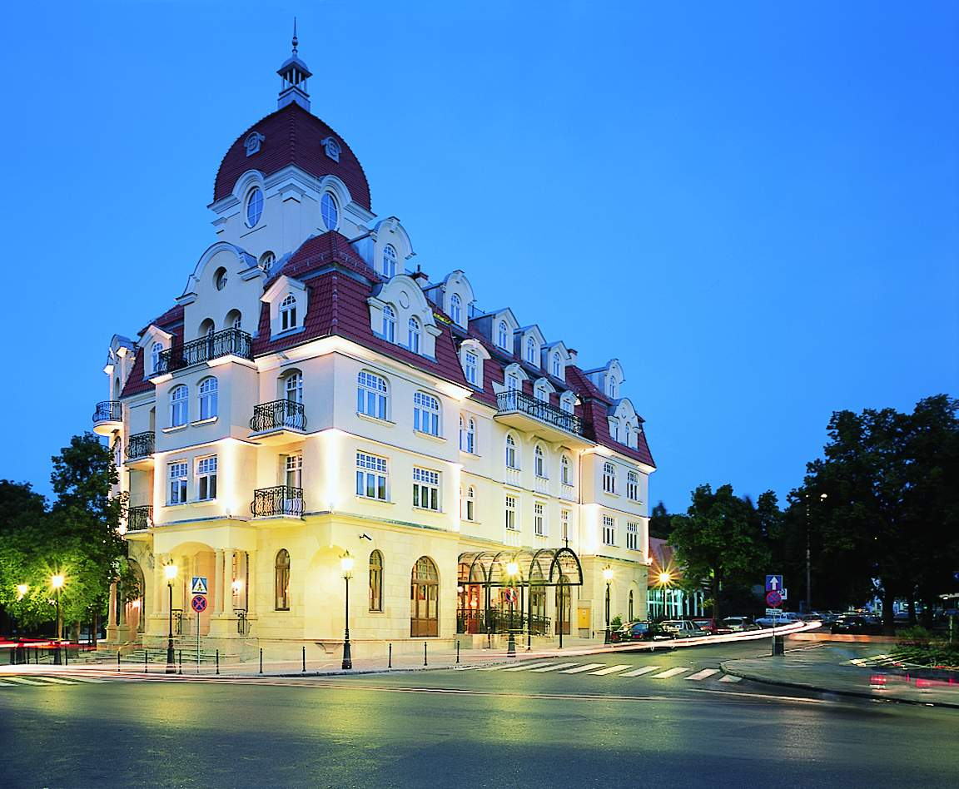





Yes, Minister
“Essential to move ahead on JP…should resolve the problem of DoL”
“Will increase coherence, impact and leverage vis-à-vis other donors”
“Learn from existing experience”
“Decentralise decision making, ensure light structures”
“Adapt to situation on the ground, not Brussels-led”

Slide 7
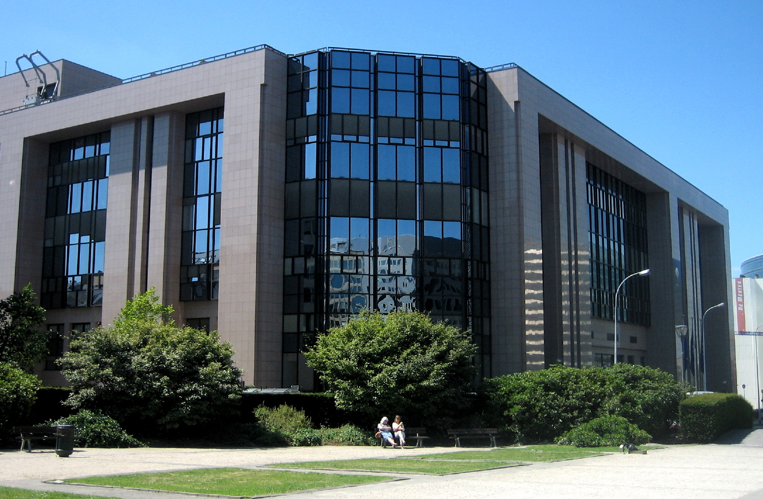
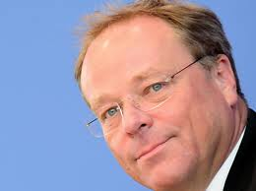





FOREIGN AFFAIRS COUNCIL, MAY 14TH 2012
More effective development policy
Show European citizens results, impact, and accountability
Advance EU brand of development: human rights, democracy, rule of law, good governance
Concrete progress in joint programming starting in 2012
Pascal Canfin
Joe Costello
Andris Piebalgs
Dirk Niebel
Marie-Josée Jacobs

Slide 8

How are we doing? Sectors…
How many projects do European donors have in Laos?
300 (total 1,200)
What % of donor projects are under $1m ?
91%
And under $100,000 ?
65%

Slide 9
Influence in Cambodia
EU vs. China: Share of Aid

Slide 10

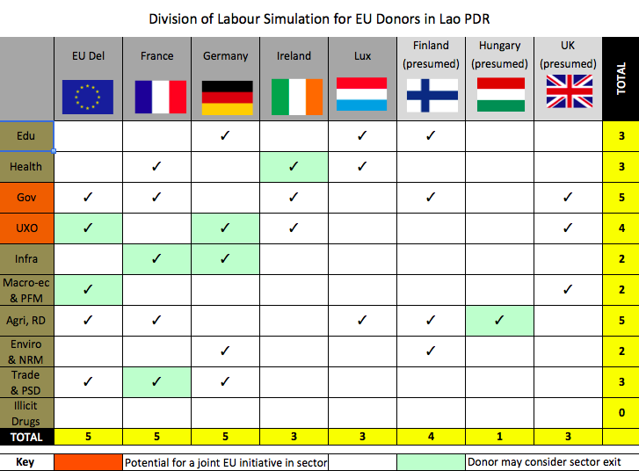
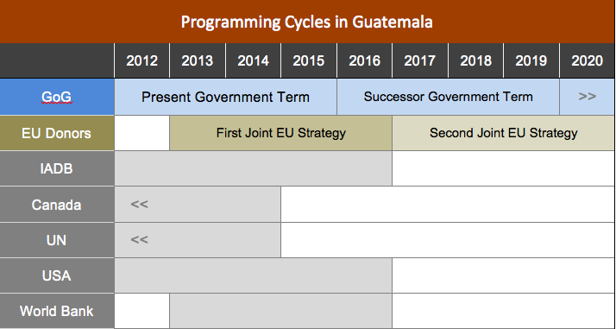
Step 3: Localise
 | 2011 | 2012 | 2013 | 2014 | 2015 | 2016 | 2017 | 2018 | 2019 | 2020
GoL | NSEDP-7 |  |  |  |  | NSEDP-8
EU | <<
Finland
France | <<
Germany
Ireland
L'bourg
Australia | <<
Japan
Korea
Switzerland | <<
UN

Slide 11
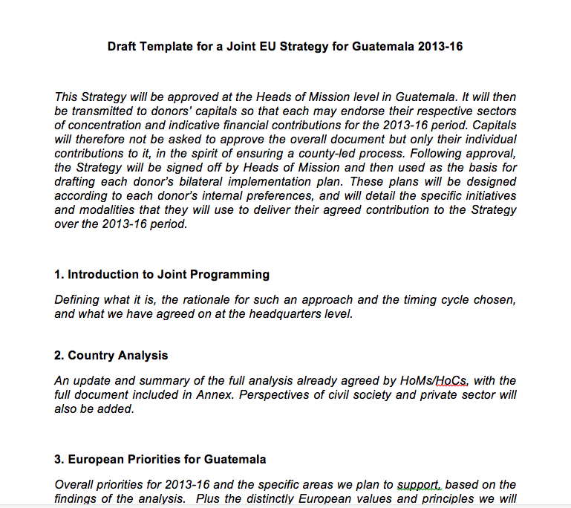
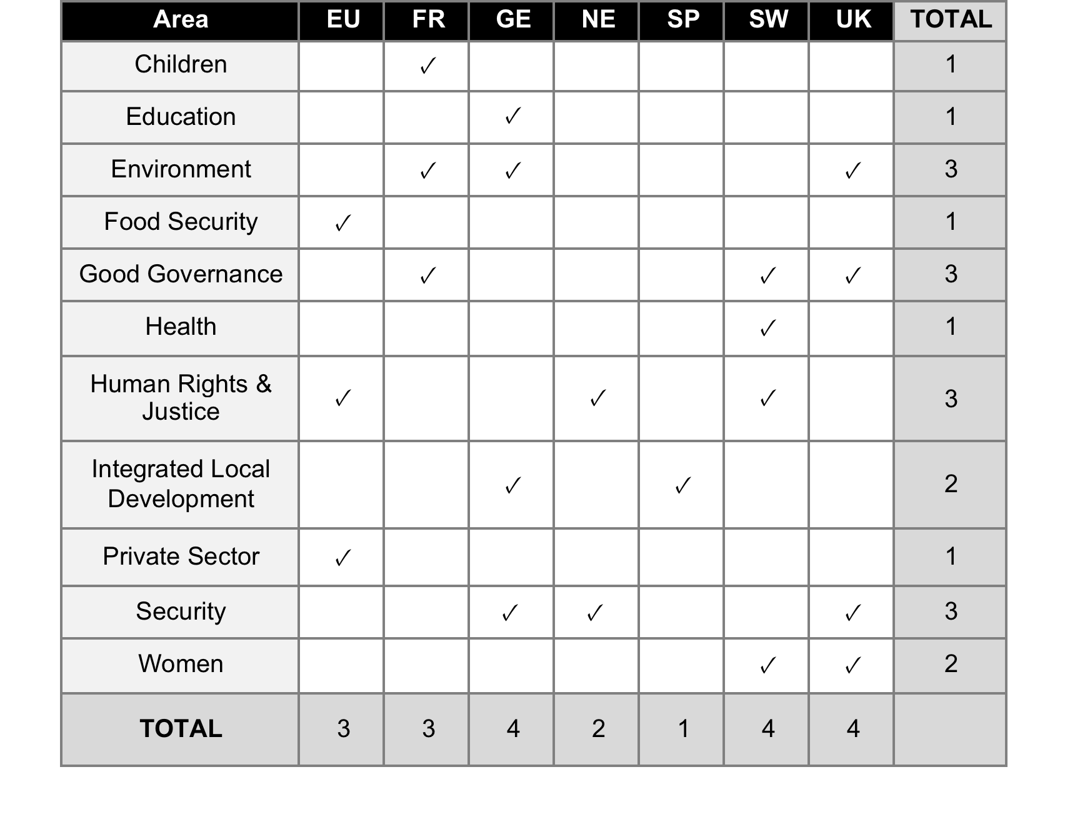
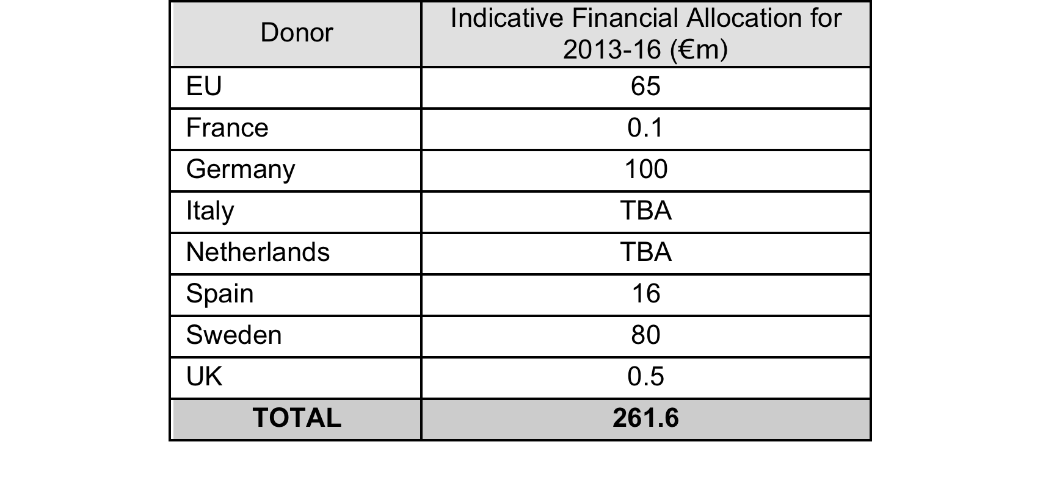
Step 4: Localise

Slide 12


R w a n d a
Strong Gov
Existing Division of Labour
Want all donors sync’d to better support national strategy

Slide 13


S o u t h S u d a n
Donor & Juba led
One Strategy with priorities, sectors, leads & financials
Synchronised to national plan
Doesn’t cover all sectors
Some work to do on DoL

Slide 14

Perspectives
Centre vs. local gap
Control, Ownership
Info
Sectors
Which MS?
Government

Slide 15
Thanks

